Slide 1

Careers in Information Technology
Written by:
Saiprasad Setty
Milton Ramer
Courtney Lisenbee
Presented by:
_______________

Slide 2

Who Are We?
Name, majors, career goals, etc.

Slide 3

What is FITC?

Slide 4
FITC and Technology
Information Technology
Information Communication Technology (ICT)
Computer Science
Computer Engineering

Slide 5

What is Information Technology?
The study or use of systems (especially computers and telecommunications) for storing, retrieving, and sending information.

Slide 6
Activities of IT Workers
Analyzing
Gathers requirements, modifying computer systems to improve production and workflow, expanding systems.
Designing
Web pages design, screen layouts, process flows
Programming
Writing code for computer software
Managing
Monitoring and controlling computer systems
Troubleshooting and Support
Help Desk technicians and service workers

Slide 7

Career Opportunities in Information Technology (IT)
“Information technology and business are becoming inextricably interwoven. I don’t think anybody can talk meaningfully about one without talking about the other.”
-Bill Gates

Slide 8
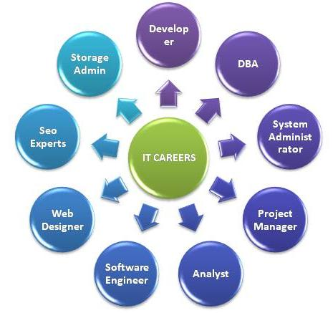
Careers in Information Technology
Web Development/Design
Game Development/Design
Systems Analyst
Network Administrator
Database Administrator

Slide 9

Careers in Information Technology
Information Security
Network Security
Mobile App Development
Software Developer
IT Project Manager

Slide 10
What do they do though?
Systems Analyst
Programmer who designs and manages the development of business applications on the computer (7-10 years)
Software Designer
Designs, creates, and maintains software (5-7 years)
Computer Programmer
Writes code for computer software (0-5 years)
Systems Administrator
Maintains and operates a computer systems or network for a company (10-15 years)
Support Personnel
Attending the issues and enable the smooth work flow (0-3 years)

Slide 11
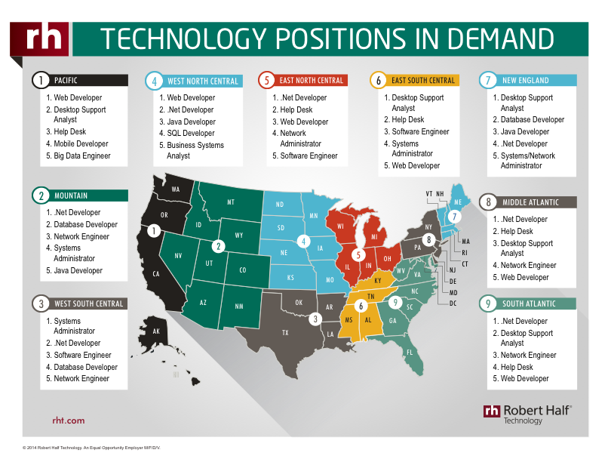
Careers in Information Technology

Slide 12
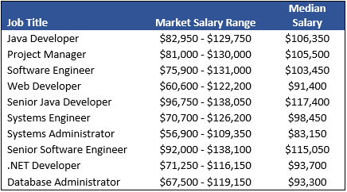
Salaries in IT
IT Jobs
IT Jobs

Slide 13




Follow us on Social Media!
/FITCAlliance
@FITCAlliance
@FITC_Alliance
#FITC
& visit fitc.cci.fsu.edu
FITC Group

