Slide 1

Chapter 15
Networks

Slide 2

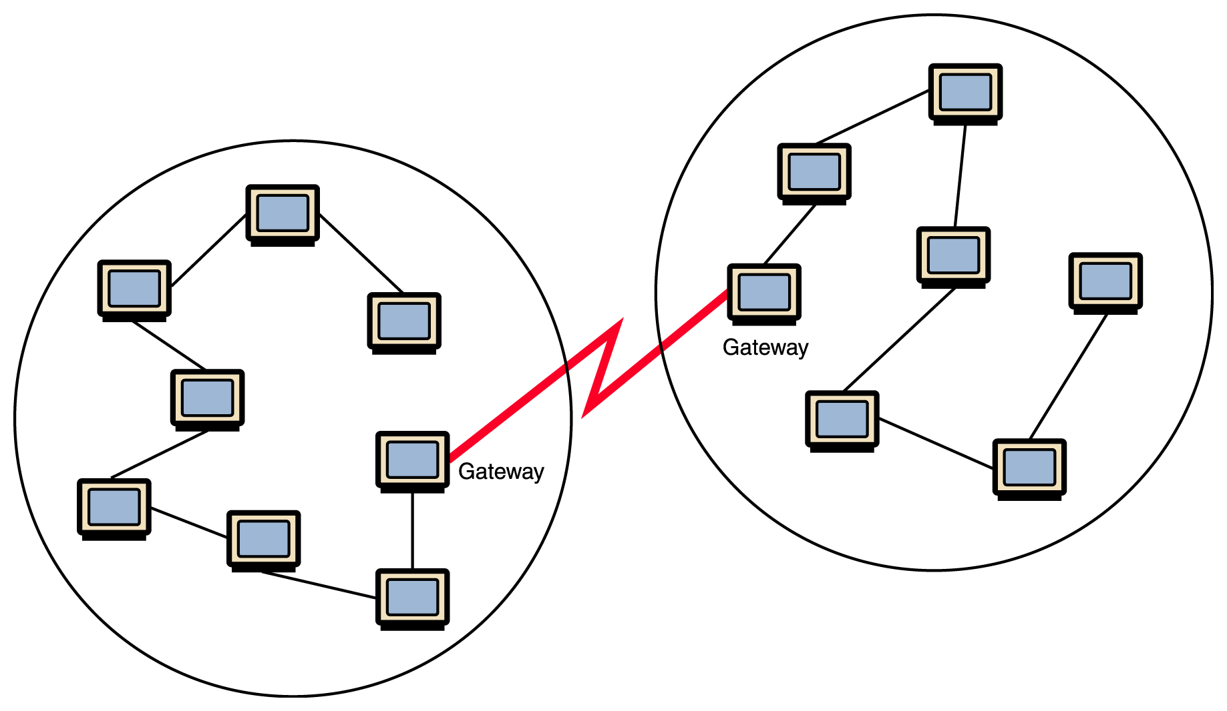
Networking
Computer network
A collection of computing devices connected in order to communicate and share resources
Connections between computing devices can be physical using wires or cables or wireless using radio waves or infrared signals

Slide 3
Overview
3
Network Topology how is hardware (physically) connected?
Addressing how is a message’s destinations identified?
Message Delivery should all data be sent in the same fashion?
Routing what path through the network is taken?
Security how can strangers pass (private) messages?
Notes:
3

Slide 4
Networking key terms
Node (host)
Any device on a network
Data transfer rate (bandwidth)
The speed with which data is moved from one place to another on a network

Slide 5
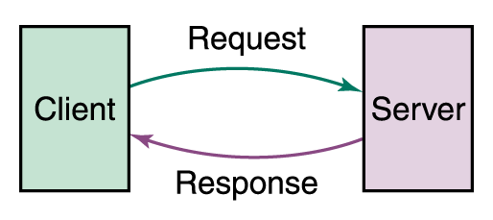
Networking
Computer networks have opened up an entire frontier in the world of computing called the client/server model
Figure 15.1 Client/Server interaction

Slide 6
Networking
Protocol
A set of rules that defines how data is formatted and processed on a network; i.e., rules that allow client/server interaction
File server
A computer that stores and manages files for multiple users on a network
Web server
A computer dedicated to responding to requests (from the browser client) for web pages

Slide 7
Issue 1: Topology
If every pair of computers on a network had a dedicated communication link, passing messages would be direct and straightforward. (e.g., the “hotline” between the White House and Kremlin)
Unfortunately, with hundreds, thousands or millions of computers on a network, they cannot all have direct links to each other.

Slide 8
Network topology
8
Local-area network (LAN)
A network that connects a relatively small number of machines in a relatively close geographical area
Ring topology connects all nodes in a closed loop on which messages travel in one direction
Star topology centers around one node to which all others are connected and through which all messages are sent
Bus topology nodes are connected to a single communication line that carries messages in both directions
Notes:
8

Slide 9
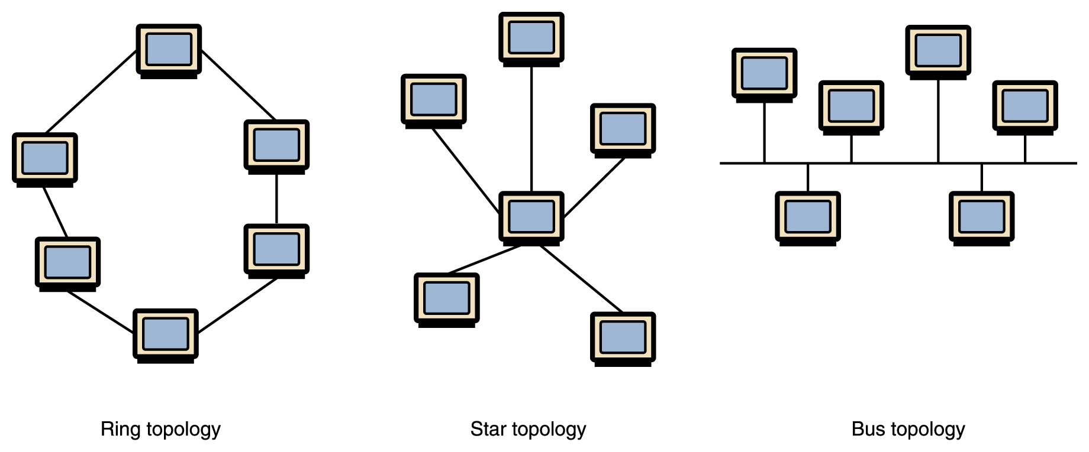
Types of Networks
Figure 15.2 Various network topologies
Ethernet
The industry standard bus technology for local-area networks

Slide 10
Pros and Cons
Pro’s and Con’s
Number of links (they cost money)
Network Performance
How efficient is communication?
Network Reliability
How does network respond to overload?
How susceptible is network to collapse?
Best choice depends on the size of the network

Slide 11
Types of Networks
11
Wide-area network (WAN)
A network that connects local-area networks over a potentially large geographic distance
Metropolitan-area network (MAN)
The communication infrastructures that have been developed in and around large cities
Gateway
One particular set up to handle all communication going between that LAN and other networks
Notes:
11

Slide 12
Types of Networks
Figure 15.1 Local-area networks connected across a distance to create a wide-area network

Slide 13
Types of Networks
Internet
A wide area network that spans the planet
So, who owns the Internet?

Slide 14
Internet Connections
Internet backbone
A set of high-speed networks that carry Internet traffic, provided by companies such as AT&T, Verizon, GTE, British Telecom, and IBM
Internet service provider (ISP)
A company that provides other companies or individuals with access to the Internet

Slide 15
Internet Connections
Various technologies available to connect a home computer to the Internet
Phone modem converts computer data into an analog audio signal for transfer over a telephone line, and then a modem at the destination converts it back again into data
Digital subscriber line (DSL) uses regular copper phone lines to transfer digital data to and from the phone company’s central office
Cable modem uses the same line that your cable TV signals come in on to transfer the data back and forth

Slide 16
Internet Connections
Broadband
A connection in which transfer speeds are faster than 768 kilobits per second
DSL connections and cable modems are broadband connections
The speed for downloads (getting data from the Internet to your home computer) may not be the same as uploads (sending data from your home computer to the Internet)

Slide 17
Issue 2: Addressing
If a device wants to send a message to another, how does it specify precisely which device?
To what address?

Slide 18
Network Addresses
Hostname
A name made up of words separated by dots that uniquely identifies a computer on the Internet:
Example: www.mathcs.slu.edu
IP address
An address made up of four one-byte numeric values separated by dots that uniquely identifies a computer on the Internet
Example: 192.0.0.1
Note: No direct way to translate between these!

Slide 19
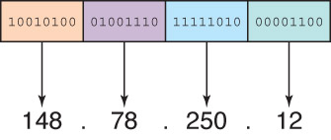
IP Addresses
Figure 15.9 An IP address is stored in four bytes
An IP address can be split into
network address, which specifies a specific network
host number, which specifies a particular machine in that network
Where does the host number
come from?

Slide 20
Network Classes
The first part of the IP address designates the network. The number of bits in the network address depends upon the size of the network
Class A network: Designated by first byte (very large; e.g., Apple has 17.x.x.x, MIT has 9.x.x.x)
Class B network: Designated by first two bytes (moderate size; e.g., SLU has 165.134.x.x)
Class C network: Designated by first three bytes (very small; e.g., Iowa Public Television iptv.org has 205.221.205.x)
20
Notes:
20

Slide 21
IPv4 and IPv6
IPv4 is the protocol using 32-bit addresses. It has been officially used since 1977
IPv6 is a new protocol (defined in 1996) using 128-bit addresses. The Internet is in the process of transitioning to IPv6
With a vastly larger address space, it provides better separation of network location and host identity, allowing better portability when devices move from network to network.

Slide 22
Domain Name System
A hostname generally consists of the computer name followed by the domain name
csc.villanova.edu is the domain name
A domain name is separated into two or more sections that specify the organization, and possibly a subset of an organization, of which the computer is a part
Two organizations can have a computer named the same thing because the domain name makes it clear which one is being referred to
22
Notes:
22

Slide 23

Domain Name System
matisse.csc.villanova.edu
Computer
name
Domain name
TLD

Slide 24
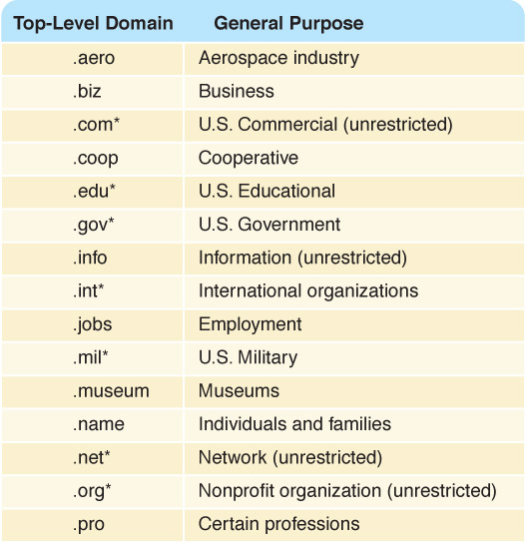
Domain Name System
Figure 15.10 Top-level domains, including some relatively new ones

Slide 25
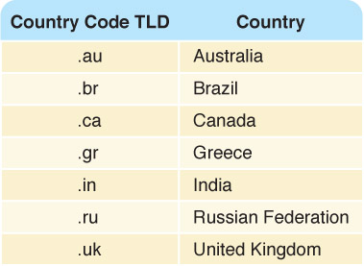
Domain Name System
Organizations based in countries other than the United States use a top-level domain that corresponds to their two-letter country codes
Figure 15.11 Some of the top-level domain names based on country codes

Slide 26
Hostnames->IP addresses
How is this conversion done?
Originally, there was one big table kept on a computer at Stanford. Whenever a computer needed to know an address, it would ask this computer.
But as the Internet grew, this computer was overloaded with requests and the underlying table was being updated too often.

Slide 27
Hostnames->IP addresses
27
The domain name system (DNS) is chiefly used to translate hostnames into numeric IP addresses
DNS is an example of a distributed database. Many computer all over the Internet keep (partial) tables.
If a server can resolve the hostname, it does
If not, that server asks another domain name server for the translations. And so on…
Notes:
27

Slide 28
Issue 3: Routing
When you send something by US Mail:
You must give an address which uniquely identifies the recipient
You usually send everything in one package. Packages are not all the same size.
You do not know what physical route your package will take on its way to destination.
Are packages ever lost?
How fast would you like delivery to be?
Do you want confirmation of receipt?
Notes:
28

Slide 29
Delivery on the Internet
Many different types of data delivered
Instant Message (very short)
Email (size ranges)
Web Page Description (size ranges)
Photographs, MP3, software (large)
Streaming Radio/Music
Streaming Video
Software protocols are used for delivery
Notes:
29

Slide 30
Packet Switching
Packet
A unit of data sent across a network
Router
A network device that directs a packet between networks toward its final destination
Packet switching
Messages are divided into fixed-sized, numbered packets; packets are individually routed to their destination, then reassembled
Notes:
30

Slide 31
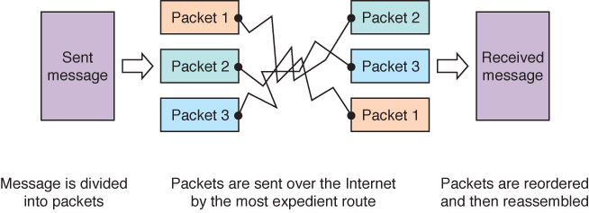
Packet Switching
Figure 15.4 Messages sent by packet switching
Take a message, break it into three packets, and
simulate this process

Slide 32
Open Systems
A logical progression...
Proprietary system
A system that uses technologies kept private by a particular commercial vendor
Interoperability
The ability of software and hardware on multiple machines and from multiple commercial vendors to communicate
Open systems
Systems based on a common model of network architecture and a suite of protocols used in its implementation

Slide 33
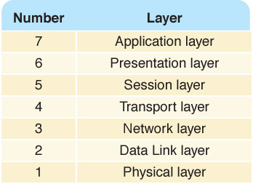
Open Systems
Open Systems Interconnection Reference Model
A seven-layer logical break down of network interaction to facilitate communication standards
Each layer deals with a particular aspect of network communication
Figure 15.5 The layers of the OSI Reference Model

Slide 34
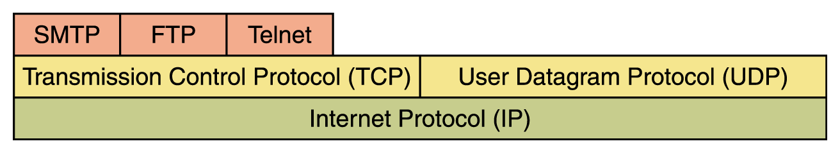
Network Protocols
Network protocols are layered such that each one relies on the protocols that underlie it
Sometimes referred to as a protocol stack
Figure 15.6 Layering of key network protocols

Slide 35
TCP/IP
35
Transmission Control Protocol (TCP)
Software that breaks messages into packets, hands them off to the IP software for delivery, and then orders and reassembles the packets at their destination
Internet Protocol (IP)
Software that deals with the routing of packets through the maze of interconnected networks to their final destination
Notes:
35

Slide 36
TCP
TCP = Transmission Control Protocol (reliable, but less efficient)
Before sending true message, it sends a warning message to recipient: “I’m about to send you a # of packets”
It then waits for an acknowledgement message from the recipient “okay, I’ll watch for them”
This process establishes a “connection”

Slide 37
TCP
37
Once “connection” is established:
Individual packets are sent
The receiver separately acknowledges each packet which arrives by sending an ACK. Or if the packet arrived damaged, a negative acknowledgement (NAK)
Sender will resend damaged packets. Also, if a long time passes without an ACK or NAK, it assumes the packet must have been lost, and so it resends.
Notes:
37

Slide 38
UDP
38
UDP stands for User Datagram Protocol (more efficient, less reliable)
Original device simply sends the packets and doesn’t worry about whether they get lost.
Which protocol would you choose for:
Email messages?
Streaming Audio?
Notes:
38

Slide 39
Other protocols
39
Ping
A program used to test whether a particular network computer is active and reachable
Traceroute
A program that shows the route a packet takes across the Internet
Notes:
39

Slide 40
High-Level Protocols
Other protocols build on TCP/IP protocol suite
Simple Mail Transfer Protocol (SMTP) used to specify transfer of electronic mail
File Transfer Protocol (FTP) allows a user to transfer files to and from another computer
Telnet used to log onto one computer from another
Hyper Text Transfer Protocol (http) allows exchange of Web documents
Which of these have you used?

Slide 41
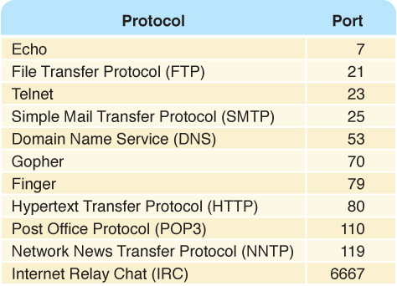
High-Level Protocols
Port
A numeric
designation
that
corresponds to
a particular
high-level
protocol
Figure 15.7 Some protocols and the ports they use

Slide 42
Issue #4: Routing
Since there are not direct connections between all devices, the communication of messages will need to routed through intermediary nodes.
Of course, there is (intentionally) more than one route between most pairs of nodes on the Internet.
Deciding on an entire route from the origination is difficult, since it might require a map of the entire Internet.

Slide 43
Message Hops
43
If a node has a packet to deliver to a destination, it does not plan the entire route.
Instead, it simply decides on the single next “hop” for the packet. That is, it chooses one of its neighbors to send it too, and leaves the rest of the routine decisions to that neighbor (or others).
Notes:
43

Slide 44
Routing Tables
44
Each node has its personal routing table which it uses to decide where to pass packets, based on the destination.
Many complications arise in having routing tables coordinated properly to avoid too many hops (or infinitely many hops in the case that a messages encounters a loop).
Last resort: “Hot Potato” routing (random)
Notes:
44

Slide 45
Final Issue: Security
45
How can you pass messages “securely” on an open network like the Internet?
Issues:
your message might be read by others
it could presumably even be modified
can others read/modify information on your computer which you did not intend to share?
can others disrupt efficiency of your system with unnecessary network activity?
Notes:
45

Slide 46
Security Solutions
46
Some possible techniques for security
A group can rely entirely on a private network for important communication.
Password Protection!
Perhaps your messages can be suitably encrypted so that anyone who intercepts it will not be able to understand it or to forward on a forgery.
A protected network could be connected to Internet through a single machine (“firewall”)
Notes:
46

Slide 47
Firewalls
Have your messages ever been
returned undelivered, blocked by a firewall?
47
Firewall
A gateway machine and its software that protects a network by filtering the traffic it allows
Access control policy
A set of rules established by an organization that specify what types of network communication are permitted and denied
Notes:
47

Slide 48
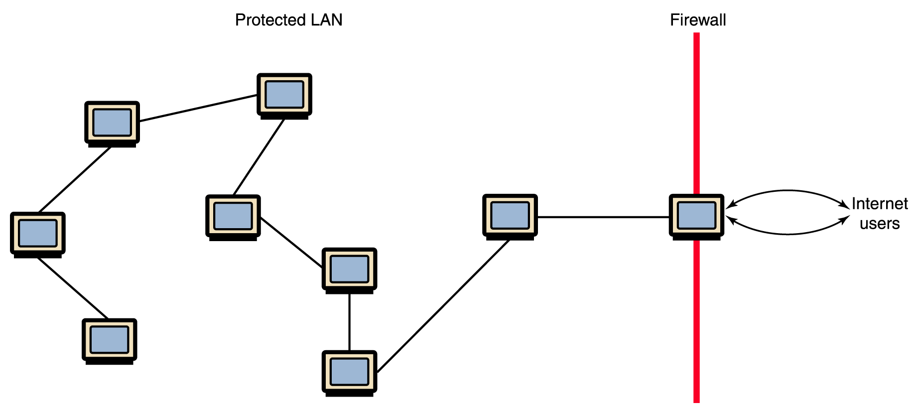
Firewalls
Figure 15.8 A firewall protecting a LAN

Slide 49
Social Networks
Social networks are a model (simulation) of how objects--individuals and organizations--interact
Internal: Participants are within a closed or private community
External: No restrictions on membership
Functionality
Participants can
describe themselves
set privacy settings
block unwanted members
have personal pages of pictures/bloggs
form or be a member of a community within the larger community
49
Notes:
49

