Slide 1
Student Performance
Prediction
A Big Data Analytics Project | Following the Data Analytics Lifecycle
Ali Khairy | Hamza Milad | Youssef Halawa | Abdelrahman Amgad
ESLSCA University | Dr. Mohamed Labib | Spring 2026

Slide 2
Big Data Context — The 5 Vs (Lec 1 & 2)
Volume
395 students, 28 features — scalable to institution-wide data
Velocity
Grades updated per period (G1→G2→G3); timely intervention needed
Variety
Numerical grades + categorical demographics + ordinal lifestyle data
Veracity
Missing values, duplicates, and outliers checked before analysis
Value
Predict at-risk students → early intervention → reduce dropout rates

Slide 3
Data Analytics Lifecycle (Lec 5)
Our project follows all 6 phases:
Phase 1: Discovery
Phase 2: Data Preparation
Phase 3: Model Planning
Define problem, KPIs, stakeholders, analytical questions
Collect, clean, encode, normalize, split
Select algorithms, define metrics, plan workflow
Phase 4: Model Building
Phase 5: Communicate Results
Phase 6: Operationalize
Train, validate, tune Regression & Classification models
Findings, recommendations, Power BI dashboard
Monitor, retrain, scale with Spark/Hadoop

Slide 4
Phase 1: Discovery
Business Problem
At-risk students are identified too late for intervention. A predictive model built on early semester data (G1, G2, habits) enables timely support.
> 75%
> 80%
< 2.5
Pass Rate KPI
Model Accuracy KPI
MAE KPI (grade pts)
Analytical Questions
Q1: Which factors most predict final grade G3?
Q2: Can a model classify pass/fail before the final exam?
Q3: How do study time and absences affect outcomes?

Slide 5
Phase 2: Data Preparation (Lec 5)
✓ Dataset
✓ StandardScaler
395 students, 28 features — UCI Student Performance (Math)
All numeric features normalized: zero mean, unit variance
✓ Missing Values
Zero nulls confirmed — no imputation needed
✓ Target Engineering
Pass/Fail derived: G3 ≥ 10 = Pass (1), G3 < 10 = Fail (0)
✓ Duplicates
Zero duplicate rows detected
✓ Train/Test Split
✓ Label Encoding
80% train / 20% test — stratified by class label
12 binary categoricals encoded as 0/1 (Lec 1&2: transformation)

Slide 6
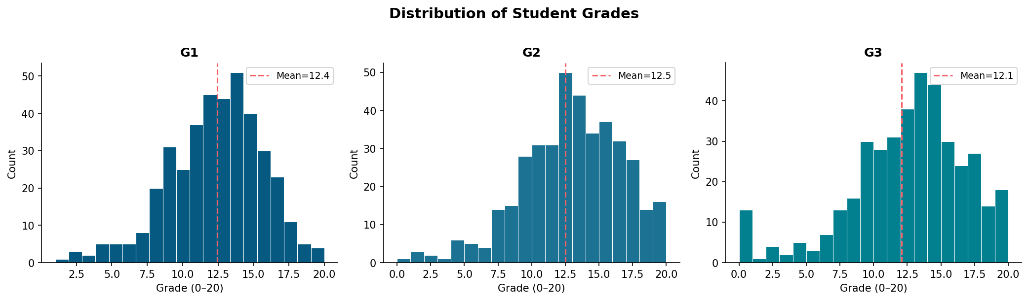
EDA — Exploratory Data Analysis (Lec 5)
76.2%
12.10
r = 0.92
Overall Pass Rate
Mean Final Grade (G3)
G2 → G3 Correlation

Slide 7
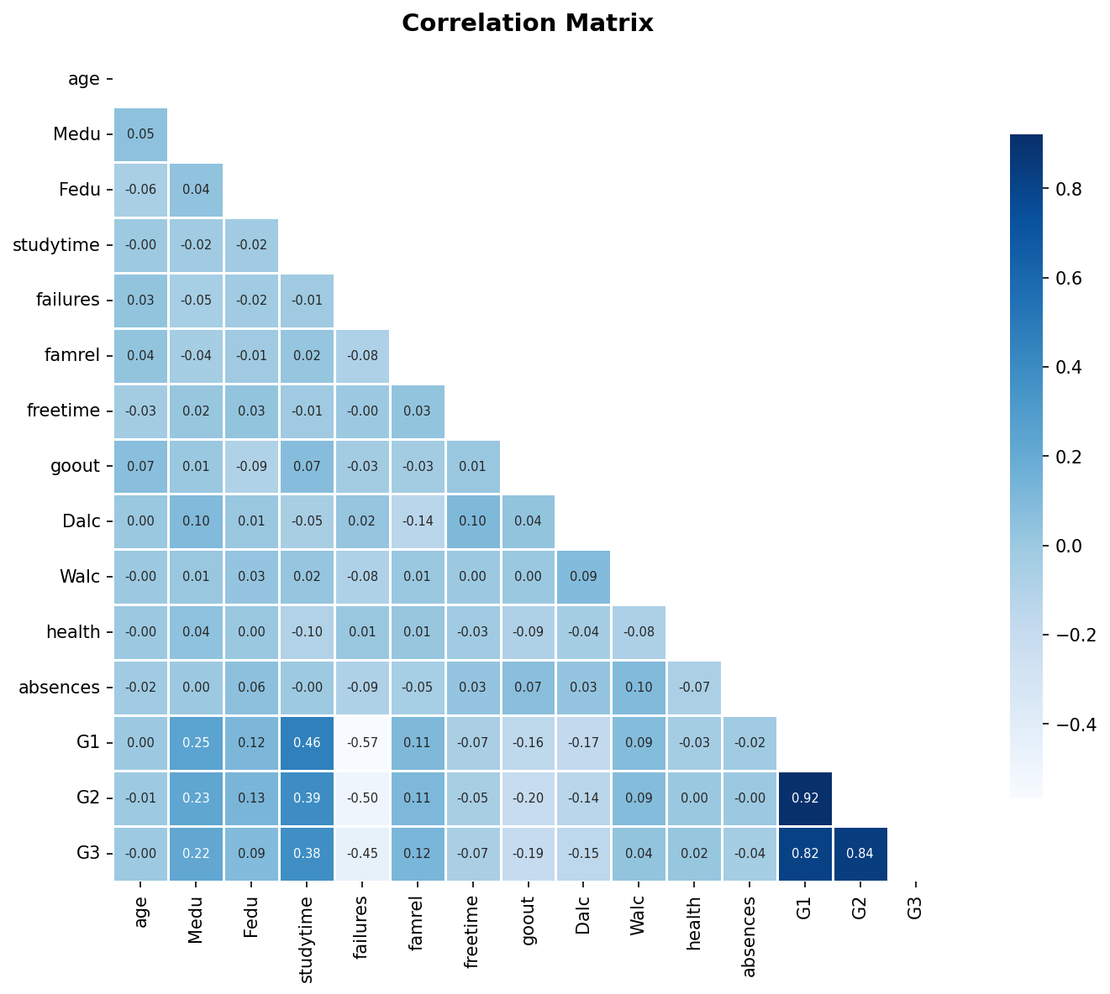
EDA — Correlation Analysis (Lec 5: "Explore trends and correlations")
Top Correlations with G3
+0.92
G2 (2nd period grade)
+0.82
G1 (1st period grade)
+0.25
Study time
-0.38
Past failures
-0.21
Going out frequency
-0.17
Daily alcohol use

Slide 8
Phase 3: Model Planning (Lec 5)
Linear Regression
Logistic Regression
Decision Tree (d=5)
Task:
Task:
Task:
Grade Prediction (G3)
Pass/Fail Classification
Pass/Fail Classification
Why:
Why:
Why:
Continuous target variable
"Quick baseline model" — Lec 5
"Classification model" — Lec 5
Course Ref:
Course Ref:
Course Ref:
Analytics Tasks — Lec 1&2
Model Planning — Lec 5
Model Planning — Lec 5
Evaluation Metrics (Lec 5: "Decide evaluation metrics: Accuracy, Precision, Recall, F1 Score")
Classification: Accuracy | Precision | Recall | F1 Score | Confusion Matrix
Regression: RMSE | MAE | R²

Slide 9
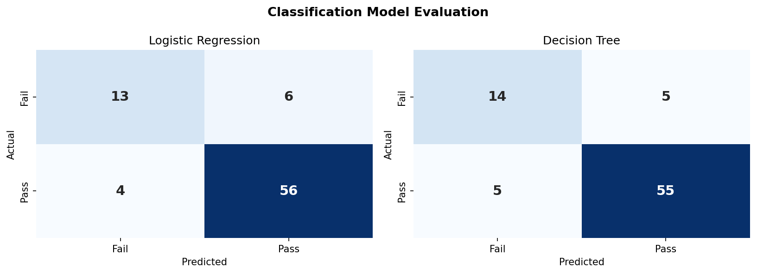
Phase 4: Model Building & Evaluation
R² = 0.621
87.3%
F1 = 0.918
Linear Regression grade prediction
Classification accuracy (both models)
Logistic Regression F1 Score

Slide 10
Phase 5: Power BI Dashboard (Lec 6)
As taught in Lec 6, a dashboard is "a collection of visuals that provide quick insight into the data." Our interactive HTML dashboard includes:
KPI Cards
Scatter Plot
Total students, pass rate, mean grade, mean absences — Numeric visuals (Lec 6)
G1 vs G3 relationship — Trend visualization
Bar Chart
Slicers
Pass rate by school and gender — Categorical visual (Lec 6)
Filter by school, gender, pass/fail — Interactive filters (Lec 6)
Column Chart
Data Table
Grade distribution by study time group — Categorical visual (Lec 6)
Student-level predictions grid — Grid visual (Lec 6)

Slide 11
Phase 5: Insights & Recommendations
✓ Early Alert System
Flag students with G1 < 10 or any past failure for immediate counselor contact
✓ Attendance Monitoring
Trigger alerts when absences exceed 6 — measurable grade impact
✓ Study Skills Program
Target students studying <2h/week with structured workshops
✓ Parent Engagement
Priority outreach to families with low parental education (Medu/Fedu ≤ 1)
✓ Scale with Big Data Tools
Deploy with Apache Spark for institution-wide rollout (Lec 1&2)

Slide 12
Conclusion
✓ Applied the 6-phase Data Analytics Lifecycle (Lec 5) end-to-end
✓ Framed within the 5 Vs of Big Data (Lec 1 & 2)
✓ Linear Regression: R² = 0.621, MAE = 1.63 — exceeds KPI target
✓ Logistic Regression & Decision Tree: 87.3% accuracy — exceeds 80% KPI
✓ Power BI-style dashboard built with KPI cards, charts & slicers (Lec 6)
✓ 5 actionable recommendations for teachers, counselors & administrators
ESLSCA University | Big Data Analysis | Dr. Mohamed Labib | Spring 2026

