Slide 1
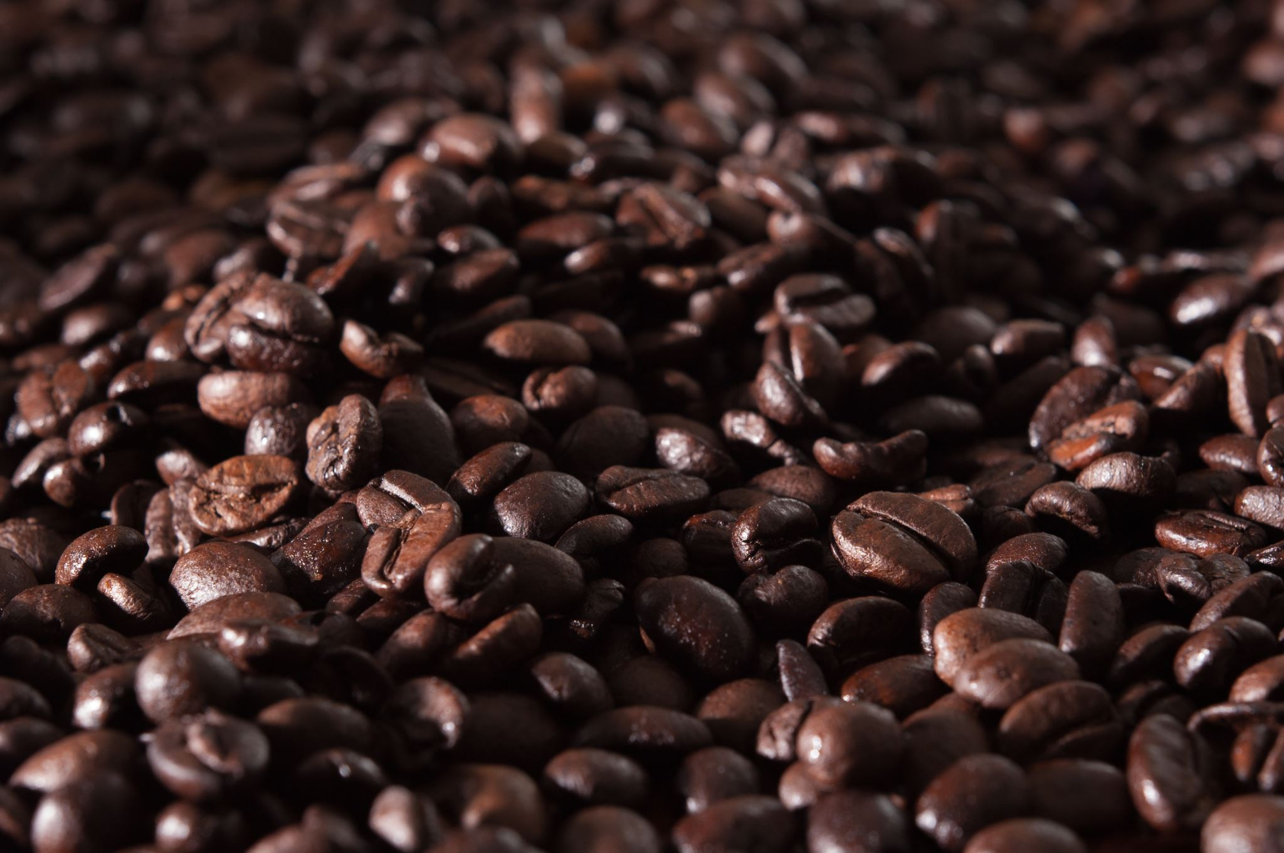
Coffee Shop Sales Dashboard
Business Insights & Performance Overview By [Ali Uddin Khan] – Aspiring Data Analyst

Slide 2

introduction
Objective : To analyze sales, customer footfall, and product performance across multiple store locations.
Tools Used : Excel
Focus : Identifying key drivers of revenue and customer behavior.

Slide 3

Key Metrics Overview
Total Sales : $698,812.33
Total Footfall : 149,116
Average Bill per Person : 4.69
Average Order per Person : 1.44
Insight : Strong customer base with consistent spending patterns.

Slide 4

Sales Trend By Hour
Observation : Orders peak between 9–10 AM, decline after 6 PM.
Insight : Morning rush hour is the most profitable period.
Recommendation : Optimize staffing and promotions during peak hours.

Slide 5
Category Contribution
Coffee: 39% | Drinking Chocolate: 28% | Bakery: 12% | Others: 21%
Insight: Coffee is the primary revenue driver.
Recommendation: Expand coffee offerings and bundle with bakery items.

Slide 6
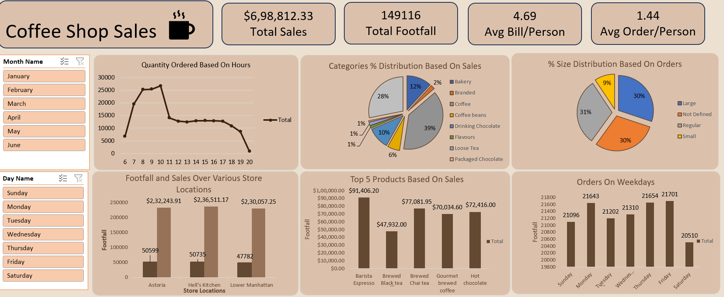

Slide 7
Order Size Distribution
Small: 31% | Regular: 30% | Large: 30% | Undefined: 9%
Insight: Balanced preference across sizes.
Recommendation: Introduce loyalty rewards for upsizing orders.

Slide 8
Store Location Performance
Astoria: $232,243.91 | Hell’s Kitchen: $236,511.17 | Lower Manhattan: $230,057.25
Insight: Hell’s Kitchen slightly leads in sales and footfall.
Recommendation: Replicate successful strategies across other locations.

Slide 9
Top 5 Products
1 . Barista Espresso – $91,406.20
2. Brewed Chai Tea – $77,081.95
3. Hot Chocolate – $72,416.00
4. Gourmet Brewed Coffee – $70,034.60
5. Brewed Black Tea – $47,932.00
Insight: Espresso is the star performer.
Recommendation: Promote top products with seasonal campaigns.

Slide 10
Weekday Footfall
Footfall is steady across weekdays (21K+ daily), slightly lower on weekends.
Insight: Consistent customer engagement during workdays.
Recommendation: Weekend promotions to boost traffic.

Slide 11
I built a dashboard to explore sales patterns for a coffee shop. It showed morning hours as the peak sales window, coffee as the primary revenue driver, and Hell’s Kitchen as the top‑performing store. I used Excel charts and PivotTables, then applied storytelling techniques to make the findings actionable. I enjoyed discovering the steady weekday footfall — it helped me prioritize staffing and promotions for slow afternoons.
Dashboard Highlights:
Morning hours as peak sales.
Coffee as the dominant revenue category.
Hell’s Kitchen store leading in performance.
Barista Espresso as the top product.
This project strengthened my Excel and storytelling skills for business decisions.

