Slide 1






Airbnb New User Bookings
Where will a new guest book their first travel experience?
Ali Khanzadi

Slide 2
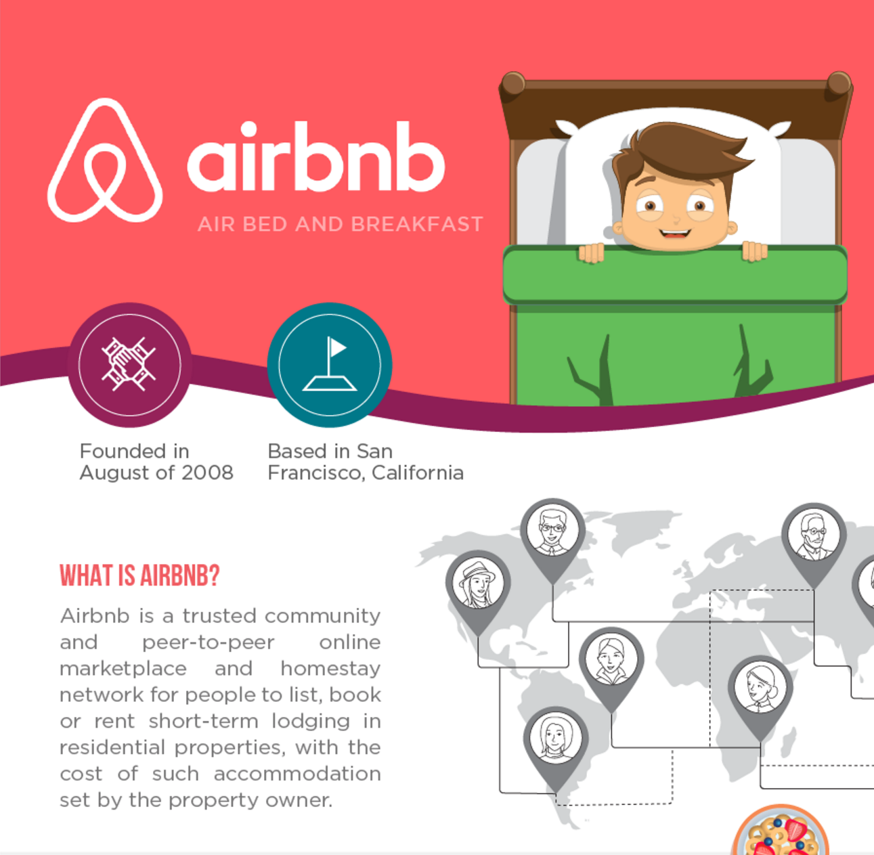
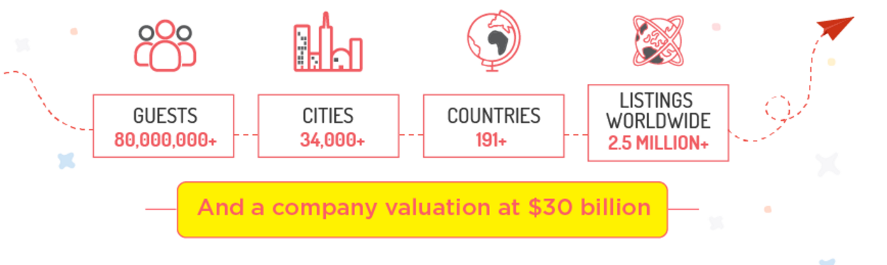
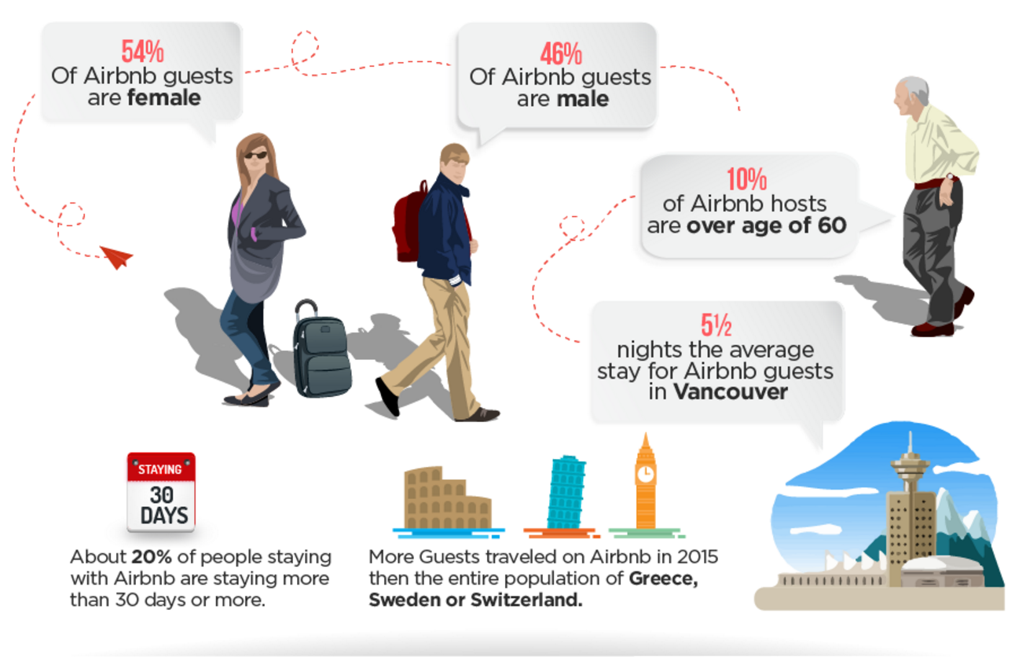
Why?
New users on Airbnb can book a place to stay in 34,000+ cities across 190+ countries.
By predicting where a new user will book their first travel experience, Airbnb can share more personalized content with their community, decrease the average time to first booking, and better forecast demand.
https://www.reviewsxp.com/blog/airbnb-infographic/
Notes:
Airbnb announced that it would move into architecture and construction, starting with a test building in a small town in Japan, a bookable house that Airbnb describes as more like a "community center" that will help revitalize the declining rural town of Yoshina.
Airbnb tries urban planning -and hotels- with 'Samara
Its business is 100 percent dependent on having enough places for its users to rent. According to Airbnb's site, it has some 2 million listings worldwide in 34,000 cities and 191 countries, and hosts over 60 million guests. (For comparison, a 2012 study estimates that are 187,000 hotels around the world offering 17.5 million guests rooms.)

Slide 3
The Data
Users
Comes in a train and test datasets
Includes user info and selected destination
Countries
Information about the destination
Age/gender
Dataset of age buckets, gender and countries
Sessions
Online activity of some users
Destinations
Country Info
Population Demographics
Users
Online session
Train Set
http://mashable.com/2016/08/04/airbnb-samara-design-hotels/#jPg6V7i6cOqU
Ali Khanzadi

Slide 4
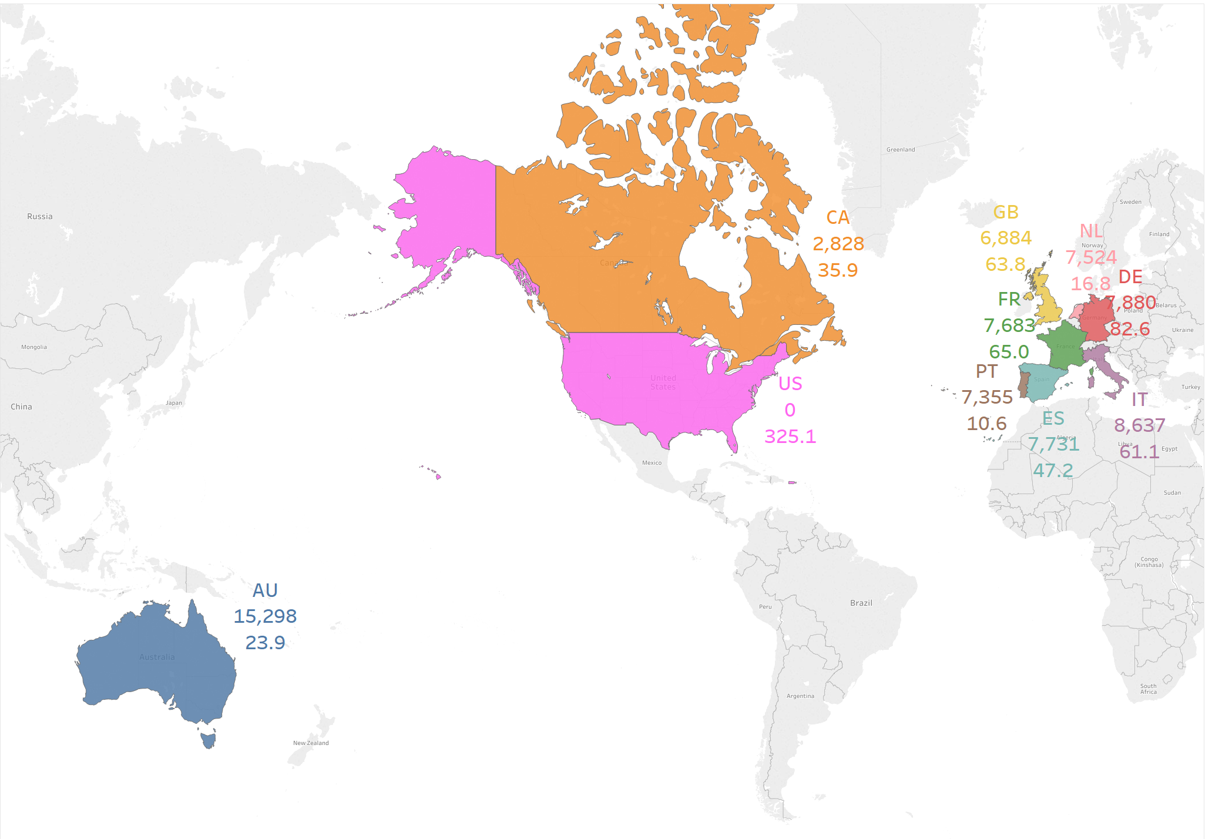
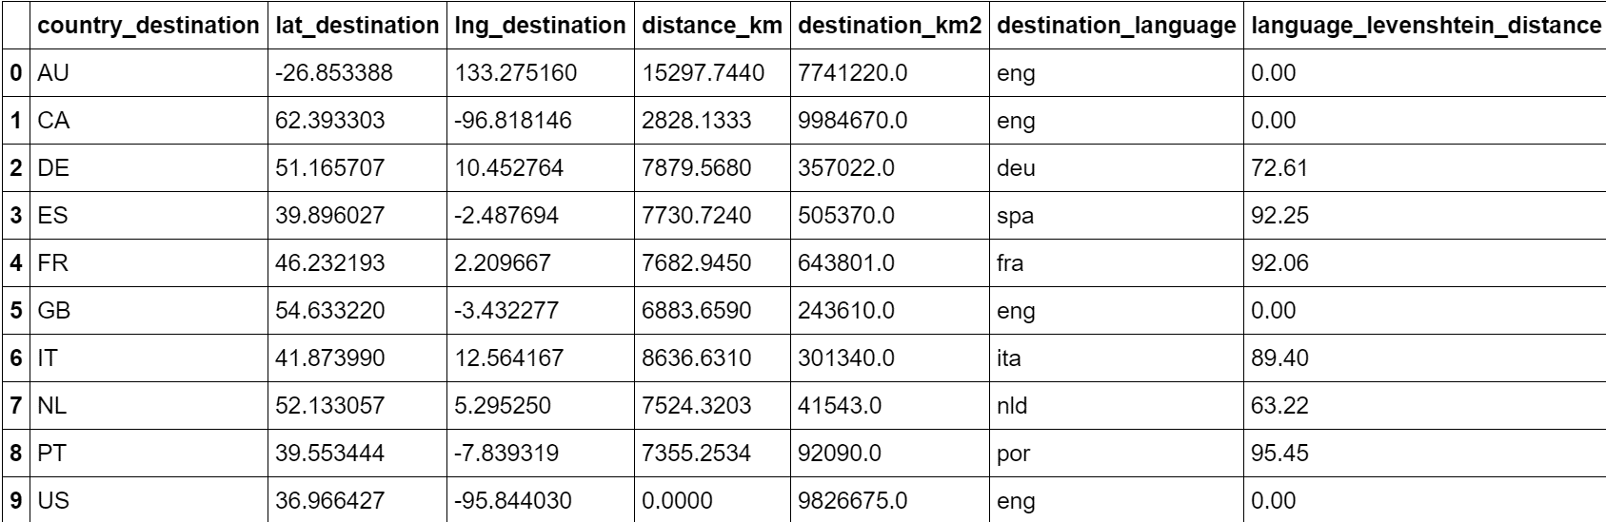
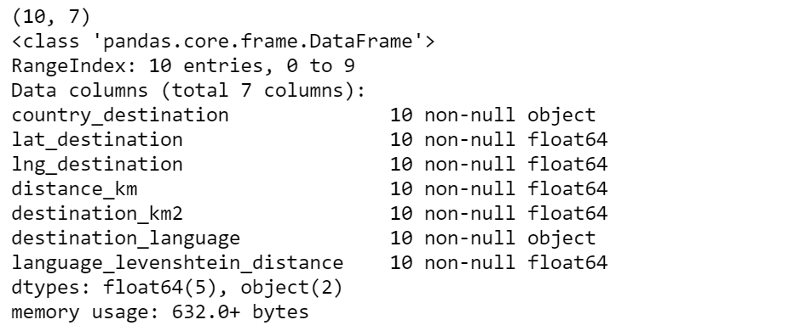
Data Countries
Country
Distance to US km
Population in millions
Levenshtein distance (LD) is a measure of the similarity between two strings
Informally, the Levenshtein distance between two words is the minimum number of single-character edits (insertions, deletions or substitutions) required to change one word into the other.

Slide 5
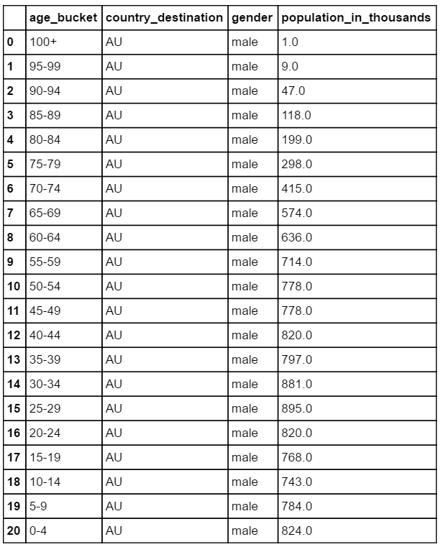
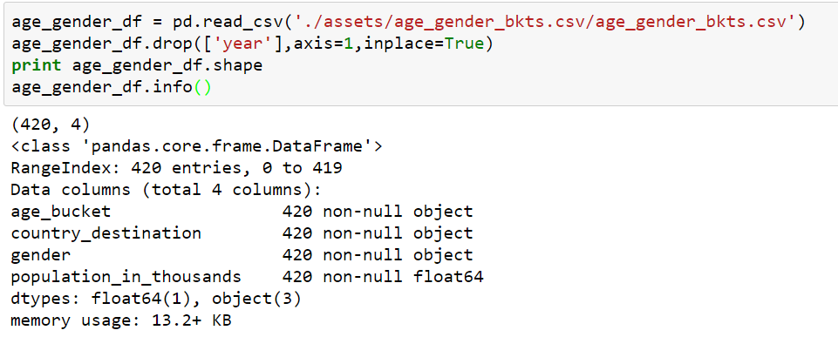
Data Age Gender Buckets
http://mashable.com/2016/08/04/airbnb-samara-design-hotels/#jPg6V7i6cOqU

Slide 6
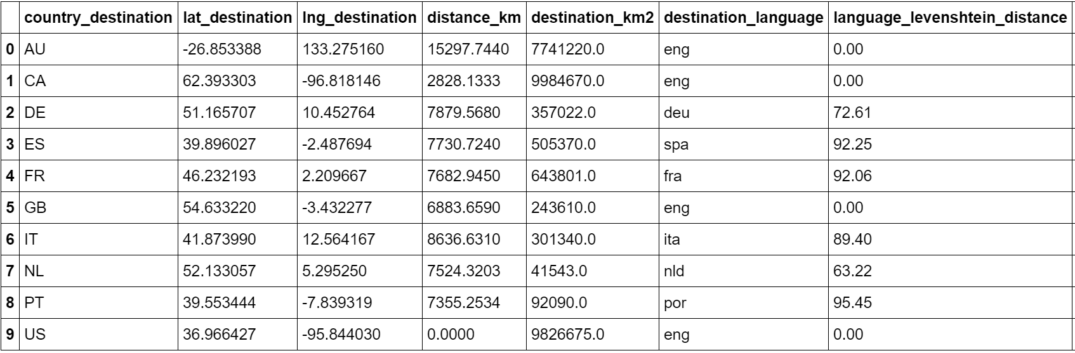
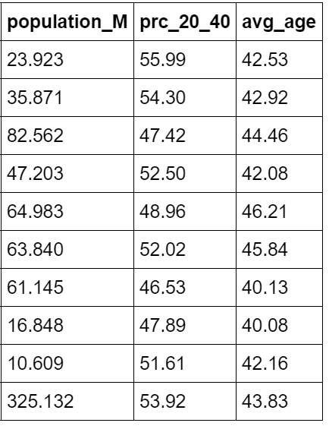
Data Country Information

Slide 7
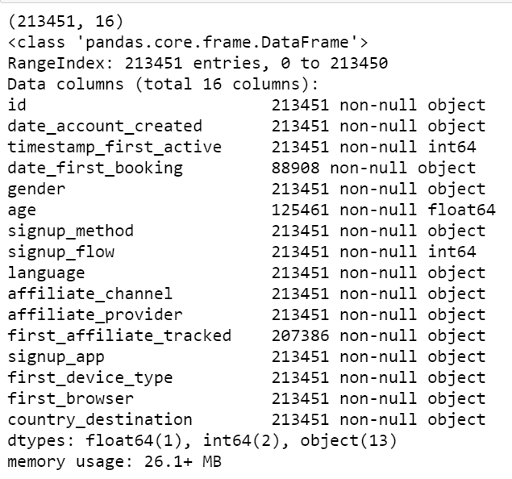
Data Users
id: user id
date_account_created: the date of account creation
timestamp_first_active: timestamp of the first activity, note that it can be earlier than date_account_created or date_first_booking because a user can search before signing up
date_first_booking: date of first booking
signup_flow: the page a user came to signup up from
language: international language preference
affiliate_channel: what kind of paid marketing
affiliate_provider: where the marketing is e.g. google, craigslist, other
first_affiliate_tracked: whats the first marketing the user interacted with before the signing up
country_destination: this is the target variable you are to predict

Slide 8
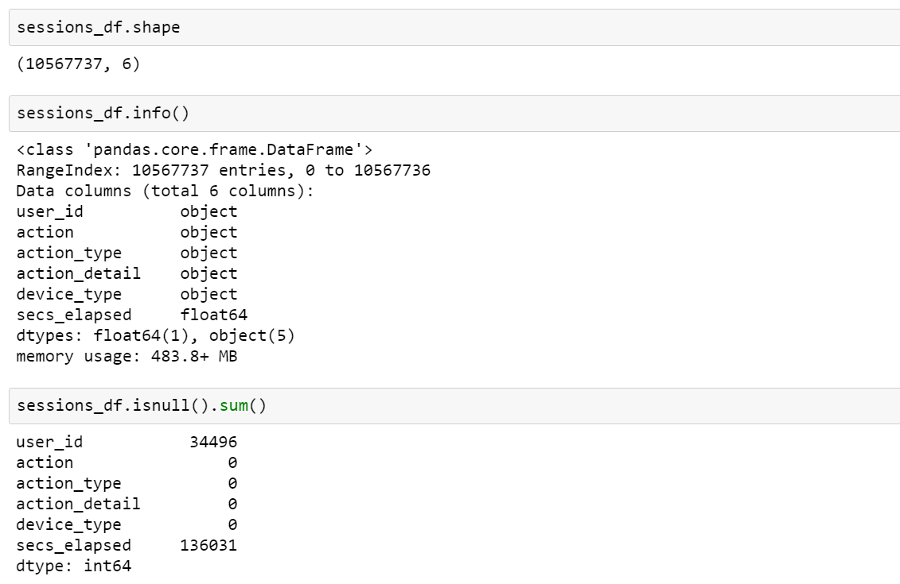
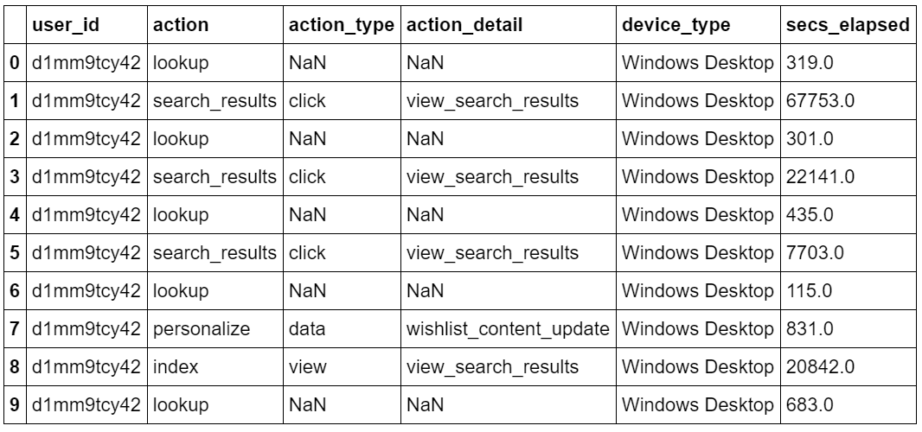
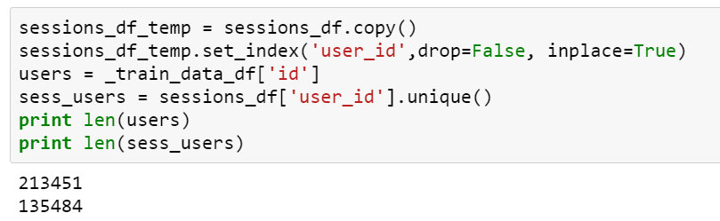
Data Sessions
In the sessions dataset, the data only dates back to 1/1/2014, while the users dataset dates back to 2010.

Slide 9
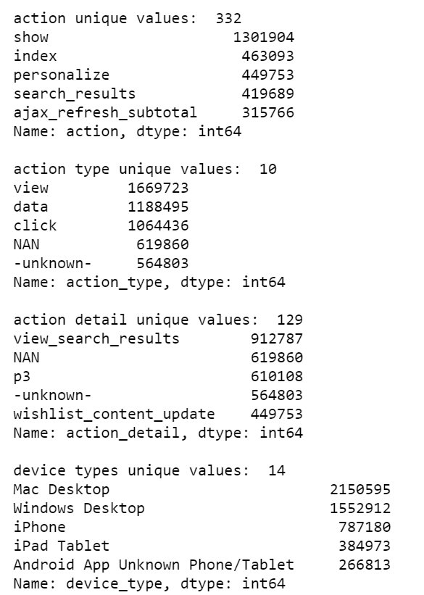
Data Sessions
Challenges
A lot of NaN and unknown values
Could not make much sense from data by looking at the values.
Do we want to keep all features?
Questions
How much time does a user spend on each session?
How many actions (actions, action types and action details) is involved per user?
What are the top actions (actions, action types and action details) among users? Does it have any value for our calculations?
What are the most time consuming actions (actions and action types, action details)

Slide 10
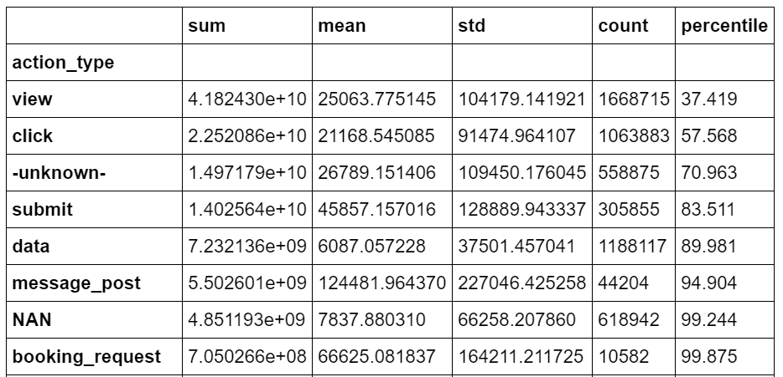
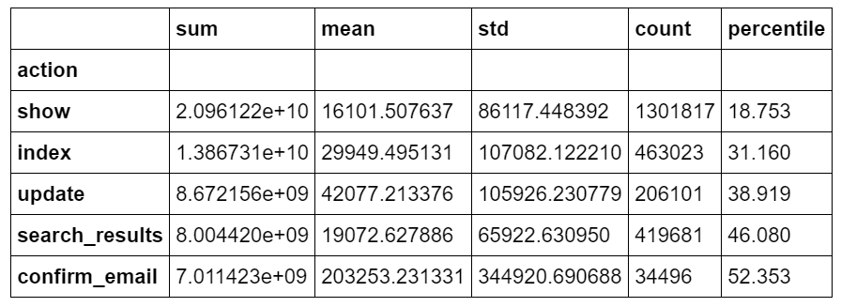
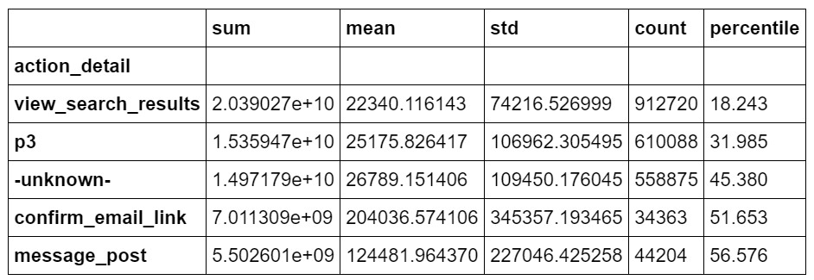
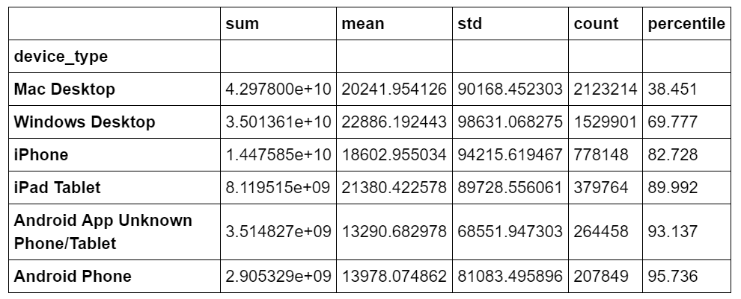
Data Sessions

Slide 11
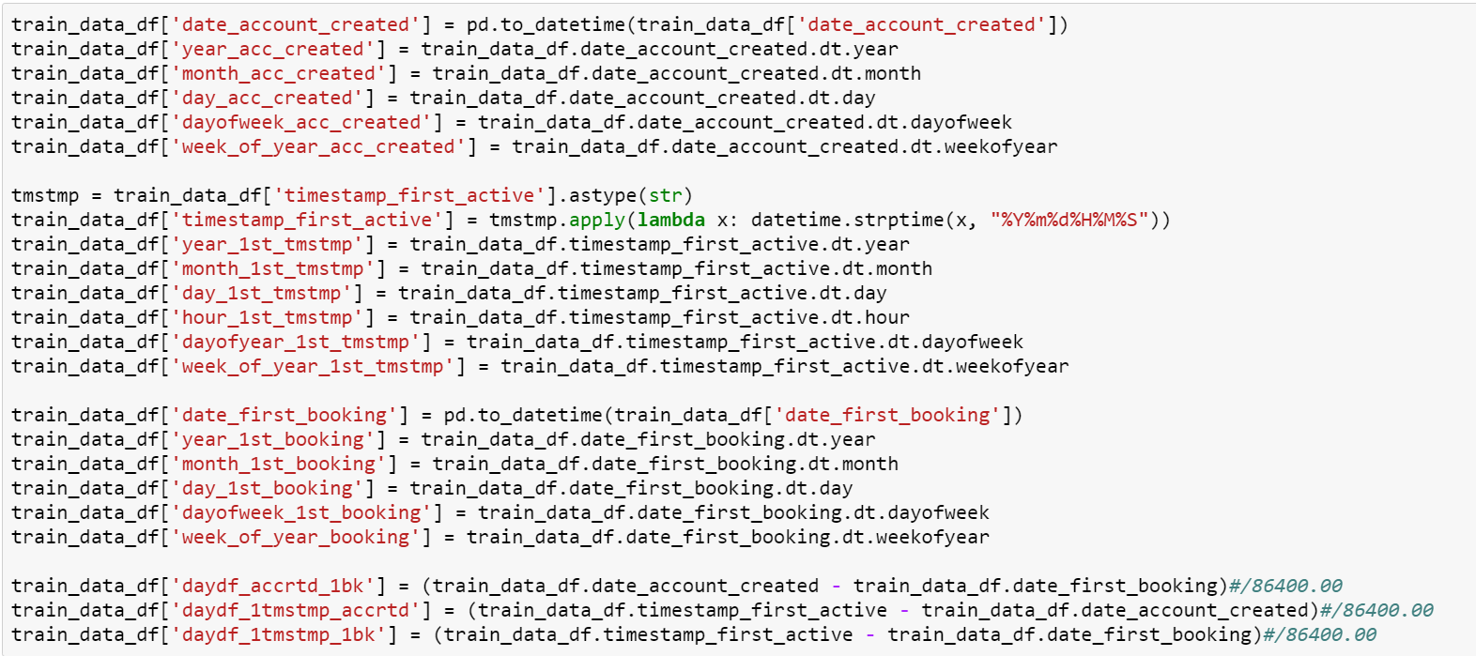
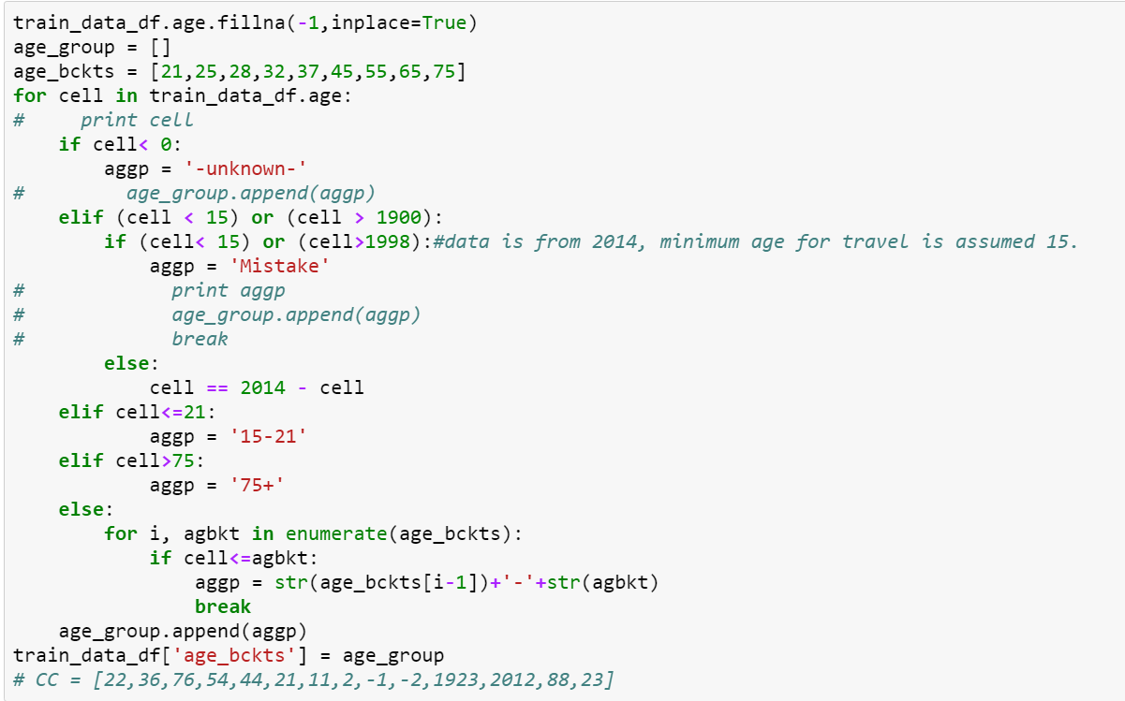
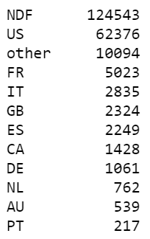
Data – Feature Engineering Users
Challenges
Missing ages – a very important feature
Dates and ages are messy
NAs exist
Categorical and numerical data
Get rid of low frequency features
Dates
Extract year, month, day, hour (if available), day of year, week of year, and difference of account creation, 1st timestamp activity, and 1st booking if available
Destinations

Slide 12
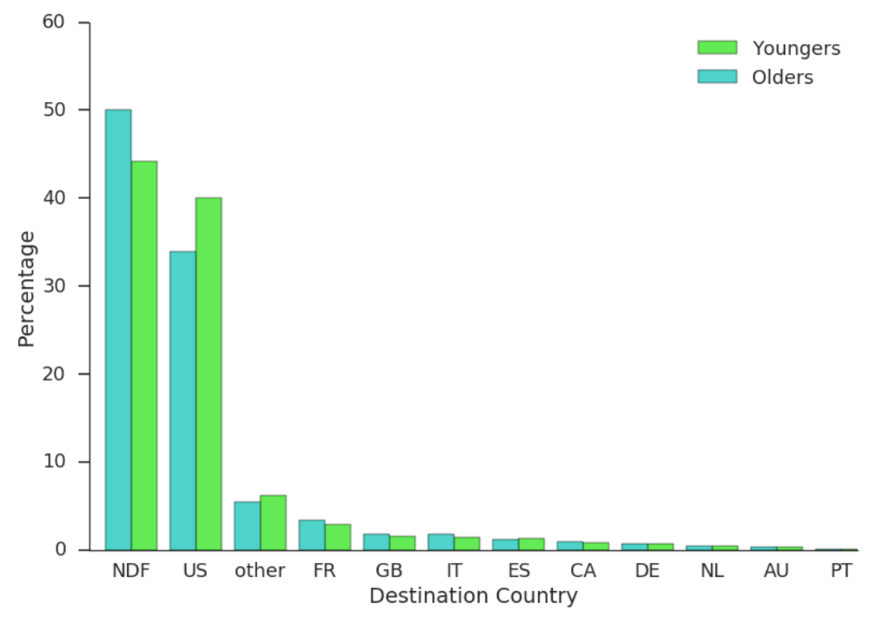
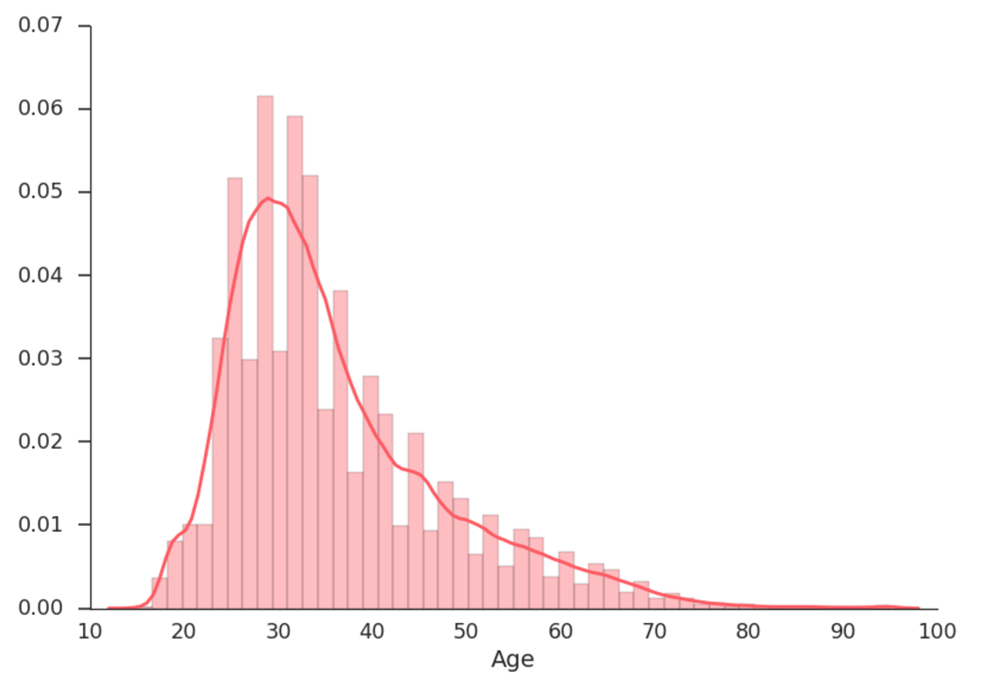
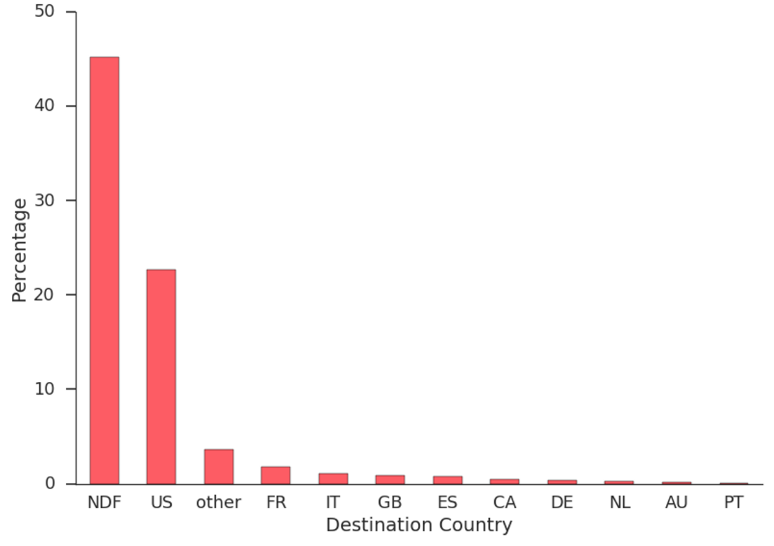
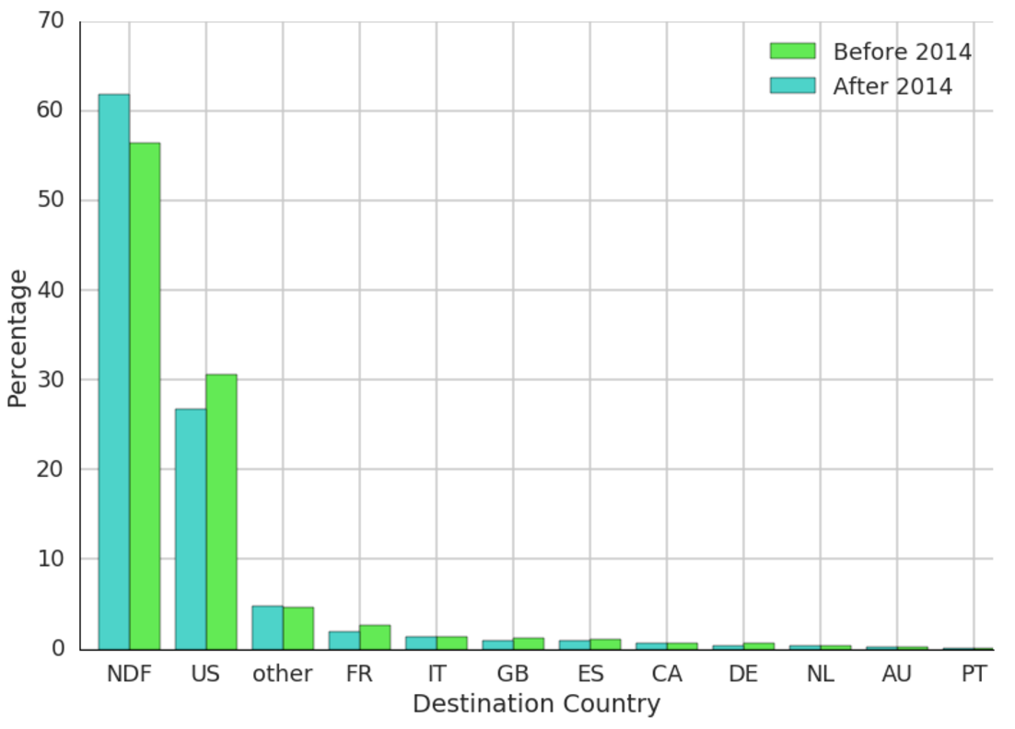
Data Users

Slide 13
Data – Feature Engineering Users – Age Imputation
Use both train and test (actual test from kaggle)
Using:
Gender
Signup method
Language
Signup app
First device type
First affiliate provider
First browser
Learning from a set of 159,000 x 75 metrix
Using Random Forest Classifier – all default values for parameters

Slide 14
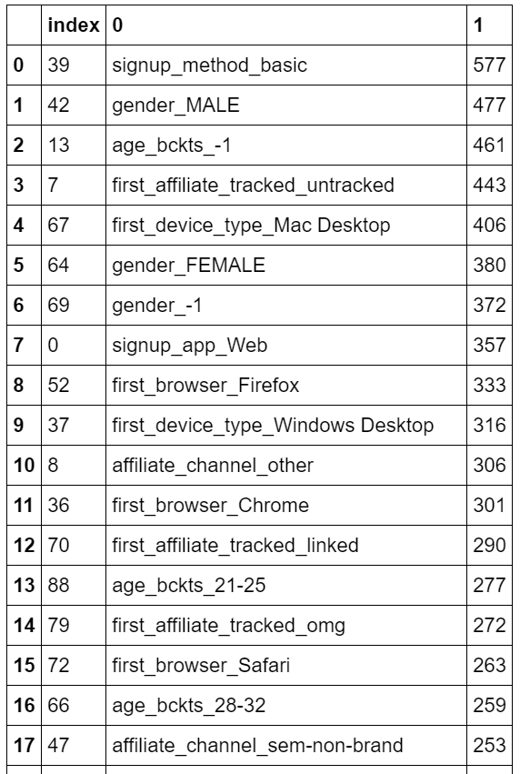
Modelling XGBoost
200 Features
214000 instances
params = {
'objective': 'binary:logistic',
'max_depth': 5,
'learning_rate': 0.25,
'silent': 1.0,
'n_estimators': 50
}
bst = XGBClassifier(**params).fit(_X_, y)

Slide 15
Modelling Next Steps
From sessions:
Check if the user booked or not (NDF or no NDF) – Logistic Regression
Correlation of features to booking or not booking
Run PCA to reduce features
Cluster Users – Kmean and add a feature
Input to users dataset for the final model.
Factor in holiday dates

Slide 16
Conclusion
Since the not so intuitive nature of the data in sessions dataset and the unknown and NA values, for this project Feature Engineering is really important
XGBoost with cross validation is needed
Furthermore ensemble method with Random Forest, SVM, Logistical Regression and XFGBoost will be used

