Slide 1

Analyze and Visualize Data Using Microsoft Excel
01-10-2023

Slide 2

Instructor Information

Slide 3

Instructor Information
Hosnia Ali Ahmed
Telegram account:
@hosnia_ali
Twitter Account:
https://twitter.com/ii_hes1
Linkedin Account:
https://www.linkedin.com/in/hosnia/

Slide 4

Google Drive Folder

Slide 5

Telegram Group

Slide 6
Agenda
Introduction
Data Import
Data Cleaning and Preparation
Formulas and Functions
PivotTables
Charts and Graphs
Conditional Formatting
Data Analysis Tools
Sharing and Collaboration
Basic Charts in Excel - Practical
Advanced Excel Visualization Techniques - Practical
Customizing and Formatting Excel Charts - Practical

Slide 7
Introduction
Microsoft Excel is a powerful tool for data analysis and visualization.
It offers a wide range of features and functions to help you make sense of your data.

Slide 8
Data Import
Excel allows you to import data from various sources, such as CSV files, databases, and web pages.
You can use the "Get Data" feature to connect to external data sources and import them into Excel.

Slide 9
Data Cleaning and Preparation
Before analyzing data, it's important to clean and prepare it.
Excel provides tools for data cleaning, such as removing duplicates, filling in missing values, and formatting data appropriately.

Slide 10
Formulas and Functions
Excel offers a vast library of built-in formulas and functions.
You can use these functions to perform calculations, manipulate data, and create custom formulas.

Slide 11
PivotTables
PivotTables are a powerful feature for summarizing and analyzing data.
They allow you to quickly group and aggregate data, perform calculations, and create interactive reports.

Slide 12
Charts and Graphs
Excel provides a wide range of chart types to visualize data effectively.
You can create bar charts, line graphs, pie charts, and more to highlight patterns and trends in your data.

Slide 13
Conditional Formatting
Conditional formatting allows you to apply formatting rules based on specific conditions.
You can use it to highlight cells that meet certain criteria, making it easier to identify outliers or important data points.

Slide 14
Data Analysis Tools
Excel offers various data analysis tools, such as regression analysis, goal seek, and scenario manager.
These tools enable you to perform advanced analysis and make predictions based on your data.

Slide 15
Sharing and Collaboration
Microsoft Excel is a versatile tool for analyzing and visualizing data.
With its rich features and functionalities, you can uncover insights, present data effectively, and make data-driven decisions.

Slide 16
Basic Charts in Excel

Slide 17
Dataset
Download the dataset file from her: GitHub.
Format the cells as needed.

Slide 18
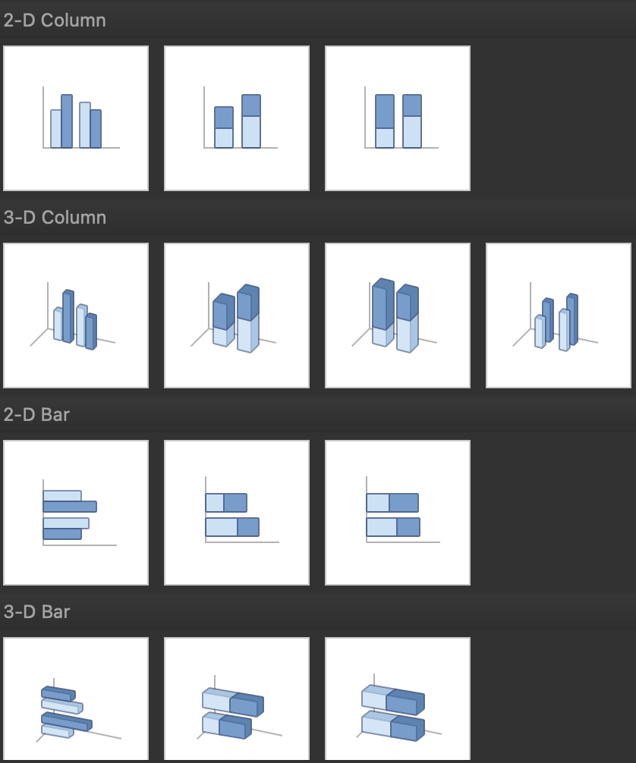
Creating Basic Charts in Excel
Excel has multiple options for choosing a particular chart type.
For example, if you want to create a column or bar chart, you are often presented with various visualization options.
For example, there are 2D and 3D versions and normal, stacked, and 100% stacked options.
Depending on your requirements, you can choose the visualization type that best suits your needs.

Slide 19
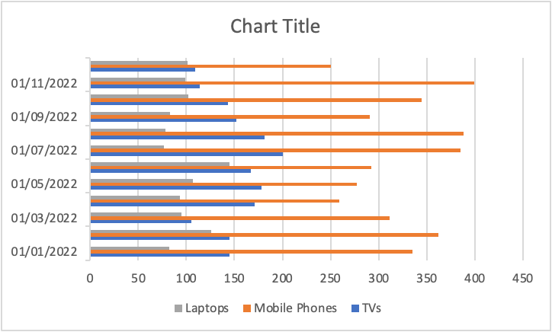
Excel Bar Charts

Slide 20
Excel Bar Charts
Bar charts are one of the easiest charts to interpret, enabling the person viewing the chart an easy way to compare categorical data quickly. On a bar chart, the categorical data is on the y-axis, and the values are on the x-axis.
To create a bar chart:
Select the data range A1:D13
Click the "Insert" tab in the Excel ribbon
Click on the columns icon button dropdown, and under the “2-D Bar” category, choose “Clustered Bar”

Slide 21
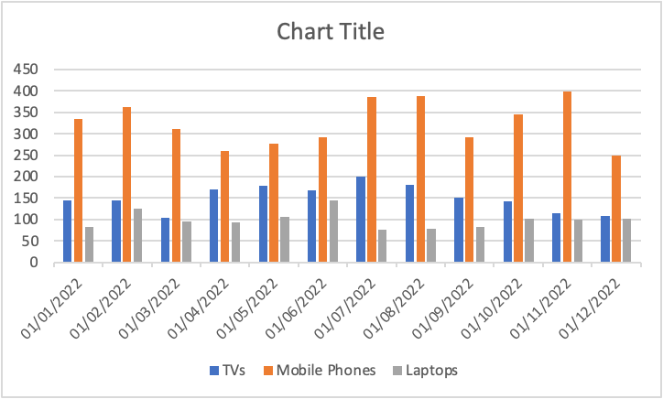
Excel Column Charts

Slide 22
Excel Column Charts
A column chart, also known as a vertical bar chart, helps visualize data where categories are placed on the x-axis and the values on the y-axis. Similar to bar charts, they help visualize data across categories.
To create a column chart in Excel:
Select the data range A1:D13
Click the "Insert" tab in the Excel ribbon
Click on the columns icon dropdown, and under the “2-D Column” category, choose “Clustered Column”
You can now see a column chart that displays the number of units sold for each product category by the month.

Slide 23
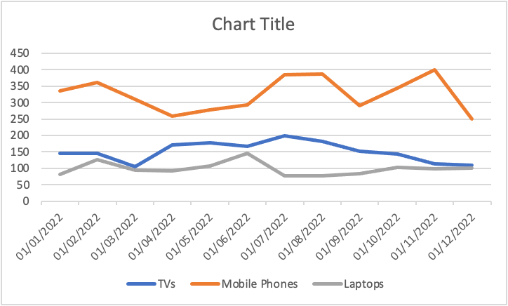
Excel Line Charts

Slide 24
Excel Line Charts
A line chart is the most useful way to capture how a numerical variable changes over time. This is helpful to identify trends in numeric values.
To create a line chart in Excel:
Select the data range A1:D13
Click the "Insert" tab in the Excel ribbon
Click on the line chart dropdown, and under the “2-D Line” category, choose “Line with Markers"
You can now see a line chart displaying units sold each month split by product category. This enables you to compare each product category performance over time easily.

Slide 25
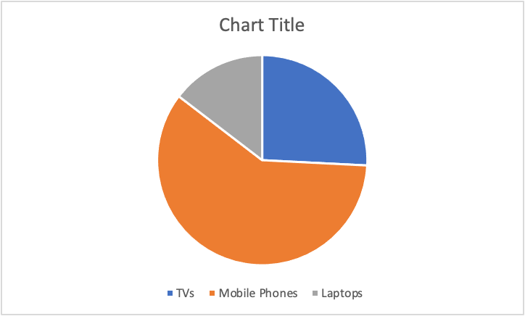
Excel Pie Charts

Slide 26
Excel Pie Charts
A pie chart is most commonly used to show the proportions of a whole. With this pie chart, we want to compare the total sales between the three categories.
To create a pie chart in Excel:
First, select the data range B1:D1
Second, using the command (for Mac) or ctrl (for Windows), select the second date range: B14:D14
Click the "Insert" tab in the Excel ribbon
Click on the pie chart dropdown, and under the “2-D Pie” category, choose “Pie”

Slide 27
Advanced Excel Visualization Techniques

Slide 28
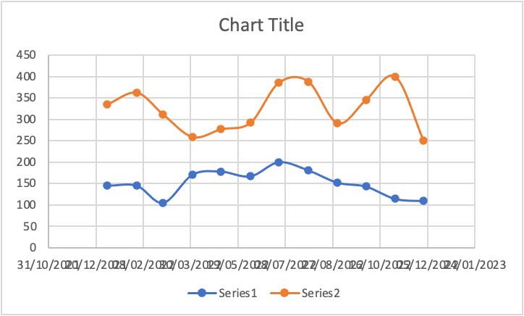
Excel Scatter Plot

Slide 29
Excel Scatter Plot
A scatter plot is commonly used to visualize the relationship between two variables. It can be useful for quickly surfacing potential correlations between data points. We’ll create a scatter plot to compare the number of TVs and laptops sold.
To create a scatter plot in Excel:
Select the data range A1:C13
Click the "Insert" tab in the Excel ribbon
Click on the scatter plot dropdown, and under the “Scatter” category, choose “Histogram”
Click "Scatter or Bubble Chart" and choose "Scatter with Smooth Lines and Markers"

Slide 30
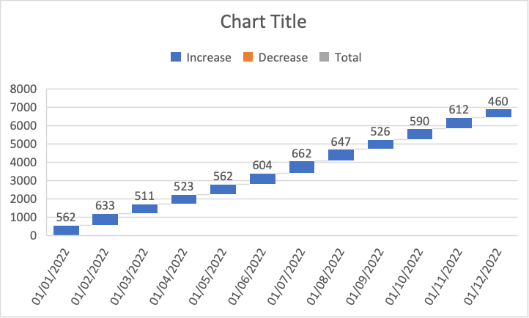
Excel Waterfall Chart

Slide 31
Excel Waterfall Chart
A waterfall chart is a special chart that helps illustrate how positive and negative values can contribute to a total. They can be great for visualizing changes over time. In our example, we’ll compare the total sales for each month regardless of the categories.
To create a waterfall chart in Excel:
First, select the data range A2:A13
Second, using the command (for Mac) or ctrl (for Windows), select the second data range E2:E13
Click on the waterfall chart dropdown, and under the “Waterfall” category, choose “Waterfall”
We’ll only see positive values in our example because the Total column only contains positive values, but this chart can be great for comparing financial data and changes over time.

Slide 32
Customizing and Formatting Excel Charts

Slide 33
Customizing and Formatting Excel Charts
Aside from creating charts in Excel, there are many options to customize and format a chart. From here, we’ll discuss some common formatting options that’ll help you enhance your visuals.
First, create a column chart based on our previous guidance that displays the number of units sold for each product category by the month.

Slide 34
Chart elements
Chart elements include titles, legends, data labels, gridlines, and axes. You can add, remove, or modify these elements as needed.
Click on the chart to select it.
In the Excel ribbon, click the "Chart Design" tab
Click the "Add Chart Element" dropdown to access the available chart elements

Slide 35
Chart title
To add a chart title, click "Add Chart Element" > "Chart Title" and choose one of the available options (e.g., "Above Chart" or "Centered Overlay"). You can then click the title placeholder and type your desired title
To remove a chart title, right-click on the title and select “Delete”
For this tutorial, rename the chart “Electronic Store Sales 2022”

Slide 36
Legend
To modify the chart legend, click "Add Chart Element" > "Legend" and choose a position for the legend (e.g., "Right" or "Top")
To remove the legend, click "Add Chart Element" > "Legend" > "None"
For this tutorial, move the legend to the top of the chart.

Slide 37
Data Labels
To add data labels, click "Add Chart Element" > "Data Labels" and choose one of the available options (e.g., "Center" or "Above"). This will display the data values directly on the chart
To remove data labels, click “Add Chart Element” > “Data Labels” > “None”
To remove data labels from individual categories, right-click on the data label of the chosen category; this will highlight all relevant data labels. You can then click “Delete”

Slide 38
Chart Styles and colors
On top of customizing individual chart elements, you can change your chart's overall look and feel by applying different styles and color schemes.
To customize a chart style, select the visual you want to update. Then take the following steps:
In the Excel ribbon, click the "Chart Design" tab
Under the “Chart Styles” section, there is an option to change styles and change colors
For chart styles: Browse the available styles and click one to apply to your chart
For color changes: Click the “Change Colors” dropdown and choose a color scheme

Slide 39
Formatting Excel chart axes
To improve the readability of our chart, we can format our axis in several ways, including axis titles, scale, or even visibility.
Axis titles
To add an axis title, click "Add Chart Element" > "Axis Titles" and choose "Primary Horizontal" or "Primary Vertical." You can then click the title placeholder and type your desired title
To remove an axis title, right-click on the axis title and click “Delete”
For this tutorial, add an x-axis title “Month” and a y-axis title “Products Sold.”

Slide 40
Formatting Excel chart axes
Axis scale and number format
To adjust the axis scale or number format:
Right-click the axis you want to modify and choose "Format Axis"
In the "Format Axis" pane, you can change the minimum and maximum values, major and minor units, or number format.

Slide 41
Formatting Excel chart axes
Axis visibility
Finally, if you would like to remove the axis labels from showing, you can take the following steps:
In the Excel ribbon, click the "Chart Design" tab
Click the "Add Chart Element" dropdown and navigate to "Axes"
By default, both options will have a darker gray box surrounding them, to remove an Axes, simply de-select the axes you’d like to remove

Slide 42
Other Excel formatting options
Other Excel formatting options
There are other formatting options available, including modifying data series colors, adjusting chart and plot area backgrounds, and customizing gridlines.
To access these options:
Right-click the chart element you want to modify (e.g., data series, plot area, or gridlines)
Select "Format [element]"

