Slide 1


Vehicle Insurance Claim Fraud Detection
This presentation outlines a machine learning project focused on detecting vehicle insurance fraud.
By Ali Koteich

Slide 2
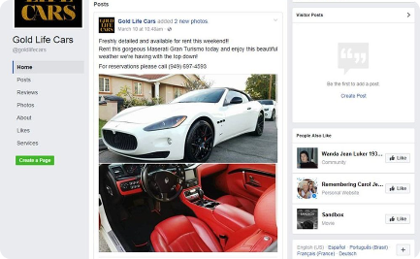


Problem Statement: Vehicle Insurance Fraud
Fraudulent Claims
Staged Accidents
Signs of Fraud
Insurance fraud is a major issue, with many individuals attempting to file false or exaggerated claims leading to financial losses for insurance companies.
Staged accidents and deliberate vehicle damage contribute to fraudulent claims, creating challenges for the insurance sector.
Identifying patterns and anomalies that indicate potential fraudulent activity requires sophisticated fraud detection techniques.

Slide 3
Overview of Machine Learning Approach
Exploratory Data Analysis
Feature Engineering
Correlation Analysis
Data Sampling
Model Selection
Model Testing

Slide 4




Data Preprocessing
Dataset Overview
Our dataset consists of 15420 records, 33 features and 1 label.
94% of the records didn’t commit fraud and 6 % committed fraud.
We have an imbalanced dataset
Data Visualization
Visualizing data to help interpreting and understanding each feature.
Identify trends, outliers, and correlations.
Feature Engineering
Drop irrelevant features.
Deal with missing values.
Convert categorical features into numerical and normalize our data.

Slide 5
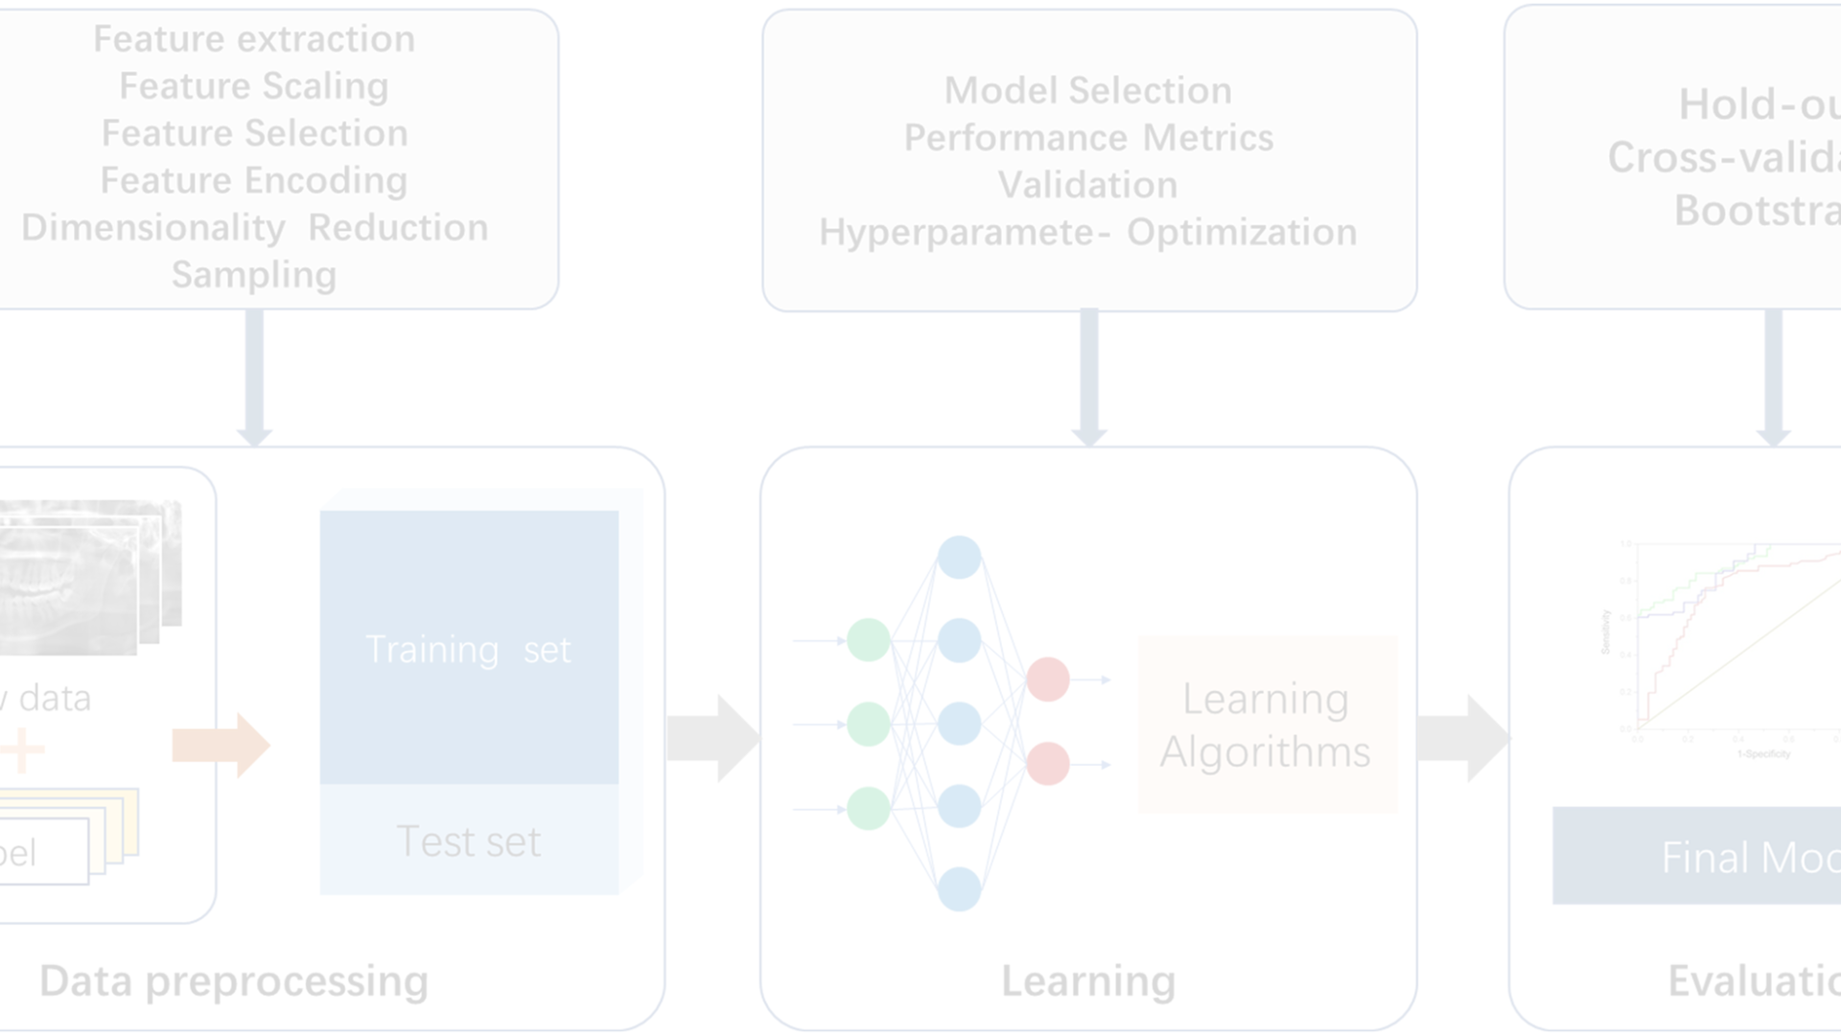
Correlation Analysis
Correlation with Target
Chi-Square Test
ANOVA Test
Assessing the connections between features and the target to determine the influence of each feature on the desired target value.
Assessing the independence between categorical variables by analyzing the difference between observed and expected frequencies in a contingency table.
Comparing means across several groups, determining whether there are notable differences in their averages and assessing the variance between groups relative to within groups.

Slide 6
Final Dataset
The final shape of the dataset: (9593,15)
Train-Test-Split:
80% Training Data
20% Testing Data
Training data is split into X_train and y_train (X features, y label).
Testing data is split into X_test and y_test (X features, y labels).

Slide 7
Data Sampling
Selecting data points randomly from the dataset, ensuring each instance has an equal chance of being chosen.
Random Sampling
Removing instances from the majority class to balance the class distribution. This helps prevent the model from being biased towards the majority class.
Under-sampling
Replicating or generating new instances of the minority class to balance the class distribution. This is beneficial when dealing with imbalanced datasets.
Over-sampling
Creating synthetic instances of the minority class to increase its representation in the dataset and improve model performance on minority class predictions.
SMOTE

Slide 8
Model Selection and Training
Models
DecisionTreeClassifier
RandomForestClassifier
XGBClassifier
LGBMClassifier
AdaBoostClassifier
EasyEnsembleClassifier
BalancedRandomForestClassifier

Slide 9
Evaluation Metrics and Results
1
Performance Metrics
Evaluating model performance using precision, recall, F1 score provides comprehensive insights into fraud detection accuracy.
2
Result Analysis
Extreme Gradient Boost Classifier gave the best results with RandomOverSampler sampling technique with recall = 76% / precision = 60% / f1 score = 67% / accuracy = 96%.
3
Recommendations
We can further enhance the performance of our model by tuning the hyperparameters of XGBClassifier using GridSearchCV or RandomizedSearchCV.

Slide 10
Conclusion
Imbalanced Dataset
Advanced Techniques
Sampling techniques enhanced the performance of our model but over sampling by injecting new data of the minority class will give the best results.
Undergoing detailed data preprocessing and data analysis techniques, testing more algorithms and tuning their hyperparameters will increase the performance of the model.

