Slide 1
Hobby Web Application
Ali Khattab 21SepSoftware
https://github.com/aliktb/HWA-Project
https://emaplejiralxc1.atlassian.net/jira/software/projects/HWA/boards/3

Slide 2
Introduction
Who am I
Hobby web application (HWA) including a front end website, 2-tabled database backend and API to connect them together
HWA based on fictional library

Slide 3
Sprint plan
Enable a user to create, read, update, delete (CRUD) new customers
CRUD functionality for books within the library
Allow users to checkout and return books
ONE customer can borrow MANY books but the book can only be borrowed by one customer
A book can exist in the library without a customer and a customer can exist in the system without borrowing a book
Have user interact with a responsive frontend website
Testing backend code aiming for 80%

Slide 4











Consultant journey
Technologies learned for this project

Slide 5


Continuous Integration (CI)
Version Control System – Git
Cloud-based hosting service - GitHub
Smart commits from GitHub linking to Jira

Slide 6
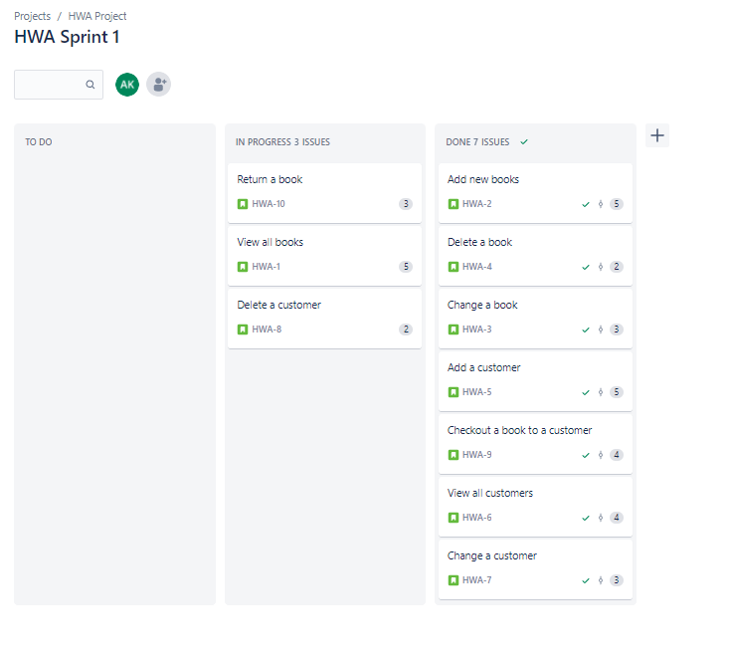
Jira sprint

Slide 7
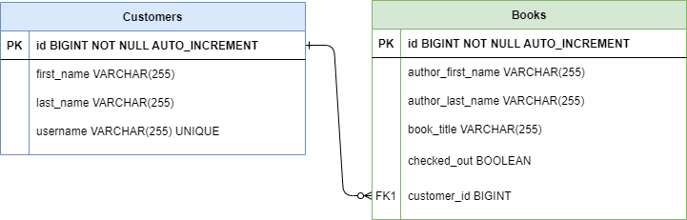
Entity Relationship Diagram

Slide 8
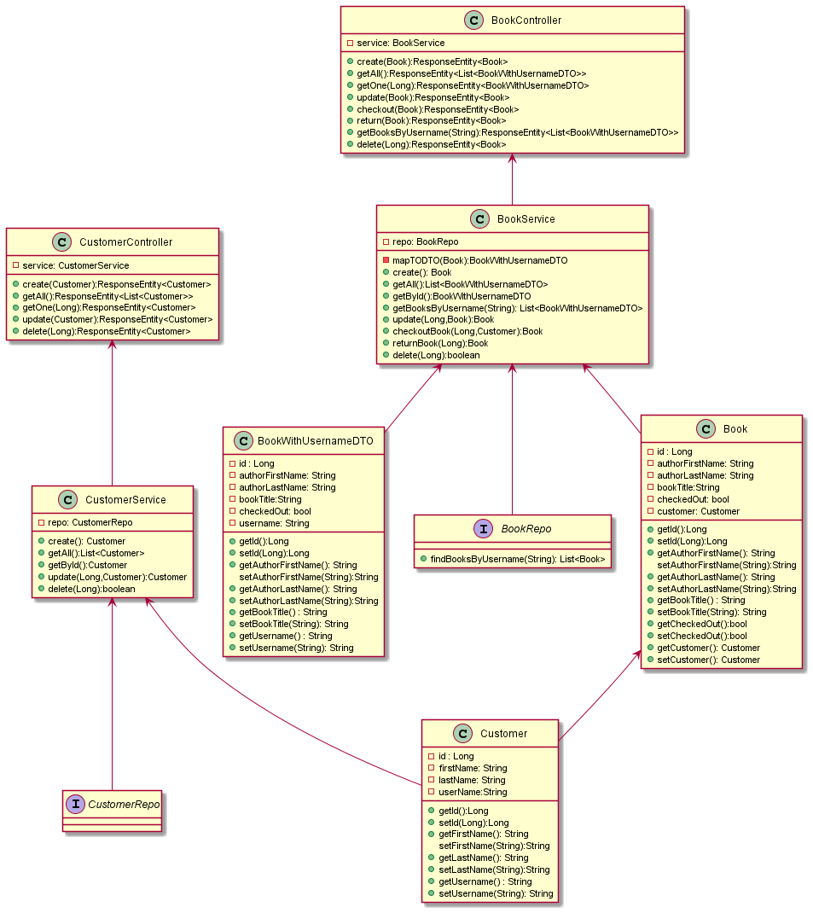
UML Diagram

Slide 9
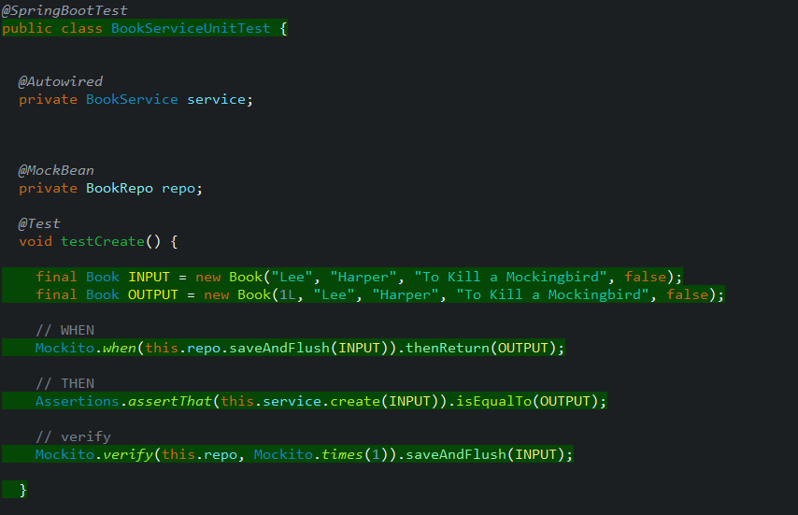
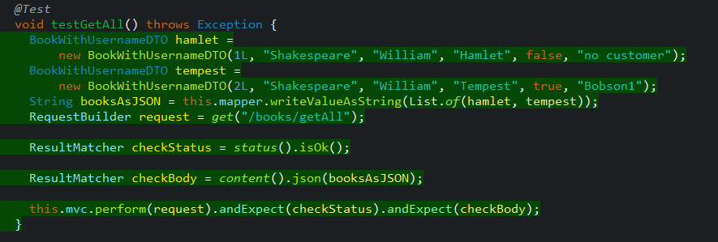
Testing

Slide 10
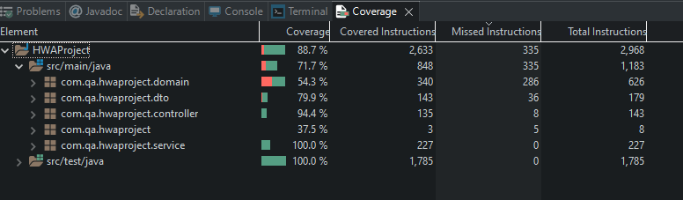
Testing Coverage

Slide 11
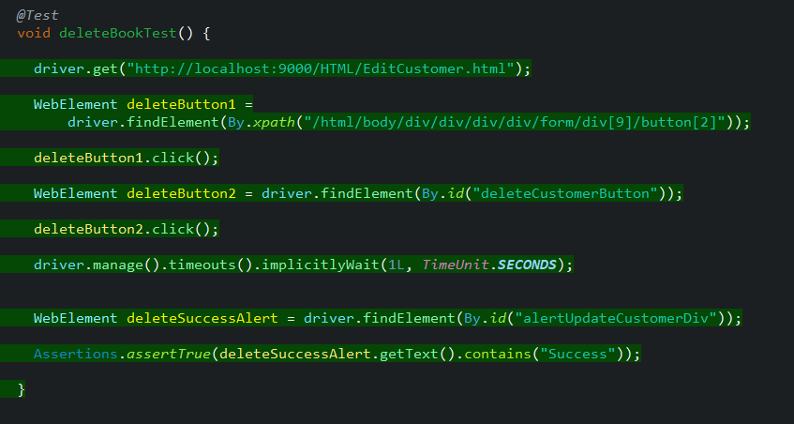
Selenium

Slide 12
Demonstrations

Slide 13
Sprint review
What did I complete?
MVP of library with 2 tables each with CRUD functionality
Functional Frontend for user interaction
What got left behind?
Backend Testing coverage at 80%
UAT for all pages

Slide 14
Sprint review
What went well?
Finished MVP with few extra features
What could be improved?
More semantic error messages for frontend
Added security (e.g. deny customer ability to checkout unavailable book)
More variables for domains (e.g. year_released, genre, customer_DOB etc.)
Enhanced search abilities (e.g. search by author, book title etc.)
Better user interactions (e.g. start search using enter key etc.)
Implement a return date based on checkout date and book popularity
Inventory system to allow multiple copies of same book with many to many relationship
Customer login with ability to view borrowing history and one-click return functionality

Slide 15
Questions?
Github: https://github.com/aliktb/HWA-Project
Jira: https://emaplejiralxc1.atlassian.net/jira/software/projects/HWA/boards/3

