Slide 1
Sales Analysis
Ali Kharabsheh

Slide 2
Overview
Category | Type | Insights | Inference
Product Behaviour | Product sales against time | Towards the end of the year, we see a peak in sales for all of the products | This could be due to the sales that happens at the end of each year (Black Friday, Christmas, … etc)
Market Opportunity | Predictions for future sales | There are 42 states that do not have any sales, they can be targeted to gain customers in these states | _______

Slide 3
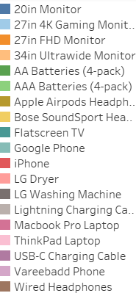
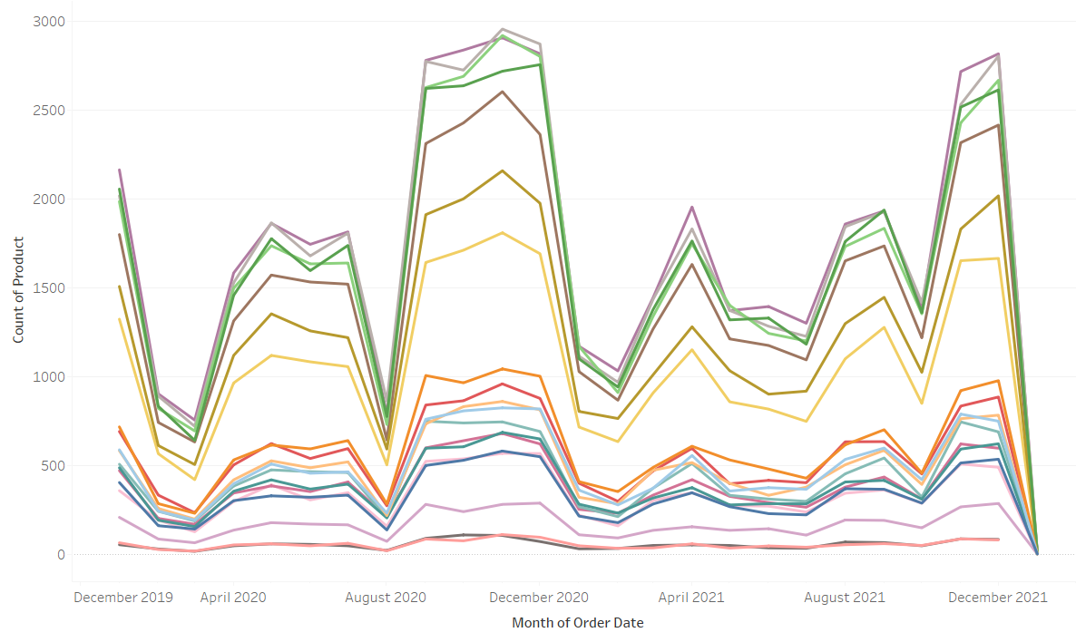
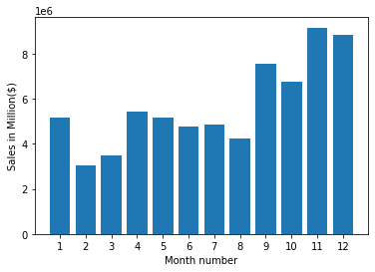
Products Sales Trends
Towards the end of the year, we see a peak in sales for all of the products.

Slide 4
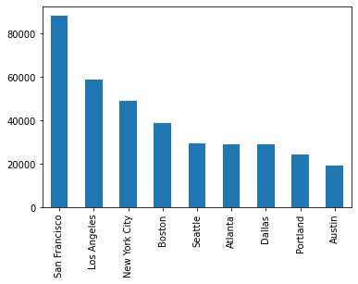
Sales in the States
San Francisco have the most sales compared to all other states.

Slide 5
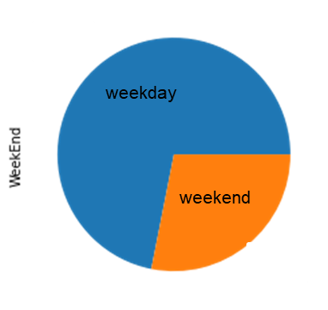
Sales percentage in Weekend and weekday
39% of the sales are made on weekends
The number of sales on weekday is 263623
The number of sales is weekend is 103107

Slide 6
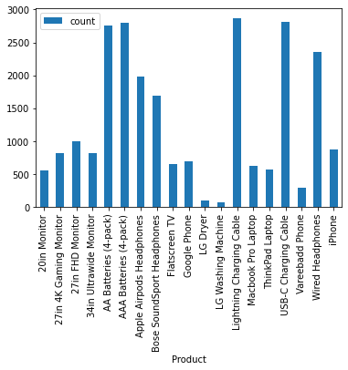
Best-selling and least-selling product
highest product sales is: Lightning Charging Cable(count: 2870)
minimum product sales is: LG Washing Machine(count: 71)

Slide 7
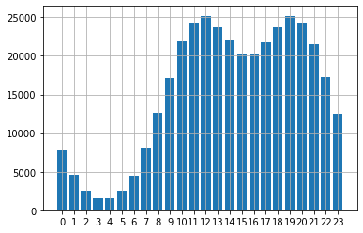
Hours with Most Sales
We can notice that in the beginning and ending of each day, there is a peak in sales

Slide 8
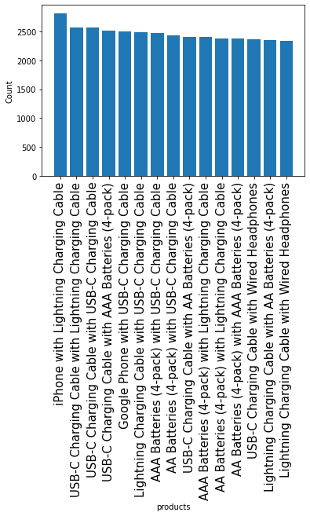
Finding the products are most often sold together

Slide 9
The End

