Slide 1
MSc Applied Artificial Intelligence · Dissertation Project
Privacy-Preserving Explainable AI for
Building Energy Performance Prediction
A Federated Learning Approach with SHAP and LIME Integration (PP-XAI)
Student ID: 202440724
Supervisor: Mona · University of Hull
PP-XAI · Student ID 202440724 · MSc Applied AI · University of Hull
1 / 14
Notes:
Introduce yourself by student ID only if required for anonymity. State the project in one sentence: privacy-preserving explainable AI for high-rise / large-building energy prediction using federated learning plus SHAP and LIME. (~45–60s)

Slide 2
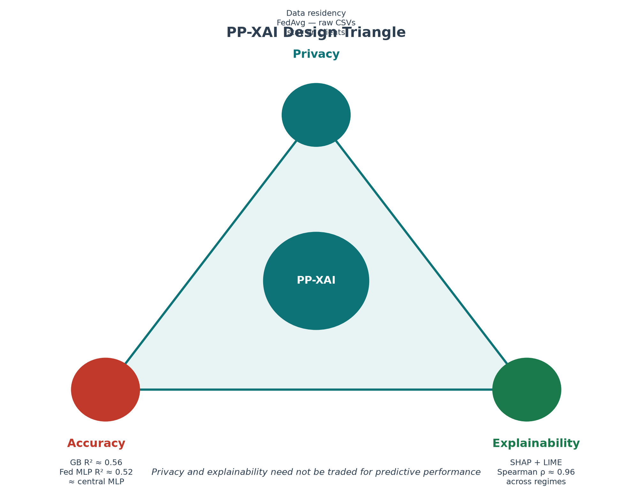
The Problem
• UK net-zero depends on better building energy insight
• Energy Performance Certificates (EPCs) are rich open data for ML
• High-rise and large commercial assets raise privacy and governance barriers
• Pooling microdata across councils / landlords is often restricted
• Centralised ML assumes data can be shared — often it cannot
PP-XAI · Student ID 202440724 · MSc Applied AI · University of Hull
2 / 14
Notes:
Hook with the tension: valuable open EPC data vs privacy walls for sensitive assets. Point to the design triangle — privacy, accuracy, explainability must be co-designed. (~60–75s)

Slide 3
Aim, Research Questions & Objectives
Aim: Develop and evaluate a privacy-preserving explainable AI framework (FedAvg + SHAP/LIME) for high-rise building energy prediction on UK EPC data.
• RQ1 — Can federated learning approach centralised accuracy while keeping data local?
• RQ2 — How stable are SHAP/LIME explanations across federated vs centralised models?
• RQ3 — Which features dominate, and are they consistent across cities?
• RQ4 — How can federated XAI support transparency (EU AI Act context)?
• Objectives: centralised baselines → FedAvg (3 cities) → SHAP/LIME → stats → Streamlit prototype
PP-XAI · Student ID 202440724 · MSc Applied AI · University of Hull
3 / 14
Notes:
State the aim once, then walk RQ1–RQ4 quickly. Emphasise that the project jointly evaluates accuracy AND explanation stability — not accuracy alone. (~60s)

Slide 4
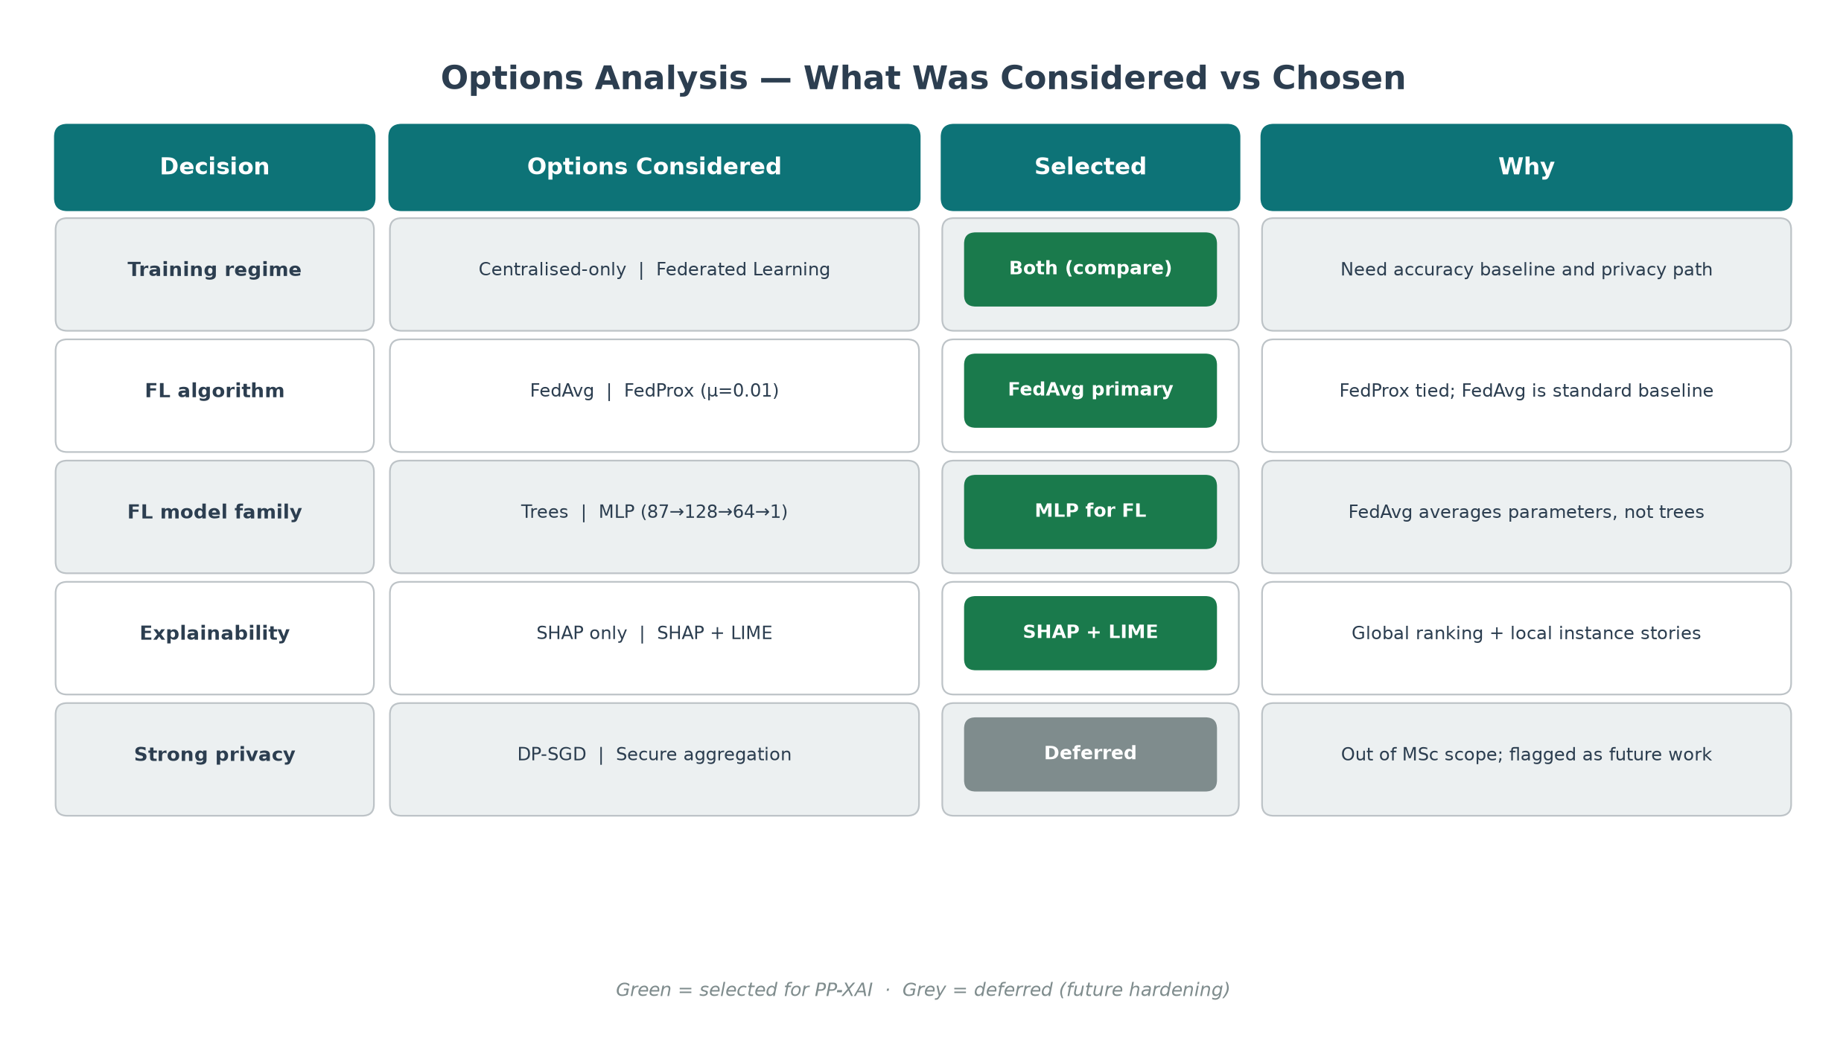
Options Analysis — What Was Considered & Why
PP-XAI · Student ID 202440724 · MSc Applied AI · University of Hull
4 / 14
Notes:
REQUIRED section. Walk the decision matrix: compared centralised and FL; FedAvg primary (FedProx essentially tied); MLP for FL because trees cannot be FedAvg-averaged; SHAP+LIME; DP/secure aggregation deferred as future work. (~75–90s)

Slide 5
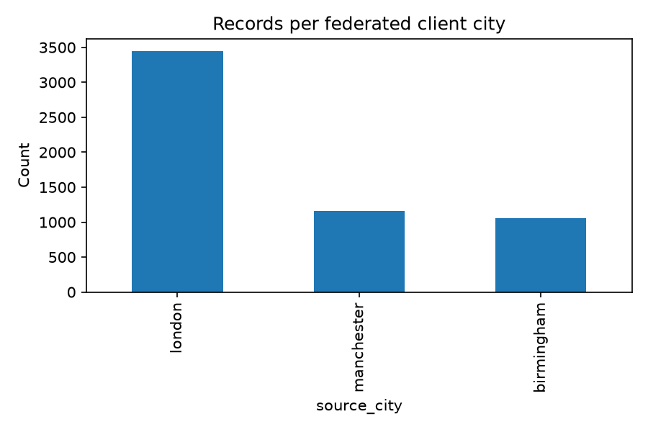
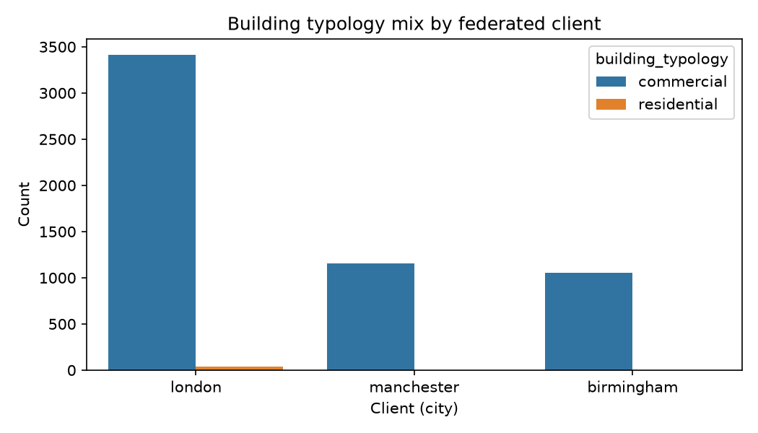
Data & High-Rise Definition
• Sources: MHCLG domestic & non-domestic EPCs (OGL v3.0)
• Scanned: ~13.8M domestic + ~841K non-domestic rows
• Filtered corpus: 5,663 records (London / Manchester / Birmingham)
• Domestic: flats with storey count ≥ 5 (honest mid/high-rise proxy)
• Non-domestic: floor area ≥ 5,000 m² (excl. schools/hospitals/etc.)
• Critical honesty: 99.4% commercial; only 36 residential flats
• Leakage controls: excluded CO₂ and asset/env score features
PP-XAI · Student ID 202440724 · MSc Applied AI · University of Hull
5 / 14
Notes:
Be explicit about the commercial dominance — examiners reward honesty. flat_storey_count ≥ 10 yields ~0 rows; ≥5 is a documented proxy. Mention leakage exclusion briefly. (~75s)

Slide 6
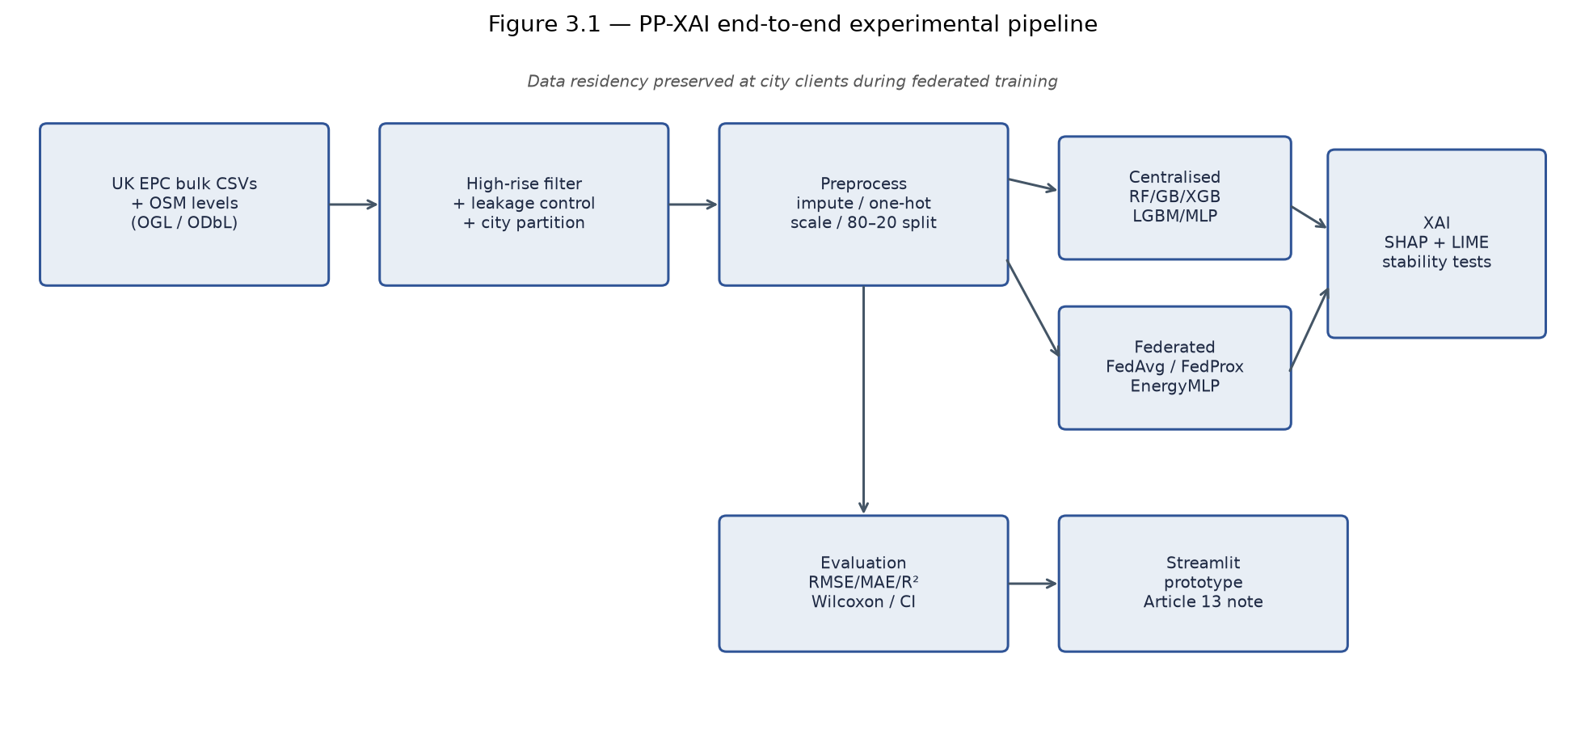
PP-XAI Pipeline — What Was Developed
PP-XAI · Student ID 202440724 · MSc Applied AI · University of Hull
6 / 14
Notes:
Walk left-to-right: ingest → filter → preprocess → centralised baselines AND federated MLP → SHAP/LIME → evaluation → Streamlit. One pipeline, two training regimes. (~60s)

Slide 7
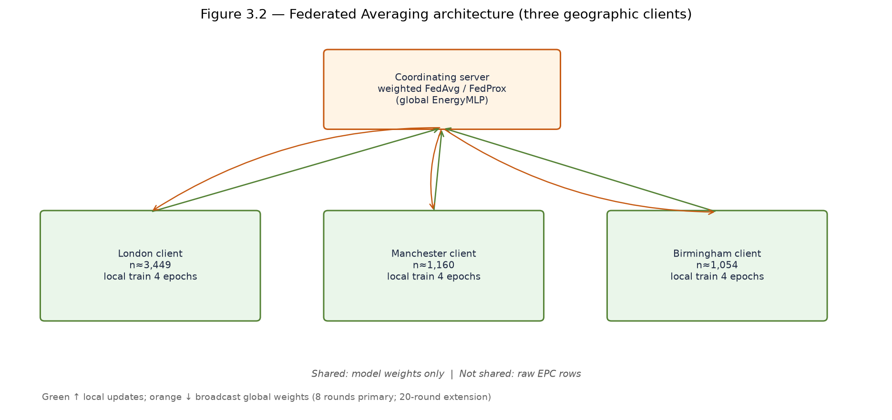
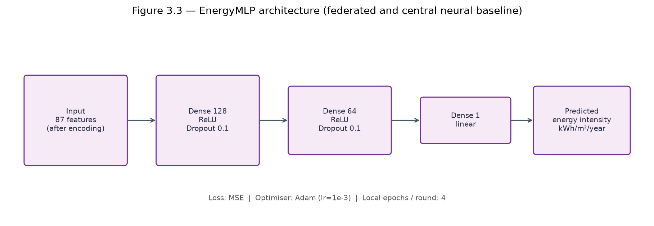
Federated Architecture & EnergyMLP
3 clients · 8 FedAvg rounds · 4 local epochs · sample-size weighted aggregation (McMahan et al., 2017; Beutel et al., 2020)
PP-XAI · Student ID 202440724 · MSc Applied AI · University of Hull
7 / 14
Notes:
Only model updates move — not raw CSVs. Same MLP topology for central neural baseline and FL for a fair comparison. Trees remain centralised competitors. (~60s)

Slide 8
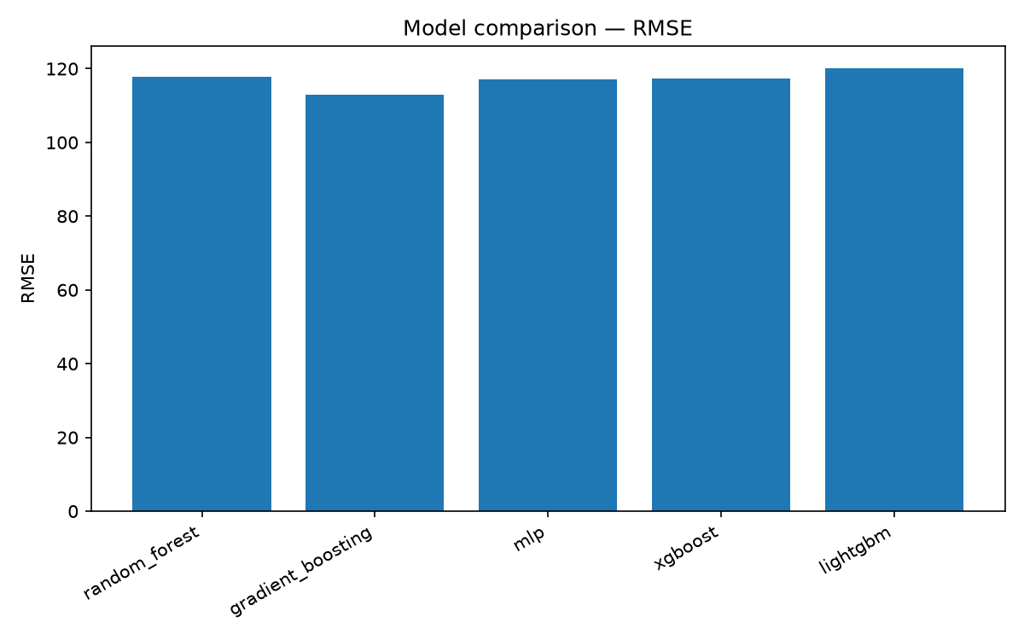
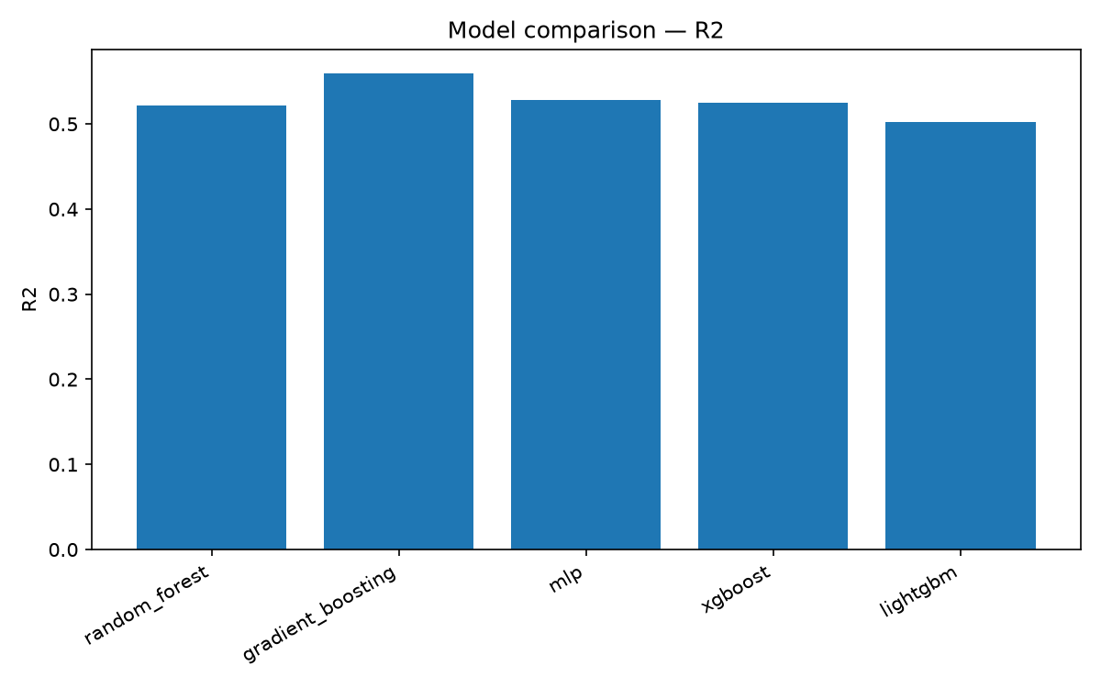
Centralised Results — Gradient Boosting Leads
Best: Gradient Boosting — RMSE 113.04 · MAE 80.02 · R² 0.559 | Moderate accuracy without leakage features (credible, not inflated)
PP-XAI · Student ID 202440724 · MSc Applied AI · University of Hull
8 / 14
Notes:
GB is best central model. Stress that excluding emissions features kept R² honest (~0.56 rather than spuriously >0.95). (~45–60s)

Slide 9
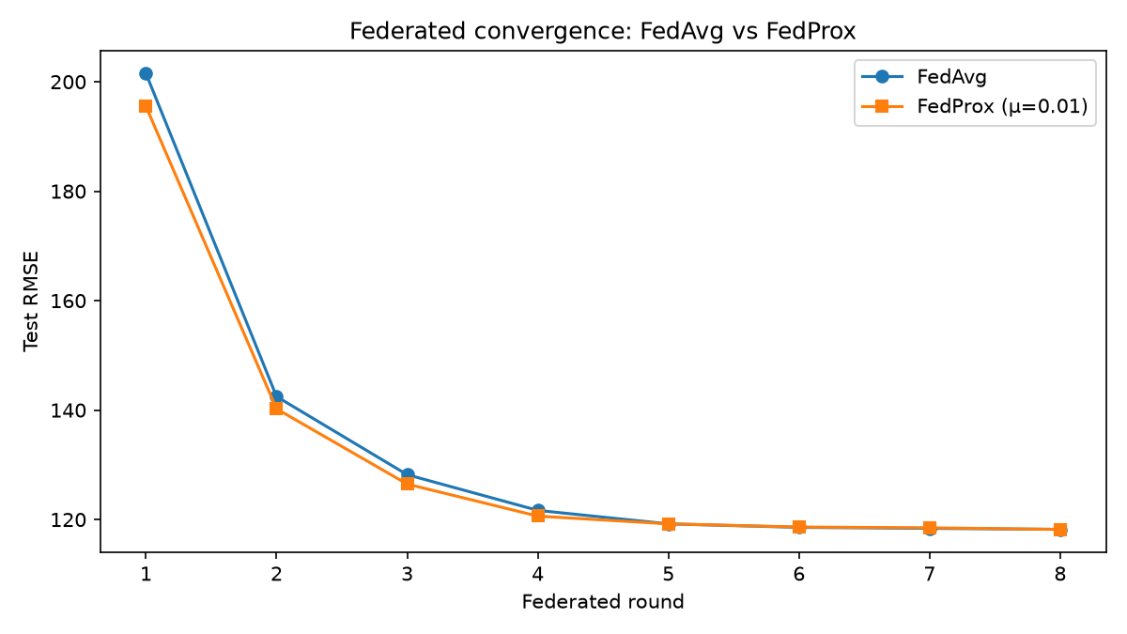
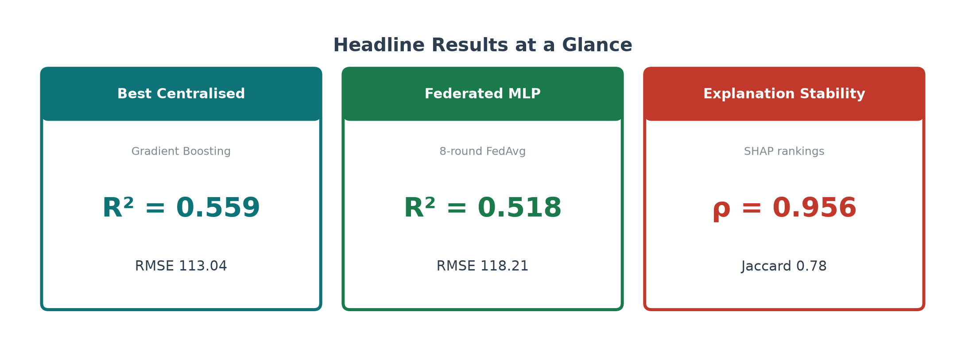
Federated Results (RQ1) — Near Parity with Central MLP
FedAvg R8: RMSE 118.21 · R² 0.518 ≈ central MLP RMSE 117.04 · R² 0.528 (H1: within ~1% RMSE of central MLP)
PP-XAI · Student ID 202440724 · MSc Applied AI · University of Hull
9 / 14
Notes:
Show convergence from poor R1 to competitive R8. Headline: federated neural model tracks central neural accuracy without pooling data. (~60s)

Slide 10
Critical Analysis — Statistical vs Practical Gap
• Wilcoxon (GB vs Fed absolute errors): p = 1.85×10⁻⁵ — statistically significant
• Paired t-test: p = 7.97×10⁻⁵
• Cohen’s d ≈ 0.059 — negligible effect size
• Bootstrap 95% CI RMSE overlap: GB 105.9–120.1 vs Fed 110.8–125.4
• Interpretation: gap is real but practically small under a privacy constraint
• Central GB still wins if pooling is allowed; FedAvg is the relevant benchmark when it is not
PP-XAI · Student ID 202440724 · MSc Applied AI · University of Hull
10 / 14
Notes:
This is the critical-analysis slide for the 70–100% band. Do not hide significance — reframe with effect size and overlapping CIs. (~60–75s)

Slide 11
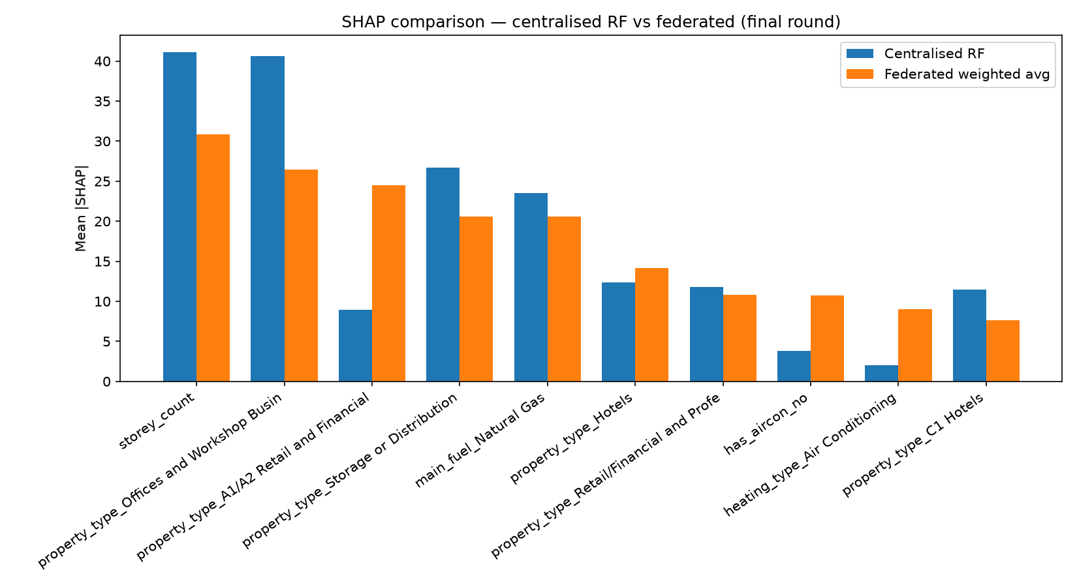
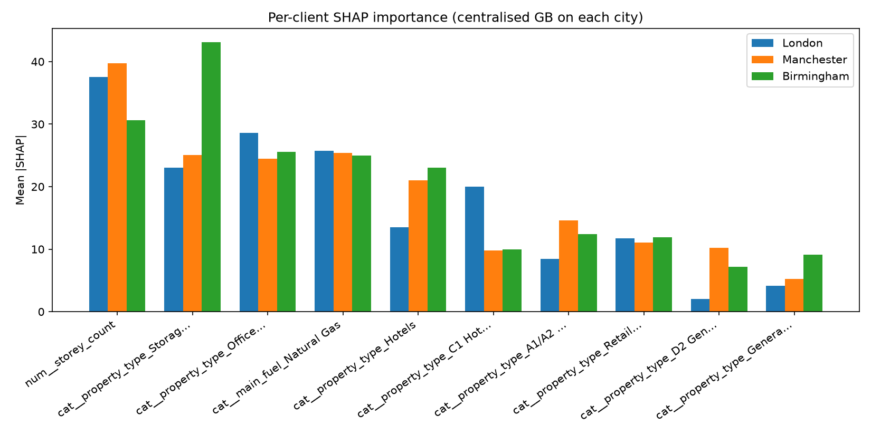
Explainability (RQ2–RQ3) — Stable Across Regimes
H2: Spearman ρ = 0.956 (central GB vs fed MLP) · H3: top-5 Jaccard avg 0.78 across cities · Drivers: storey_count, property type, natural gas (Lundberg & Lee, 2017)
PP-XAI · Student ID 202440724 · MSc Applied AI · University of Hull
11 / 14
Notes:
Privacy-preserving training did not arbitrarily reshuffle feature importance. Mention LIME complements SHAP for local stories (shown in demo). (~60s)

Slide 12
Live Demonstration — Streamlit Prototype
• Interactive prediction of energy intensity (kWh/m²/year)
• Building inputs → preprocessor → best model → prediction
• Global SHAP importance table for transparency
• EU AI Act Article 13 transparency note embedded in the UI (H4)
• Demo command: source scripts/env.sh && streamlit run src/webapp/app.py
Switch to the running app now — try 2–3 non-scripted buildings (different cities / property types).
PP-XAI · Student ID 202440724 · MSc Applied AI · University of Hull
12 / 14
Notes:
PAUSE SLIDES. Demo live for ~2–3 minutes. Prefer interactive, non-scripted inputs. Show prediction + SHAP. Return to slides for discussion. (~120–180s)

Slide 13
Discussion & Limitations
• Trade-off: central GB wins on RMSE if pooling is allowed; FedAvg wins on data residency
• Explanation stability reduces fear that FL yields an ‘alien’ uninterpretable model
• Limitation: domestic high-rise labelling in bulk EPC is weak — commercial proxy dominates
• Limitation: in-process FedAvg simulator ≠ production secure FL (no DP / secure aggregation yet)
• Limitation: KernelSHAP uses subsamples; rankings can shift with background choice
• Strength: leakage ablation and schema honesty strengthen scientific credibility
PP-XAI · Student ID 202440724 · MSc Applied AI · University of Hull
13 / 14
Notes:
Be candid. Examiners mark critical evaluation highly. Position limitations as methodological contributions, not excuses. (~75s)

Slide 14
Conclusions, Contributions & Future Work
• Federated MLP approaches central neural accuracy (R² ≈ 0.52 vs 0.53) without pooling raw data
• SHAP rankings remain highly aligned across regimes (ρ ≈ 0.96); cross-city consistency holds
• Working Streamlit prototype demonstrates stakeholder-facing prediction + explanations
• Contributions: PP-XAI pipeline, FL↔XAI stability evidence, honest high-rise schema audit
• Future work: UPRN–OSM residential linkage, DP-SGD / secure aggregation, more clients
Thank you — Questions welcome
Key refs: McMahan et al. (2017); Lundberg & Lee (2017); Ribeiro et al. (2016); Beutel et al. (2020); UK EPC data under OGL v3.0
PP-XAI · Student ID 202440724 · MSc Applied AI · University of Hull
14 / 14
Notes:
Close with the triangle message. Invite Q&A. Keep under 15 minutes total including demo. (~45–60s)

