Slide 1
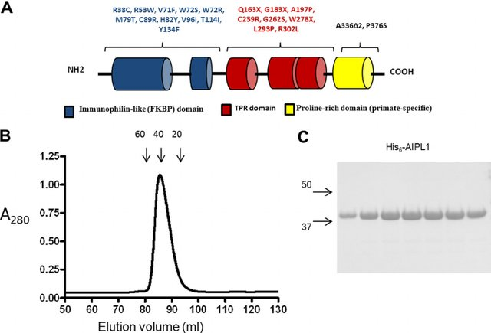
interaction with the C-terminal isoprenyl (farnesyl and geranylgeranyl) moieties present in PDE6 subunits due to posttranslational modifications
responsible for the interaction of AIPL1 with HSP90
deletion of the PRD enhanced the affinity of AIPL1 for full length HSP90, suggesting that the PRD may have an inhibitory effect on HSP90 binding
in concert with HSP90, as a specialized molecular co-chaperone for cGMP-specific phosphodiesterase-6 (PDE6)

Slide 2
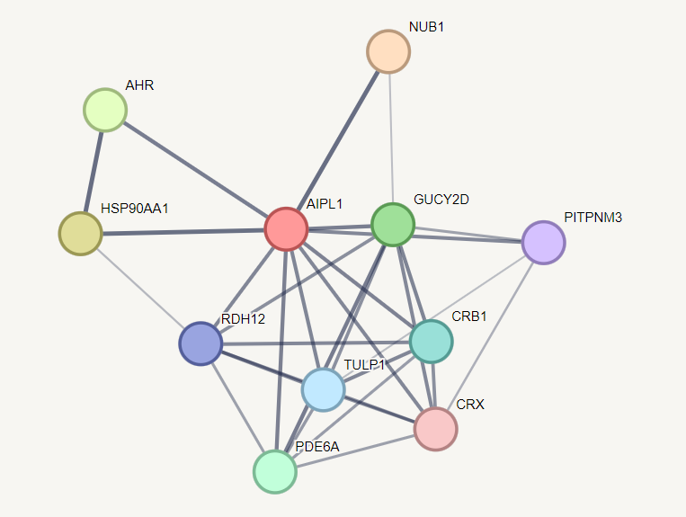
NUB1 ( involved in regulation of cell cycle progression)

Slide 3
https://www.ncbi.nlm.nih.gov/pmc/articles/PMC7567831/
https://www.jbc.org/article/S0021-9258(20)45565-6/pdf

