Slide 1
PCB Defect Detection
Ahmed Aly Maged Mohamed Mohamed Sayed (Mat: 946984)
Askar Amro Emad Hassan (Mat: 946807)
Notes:
Good Evening, I hope you’re all doing well.
I’m Askar, and my teammate Ahmed are going to present the project about PCB Defect detection

Slide 2
Table of Contents
01
02
Data Analysis
Our Problem
03
Solutions
04
Alternative
Dataset and Analysis before training
Training a model from scratch
Training a model with a ResNet backbone
Using YOLOv11 with edited blocks
Notes:
We’re going to first talk about our problem, and then some data analysis to help for training, and then for proposed solutions , and lastly about some alternatives

Slide 3
01
Our Problem

Slide 4
Our Problem
PCB defects are small, varied, and expensive to inspect manually. In an industrial setting, missing holes, mouse bites, open circuits, shorts, spurs, and spurious copper can reduce board quality, cause downstream failure, and slow production. The challenge is to build a model that can reliably detect and localize these defects from images.
Notes:
So our problem in a brief, is that PCB defects are small and varied and very expensive to inspect manually, and yet these defects cause failure and slow production, that’s why we want to build a model that can detect and localize these defects automatically from images by deep learning

Slide 5
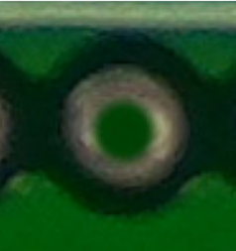
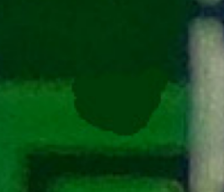
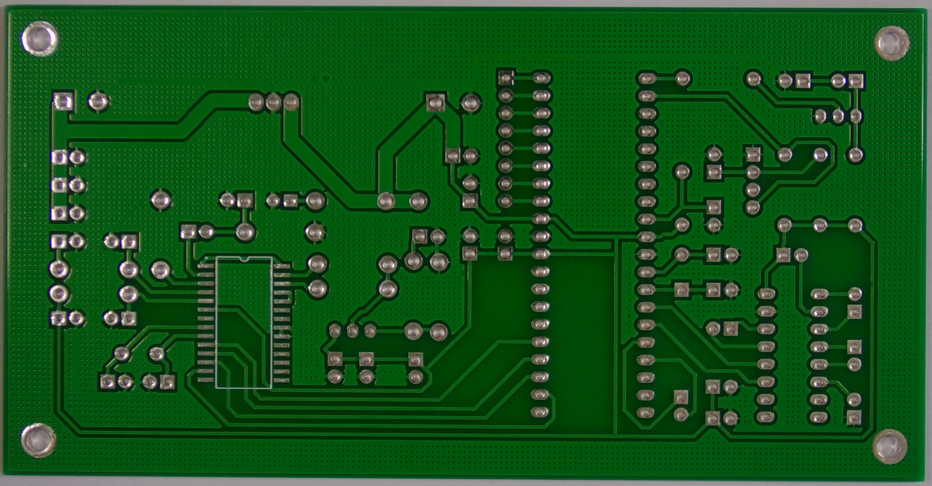
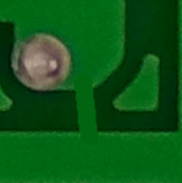
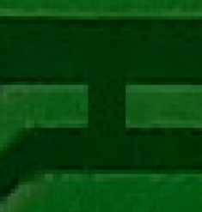
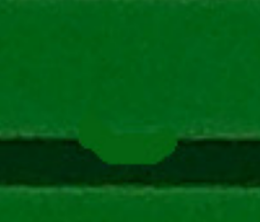
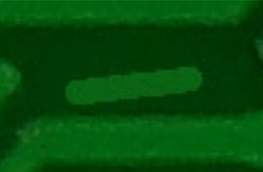
Our Problem
Missing Hole
Mouse
Bite
Open
Circuit
Short
Circuit
Spur
Spurious
Copper
Notes:
Here are the defects we are going to work on and we were talking about trying to detect and localize, which are :
- missing holes
- Mouse bites
- Open circuits
- Short circuits
- Spurs
- Spurious copper

Slide 6
02
Data Analysis
Dataset and Analysis before training
Notes:
Now let’s talk about our dataset and some data analysis which will help us in our project

Slide 7
Dataset
About the dataset
693 PCB images total
2,953 annotated defect instances total (Average of 4 defects per image)
6 defect classes
Each image is RGB, with image sizes ranging from 2240 x 1586 to 3056 x 2530
Class distribution by annotated defects
Missing hole: 497
Mouse bite: 492
Open circuit: 482
Short: 491
Spur: 488
Spurious copper: 503
Notes:
First of all, about our dataset, our dataset consists of 693 pcb images which are not a lot and will need some processing and augmentation, and in each pcb image there is an average of 4 defects with the total of 2953 defects in all of the images, and as we saw in the previous slide we have 6 defects classes , and our images size are ranging from 2240 x 1586 to 3056 x 2530 pixels which we will see the importance of this information in the next slide.
Also we did check the defects class distributions , and as we can see al of our defects are evenly distributed which make us not worry about the class imbalance.

Slide 8

Dataset
Problem with the dataset
Each image is RGB, with image sizes ranging from 2240 x 1586 to 3056 x 2530
By class, the average width and height of defects are:
Missing hole: 66.76 x 68.10
Mouse bite: 63.07 x 61.43
Open circuit: 52.36 x 49.79
Short: 86.74 x 78.75
Spur: 75.41 x 69.36
Spurious copper: 80.21 x 77.48
Relatively too small !!
Hard for feature extraction and for detection
Notes:
As we said that our image sizes ranging from 2240 x 1586 to 3056 x 2530, and when we did the same with the defects , we found that the defects size are relatively too small compared to the image size, which make it hard for feature extraction and for detection and it adds a challenge to our project and we will see later how to deal with it.

Slide 9
03
Solutions
Training a model from scratch
Training a model with a ResNet backbone
Notes:
Now we will talk about solutions for solving our problem

Slide 10
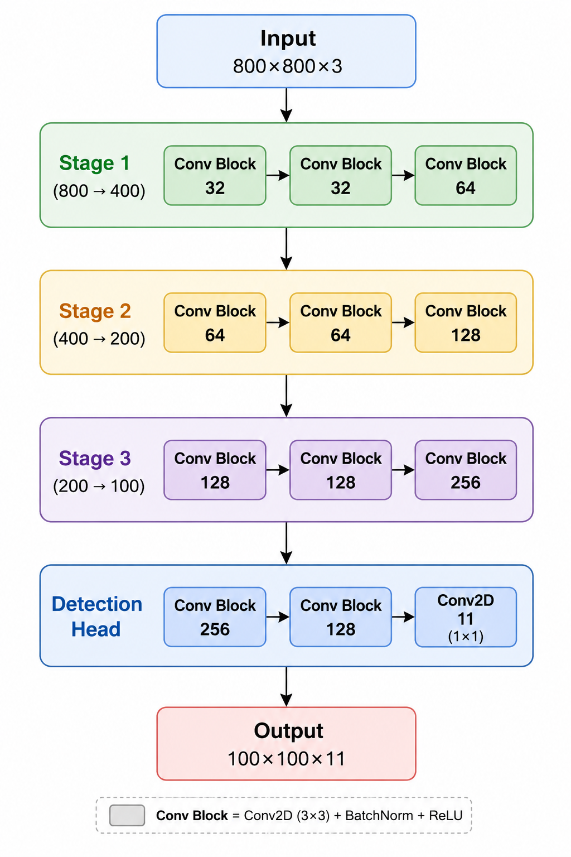

Training a model from scratch
CNN Architecture
(Grid Yolo-Style)
Loss Function Design
$$L=L_{obj}+L_{cls}+{5L}_{box}$$
Where
Objectness Loss: BCEWithLogits
Classification Loss: Cross Entropy
Localization Loss: Smooth L1
Data Augmentation
Horizontal Flip
Vertical Flip
Slight Brightness Adjustment
Slight Contrast Adjustment
Number of parameters: 1,654,507
*Figure generated by ChatGPT
Notes:
So the first proposed solution was a network completely built from scratch, we started by resizing the images to be 800x800 and then we had 3 stages of feature extraction as shown in the figure, and each conv block consists of a 3x3 convolution followed by a batch normalization followed by relu function, and then for the detection head which is a vector of 11 information, 1 for objectness, 6 for the classes after one hot incoding it , and 4 for the localiztion, as for the loss function it is trying to learn 3 things which are objectness by the binary cross entropy , and the classification with the cross entropy and the localization with the smooth L1 function, we also did data augmentation by horizontal and vertical flips and slight brightness and contrast adjustments

Slide 11
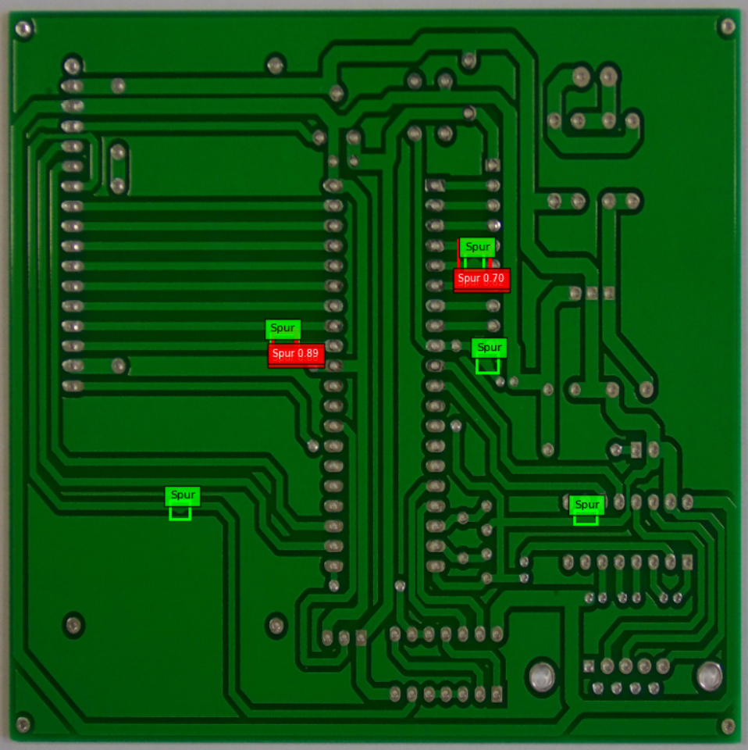
Training a model from scratch
Kinda Failed !!
The model wasn’t able to extract the features well due to the small size of the defects
Notes:
And this model failed because it failed to do the feature extraction well due to the small size of the defects, so when we lowered the threshold for detection it started hallucinating and when we made it higher it failed to detect a lot of defects as shown in the figure, and my teammate Aly will say how did we fix it in the next slide

Slide 12
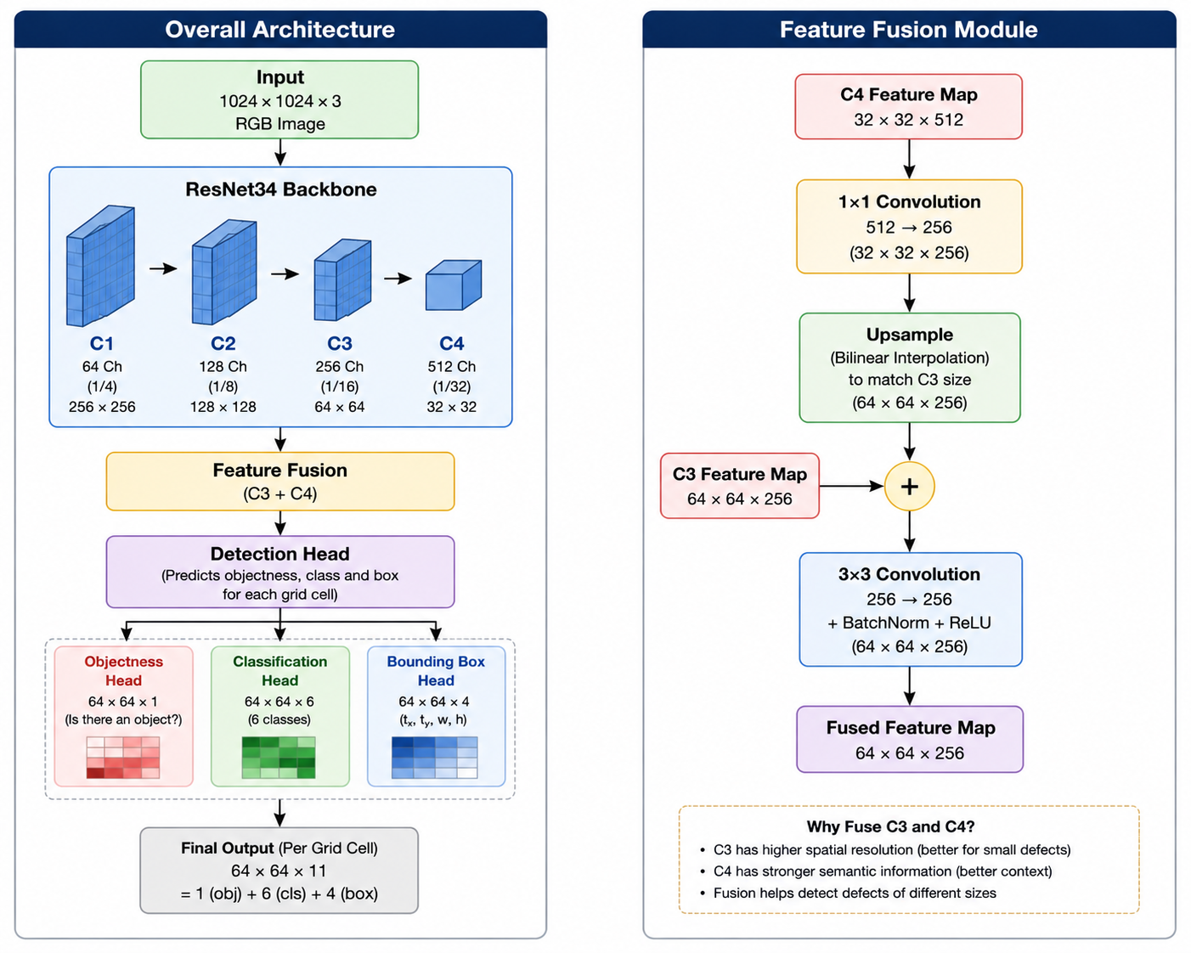

Training a model with a ResNet backbone
Loss Function Design
$$L=L_{obj}+L_{cls}+L_{box}$$
Where
Objectness Loss: BCEWithLogits
Classification Loss: Cross Entropy
Localization Loss: Smooth L1
Data Augmentation
Horizontal Flip
Vertical Flip
Number of parameters: 22,893,899
*Figure generated by ChatGPT
Notes:
Good evening I’m Aly, and I’m going to talk first about how we solved this problem, we solved this problem by choosing to do the feature extraction by using the resnet34 backbone which was trained on the imagenet dataset, and we chose to have just the first 4 layers of the resnet and then fusing the features from the third and forth layer which combines the high spatial resolution of C3 (which prevents tiny defects from getting lost during downsampling) with the deep semantic context of C4 (which is necessary to identify and classify the defects accurately). and then continue with the same style of the detection head shown in the previous slide, we kept the loss function as it is and we did nearly the same augmentation but we removed the brightness and contrast

Slide 13
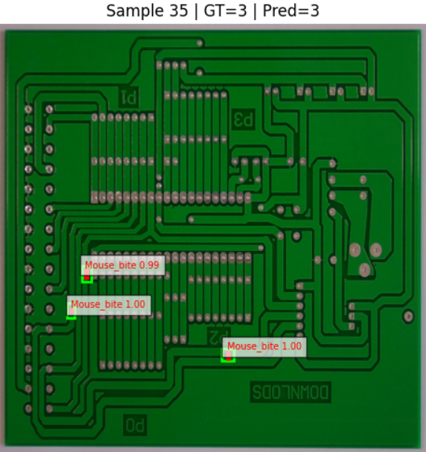
Training a model with a ResNet backbone
But why aren’t precision and recall the best ?
Metric | Value
Precision* | 78.14%
Recall** | 75.17%
F1 | 76.63%
Image Classification Accuracy*** | 95.71%
For our goal and project, it’s a success
* Precision = TP / FP+TP​
** Recall = TP / FN+TP​
***Image Classification Accuracy: How many correct defects are classified in the images despite the localization
Notes:
So when we trained this model, we got a 95.71% image classification accuracy which is how many correct defects are classified in the image despite the localization, and as for the other metrics which are computed through the intersection over union, it wasn’t bad also but it’s not the best, and when we tracked why wasn’t it the best, we found out it was because iof this what we see the slide, the model succeeded to detect the 3 defects with the right classes and it also succeeded to localize it, but looking at the red and green boxes, it didn’t exactly match making the other metrics concerning the localization not the best, although for out project this case we see is a success we don’t need the best quality for the box we neet it to be detected and localized well.

Slide 14
04
Alternatives
Using YOLOv11 with added blocks
Notes:
And now in just 2 minutes we’re going to talk about some alternatives we explored without getting into much details because of the time limit.

Slide 15
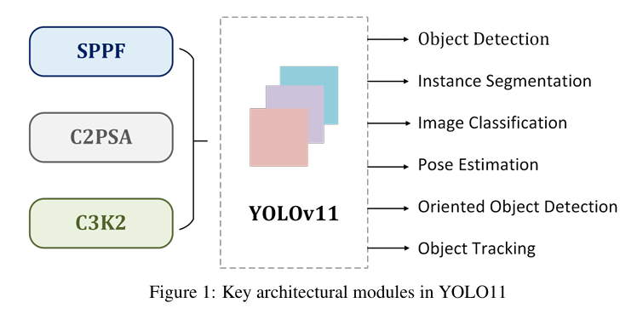
Training a pretrained YOLOv11 model
YOLOv11 already very powerful !!
Containing:
SPPF (Spatial Pyramid Pooling – Fast): Multi-scale context extraction.
C2PSA (Cross-Stage Partial with Spatial Attention): Attention mechanism that highlights important image regions.
C3k2 (CSP Bottleneck with Two Small Kernels): Lightweight feature extraction block for faster and more efficient learning.
But still the same problem
Defects relatively too small as YOLO is trained on COCO
*Figure taken from the paper “YOLOV11: AN OVERVIEW OF THE KEY ARCHITECTURAL ENHANCEMENTS”
Notes:
So after literature review and exploring different solutions, we found out that all the modern papers for this problem or similar problems use the yolov11 as a back bone which is alone is very strong because nowadays just the yolo itself has multi-scale context extraction blocks, it has attention mechanism that highlights important image regions as in our problem the defects , and the attention helps so much with the feature extraction in our problem, but it still has the same problem of the defects being very small because yolo is trained on common objects in context like cars, dogs, cats etc..

Slide 16
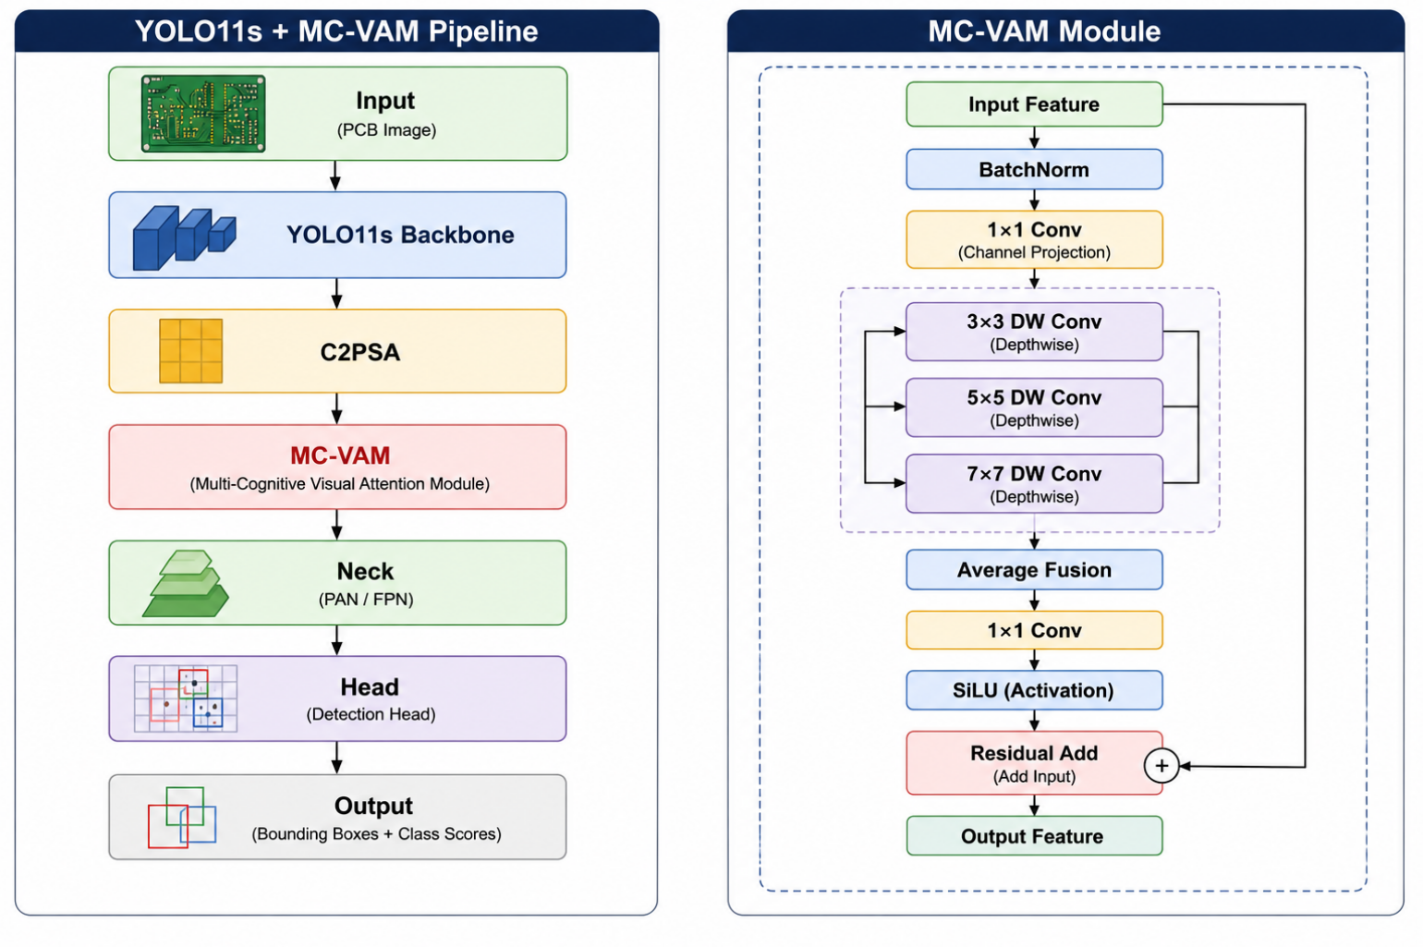
Training a pretrained YOLOv11 model enhanced with MC-VAM
(inspired by the paper “A multi-cognitive PCB defect detection model integrating Mamba)
Multi-Cognitive Visual Attention Module (MC-VAM)
MC-VAM is a lightweight attention module designed to improve feature extraction by capturing information at multiple spatial scales.
Objectives
Enhance small defect detection
Capture local and global context simultaneously
Preserve important shallow features
Improve feature representation with minimal computational overhead
*Figure generated by ChatGPT
Notes:
So upon literature review, we found that paper called a multi cognitive pcb defect detection model integrating mamba, it also used the yolov11 as a backbone but it introduced a block called MC-VAM which is a multi cognitive visual attention module designed to improve the feature extraction by capturing information at multiple spatial scales which enhances the small defect detection which is suitable for our project, and as we can see on the right figure that it chooses different activation function and it adds more attention from the input feature to enhance it.

Slide 17
Comparing results
Metric | YOLOv11 baseline | Enhanced YOLOv11
Precision* | 0.969 | 0.971
Recall** | 0.947 | 0.946
mAP50*** | 0.967 | 0.972
mAP50-95**** | 0.529 | 0.527
* Precision = TP / FP+TP​
*** mAP50 : Mean Average Precision at IoU = 50%. Measures overall detection performance.
**** mAP50-95 : Mean Average Precision averaged across IoU thresholds from 50% to 95%.
Measures both detection and localization accuracy.
** Recall = TP / FN+TP​
Notes:
Comparing the yolov11 baseline to the enhanced yolo didn’t add THAT much, but because the paper mentions also added two more sophisticated blocks as the MC-VAM block, and adding the three blocks to the yolov11 backbone increased the results more but we didn’t have much time to explore more, so in the future work hopefully we can explore more and explore the added blocks in the paper mentioned

Slide 18
Thanks
Do you have any questions?
Notes:
And thank you for listening to us, and now for the questions part

