Slide 1
Olympic Data Lakehouse Project
A Medallion Architecture for Olympic Analytics
Groupe 4 Members
1. Ali Mahha
2. Valentin Gabriel Paul TARDY
3. Shivam Bhandari
Python
DuckDB
Delta Lake
Parquet
MinIO
Data Lakehouse Final Project

Slide 2
INTRODUCTION
Background & Problem Statement
Background
The Olympic Games generate vast historical records spanning 125+ years, hundreds of nations, and thousands of athletes. This data exists across multiple heterogeneous sources — making unified analysis difficult without a structured pipeline.
Problem Statement
Project Purpose
Raw data spread across multiple CSV sources with inconsistent formats
No deduplication — risk of reprocessing the same data multiple times
No structured analytical model for querying Olympic history efficiently
Build an end-to-end Data Lakehouse following the Medallion Architecture
Implement idempotent ingestion with MD5-based deduplication
Enable fast SQL analytics via DuckDB on a Star Schema Gold layer

Slide 3
DATA SPECIFICATION
Data Sources & Volume
athlete_events.csv
wikidata_olympic.csv
Source: Kaggle
Source: WikiData
ID
Unique athlete identifier
athleteLabel
Athlete Name
Name
Athlete full name
countryLabel
Athlete Country
Sex
M / F
sportLabel
Athlete sport
Age / Height / Weight
Physical attributes
Team / NOC
Country & team code
Games / Year / Season
Edition metadata
Sport / Event
Discipline info
Medal
Gold / Silver / Bronze / NA
271,116 rows · 15 columns
35 rows · 3 columns

Slide 4
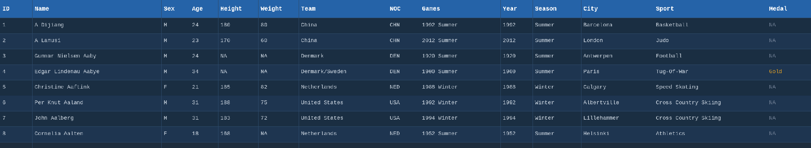
DATA SPECIFICATION
Sample Data — Original Files
athlete_events.csv — first 8 rows of raw data (271,116 rows total)

Slide 5
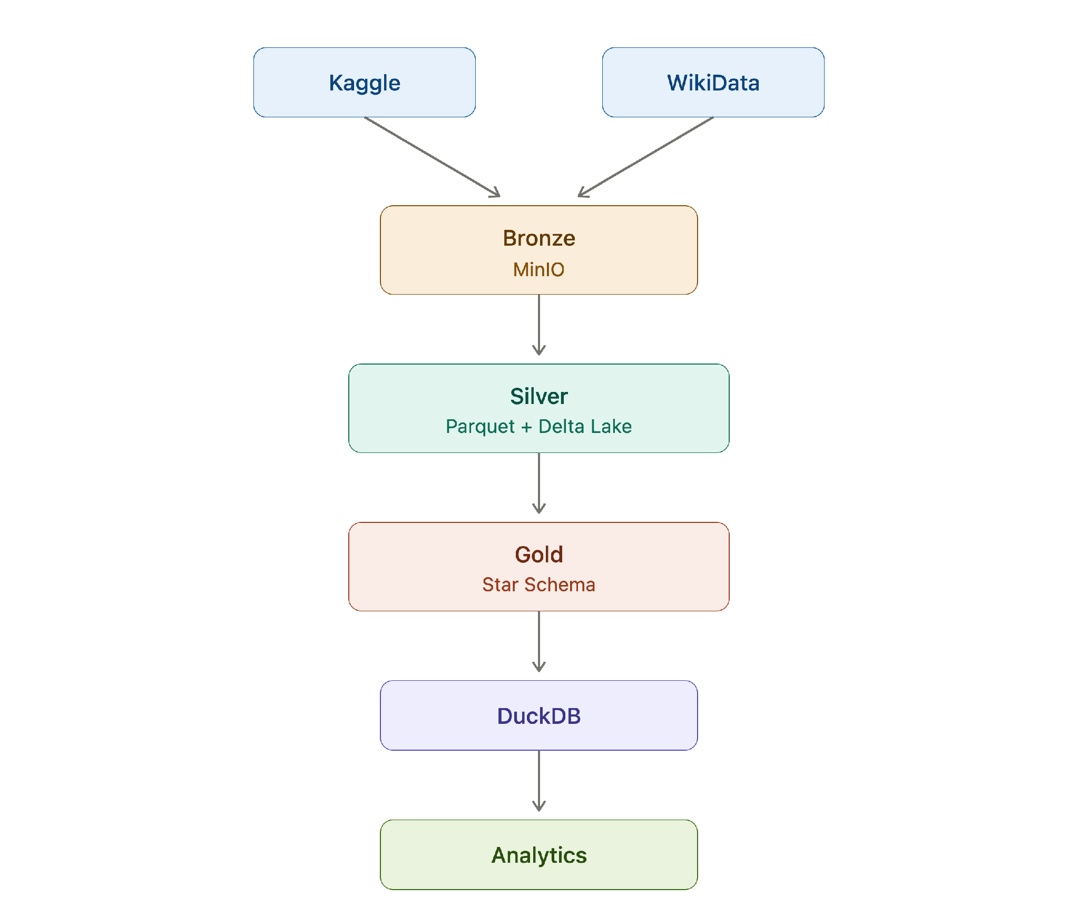
LAKEHOUSE ARCHITECTURE
Medallion Architecture — Data Pipeline

Slide 6
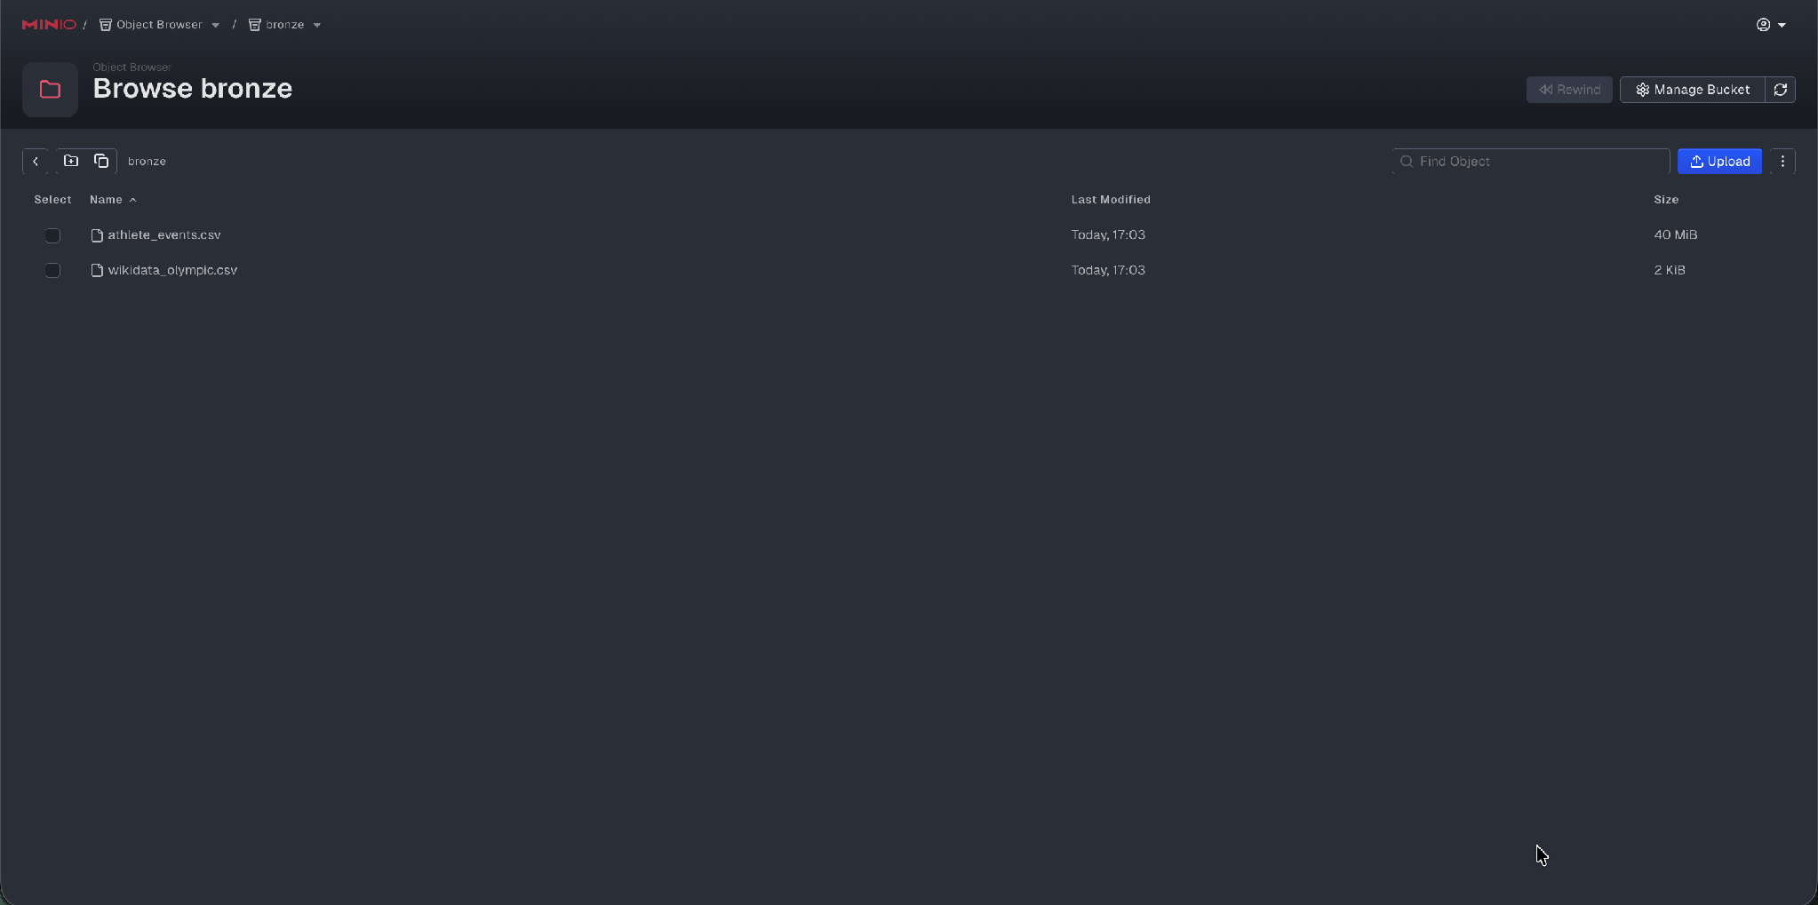

BRONZE LAYER
Bronze — Raw Ingestion with Deduplication
Key Features
MD5 checksum detection prevents duplicate ingestion
CSV files uploaded to MinIO Bronze bucket
checksums.csv tracks all processed files
Skips unchanged files — only processes NEW data
Incremental Skip Logic

Slide 7
BRONZE LAYER
Incremental Ingestion — How MD5 Works
1
2
3
Compute MD5
Compare
Decide
Hash the file content into a unique fingerprint
Check against checksums.csv — record of all past ingestions
[SKIP] if unchanged · [NEW] or [UPDATED] if different
Terminal output — idempotency in action

Slide 8
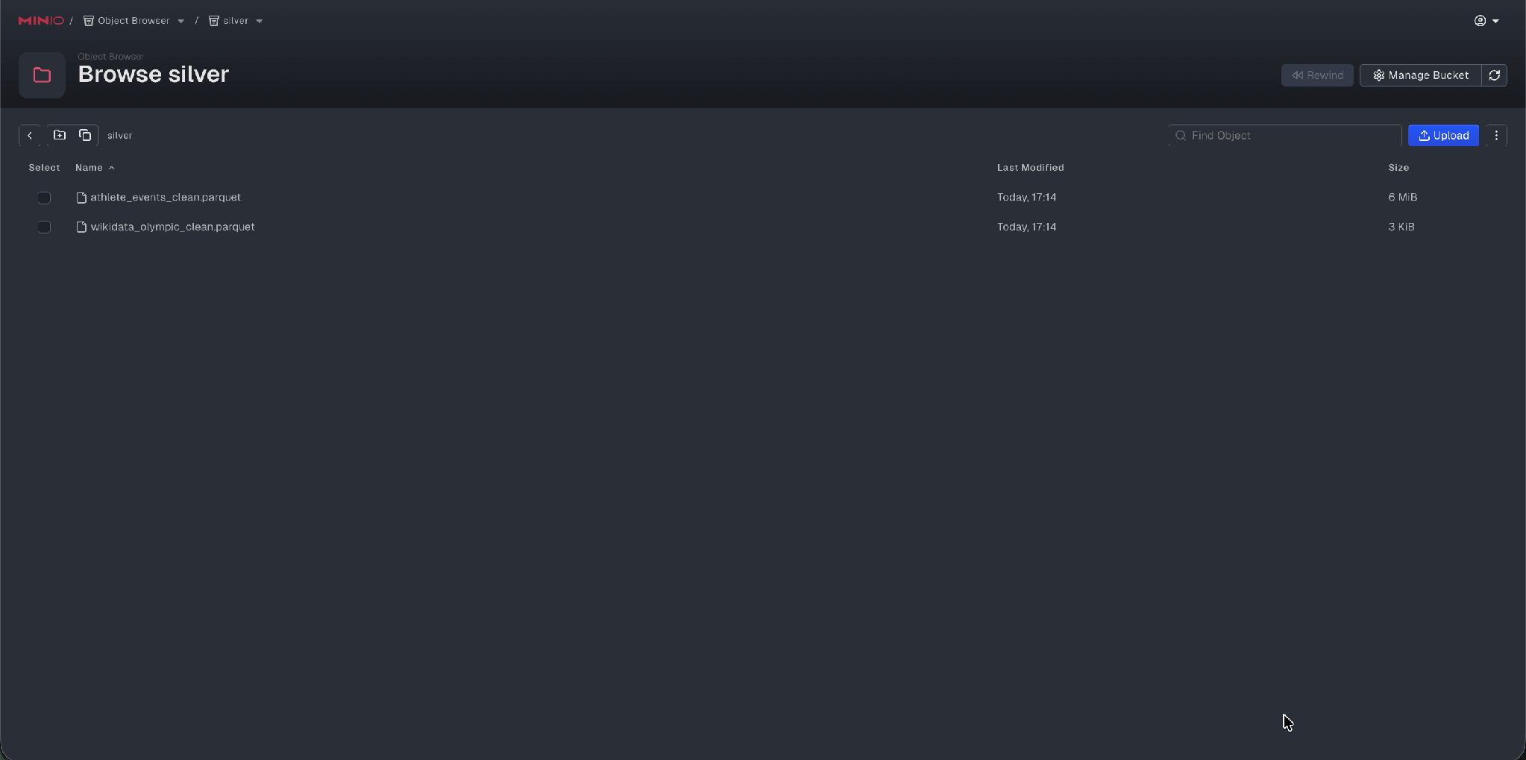
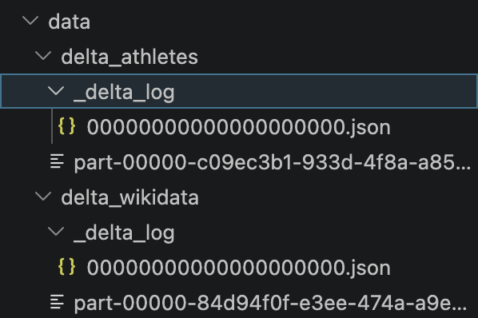
SILVER LAYER
Silver — Cleaning & Delta Lake Integration
athlete_events.csv
wikidata_olympic.csv
Remove duplicates
CSV → Parquet
Delta Lake table
Data standardisation
CSV → Parquet
Delta Lake table
Delta Lake Advantages
Delta Log snapshot
ACID transactions · Version control · Data consistency

Slide 9
SILVER LAYER — VERSIONING
Delta Lake — Beyond Plain Parquet
ACID Transactions
Time Travel
Every write is atomic — no partial updates, no corruption
Query any previous version of the data using VERSION AS OF
Transaction Log
Overwrite-safe
_delta_log stores every operation as a JSON entry
mode='overwrite' replaces data cleanly without side effects

Slide 10
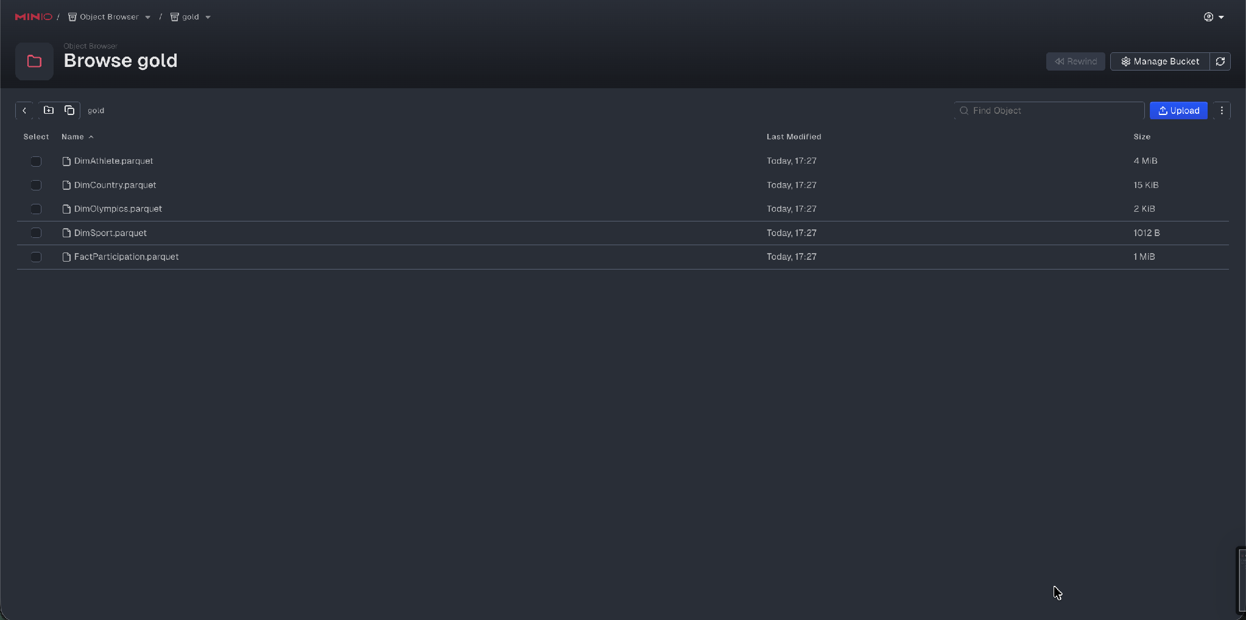
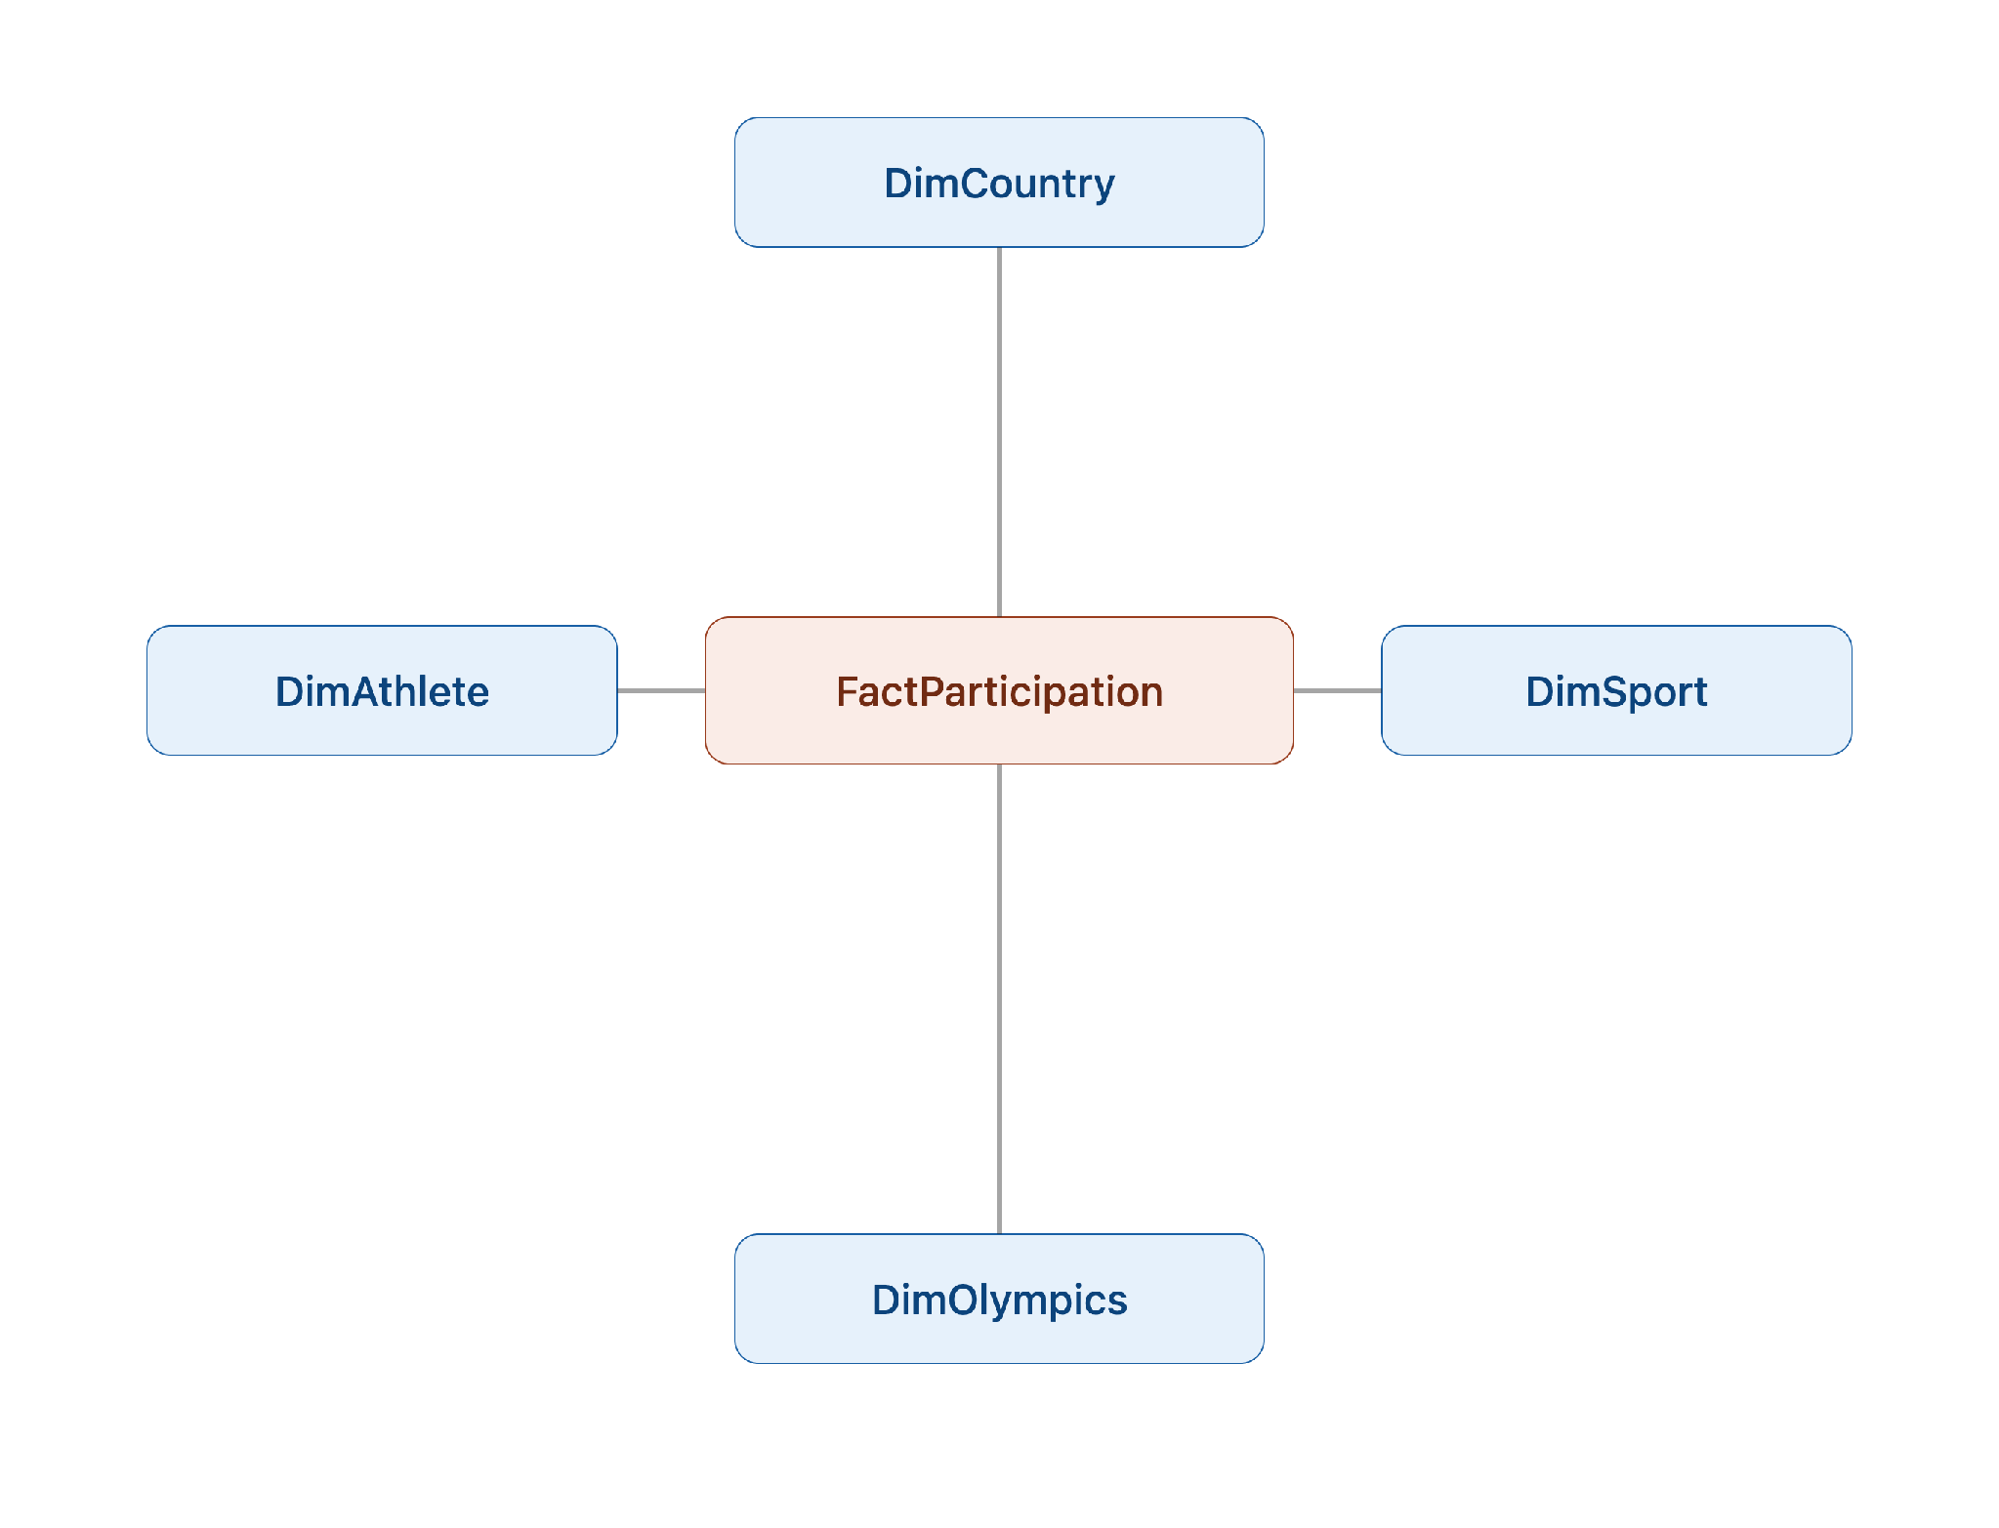
GOLD LAYER — ERD
Gold — Star Schema (ERD)
Star Schema

Slide 11
GOLD LAYER
Why DuckDB?
In-Process
Reads Parquet Natively
Runs inside Python — no server, no config, no network latency
Queries Parquet files directly without loading them into memory
Columnar Engine
Full SQL Support
Vectorized execution — built for analytical workloads, not row lookups
JOINs, aggregations, window functions — everything you need

Slide 12
ANALYTICAL QUERIES
6 SQL Analytics Queries via DuckDB
Q1
Top 10 countries by total medals
Q2
Sports with most gold medals
Q3
Avg age of medal winners
DuckDB SQL
DuckDB SQL
DuckDB SQL
Q4
Athletes by gender
Q5
Participation by Games edition
Q6
Medals by Olympic season
DuckDB SQL
DuckDB SQL
DuckDB SQL

Slide 13
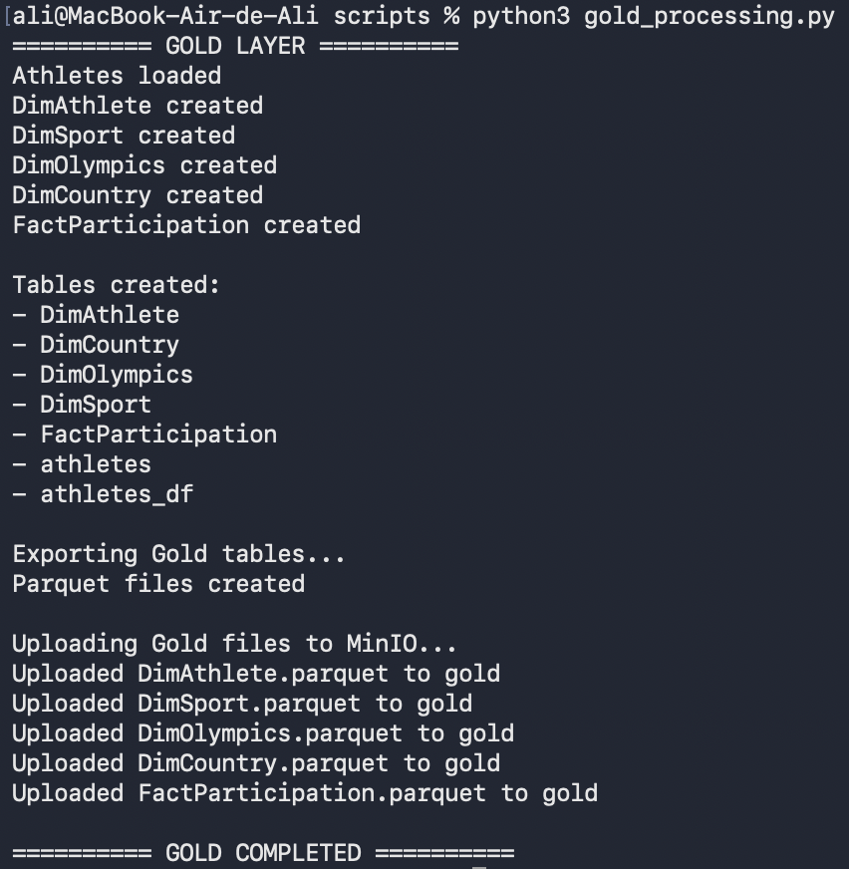
RESULTS
ETL Results — Terminal Output
Gold layer ETL terminal output — all tables created successfully

Slide 14
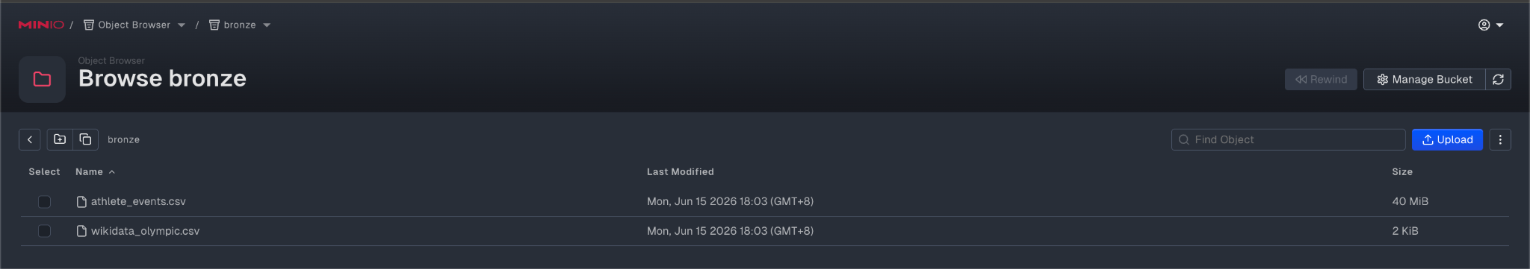
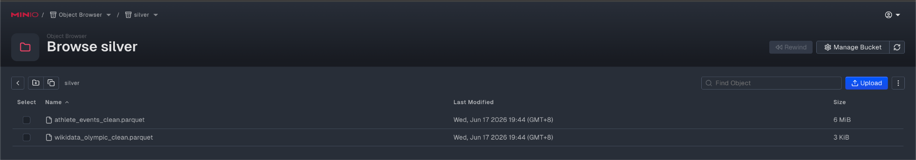
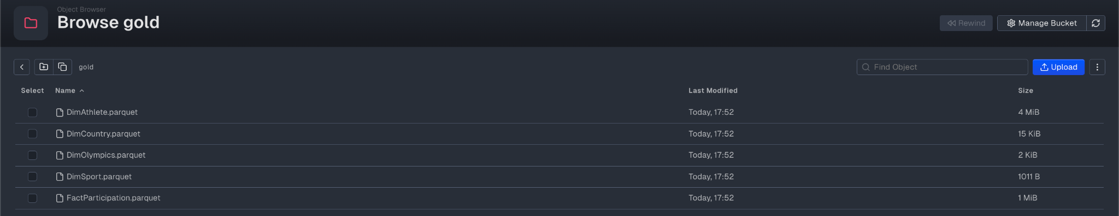
RESULTS — MINIO BUCKETS
MinIO Bucket Contents
Bronze — raw CSV files
Silver — clean Parquet files
Gold — Star Schema Parquet files

Slide 15
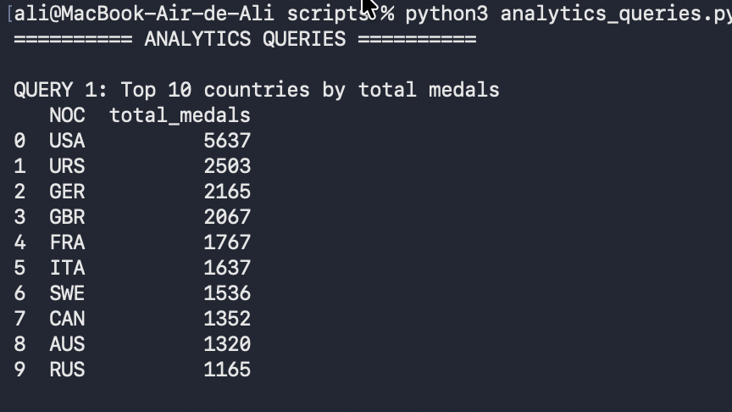
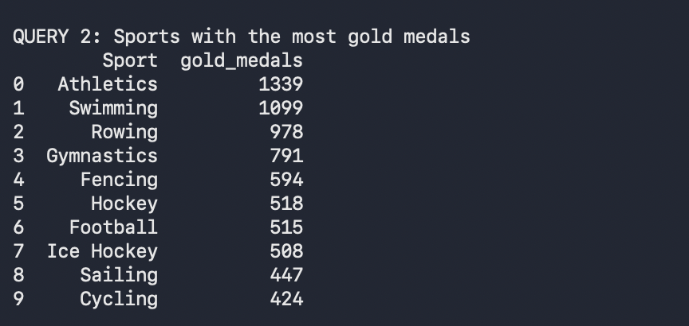
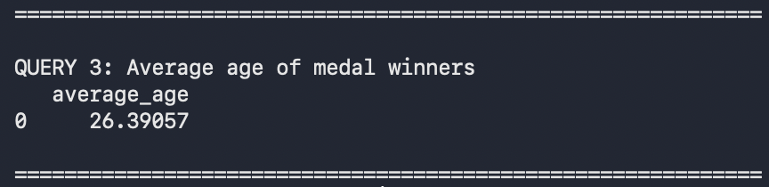
RESULTS — QUERY OUTPUTS
Query Results — Q1 to Q3
Q1 — Top countries by medals
Q2 — Sports with most gold medals
Q3 — Avg age of medal winners

Slide 16
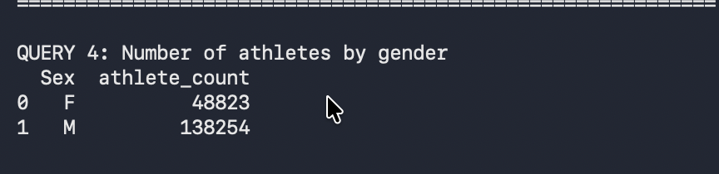
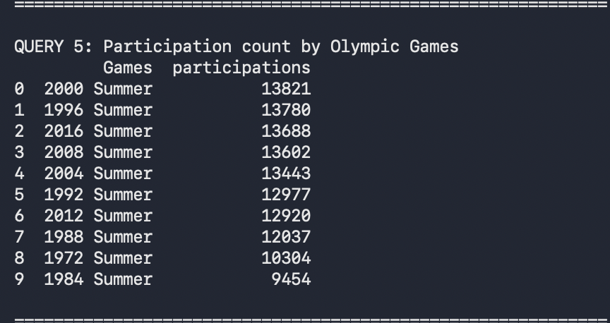
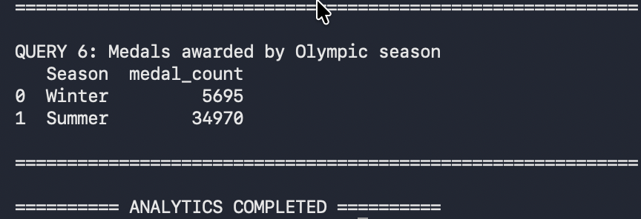
RESULTS — QUERY OUTPUTS
Query Results — Q4 to Q6
Q4 — Athletes by gender
Q5 — Participation by Games edition
Q6 — Medals by Olympic season

Slide 17
TECHNOLOGY
Technology Stack
Ingestion
Object Storage
File Format
Python
MinIO
Parquet
MD5 checksums, MinIO uploads
Bronze & Silver buckets
Columnar, efficient storage
Transaction Layer
Analytical Engine
Analytics
Delta Lake
DuckDB
SQL
ACID, versioning
Fast in-process SQL
6 custom analytical queries

Slide 18
TASK DISTRIBUTION
Work Contribution — Group Members
Ali Mahha
Valentin Gabriel Paul TARDY
Shivam Bhandari
Bronze Ingestion & Silver Processing
Gold Layer & Analytics
Warehouse Schema
bronze_ingestion.py — MD5 deduplication
utils.py — helper functions
silver_processing.py — cleaning & Delta Lake
Queries: Q1, Q2
gold_processing.py — Star Schema modeling
analytics_queries.py — SQL queries
DuckDB database setup & architecture
Queries: Q3, Q4
Star Schema ERD design
Queries: Q5, Q6

Slide 19
Conclusion
A Complete Data Engineering Workflow
Delivered
Next Steps
Incremental ingestion with MD5 deduplication
MinIO object storage (Bronze + Silver + Gold buckets)
Parquet + Delta Lake for reliable data transformation
DuckDB Star Schema for fast analytical queries
Apache Airflow orchestration
Docker containerisation
Power BI dashboard
Cloud deployment
Thank you

