Slide 1


MANZIL
Intelligent Traffic and Emergency Routing
Final Year Project · Deliverable 2 Presentation
Muhammad Ali Mahoon · 23L-0531
Muzammil Ahmed Bhatti · 23L-0688
Mohammad Ibrahim Salman · 23L-0723
Supervisor
Miss Umm-e-Ammarah
National University of Computer and Emerging Sciences
Notes:
Source: Manzil Deliverable 2 report front matter and project context.

Slide 2
Problem statement
02
A single traffic event can expose weaknesses in sensing, control, routing, and recovery
Current gap
Observe
Video or SUMO state
The project lacks one reproducible environment that can compare normal signal-control strategies and isolate the effects of emergency routing and coordinated signal priority under the same demand conditions.
Decide
Control and routing
Act safely
Validated signal action
Why integration is difficult
Measurements need defined units, freshness, and provenance.
Routes must remain legal from the ambulance’s current position.
Signal transitions must preserve minimum green, clearance, and recovery.
Explain
Versioned evidence
MANZIL • FYP DELIVERABLE 2
FAST–NUCES
Notes:
Source: Manzil Deliverable 2 report, Sections 2.2 and 2.3.

Slide 3
Five connected research problems
03
01
Traffic observation
Detection must become stable tracks, counts, and queue-related observations.
02
Normal signal control
Fixed and transparent adaptive baselines must work before RL can be judged.
03
Dynamic routing
Time-based costs must avoid double counting and support stable rerouting.
04
Moving priority corridor
Activation, clearance, passage, cancellation, and recovery require one safe lifecycle.
05
Reproducible evaluation
Matched demand, seeds, timing, and metrics must remain fixed across comparisons.
Dependencies matter: stale observations can change route costs, route revisions can invalidate priority requests, and emergency gains can shift delay to ordinary traffic.
MANZIL • FYP DELIVERABLE 2
FAST–NUCES
Notes:
Source: Manzil Deliverable 2 report, Section 2.3 Problem Elaboration.

Slide 4
Project scope
04
The prototype is deliberately narrower than an operational city traffic system
Included
Excluded from the current project
Recorded-video vehicle detection, tracking, counts, and queue proxies
A manageable multi-intersection SUMO network with repeatable demand
Fixed-time, rule-adaptive, and one feasible RL controller
One active ambulance with congestion-aware routing and a moving priority corridor
React dashboard, FastAPI boundary, run manifests, and experimental records
Controlled closures or incidents for rerouting experiments
Live government CCTV integration or citywide camera calibration
Direct control of public signals or safety-certified field deployment
All-Lahore coverage and multiple competing emergency fleets
Accident classification, forecasting, enforcement, or plate and face recognition
Claims about patient outcomes, certified emergency preemption, or deployment readiness
A guarantee that imported map attributes are complete or current
MANZIL • FYP DELIVERABLE 2
FAST–NUCES
Notes:
Source: Manzil Deliverable 2 report, Section 2.5 and Table 2.1 Scope Boundaries.

Slide 5
Goals achieved and future goals
05
Repository evidence supports design completion, not implementation or measured performance
Completed for Deliverable 2
Next implementation goals
Defined the bounded problem, stakeholders, scope, and measurable objectives
Reviewed verified literature across perception, signal control, RL, routing, and emergency priority
Specified functional requirements, use cases, interfaces, risks, and failure behavior
Designed the architecture, data model, algorithms, wireframes, and evaluation protocol
Established reproducibility rules for configurations, route versions, applied actions, and retained failures
Prepare and validate the selected SUMO network and demand scenarios
Evaluate the detector and tracker on held-out, source-separated video
Implement fixed and rule-based controllers before training one RL policy
Integrate stable rerouting with the corridor lifecycle and safety filter
Build the dashboard and persistence layer, then run matched repeated experiments
Report positive, negative, or mixed results against the predeclared metrics
Status rule
No slide claims implementation, accuracy, travel-time improvement, or field readiness until traceable evidence exists.
MANZIL • FYP DELIVERABLE 2
FAST–NUCES
Notes:
Source: Manzil Deliverable 2 report, Sections 1.1 and 2.4; Manzil_FYP_Context.md implementation-status notes.

Slide 6
Research and development evidence
06
The literature supports building blocks and also defines what Manzil must validate itself
01
Perception
YOLO enables one-stage detection. ByteTrack and DeepSORT address temporal identity, but local viewpoint, occlusion, and region mapping still require validation.
Detection boxes alone are not traffic state.
02
Signal control
Max-pressure research motivates a transparent adaptive baseline. PressLight and related RL studies show feasible learning formulations under declared simulations.
RL needs fair baselines and a shared safety envelope.
03
Routing
Dijkstra supplies the reference optimum for nonnegative time costs. A* remains valid only with an admissible lower bound.
Dynamic behavior comes from costs, freshness, and rerouting rules.
04
Emergency priority
Preemption research emphasizes lawful transition, bounded service, queue clearance, passage detection, cancellation, and recovery.
Ambulance benefit must be reported with ordinary-traffic impact.
Manzil’s contribution is the controlled evaluation of an integrated, traceable prototype. It does not claim a new detector, shortest-path algorithm, or RL family.
MANZIL • FYP DELIVERABLE 2
FAST–NUCES
Notes:
Sources: Manzil Deliverable 2 report, Chapter 3.
Redmon et al. (2016), DOI 10.1109/CVPR.2016.91.
Wojke et al. (2017), DOI 10.1109/ICIP.2017.8296962.
Zhang et al. (2022), DOI 10.1007/978-3-031-20047-2_1.
Varaiya (2013), DOI 10.1016/j.trc.2013.08.014.
Wei et al. (2019), DOI 10.1145/3292500.3330949.
Qin and Khan (2012), DOI 10.1016/j.trc.2012.04.004.

Slide 7
Related systems and research applications
07
Each reference solves part of the problem; none substitutes for Manzil’s controlled integration
System or method | Primary strength | Boundary for Manzil | Use in this project
SUMO + TraCI | Detailed microscopic simulation and external control | Simulation behavior depends on network and demand configuration | Core controlled experiment environment
CityFlow | High-throughput traffic RL at larger scale | Migration would add scope and equivalence work | Documented alternative, not selected
YOLO + tracker | Vehicle detection and temporal association | Does not produce calibrated queues or complete network state | Recorded-video perception path
PressLight / CoLight | Pressure-informed or cooperative RL control | Training complexity and transfer remain scenario dependent | Design evidence, not copied result
Dijkstra / A* | Minimum-cost graph routing | Needs legal movement graph, time costs, freshness, and stability | Reference route and conditional optimization
Selection principle
Choose tools that preserve reproducibility, inspectable signal behavior, legal routing, and feasible integration on the team’s available hardware.
MANZIL • FYP DELIVERABLE 2
FAST–NUCES
Notes:
Sources: Manzil Deliverable 2 report, Chapter 3 and Section 6.4.1.
Alvarez Lopez et al. (2018), DOI 10.1109/ITSC.2018.8569938.
Zhang et al. (2019), DOI 10.1145/3308558.3314139.
Wei et al. (2019), DOI 10.1145/3292500.3330949 and 10.1145/3357384.3357902.
Dijkstra (1959), DOI 10.1007/BF01386390; Hart et al. (1968), DOI 10.1109/TSSC.1968.300136.

Slide 8
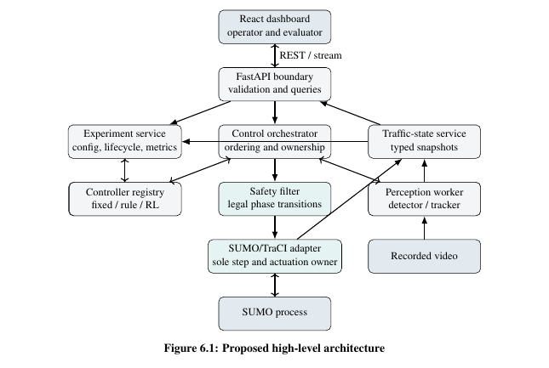
Proposed system architecture
08
One controlled actuation path separates commands, evidence, and presentation
Design rules
Single actuation owner
Only the SUMO/TraCI adapter advances time and applies validated signal changes.
Safety before application
Controllers request actions. The safety filter enforces legal phases and timing before actuation.
Evidence remains traceable
Snapshots, route versions, requested actions, applied actions, metrics, and failures retain causal links.
MANZIL • FYP DELIVERABLE 2
FAST–NUCES
Notes:
Source image and content: Manzil Deliverable 2 report, Figure 6.1 and Section 6.1.4.

Slide 9
Core decision workflow
09
The same safety and evidence rules apply to normal control and emergency priority
1
Advance
4
Select owner
SUMO moves exactly one configured step
Corridor or normal controller requests an action
2
Observe
5
Validate
Build a timestamped traffic snapshot
Safety filter checks phase and timing rules
3
Route
6
Apply and record
Refresh time costs and assess rerouting
Adapter acts; evidence is stored before display
Control invariant
The dashboard, perception worker, controller, and repository cannot advance simulation time or bypass backend validation.
MANZIL • FYP DELIVERABLE 2
FAST–NUCES
Notes:
Source: Manzil Deliverable 2 report, Algorithm 3 Integrated Control Loop and Figure 6.1.

Slide 10
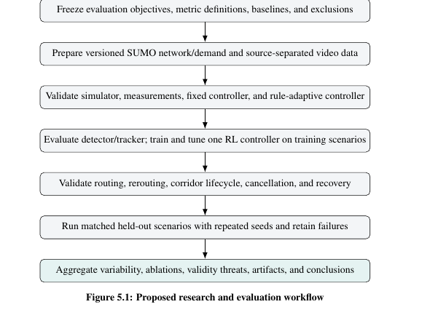
Methodology of work
10
Validation proceeds from definitions and baselines to integration and held-out evaluation
Methodological safeguards
Freeze objectives, metrics, baselines, and exclusions before final runs.
Keep recorded-video perception evidence separate from exact SUMO state.
Validate fixed and rule-based controllers before training the RL policy.
Use development, tuning, and held-out scenario families.
Run matched seeds and retain failed, stopped, and no-route outcomes.
Aggregate variability and component ablations before drawing conclusions.
The workflow prevents a polished integrated demo from hiding a weak measurement, unsafe transition, or unstable baseline.
MANZIL • FYP DELIVERABLE 2
FAST–NUCES
Notes:
Source image and content: Manzil Deliverable 2 report, Figure 5.1 and Chapter 5.

Slide 11
Important requirements, constraints, and limitations
11
Requirements
Constraints
Limitations
Versioned traffic snapshots with source, time, unit, confidence, and validity
Legal signal actions through one safety filter
Stable route revisions with no-route handling and cancellation
Reproducible manifests, metrics, checksums, and visible failures
One active ambulance in the core case
Small validated network suitable for repeated runs
Recorded video for perception validation, not citywide live sensing
Finite hardware may require offline inference or a compact network
Simulation results do not establish public-road performance
Queue length remains a proxy without camera calibration
Final tracker, RL hyperparameters, database, and hardware remain to be confirmed
No authority approval, roadside integration, or field trial exists
Fallback principle
When data, maps, models, or routes fail validation, the system reports the condition or uses a declared fallback. It does not silently change the experiment.
MANZIL • FYP DELIVERABLE 2
FAST–NUCES
Notes:
Source: Manzil Deliverable 2 report, Sections 2.7, 4.3–4.5, and 6.2.

Slide 12
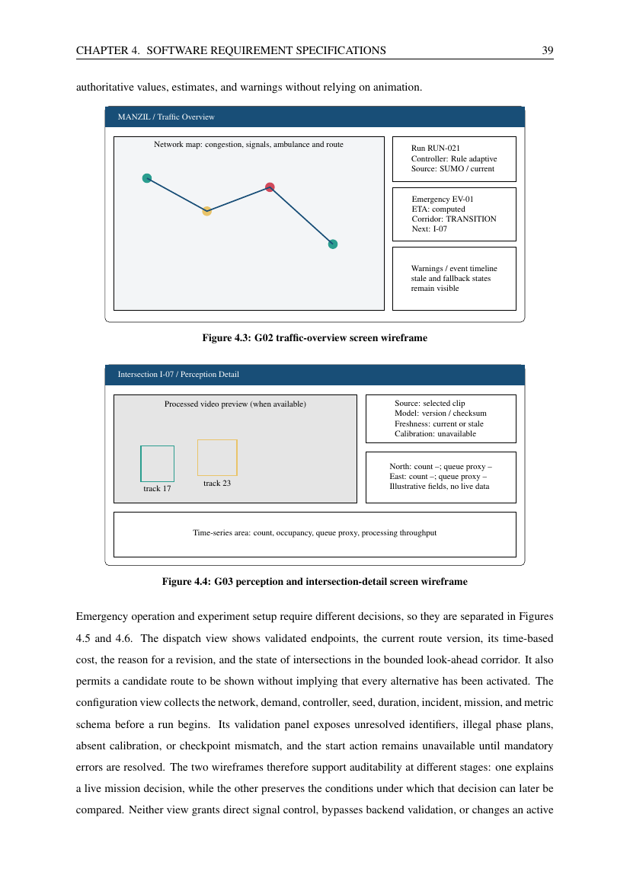
Proposed graphical user interface
12
The interface makes configuration, evidence, warnings, and mission state visible without granting direct signal control
Five planned screens
Experiment configuration
Traffic overview
Perception and intersection detail
Emergency dispatch and route
Comparative analytics
Interface principles
Warnings remain visible beside the map or metric.
Provenance and freshness accompany estimated observations.
Charts disclose run compatibility and failed runs.
All figures are wireframes, not implemented screenshots.
MANZIL • FYP DELIVERABLE 2
FAST–NUCES
Notes:
Source image and content: Manzil Deliverable 2 report, Figures 4.3–4.7 and Section 4.8.

Slide 13
Planned evaluation
13
Each claim has a controlled comparison and a metric that exposes tradeoffs
Evaluation area
Controlled comparison
Primary evidence
Perception
Predictions versus held-out annotations
Count error, tracking stability, queue-proxy error, throughput
Normal control
Fixed vs rule-adaptive vs one RL policy
Delay, waiting, queues, throughput, fairness, interventions
Routing
Unassisted vs dynamic time-cost routing
Ambulance travel time, excess delay, revisions, no-route rate
Corridor
Routing alone vs routing with moving priority
Ambulance benefit, ordinary-traffic impact, recovery time
Robustness
Demand, incidents, seeds, and approved noise conditions
Variability, failures, sensitivity, reproducibility artifacts
Protocol: 900-second warm-up, 3,600-second measurement interval, and ten matched seeds; a pilot may increase but not reduce repetitions.
MANZIL • FYP DELIVERABLE 2
FAST–NUCES
Notes:
Source: Manzil Deliverable 2 report, Chapter 5 and Table 5.1.
The durations and matched-seed count are predeclared protocol settings, not experimental results.

Slide 14
Development roadmap
14
Implementation proceeds in dependency order so later components cannot hide earlier faults
01
02
03
04
05
D2 complete
Foundation
Research modules
Integration
Evaluation
Research, SRS, architecture, methodology, diagrams, wireframes
Network validation, manifests, fixed controller, metric collection
Perception evaluation, rule controller, RL training, dynamic routing
Corridor lifecycle, safety filter, dashboard, persistence
Matched held-out runs, ablations, error analysis, final conclusions
Decision gates
Do not train RL until baseline actions, safety transitions, and metrics are stable.
Do not interpret integrated results until the detector, routing, and corridor modules pass their own checks.
Freeze final scenarios and metric definitions before held-out evaluation.
MANZIL • FYP DELIVERABLE 2
FAST–NUCES
Notes:
Source: Manzil Deliverable 2 report, Figure 5.1 and Chapters 5–6.

Slide 15
Manzil
A controlled platform for studying normal traffic control and one emergency mission
What the project contributes
Next milestone
A traceable architecture that separates observation, decision, safe application, and evidence
A staged method for comparing perception, normal control, routing, and corridor effects
Clear scope boundaries that prevent simulation and wireframes from being presented as field deployment
Implement the validated foundation, then generate evidence through matched, repeatable experiments.
Questions
Muhammad Ali Mahoon · Muzammil Ahmed Bhatti · Mohammad Ibrahim Salman
Notes:
Source: Manzil Deliverable 2 report conclusions and project context.

