Slide 1
MANZIL
INTELLIGENT TRAFFIC & EMERGENCY ROUTING
Final Year Project • Deliverable 2
Muhammad Ali Mahoon • 23L-0531
Muzammil Ahmed Bhatti • 23L-0688
Mohammad Ibrahim Salman • 23L-0723
Supervisor: Miss Umm-e-Ammarah
National University of Computer and Emerging Sciences
Notes:
Project and team details are taken from the Manzil Deliverable 2 report.

Slide 2

PROBLEM STATEMENT
02
Emergency mobility fails when sensing, routing, signal priority, and recovery are treated as separate tasks.
THE GAP
01
Observe traffic
Create fresh traffic-state evidence
An ambulance may receive a fast route yet remain blocked at signals. A priority action may help the ambulance but create unsafe transitions or excessive delay for ordinary traffic.
02
Select a route
Use current time-based road costs
03
Create a corridor
Apply safe and bounded priority
Manzil studies the complete chain in one controlled and reproducible environment.
04
Measure impact
Compare emergency benefit and network cost
Notes:
Source: Manzil Deliverable 2 report, problem statement and elaboration sections.
The traffic signal and car illustration is AI-generated for this presentation.

Slide 3
ONE CONNECTED DECISION CHAIN
03
A result is credible only when every upstream decision remains traceable.
01
02
03
04
05
SENSE
DECIDE
VALIDATE
ACT
RECORD
Counts, queues,
and timestamps
Control action
and route version
Legal phase and
corridor ownership
Advance the
simulation
Metrics, failures,
and recovery
Why this matters
Stale observations alter route costs. A route change alters which intersection may receive priority. Priority can reduce ambulance delay while shifting delay to ordinary traffic. Manzil records each dependency before comparing outcomes.
Notes:
Source: Manzil Deliverable 2 report, connected problem and evidence-chain discussion.

Slide 4
PROJECT SCOPE
04
The prototype supports controlled research; it is not an operational city deployment.
INCLUDED
OUTSIDE THE CURRENT PROJECT
Recorded-video traffic observation
Repeatable multi-intersection SUMO network
Fixed, adaptive, and one feasible RL controller
One ambulance with dynamic routing and priority
Dashboard, run records, and comparison evidence
Live government CCTV integration
Direct control of public traffic signals
Multiple emergency fleets across Lahore
Accident, plate, or face recognition
Claims about patient outcomes or field readiness
All conclusions remain limited to the declared simulation or recorded-video condition.
Notes:
Source: Manzil Deliverable 2 report, project scope and exclusions.

Slide 5
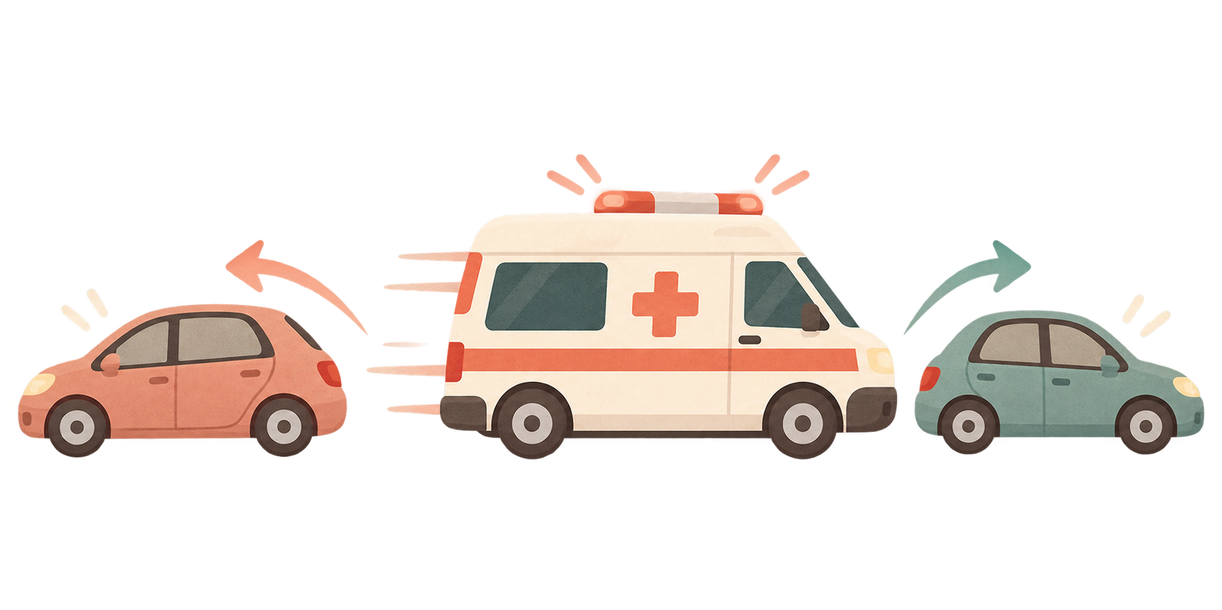
GOALS ACHIEVED AND FUTURE GOALS
05
A milestone view makes completed design work and dependent implementation work easy to distinguish.
01
02
03
04
RESEARCH & DESIGN
NETWORK & BASELINES
SYSTEM INTEGRATION
EVALUATION
Completed
Next
Future
Future
Completed
Implementation and evaluation proceed after each dependency is stable and testable.
Notes:
Completed means Deliverable 2 research, requirements, architecture, and interface design. No unverified implementation or performance claim is made.
The ambulance and cars illustration is AI-generated for this presentation.

Slide 6
DEVELOPMENT AND R&D
06
Prior work defines strong baselines and design rules; it does not become a claimed Manzil result.
01
02
03
PERCEPTION
TRAFFIC CONTROL
ROUTING & PRIORITY
YOLO, DeepSORT, ByteTrack
Max-pressure, PressLight, CoLight
Dijkstra, A*, SUMO + TraCI
Validate complete counts and queue estimates, not detector output alone.
Establish fixed and transparent adaptive baselines before one RL policy.
Use fresh time costs, stable rerouting, and a bounded emergency corridor.
Related applications
SUMO and TraCI form the controlled simulation environment. CityFlow is a documented alternative; PressLight and CoLight inform the learned-control design.
Notes:
Sources summarized in the Manzil Deliverable 2 literature review: YOLO, DeepSORT, ByteTrack, max-pressure control, PressLight, CoLight, Dijkstra, A*, SUMO, and TraCI.

Slide 7
REQUIREMENTS, CONSTRAINTS, AND LIMITATIONS
07
Short operational statements define what must remain true during implementation and evaluation.
REQUIREMENTS
CONSTRAINTS
LIMITATIONS
One validated owner applies each signal action.
Every observation carries source and simulation time.
Routes use the active version and current ambulance position.
The core scenario contains one ambulance.
The validated SUMO network remains intentionally small.
Recorded video stays separate from simulator ground truth.
Simulation does not prove public-road performance.
Queue estimates depend on camera viewpoint and calibration.
Final model performance has not yet been measured.
Fallback rule: invalid data, routes, timing, or model output must stop the run or activate a declared baseline.
Notes:
Source: Manzil Deliverable 2 report, software requirements and design constraints.

Slide 8

HOW MANZIL WORKS
08
A single control loop connects traffic observation, ambulance priority, safe signal control, and the mobile view.
OBSERVE
BUILD STATE
DECIDE
MAKE WAY
APPLY
SHOW RESULT
Camera + SUMO
Traffic and queues
Route + controller
Safe green corridor
Signals change
App + evaluation
1
→
2
→
3
→
4
→
5
→
6
Detector / TraCI
State service
Router / policy
Safety manager
TraCI / SUMO
Dashboard / evidence
AMBULANCE MISSION
NORMAL TRAFFIC
destination and live position
continues after safe recovery
↺ Each SUMO step creates the next traffic observation
Notes:
This is one continuous diagram, not separate architecture panels.
Read left to right: Manzil observes the current network, creates a fresh traffic state, selects normal control and an ambulance route, validates a safe green corridor, applies the signal action through TraCI, then shows the result and stores evidence for evaluation.
The next SUMO step returns to observation, forming the closed control loop. The mobile interface displays the route, corridor state, warnings, and run status but does not directly advance the simulator.

Slide 9
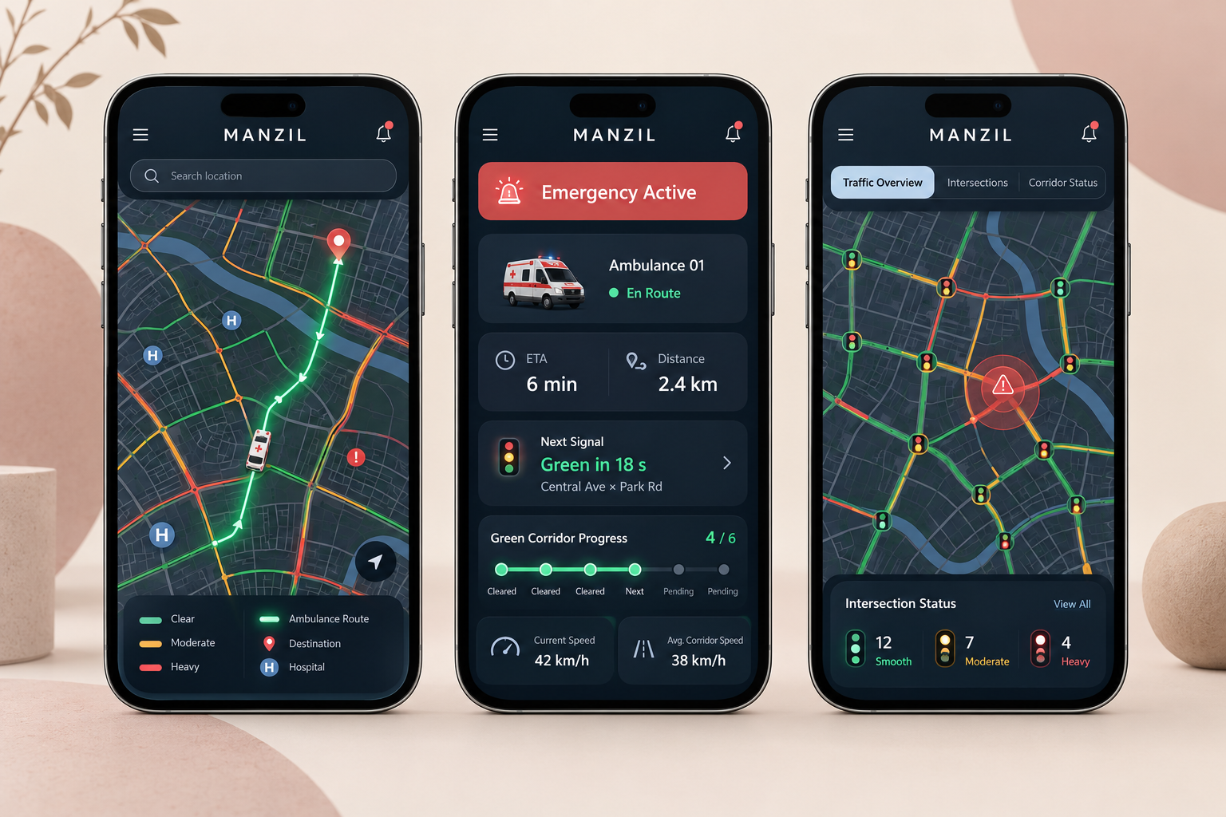
GRAPHICAL USER INTERFACE
09
Generated concept screens show the intended mobile experience, not a completed application screenshot.
THE OPERATOR MUST SEE
Ambulance position, destination, and remaining route
Next signal and current emergency-corridor state
Congestion, queue, incident, and data-freshness warnings
Controller, route version, run identifier, and failures
UI CONCEPT
Final visual design remains subject to implementation and usability review.
MANZIL • DELIVERABLE 2
Notes:
The mobile visual is an AI-generated interface concept prepared for this presentation. It is not evidence of implementation.

Slide 10
METHODOLOGY OF WORK
10
Each stage produces evidence that becomes the input and acceptance check for the next stage.
01
02
03
04
PREPARE
BASELINE
INTEGRATE
EVALUATE
Validate network, demand, signal plans, video provenance, and metrics.
Run fixed-time and transparent adaptive control before learning.
Add routing, bounded priority, cancellation, and recovery.
Use matched seeds and demand; retain failures and trade-offs.
Notes:
Source: Manzil Deliverable 2 report, methodology and evaluation chapters.

Slide 11
EVALUATION PLAN
11
Success is measured across emergency movement, ordinary traffic, safety, reproducibility, and runtime.
AMBULANCE
NETWORK
ROUTING
SAFETY
A
N
R
S
Travel time and excess delay
Delay, waiting time, queues, fairness
Reroutes, freshness, and stability
Blocked actions and legal transitions
Decision rule
Report positive, negative, and mixed outcomes under the same declared conditions.
Notes:
No performance figures are claimed because final implementation experiments have not yet been completed.

Slide 12
MANZIL
A controlled platform for studying traffic management and one emergency mission
QUESTIONS
Muhammad Ali Mahoon • Muzammil Ahmed Bhatti • Mohammad Ibrahim Salman
Notes:
Closing slide.

