Slide 1
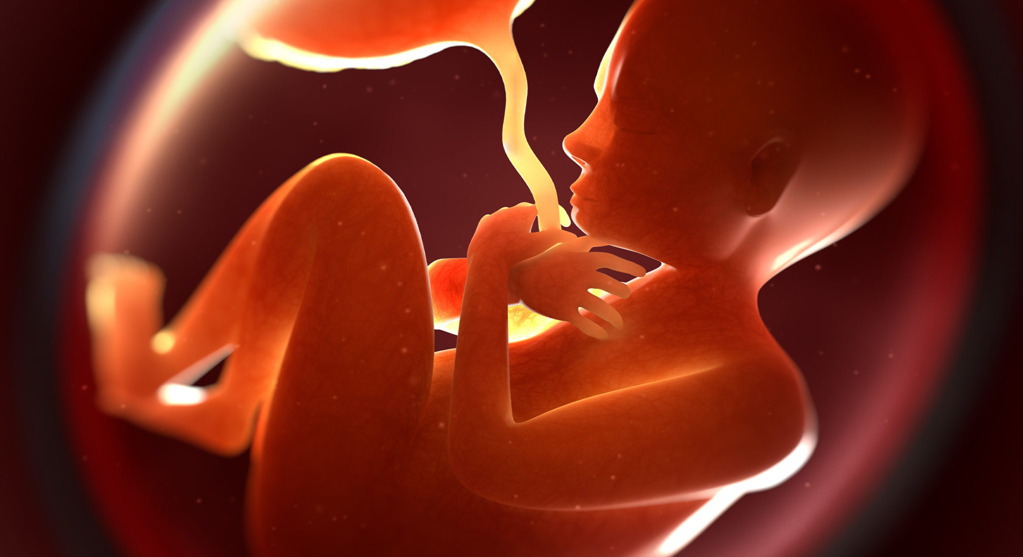
Fetal health classification
Supervised Machine Learning
Ali Mahzoon

Slide 2
Overview
Reduction of child mortality is reflected in several of the United Nations' Sustainable Development Goals and is a key indicator of human progress.
Cardiotocograms (CTGs) are a simple and cost accessible option to assess fetal health, allowing healthcare professionals to take action in order to prevent child and maternal mortality.
In this research I used 10 different supervised machine learning algorithms to predict fetal health classification.
Created a multiclass model to classify CTG features into the three fetal health states.
1. Normal
2. Suspect
3. Pathological

Slide 3
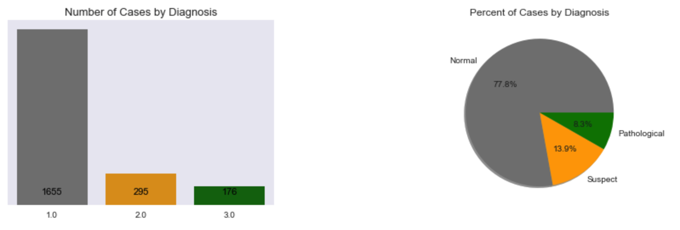
Dataset
I used a provided dataset by Automated Analysis of Cardiotocograms (CTGs)
In this dataset we are dealing with 2126 records and 22 features including fetal heart rate (FHR), fetal movements, uterine contractions and more.
Distribution of my target classes are imbalanced

Slide 4

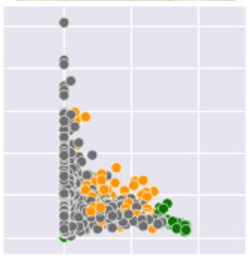

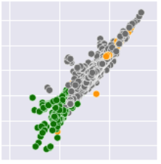
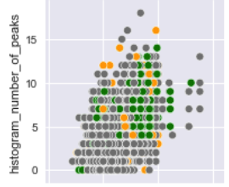



Explanatory data analysis
There are 484 of these plots available to visualize each pair feature in my dataset to check the separability of data with the hue of my target variable.
Here we have 3 different examples of those visualizations.
Pathological
Suspect
Normal

Slide 5
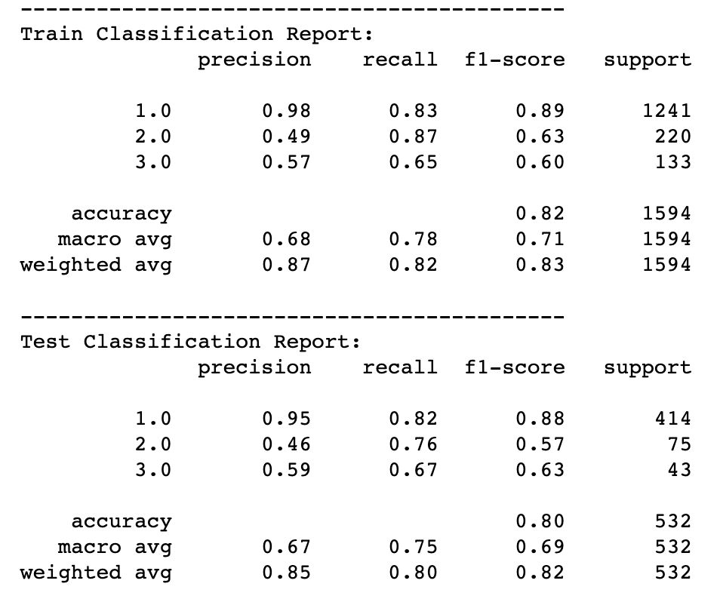
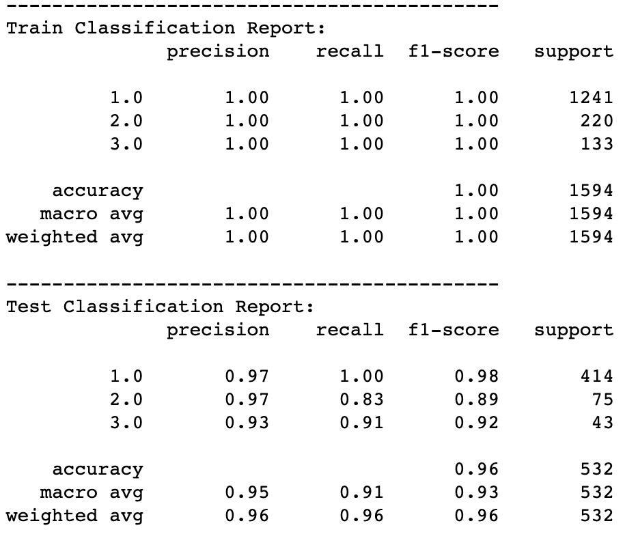
Models
These are the evaluation metrics of both worst and best models
As we all know human lives matter, so every evaluation metric is important in this case
Worst Model (GNB)
Best Model (Hist Gradient Boosting)

Slide 6
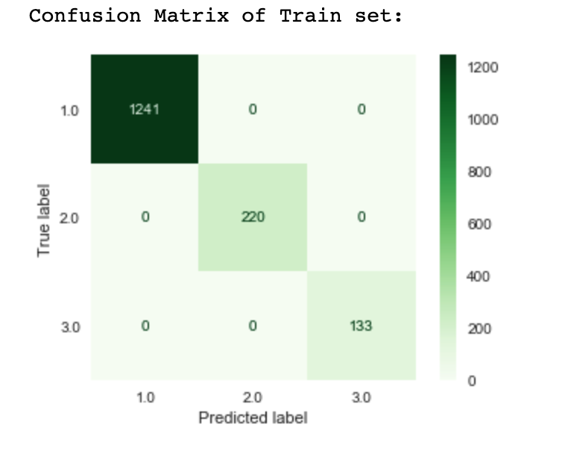
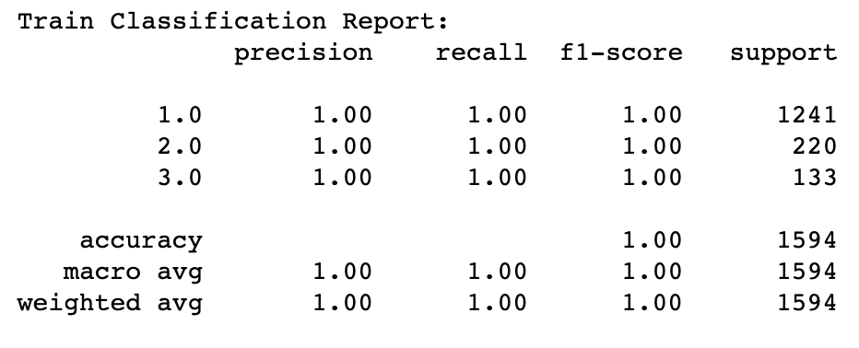
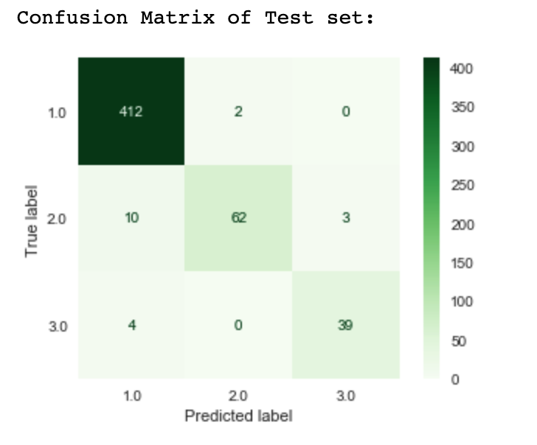

Confusion matrix

Slide 7
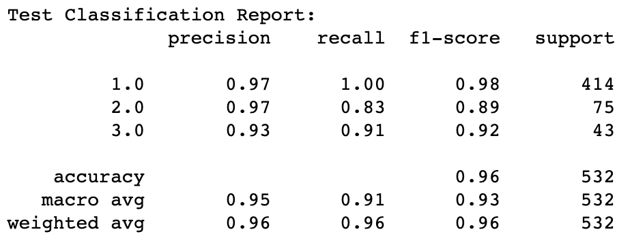
Interpretation Of Evaluation Metrics
precision is the ratio of correctly predicted positive observations to the total predicted positive observations. The question that this metric answers is of all fetal_health that labeled as Suspect or Pathological how many actually are Suspect and Pathological? High precision rate relates to the low False Positive. We have got 0.97 for Suspect and 0.93 for Pathological
Recall is the ratio of correctly predicted positive observations to the total actual positive observations. The question that Recall answers is of all the fetuses that truly Suspect or Pathological, how many did we label? we have got recall of .83 for Suspect and .91 for Pathological
Accuracy is simply a ratio of correctly predicted observations to the total observations. (Diagonal of Confusion Matrix)
F1-Score is the weighted average of precision and recall. Therefore, this score takes all misclassified data into account.

Slide 8
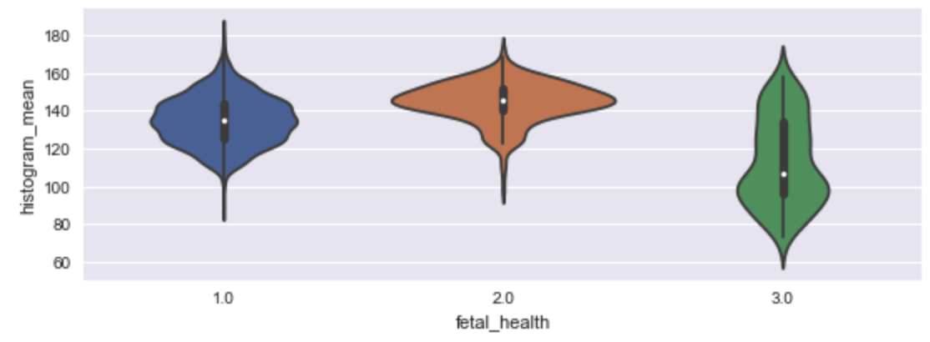
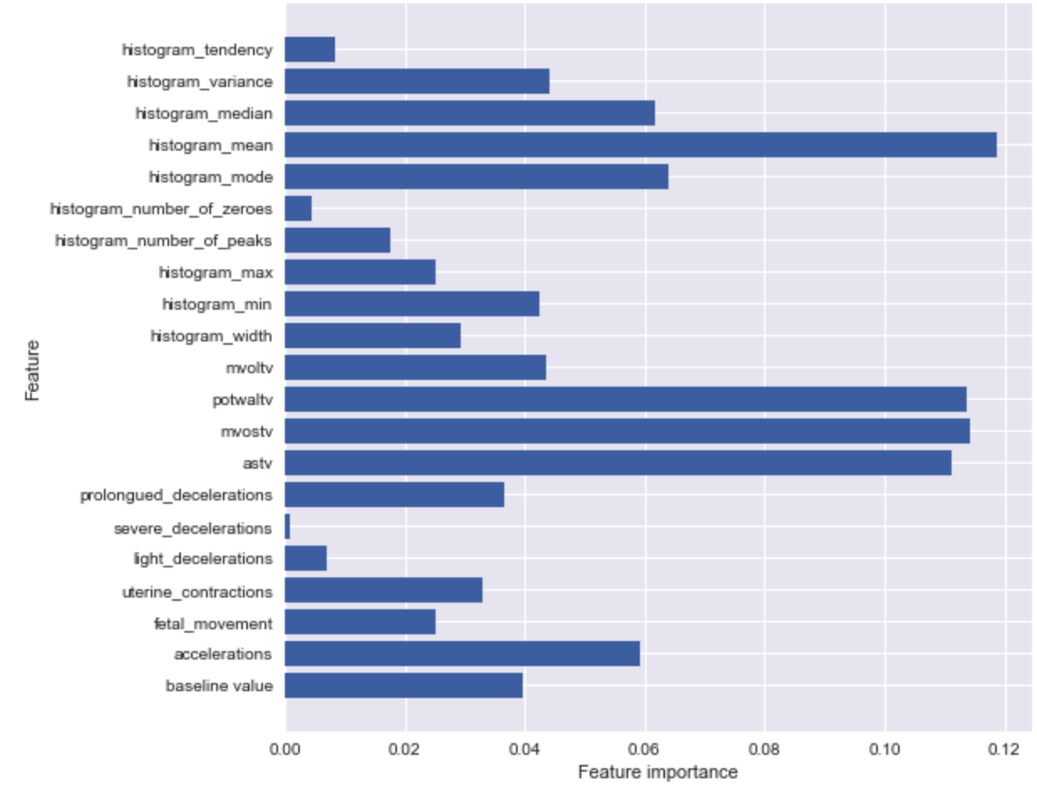
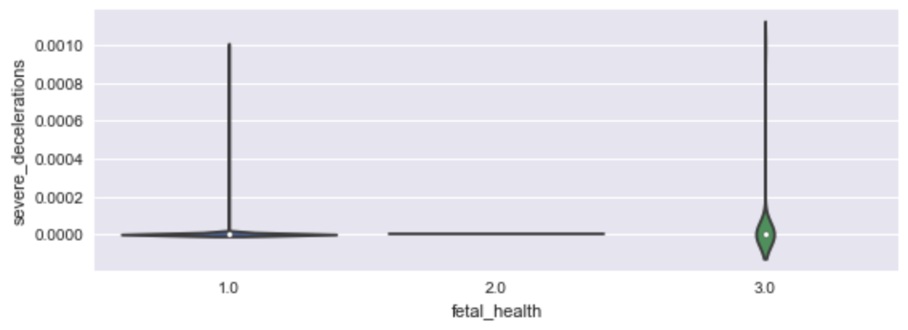
Feature Importance
Most Important feature: histogram_mean
Least Important feature: severe_decelerations

Slide 9
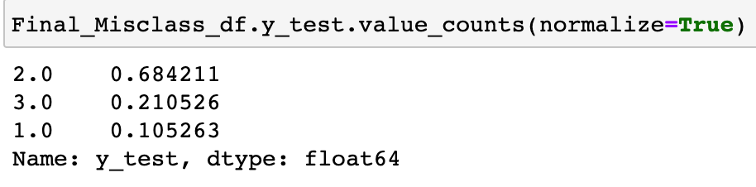
Conclusion
As we saw in our models the most important features to classify fetal health are the ones with different densities in different points. Another important point to consider is that features with variances close to zero are not useful either to learn from or for prediction.
Recommendation
Based on the data and modeling, short term abnormality must take into consideration for both baby and mother to reduce mortality among them.
Future Work
I have 4% misclassified data (96% accuracy). I need to find a pattern among misclassified data

Slide 10
Thank you
Citation:
Ayres de Campos et al. (2000) SisPorto 2.0 A Program for Automated Analysis of Cardiotocograms. J Matern Fetal Med 5:311-318
E-mail:
Ali.mahzoon.1989@gmail.com

