Slide 1
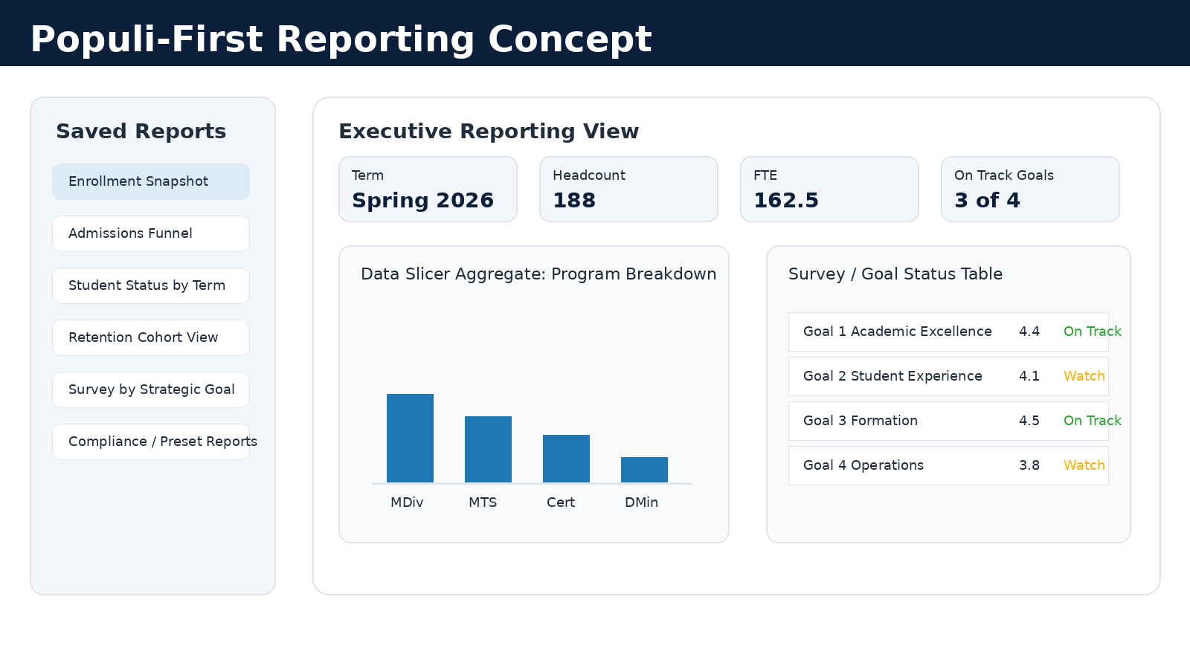
Turner Dashboard + Populi Reporting Discussion
Meeting with SACSCOC Liaison • Prototype-to-Implementation Planning
Goal: determine whether Populi should be the dashboard home, the source data engine, or both.
Turner Theological Seminary • Dashboard Planning
1
Notes:
Open by saying this is not a final technical request. It is a planning conversation to understand how to maximize Populi and reduce manual work.

Slide 2
Meeting Goals
What we need to learn and decide today
Confirm the best home
Map the data
Build a rhythm
Can Populi function as the executive dashboard, or should it mainly provide source data for Excel or Power BI?
Identify the Populi reports, saved views, fields, tags, and filters needed for the dashboard.
Create a bi-weekly refresh process that supports leadership decisions and SACSCOC evidence.
Desired outcome: a recommended implementation path
Turner Theological Seminary • Dashboard Planning
2
Notes:
Use this to keep the meeting practical and focused on implementation.

Slide 3
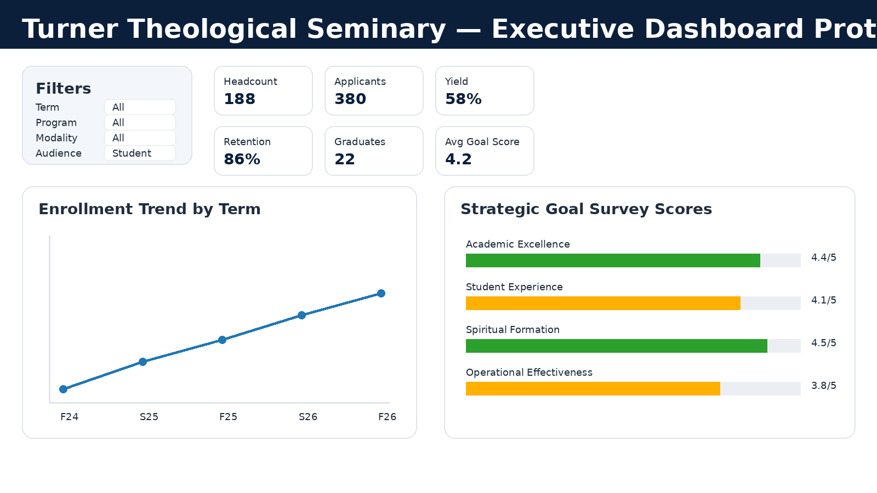
Brief Overview: What the Dashboard Will Entail
A single executive view of enrollment, student success, and strategic goal progress
Enrollment + Pipeline
Headcount, FTE, applicants, admits, enrolled, yield, modality/program trends
Student Profile + Success
Status, demographics, retention, credits, completion, and course outcomes where available
Survey + Strategic Goals
Survey scores, response rates, goal alignment, trend over time, and evidence for action
Prototype exists in Excel; today we test a Populi-first approach.
Turner Theological Seminary • Dashboard Planning
3
Notes:
Say: The Excel dashboard is only a visual prototype. We want to learn whether Populi can provide this kind of executive view natively.

Slide 4
Expected Executive Dashboard View
The President needs at-a-glance clarity with the option to drill down
Turner Theological Seminary • Dashboard Planning
4
Notes:
Walk through filters, KPI tiles, trends, and goal scores. Ask what can be replicated in Populi.

Slide 5
Proposed KPI Set
Start with a small executive set, then expand as data quality improves
Enrollment KPIs
Student Success KPIs
Strategic Goal KPIs
Headcount
FTE
Applicants → admits → enrolled
Yield and conversion rates
Enrollment status
Retention / persistence
Graduation / completion
Credits, GPA, or course bottlenecks
Average survey score by goal
Response rate
Trend over time
Targets, status, and action evidence
Turner Theological Seminary • Dashboard Planning
5
Notes:
Ask which of these Populi can calculate cleanly and which require saved reports, custom fields, or manual validation.

Slide 6
Populi-First Dashboard Concept
Use Populi as much as possible before defaulting to manual Excel work
Turner Theological Seminary • Dashboard Planning
6
Notes:
Frame as a question: Can Populi be the home for saved executive reports and aggregate charts? If not, can Populi generate a standardized report pack that feeds Excel?

Slide 7
Populi Tools to Explore
Confirm what Populi can do natively and what still needs an external dashboard
Data Slicer
Analytics + Presets
Exports + API Later
Custom student reporting, saved reports, filters, columns, aggregates, and exports.
Term comparisons, term-series trends, term-range views, and compliance reporting support.
Phase 1 can be saved reports. Phase 2 can explore automation only if needed.
Turner Theological Seminary • Dashboard Planning
7
Notes:
Ask the liaison to correct the assumptions and recommend the best reporting tools for Turner.

Slide 8
Question Set 1: Can Populi Be the Dashboard?
Start with feasibility before discussing individual reports
1
Can Populi serve as the executive dashboard home, or is it better as the source data system?
2
What does a strong Populi-based executive reporting routine look like at other small seminaries or schools?
3
What are Populi’s limits for one-page dashboards, KPI tiles, trend charts, and drill-down views?
4
Would you recommend Populi-only, Excel-only, or a hybrid approach for our use case?
Turner Theological Seminary • Dashboard Planning
8
Notes:
Let the liaison share best practice. The main decision is whether Populi is the dashboard home or the data source.

Slide 9
Question Set 2: What Reports and Fields Do We Need?
Move from concept to the actual build
1
Which Populi tools should we use for enrollment, retention, graduation, and survey/goal reporting?
2
Can we save a standard set of reports so bi-weekly refresh does not require rebuilding filters?
3
How should cohorts and retention definitions be structured in Populi for consistency?
4
How can survey questions be tagged or mapped to strategic goals in Populi?
Turner Theological Seminary • Dashboard Planning
9
Notes:
This slide moves into field-level structure: cohorts, tags, saved reports, and goal mapping.

Slide 10
Question Set 3: Governance, Permissions, and Evidence
Make sure the dashboard is trusted and accreditation-ready
1
What roles or permissions are needed so leaders see summary data without overexposing student records?
2
What should be the source-of-truth definitions for active, enrolled, retained, withdrawn, and graduated?
3
What evidence should we preserve for SACSCOC: baseline, finding, action, follow-up, and improvement?
4
Where should we store the reporting packet, notes, and action evidence so it is easy to retrieve later?
Turner Theological Seminary • Dashboard Planning
10
Notes:
Connect this to closing the loop and institutional effectiveness evidence.

Slide 11
Decision Points Before We Leave
A productive meeting should answer these
Dashboard location
Populi report pack, Populi dashboard, Excel dashboard, or hybrid?
Refresh process
Bi-weekly saved report run, export workflow, or automated query later?
Data ownership
Who maintains report definitions, fields, and data quality?
KPI definitions
Official definitions for headcount, FTE, active, retained, withdrawn, and graduated.
Evidence routine
Where findings, minutes, actions, and follow-up proof will live.
Ask for a recommended path and a first set of reports to build.
Turner Theological Seminary • Dashboard Planning
11
Notes:
Use this as a close-the-loop slide for the meeting.

Slide 12
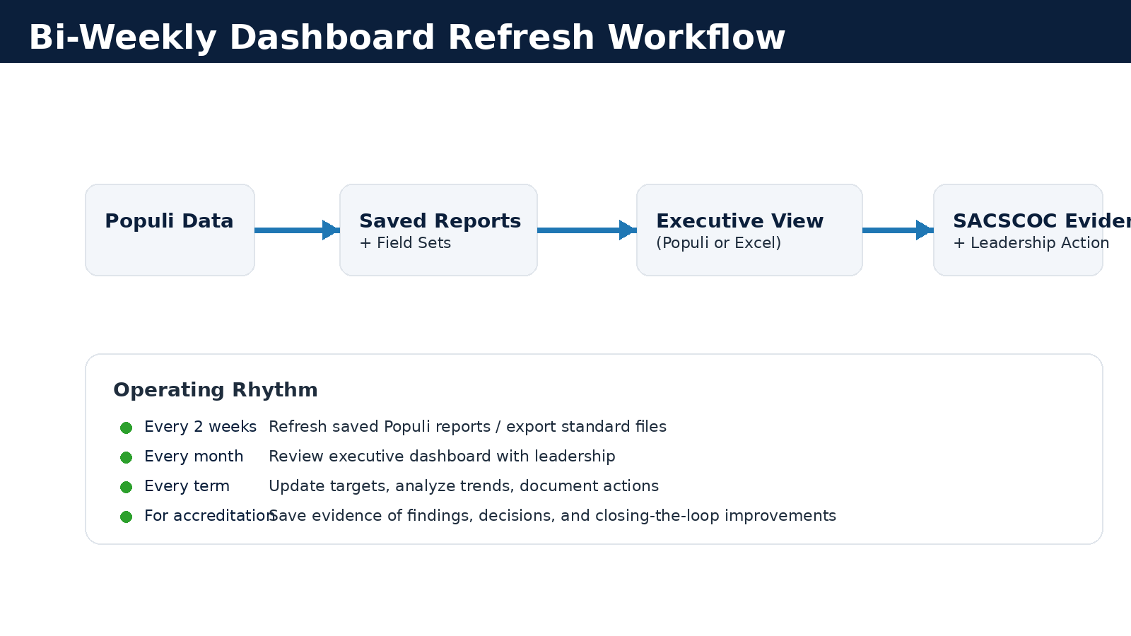
Proposed Bi-Weekly Workflow
Simple now, more automated later if needed
Phase 1: saved Populi reports + bi-weekly refresh | Phase 2: API/automation only if necessary
Turner Theological Seminary • Dashboard Planning
12
Notes:
Explain that this workflow keeps the project manageable and avoids overbuilding.

Slide 13
Suggested Next Steps After the Meeting
Translate guidance into a build plan
Within 1 Week
Within 2–3 Weeks
By End of Term
Confirm Populi reporting path
Identify exact saved reports
Confirm required fields
Set permissions
Test bi-weekly refresh
Validate numbers
Add survey-to-goal mapping
Prepare executive summary view
Establish trend baseline
Add targets/status
Document findings and actions
Decide if automation is needed
Turner Theological Seminary • Dashboard Planning
13
Notes:
Close with a practical timeline and next steps.

Slide 14
Reference Sources Used for Planning
Official Populi resources consulted while drafting this guide
Populi Data Slicer
Saved reports, columns, aggregate graphs/tables, export XLS/CSV, and export aggregate PDF.
Populi Analytics / Preset Reports
Compare terms, term series, term range, preset reports, and exports.
Populi API / Webhooks
Useful for later automation discussions if saved reports are not enough.
Use this slide only if asked where the assumptions came from. The meeting should focus on the liaison’s implementation guidance.
Turner Theological Seminary • Dashboard Planning
14
Notes:
Backup slide only.

