Slide 1
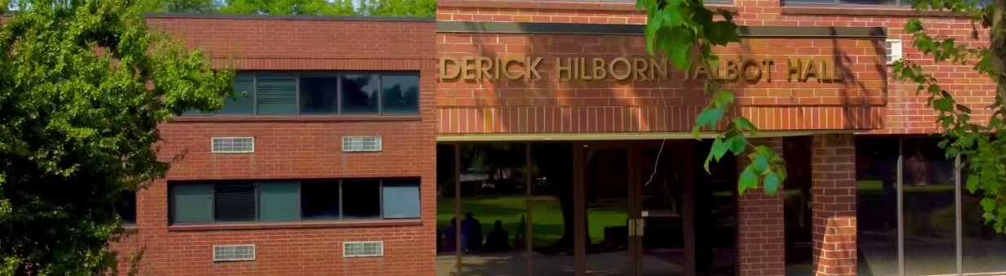

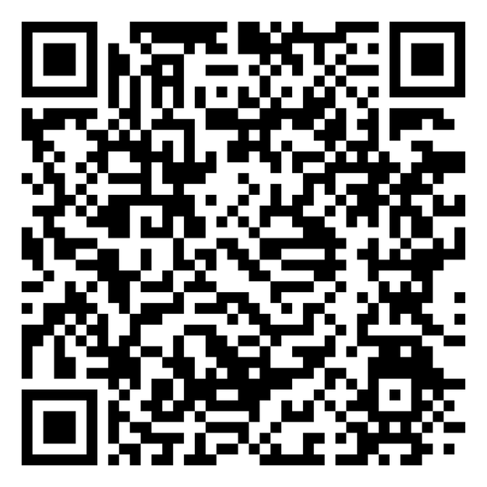

5-YEAR OPERATING BUDGET
DONATE TODAY
Office of Business & Finance · April 2026
THE 1894 LEGACY IMPACT CAMPAIGN
| FOR A PREPARED MINISTRY

Slide 2

BUDGET ARCHITECTURE
1
TAB 1 — SUMMARY
4
TAB 4 & 5 — EXPENSES
TRACS-facing face — no plug figures — same structure accreditors have seen
Personnel + LOC interest + operations · 3% COLA applied automatically
2
TAB 2 — ASSUMPTIONS
5
TAB 6 — HOUSING SCENARIOS
Only tab where numbers are entered — all other tabs pull from here
75% base case vs 100% full occupancy — side-by-side with variance
3
TAB 3 — REVENUE DETAIL
Tuition build · Housing model · AME support · Title IV impact timeline

Slide 3
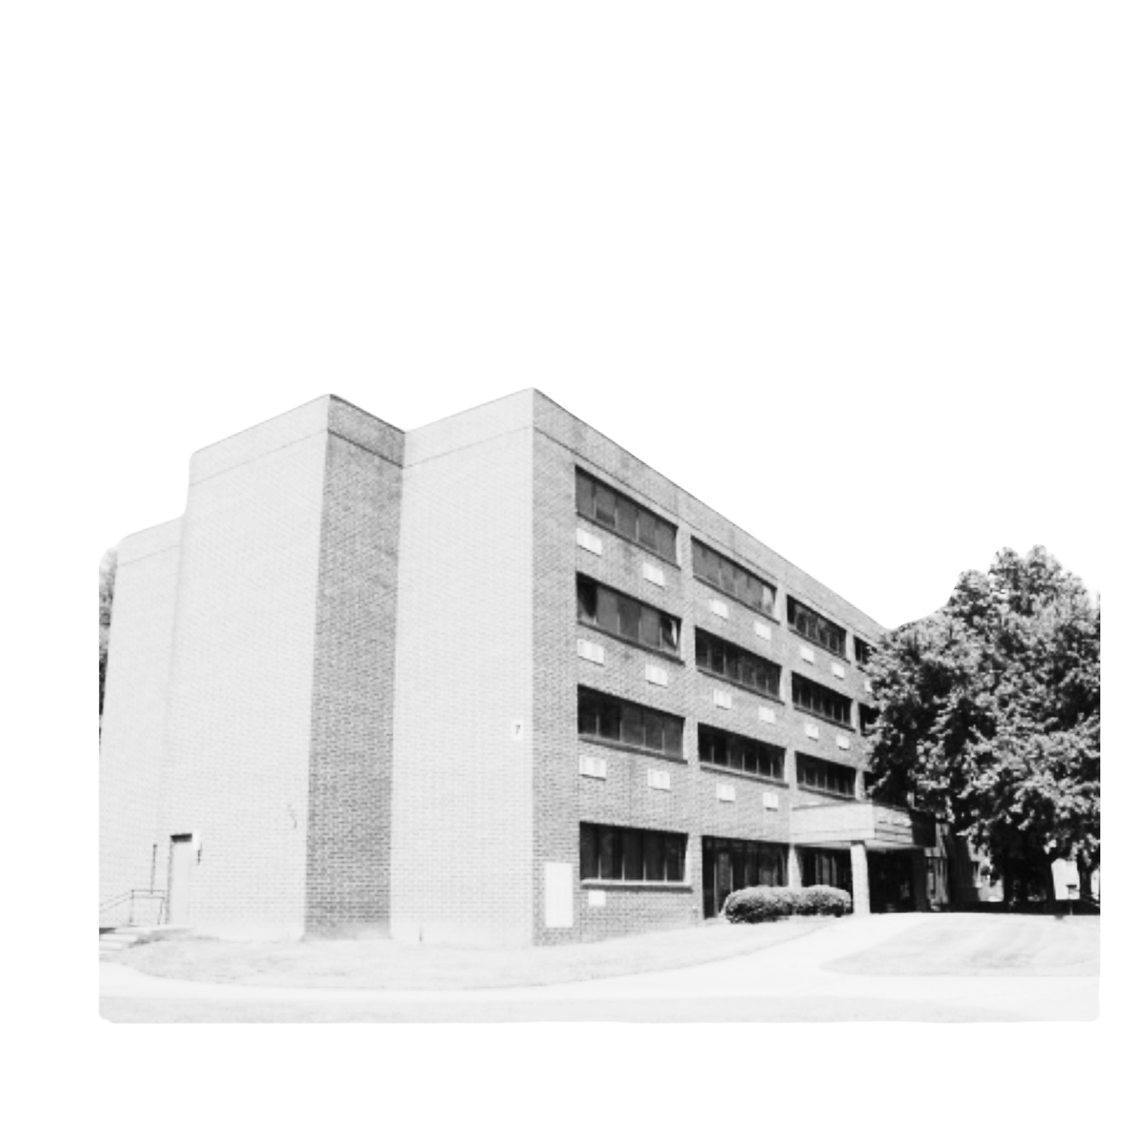
5-YEAR SUMMARY
FY2026: Revenue $2,566K → Net Surplus $229K (Spelman final year)
FY2027: Revenue $2,441K → Net Surplus $71K (Housing cliff — self-managed begins)
FY2028: Revenue $2,854K → Net Surplus $153K (Title IV begins — inflection point)
FY2029: Revenue $3,093K → Net Surplus $243K (Stabilizing)
FY2031: Revenue $3,574K → Net Surplus $544K (Sustainable surplus)

Slide 4
THE FY2027 CLIFF
Spelman MOU final year: FY2026 auxiliary revenue $1,287,354
Self-managed at 75% occupancy: FY2027 auxiliary revenue $830,376
Revenue drop of $457K in Year 1 of self-management — managed, not hidden
+5% occupancy/year recovery: 75% → 80% → 85% → 90% → 95% by FY2031
Budget is built to show this honestly — not to paper over the transition

Slide 5
KEY ASSUMPTIONS
1
ENROLLMENT
4
EXPENSES
MDiv: 34 students FY2026 → 85 by FY2031 · Title IV assumed Spring 2027
3% COLA on non-personnel · LOC interest $73,665/yr declining with paydown
2
HOUSING
5
MILESTONES
75% base occupancy FY2027 · +5%/year to 95% · A.T.I. $65,800 confirmed
Title IV Spring 2027 · LOC paydown FY2028 · SACSCOC ≥1.5 by FY2028
3
AID REFORM
Aid rate: 95% → 40% as federal aid replaces institutional scholarships

Slide 6
COMPOSITE SCORE RECOVERY PATH
FY2025: 0.6 (Audit result — isolated, not trending)
FY2026: 1.2 (Recovery year — FY2026 surplus restores trajectory)
FY2027: 0.9 (Housing cliff year — temporary dip)
FY2028: 1.5 (Title IV inflection — target reached)
FY2029: 1.8 (Stabilizing — above threshold)
FY2031: 2.4 (Sustainable — well above DOE requirement)

Slide 7
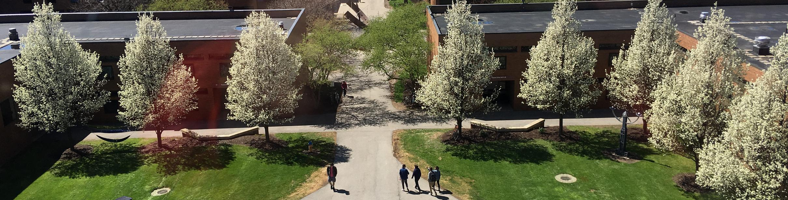


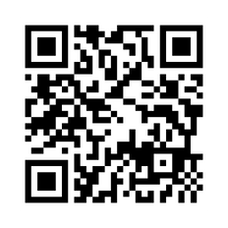



Thoughts & Clarifying Questions
(404) 527-0080
turnerseminary.org
aneal@turnerseminary.org
702 Martin Luther King Jr. Dr. SW,
Atlanta, GA 30314

