Slide 1


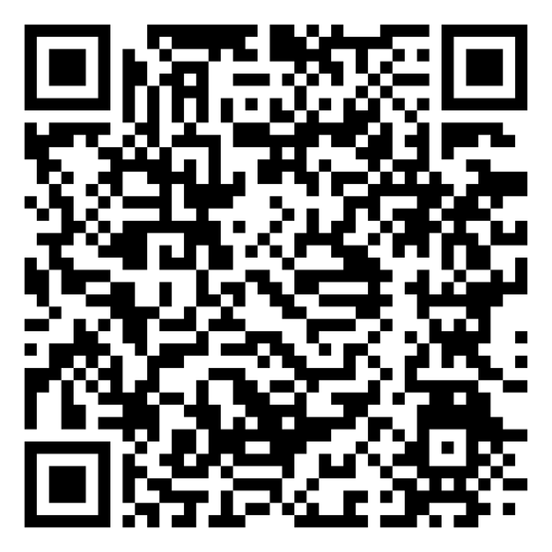

FY2025 AUDIT REPORT SUMMARY
DONATE TODAY
Wesley Peachtree Group, CPAs · Issued: March 2, 2026
THE 1894 LEGACY IMPACT CAMPAIGN
| FOR A PREPARED MINISTRY

Slide 2

AUDITOR'S OPINION
1
OPINION TYPE
4
TITLE IV
UNQUALIFIED (CLEAN) OPINION — FY2025 and FY2024
PPA submitted March 20, 2026 — Pending USDE approval anticipated Spring 2027
2
NO GOING CONCERN
5
AUDIT PERIOD
Financial statements present fairly in all material respects per US GAAP
July 1, 2024 – June 30, 2025 · Conyers, Georgia
3
TRACS CONFIRMED
TRACS Candidacy confirmed in audit notes — USDE recognition confirmed

Slide 3
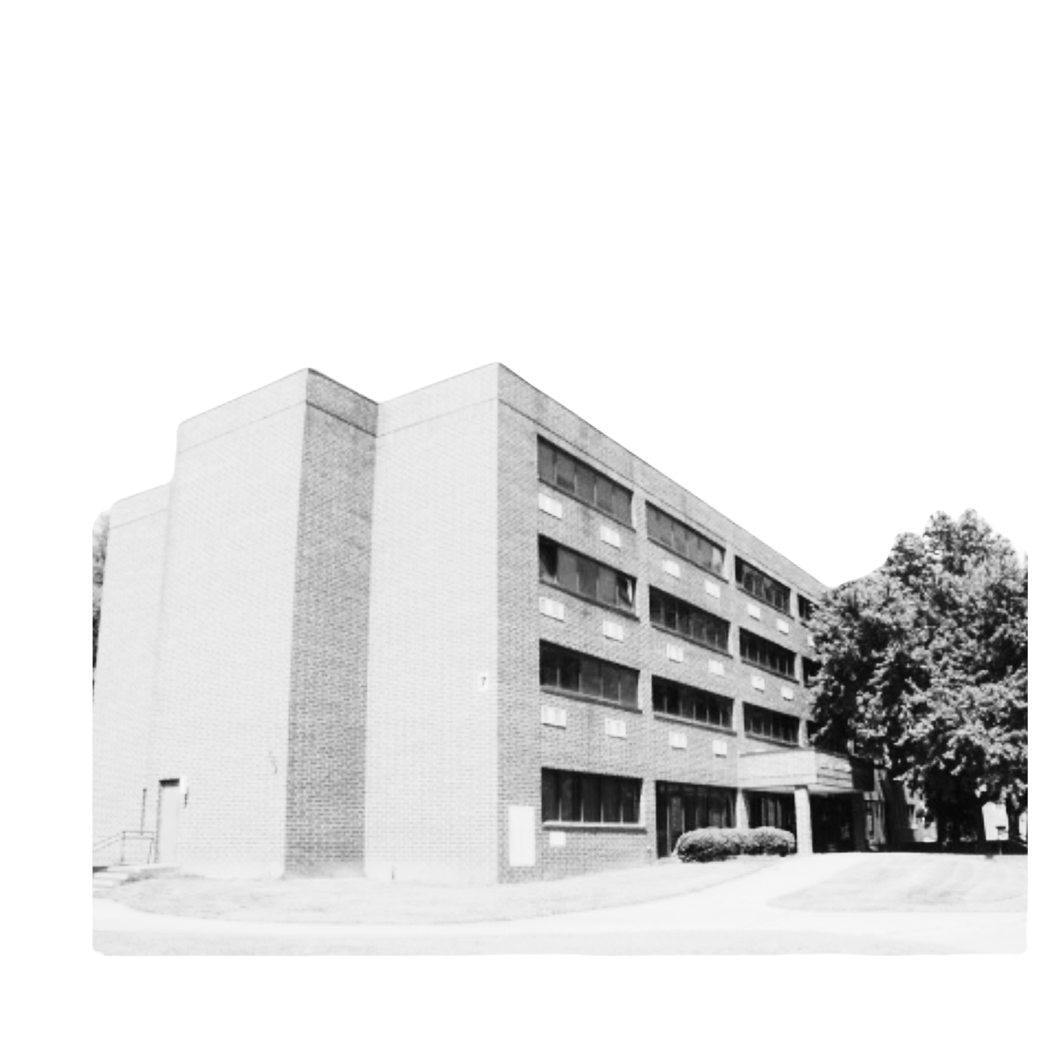
STATEMENT OF FINANCIAL POSITION
Total Assets: $1,890,851 (up from $1,728,487 in FY2024)
Total Net Assets: $866,041 (down from $967,667 — FY2025 deficit of $101,626)
Cash & Equivalents: $127,330 (down from $341,566 — see cash bridge)
Line of Credit: $866,645 at 8.5% (new September 2024 — Pinnacle Financial Partners)
Property & Equipment (Net): $1,334,204 (up $322K — Talbot Hall improvements)

Slide 4
DEPRECIATION BRIDGE
Aaron's Principle: Depreciation is non-cash. True result is positive.
Reported Net Deficit: ($101,626)
+ Depreciation Add-Back (Non-Cash): + $115,617
= Cash-Adjusted Operating Result: + $13,991 ✓
Cash decrease $214,236 = Spelman timing ($621K) + Capex ($438K) + LOC proceeds ($867K)

Slide 5
FUNCTIONAL EXPENSES — FY2025
Total Expenses FY2025: $2,075,549 (up 47% — driven by capital investment)
Salaries and Wages: $921,279 (44% of total expenses)
Depreciation (NON-CASH): $115,617 — adds back to produce cash-positive result
Accreditation Fees: $112,143 — full institutional commitment demonstrated
Interest Expense: $41,940 — LOC servicing at 8.5%

Slide 6
SACSCOC CONTEXT
1
COMPOSITE SCORE
4
FY2026 ON TRACK
FY2022: 0.9 → FY2023: 1.4 → FY2024: 1.7 (peak) → FY2025: 0.6
$287K net income YTD through February 2026. Corrective actions executing.
2
AUDIT SUPPORTS PETITION
5
TITLE IV UPSIDE
Clean audit opinion provides the strongest evidence for SACSCOC exception petition
Revenue expansion not yet reflected in FY2025 results — PPA submitted March 2026
3
PETITION FILED
Exception petition submitted March 31, 2026 — Dr. Stephen L. Pruitt, SACSCOC

Slide 7
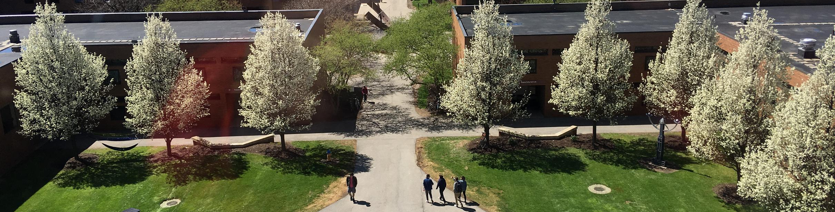


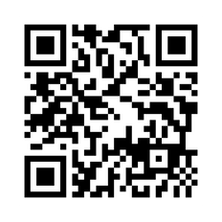



Thoughts & Clarifying Questions
(404) 527-0080
turnerseminary.org
aneal@turnerseminary.org
702 Martin Luther King Jr. Dr. SW,
Atlanta, GA 30314

