Slide 1


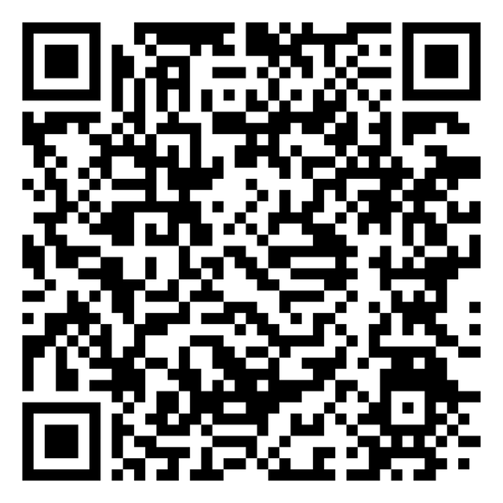

BOARD FINANCIAL REPORT
DONATE TODAY
Dr. Ammie L. Davis, President & CEO
THE 1894 LEGACY IMPACT CAMPAIGN
| FOR A PREPARED MINISTRY

Slide 2

FY2025 AUDIT RESULTS
1
AUDIT OPINION
4
TITLE IV STATUS
Unqualified (Clean) Opinion — Wesley Peachtree Group, CPAs — March 2, 2026
PPA submitted March 20, 2026 — Pending USDE approval — anticipated Spring 2027
2
NO GOING CONCERN
5
CASH POSITION
Financial statements present fairly in all material respects per US GAAP
FY2025 deficit ($101,626) resolves to +$13,991 after $115,617 non-cash depreciation
3
TRACS CANDIDACY
TRACS Candidacy confirmed in audit — USDE recognition confirmed

Slide 3
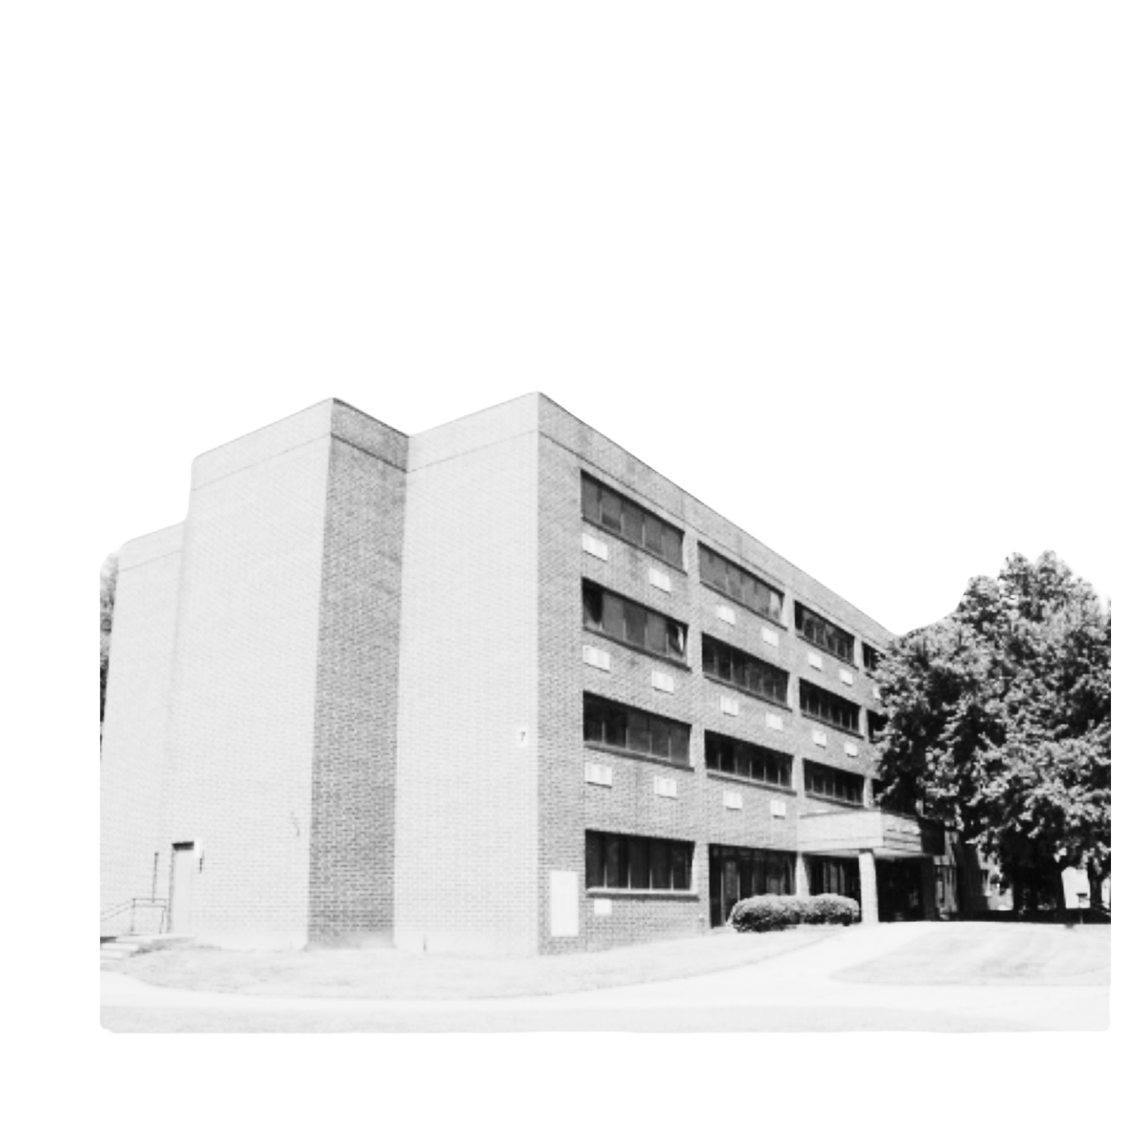
DEPRECIATION BRIDGE
The FY2025 reported deficit includes $115,617 in depreciation — a non-cash charge.
Reported Net Deficit: ($101,626)
+ Depreciation Add-Back: + $115,617
= Cash-Adjusted Result: + $13,991 ✓ Cash-Positive
Cash decrease of $214,236 = Spelman timing ($621K) + Capex ($438K) + LOC proceeds ($867K)

Slide 4
FY2026 YEAR-TO-DATE
1
TOTAL REVENUE
4
LINE OF CREDIT
$1,782,964 (July 2025 – February 2026 · 8 months)
$899,102 outstanding at 8.5% — ~$76,000 annual interest — Matures Aug 2027
2
NET INCOME
5
BOARD GIVING
$287,116 including investment gains
$27,785 received of $100,000 FY2026 commitment (41.7%)
3
HOUSING REVENUE
$1,163,154 — $337,251 above budget (+41%)

Slide 5
RISK FLAGS — BOARD ACTION
CRITICAL — LOC: $899,102 at 8.5% = 50% of YTD revenue. Paydown plan required at this meeting.
CRITICAL — Aid Rate: 95.4% of gross tuition. Net tuition only $86,720 on $790K gross.
HIGH — Board Giving: 41.7% of YTD target. Full participation required before June 30.
HIGH — Housing: Fall 2026 at 44% occupancy. World Cup window closing — decision needed.
MONITOR — SACSCOC: Petition filed March 31. Council response expected Q2 2026.

Slide 6
SACSCOC CORRECTIVE PLAN
1
COMMITMENT 1
4
COMMITMENT 4
Contractor and payroll reductions in FY2026 — IMPLEMENTED
Scholarship award limits being formalized for Fall 2026 — IN PROCESS
2
COMMITMENT 2
5
COMMITMENTS 5 & 6
Strengthened advancement and enrollment strategies — IN PROGRESS
Enrollment initiatives active; Active Board oversight confirmed and documented
3
COMMITMENT 3
Executive Director of Institutional Advancement engaged — HIRED

Slide 7
RECOMMENDATIONS FOR BOARD ACTION
1. Present LOC paydown schedule at this meeting
2. Full Board giving participation before June 30
3. Adopt formal scholarship limits before Fall 2026 enrollment
4. Confirm execution of all 6 SACSCOC petition commitments
5. Execute World Cup housing agreement before May 15
6. Assign Title IV tracking champion — monthly status to Board
7. Board approval required: 6 financial policies (Petty Cash, Cash Handling, EFT, etc.)

Slide 8
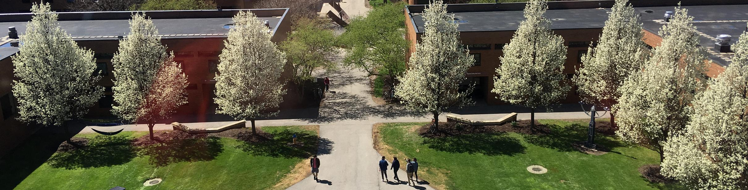


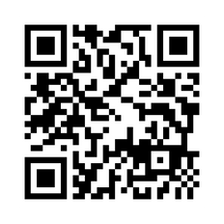



Thoughts & Clarifying Questions
(404) 527-0080
turnerseminary.org
aneal@turnerseminary.org
702 Martin Luther King Jr. Dr. SW,
Atlanta, GA 30314

