Slide 1
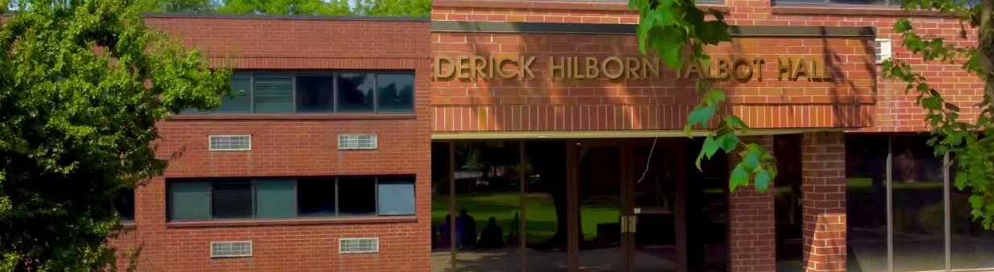

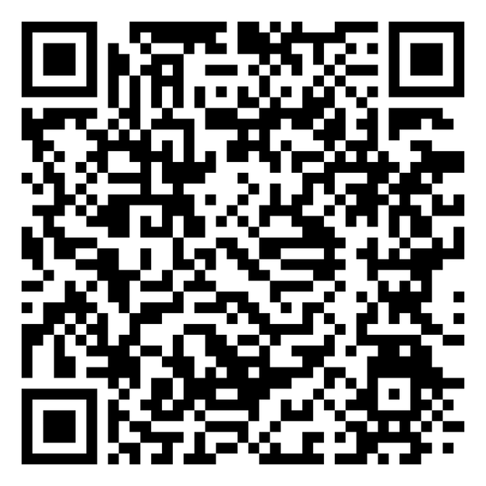

TALBOT HALL HOUSING TRANSITION
DONATE TODAY
Office of Business & Finance
THE 1894 LEGACY IMPACT CAMPAIGN
| FOR A PREPARED MINISTRY

Slide 2

TRANSITION OVERVIEW
1
SPELMAN MOU
4
CONFIRMED REVENUE
FY2022–FY2026 — $1,280,440/year ($640,220/installment) — Final year FY2026
Fall 2026: $148,000 + A.T.I. Summer: $65,800 = $213,800 combined
2
SELF-MANAGED
5
BUILDING STATUS
Fall 2026 forward — Direct leasing, corporate housing, event-driven revenue
Clears May 15 · Reloads Aug 10 · $437K capital investment complete
3
RATES SET
Pvt Eff $8K · Shd Eff $7K · Pvt Dorm $6K · Shd Dorm $5K (per semester)

Slide 3
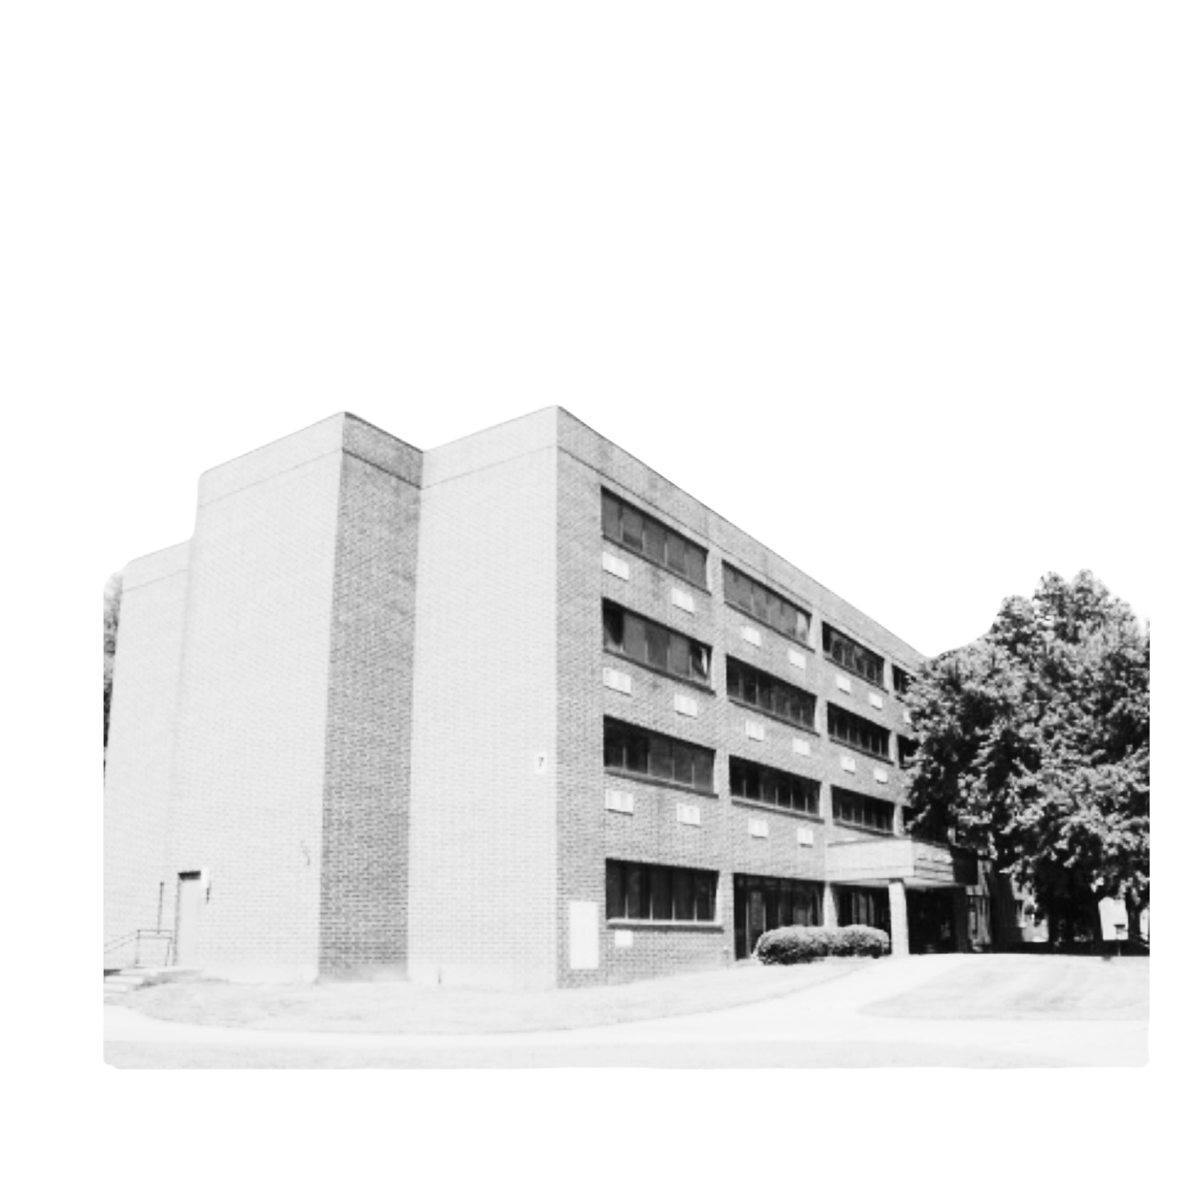
FALL 2026 OCCUPANCY
Current status: 44% occupied (20 of 48 rooms confirmed — Spelman students)
Private Efficiency: $8,000/sem · 7 of 8 occupied · Revenue: $56,000
Shared Efficiency: $7,000/sem · 2 of 10 occupied · Revenue: $14,000
Private Dorm: $6,000/sem · 10 of 10 occupied · Revenue: $60,000
Shared Dorm: $5,000/sem · 1 of 20 occupied · Revenue: $5,000

Slide 4
A.T.I. SUMMER AGREEMENT — SIGNED
AUCC Center for Excellence in Public & Government Space · Dr. Anika A. Evans
11 shared dorm rooms (June 1 – July 6, 2026): $52,800
2 private efficiency units: $8,000
Jacob's Conference Room (19 days): $5,000
Amenities: Waived · TOTAL CONTRACT VALUE: $65,800

Slide 5
WORLD CUP OPPORTUNITY
FIFA World Cup Atlanta 2026 — Window: May 15 – August 10 (87 days)
Exclusive facility lease target: $275,000 – $450,000
Prospectus prepared and sent to Dan Corso / Atlanta Sports Council
Contact: Dan Corso · asc@macoc.com
Decision required before May 15 — building available and renovated

Slide 6
HOUSING RECOMMENDATIONS
1. Execute World Cup housing agreement before May 15
2. Aggressive outreach for 28 remaining Fall 2026 vacant rooms
3. COI from A.T.I. required before June 1 — follow up immediately
4. Build corporate housing pipeline for Summer 2027
5. Target: 75% occupancy ($360K/semester) in FY2027 model

Slide 7
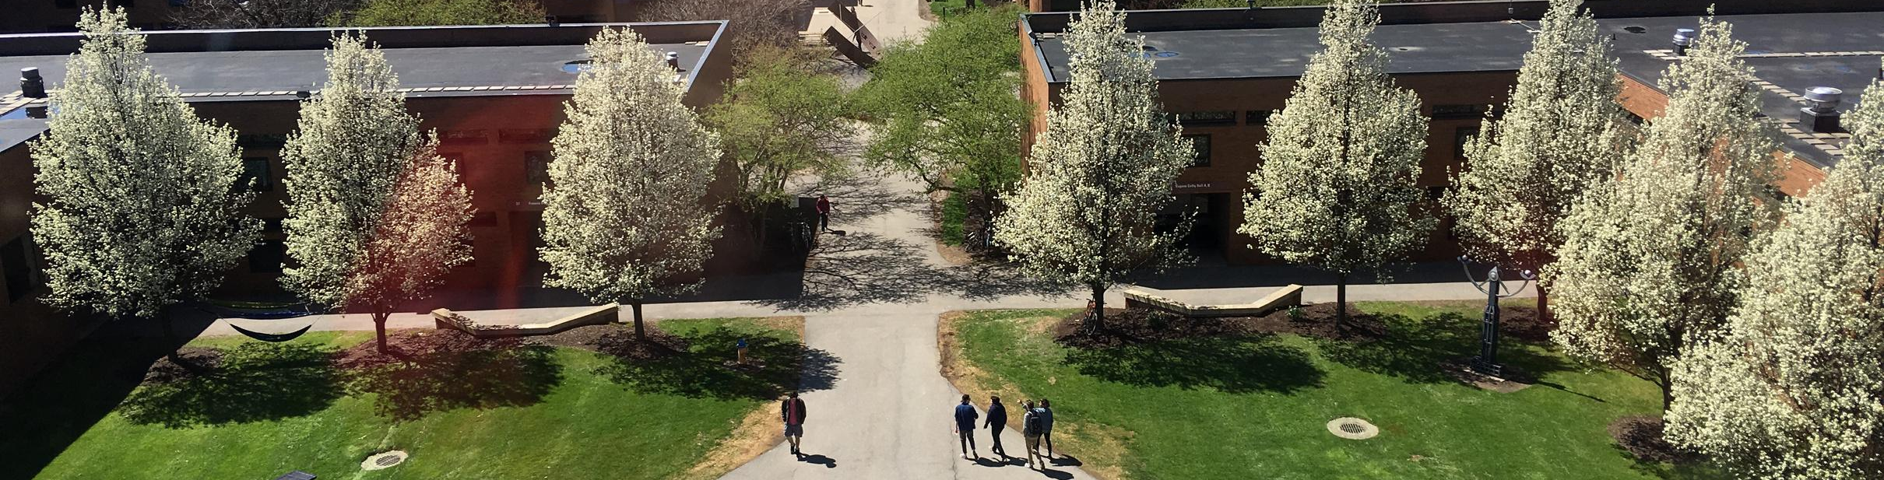


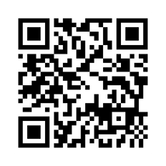



Thoughts & Clarifying Questions
(404) 527-0080
turnerseminary.org
aneal@turnerseminary.org
702 Martin Luther King Jr. Dr. SW,
Atlanta, GA 30314

