Slide 1
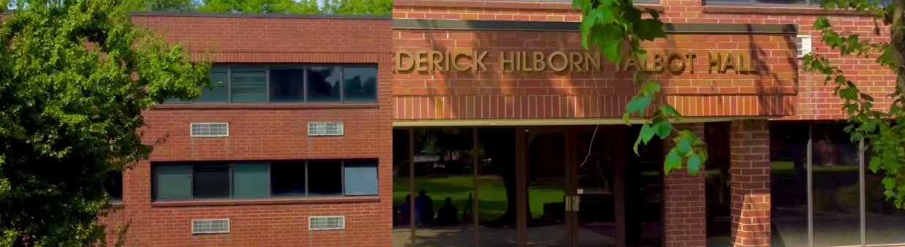

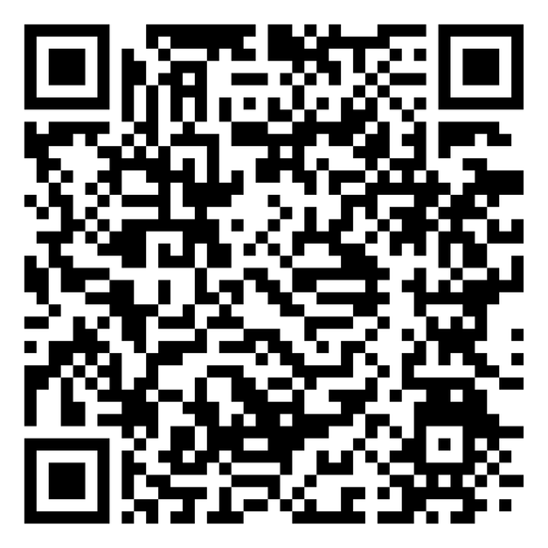

STATE OF THE INSTITUTION
DONATE TODAY
Historic in Legacy. New in Vision.
THE 1894 LEGACY IMPACT CAMPAIGN
| FOR A PREPARED MINISTRY

Slide 2

EXECUTIVE OVERVIEW
1
FY2026 NET INCOME
4
NET ASSETS
$287,116 YTD through February 2026 (July 2025 – February 2026)
$866,041 total net assets at June 30, 2025
2
HOUSING REVENUE
5
TRACS + TITLE IV
$1,163,154 YTD — $337,251 above budget (+41%)
TRACS Candidacy confirmed · Title IV PPA submitted March 20, 2026
3
AUDIT RESULT
Unqualified Opinion FY2025 · Cash-adjusted result: +$13,991

Slide 3
FIVE STRATEGIC GOALS
1
GOAL 1
4
GOAL 4
7
GOAL 7
Educate men and women for leadership in Christ’s Church and the world.
Provide a critique, informed by the perspectives of African American and other global interpretations of Western, male-dominated theological education.
Ensure that the learning, working, and living environment is healthy, safe, and secure through strong administrative practices.
2
GOAL 2
8
GOAL 8
5
GOAL 5
Demonstrate academic excellence in teaching and research.
Develop and sustain partnerships that enhance the education of students, provide opportunities for community service, and foster interreligious dialogue.
Encourage scholarly research and publications related to African and the Diaspora African religious experience, the African American Church, and the church universal.
3
GOAL 3
Attract, support, and retain qualified students capable of fulfilling the mission of the institution, who will foster and advocate diversity; promote integrity and competence in Christian leadership; and encourage justice, reconciliation, liberation, and peace.
6
GOAL 6
9
GOAL 9
Attract, develop, and retain competent faculty, staff, and administrators.
Maintain fiscal stability and to strengthen the financial vitality of Turner Theological Seminary.

Slide 4
GOALS STATUS SUMMARY
1
GOAL 1 — ENROLLMENT
4
GOAL 4 — FUNDING
IN PROGRESS — MDiv $708K YTD (200% of budget) · Aid reform underway
STRONG / ACTION REQUIRED — Housing above budget · Board giving 41.7%
2
GOAL 2 — ACADEMICS
5
GOAL 5 — HUMAN RESOURCES
ON TRACK — TRACS confirmed · Lilly Endowment $10M awarded
ON TRACK — ED of Advancement hired · HR reductions implemented
3
GOAL 3 — ACCREDITATION
ADVANCING — SACSCOC petition filed · ATS self-study in progress

Slide 5
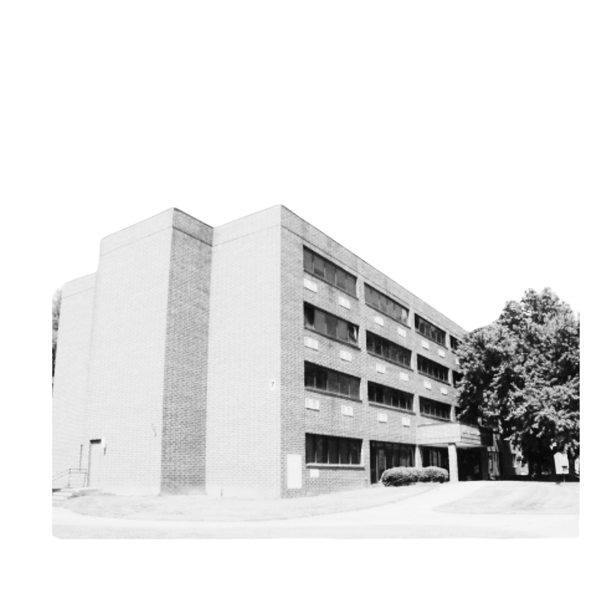
GOALS 1 & 2 DETAIL
Goal 1 — Enrollment: MDiv gross tuition $708,380 YTD vs $353K annual budget (200%)
Institutional aid at 95.4% of gross — scholarship limits being formalized for Fall 2026
Title IV PPA submitted March 20, 2026 — Federal aid access transforms enrollment model
Goal 2 — Academic Excellence: TRACS Candidacy confirmed in independent audit
Lilly Endowment Collaborative Shared Services Grant ($10M) awarded · ATS self-study active

Slide 6
GOALS 3, 4 & 5 DETAIL
Goal 3 — Accreditation: SACSCOC petition March 31 · GNPEC renewal active · ATS on schedule
Goal 4 — Funding: Housing $337K above budget · Endowment $405K (10% growth) · Lilly $10M
A.T.I. Summer confirmed $65,800 · FIFA World Cup window active May 15 – Aug 10
Goal 5 — HR: Executive Director of Advancement hired · Major gift cultivation program active
Board giving at 41.7% of $100K commitment — direct engagement required before June 30

Slide 7
SACSCOC CORRECTIVE PLAN
1
GOAL 1
4
GOAL 4
7
GOAL 7
Educate men and women for leadership in Christ’s Church and the world.
Provide a critique, informed by the perspectives of African American and other global interpretations of Western, male-dominated theological education.
Ensure that the learning, working, and living environment is healthy, safe, and secure through strong administrative practices.
2
GOAL 2
8
GOAL 8
5
GOAL 5
Demonstrate academic excellence in teaching and research.
Develop and sustain partnerships that enhance the education of students, provide opportunities for community service, and foster interreligious dialogue.
Encourage scholarly research and publications related to African and the Diaspora African religious experience, the African American Church, and the church universal.
3
GOAL 3
Attract, support, and retain qualified students capable of fulfilling the mission of the institution, who will foster and advocate diversity; promote integrity and competence in Christian leadership; and encourage justice, reconciliation, liberation, and peace.
6
GOAL 6
9
GOAL 9
Attract, develop, and retain competent faculty, staff, and administrators.
Maintain fiscal stability and to strengthen the financial vitality of Turner Theological Seminary.

Slide 8
COMMITMENTS TO SACSCOC
1
COMMITMENT 1
4
COMMITMENT 4
Reduction in contractor and payroll expenses in FY2026 — IMPLEMENTED
Scholarship award limits before Fall 2026 — IN PROCESS
2
COMMITMENT 2
5
COMMITMENTS 5 & 6
Strengthened advancement and enrollment strategies — IN PROGRESS
Enrollment initiatives active · Active Board oversight documented and confirmed
3
COMMITMENT 3
Executive Director of Institutional Advancement — HIRED

Slide 9
LOOKING AHEAD — PRIORITIES
Title IV: Active USDE engagement — upon approval, implement aid infrastructure
Aid Reform: Finalize scholarship limits before Fall 2026 — operational imperative
LOC Management: Paydown schedule to Finance Committee — reduce before June 30
World Cup Revenue: Execute Talbot Hall lease before May 15 — time-limited opportunity
Endowment: 10-11% growth trajectory — targeting $1M by December 2026

Slide 10
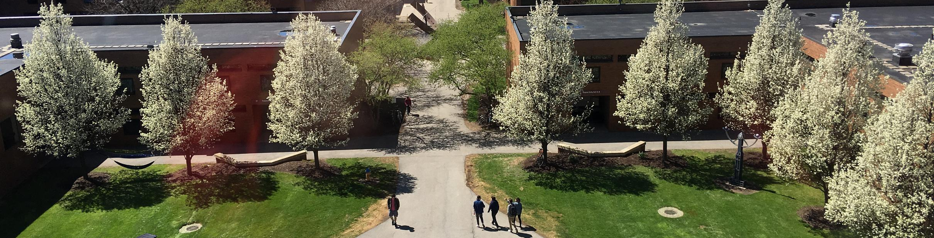


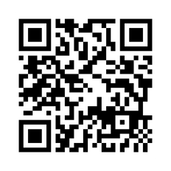



Thoughts & Clarifying Questions
(404) 527-0080
turnerseminary.org
aneal@turnerseminary.org
702 Martin Luther King Jr. Dr. SW,
Atlanta, GA 30314

