Slide 1
nervousnet
Re-engineering

Slide 2

nervousnet
The Ecosystem
Community
Development
Products | Applications
Tools
Maintenance
Visualization
New Features
Status Checking
Data Analytics
Forums
Internal
Surveys
IoT devices
White-label
Tutorials
Blogs
External

Slide 3
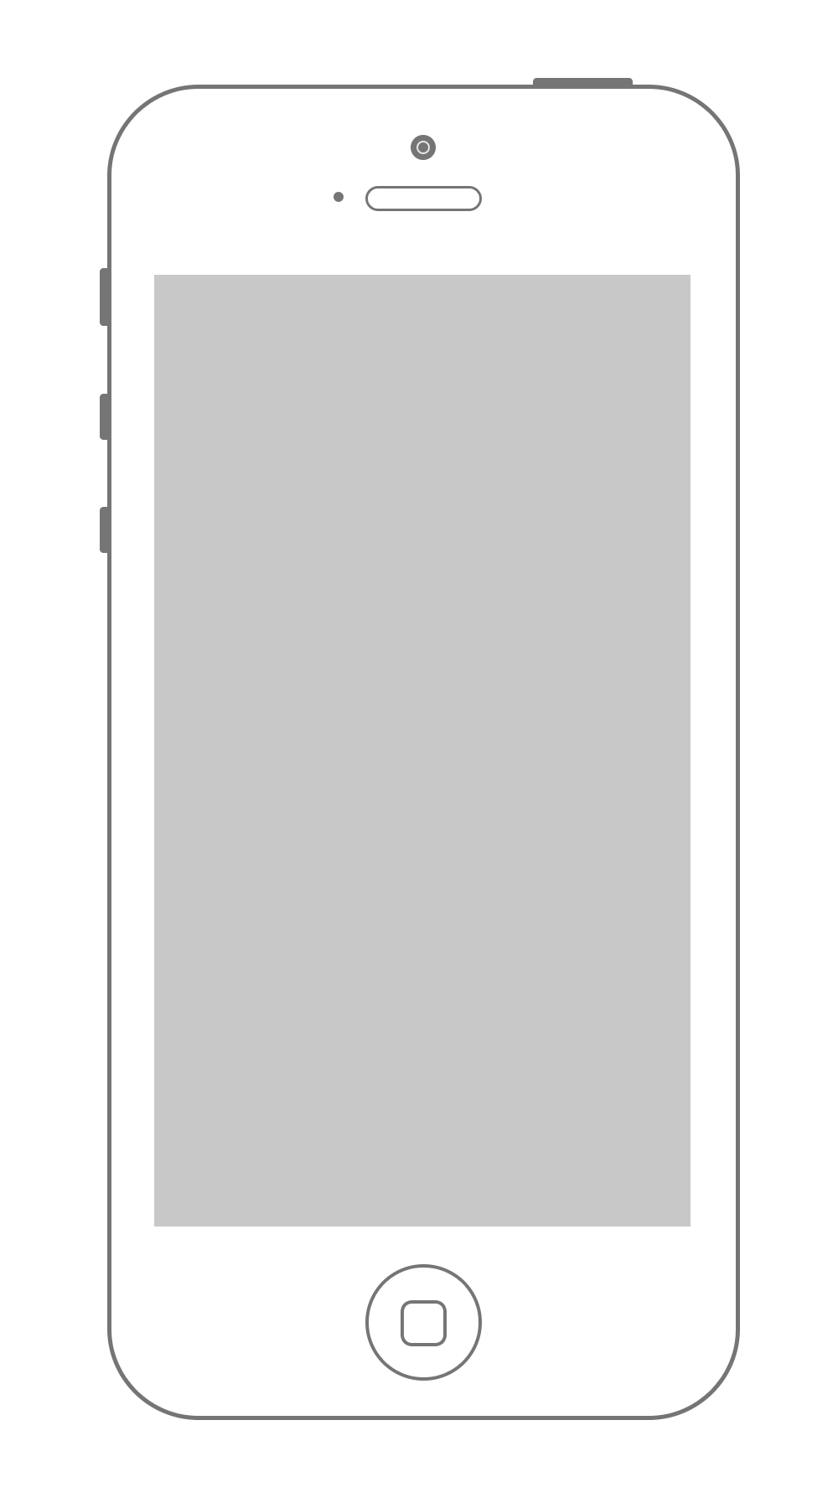

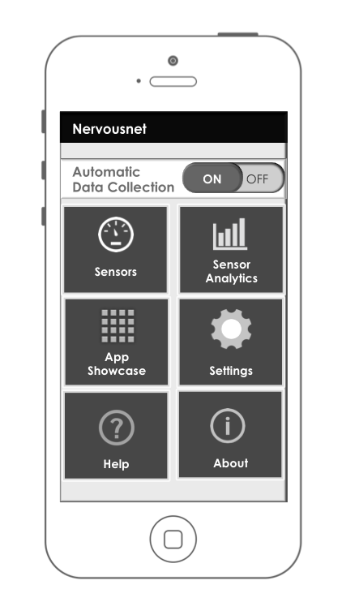

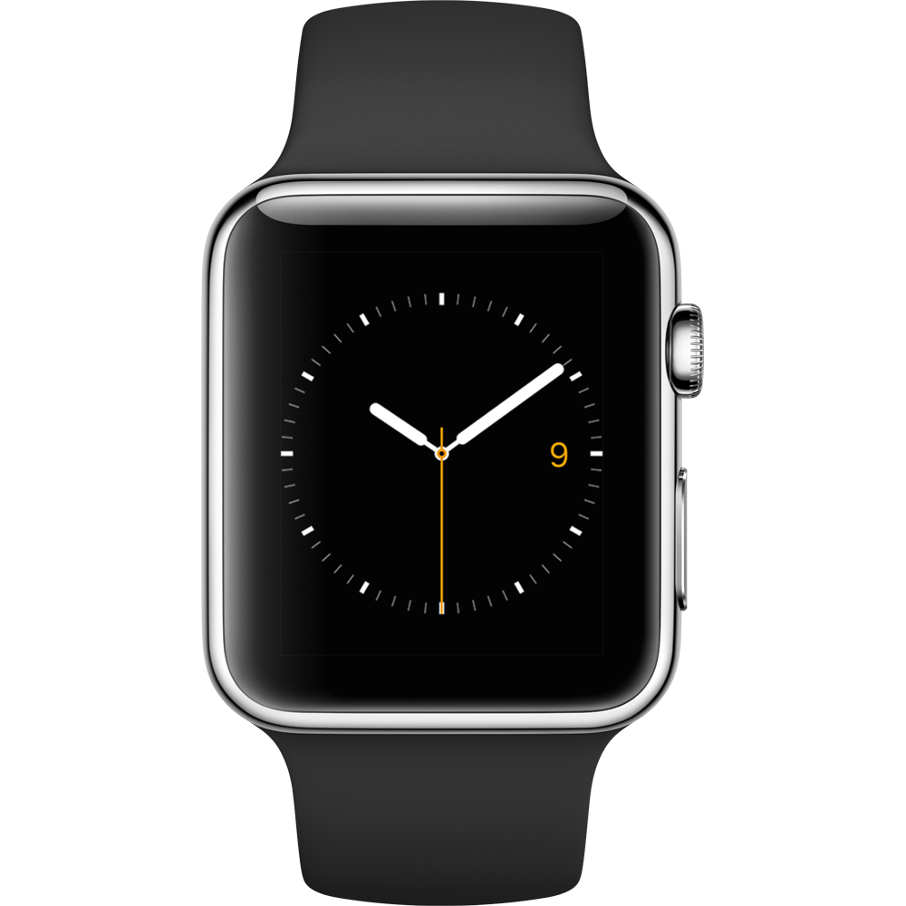

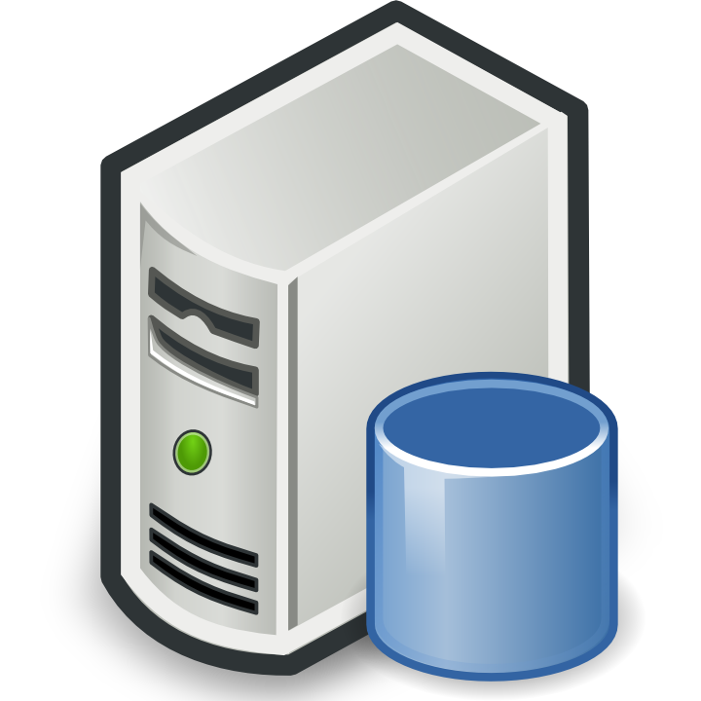




nervousnet
The Platform
Extensions
Or
Axons
Analyze
HUB
IOT
devices
Visualize
Nervousnet CORE
( Distributed Servers )
Partner
platforms
Utilize

Slide 4
nervousnet HUB
Proposed architecture for re-engineering
Background Services
WebView
API’s
Third party applications / Extensions
Third party applications / Axons
App Manager
WebView Controller
Local Analytical Engine
Controller
Storage Engine
nervousnet Proxy / Server
SSL
nervousnet VM
nervousnet Mobile App

Slide 5
nervousnet HUB
Mobile Application
nervousnet Applications
Allowing Third party developers to extend and use nervousnet API’s to use within their own Applications.
Such applications are dependent and requires the installation of nervousnet Core Application.
Ways to achieve this:
WebViews: Applications using WebViews run within webview component. Application modules are created using Html and JavaScript and not as independent applications rather run inside the webview component of the nervousnet core application. This approach also requires the creation of an external App Store which allows the developers to submit, update, theirs apps. Implementation will be complex and restricts the type of apps developers can create.
Background Services (Android): Native and supports all required functionality. Only possible in Android. Will not work with iOS as it does not allow to keep apps running in the background.
App groups (iOS): iOS 8 allows for Communicating and persisting data between apps with App Groups. We need to investigate this further to see if we can work with this. (this works only for iOS apps released from the same developer)
Background Services
WebView
Third party applications
App Manager
WebView Controller
Local Analytical Engine
Controller
Storage Engine
nervousnet VM
nervousnet Mobile App

Slide 6
nervousnet HUB Controller
What it does?
Controls the flow of the application.
Manages various components and other features of the application
Android & iOS
First option is to Replace Protobuf with a JSON implementation wherever required
Protobuf replacement will effect the Server and Storage Engine.
Second Option is to keep the Protobuf implementation, but document the implementation and required files, so any new changes can be easily implemented.
Background Services
WebView
Third party applications
App Manager
WebView Controller
Local Analytical Engine
Controller
Storage Engine
nervousnet VM
nervousnet Mobile App

Slide 7
HUB Storage Engine
Android
Replace local file storage with Sql Lite.
iOS
No changes required
Background Services
WebView
Third party applications
App Manager
WebView Controller
Local Analytical Engine
Controller
Storage Engine
nervousnet VM
nervousnet Mobile App

Slide 8
HUB Local Analytical Engine
What it does?
Implements functions that allows for analyzing the sensor data collectively stored on the local device.
These analytical functions or API’s will be used by the WebView’s and Background Services to request information.
Android & iOS
No changes to be done.
Further features and functionalities to be implemented
Background Services
WebView
Third party applications
App Manager
WebView Controller
Local Analytical Engine
Controller
Storage Engine
nervousnet VM
nervousnet Mobile App

Slide 9
HUB App Manager & Store
What it does?
Manages list of nervousnet Apps that are installed within the local installation instance.
Allows the user to browse through the list of available apps and install whatever is required.
High complexity, similar to a scaled down version of app store, but running within the nervousnet app.
Keeps track of which module is installed on a device.
Android & iOS
New feature to be built.
Use Webview to allows users to browse and install apps.
Background Services
WebView
Third party applications
App Manager
WebView Controller
Local Analytical Engine
Controller
Storage Engine
nervousnet VM
nervousnet Mobile App

Slide 10
HUB WebView Controller
What it does?
Allows for external applications running within a WebView to communicate with the LAE and request for content and data.
Android & iOS
Completely new feature.
Define the protocol required for communication between the WebView apps and the LAE
Background Services
WebView
Third party applications
App Manager
WebView Controller
Local Analytical Engine
Controller
Storage Engine
nervousnet VM
nervousnet Mobile App

Slide 11
TLS / SSL
Secure transmission of data from mobile client to Server.
Steps:
Generate key on the server using KeyTool.
Send key to CA authority for signing
Configure server to use HTTPS
Replace code to use https connections from the client
Background Services
WebView
Third party applications
App Manager
WebView Controller
Local Analytical Engine
Controller
Storage Engine
nervousnet Proxy / Server
SSL
nervousnet VM
nervousnet Mobile App

Slide 12
nervousnet HUB
Mobile App – Why would users download it?
Utility
Extensions
Visualize Sensor Readings
View Sensor Analytics
View nervousnet Extension Apps
*******
Applications depending upon the nervousnet App
Every time an extension app is started it checks if the “HUB” app is installed and running. If not, prompts to download it.
e.g. SwarmPulse, nervousnet Competition app, Falling walls treasure hunt app and more external developer apps.
nervousnet
HUB

Slide 13




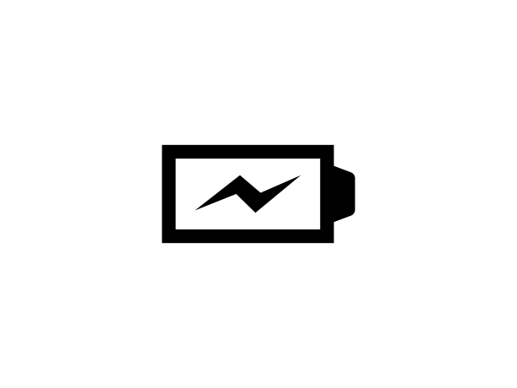





nervousnet HUB
Mobile App UI Wireframes
nervousnet
Sensors
Accelerometer
App Showcase
Automatic
Data Collection
Accelerometer
Light
ON
OFF
Sensors
Sensor Analytics
Sound
Battery
App Showcase
Settings
Proximity
Temperature
Help
About
Home Screen
Sensors Main Screen
Accelerometer Reading

Slide 14

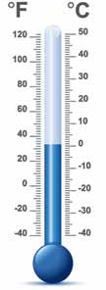
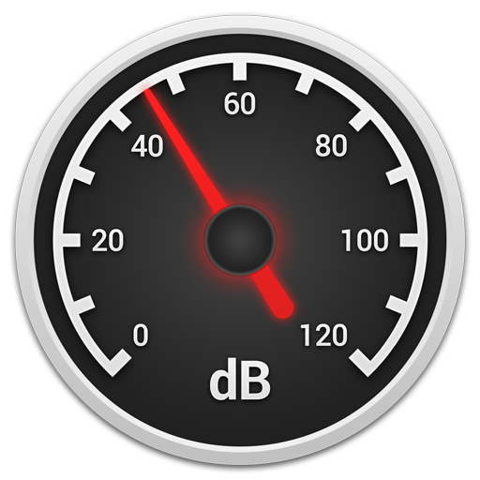
nervousnet HUB
Mobile App UI Wireframes
Light Sensor
Sound Sensor
Temperature
560
luxes
46
dB
Light Reading Screen
Sound Reading Screen
Temperature Reading Screen

Slide 15

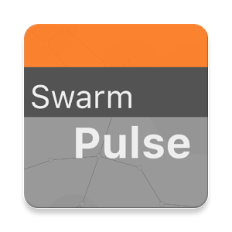


nervousnet HUB
Mobile App UI Wireframes
App Showcase
App Showcase
Sensor Analytics
App Showcase
App Showcase
Select a sensor:
Accelerometer
Battery
Gyroscope
Magnetic
Pressure
Proximity
Temperature
SwarmPulse
nervousnet
Competition
The SwarmPulse service allows for collective visualization and sharing of mobile sensor data, text messages, media files and more.
The "SwarmPulse" service is built on top of the nervousnet research platform, a large-scale distributed research platform that provides real-time social sensing services as a public good. Existing Big Data
SwarmPulse
Time-Range
Plot
Real-time
Plot
Download from App Store
Sensor Analytics Screen
App Showcase List Screen
App Showcase Details Screen

Slide 16
nervousnet HUB
Mobile App UI Wireframes
nervousnet
Automatic
Data Collection
ON
OFF
Sensors
Sensor Analytics
Home Screen
0
App Showcase
Settings
Help
About

Slide 17
nervousnet HUB
Mobile App UI Wireframes
Sensors
Accelerometer
Light Sensor
Accelerometer
Light
560
lux
Sensors Main Screen
0-1
Sound
Battery
Proximity
Temperature
Sound Sensor
Temperature
46 dB

Slide 18
nervousnet HUB
Mobile App UI Wireframes
Sensor Analytics
Select a sensor:
Accelerometer
Battery
Gyroscope
Magnetic
Pressure
Proximity
Temperature
Sensor Analytics Screen
0-2
Time-Range
Plot
Real-time
Plot

Slide 19
nervousnet HUB
Mobile App UI Wireframes
App Showcase
App Showcase
nervousnet
Competition
App Showcase
SwarmPulse
App Showcase Screen
0-3
The SwarmPulse service allows for collective visualization and sharing of mobile sensor data, text messages, media files and more.
The "SwarmPulse" service is built on top of research platform, a
SwarmPulse

Slide 20
nervousnet HUB
Mobile App UI Wireframes
Settings
Sensor Settings
App Showcase
App Showcase
Data Retention:
(Store Shared Data on Server)
Retain data for:
Log
Share
Delay
(secs)
ON
OFF
Accelerometer
☑
☑
10
Battery
☑
☑
30
Settings Screen
0-4
1 day
Beacons
☐
☐
-
Connectivity
☑
☑
30
Sensor Settings
Save

Slide 21
nervousnet HUB
Mobile App UI Wireframes
Help
App Showcase
Help Screen
0-5

Slide 22
nervousnet HUB
Mobile App UI Wireframes
About
nervousNet HUB
v 0.0.1 – beta
www.nervousnet.info
About Screen
0-6

Slide 23
nervousnet HUB
Mobile App UI Wireframes
Light Sensor
Sound Sensor
Temperature
560
luxes
46
dB
Light Reading Screen
Sound Reading Screen
Temperature Reading Screen

Slide 24
nervousnet HUB
Mobile App UI Wireframes
App Showcase
App Showcase
App Showcase
App Showcase
SwarmPulse
nervousnet
Competition
The SwarmPulse service allows for collective visualization and sharing of mobile sensor data, text messages, media files and more.
The "SwarmPulse" service is built on top of the nervousnet research platform, a large-scale distributed research platform that provides real-time social sensing services as a public good. Existing Big Data
SwarmPulse
Download from App Store
App Showcase List Screen
App Showcase Details Screen

Slide 25
nervousnet
Targeting Users
nervousnet
Team
*
COSS
Team
*
ETH Zurich
*
External Users
*

