Slide 1
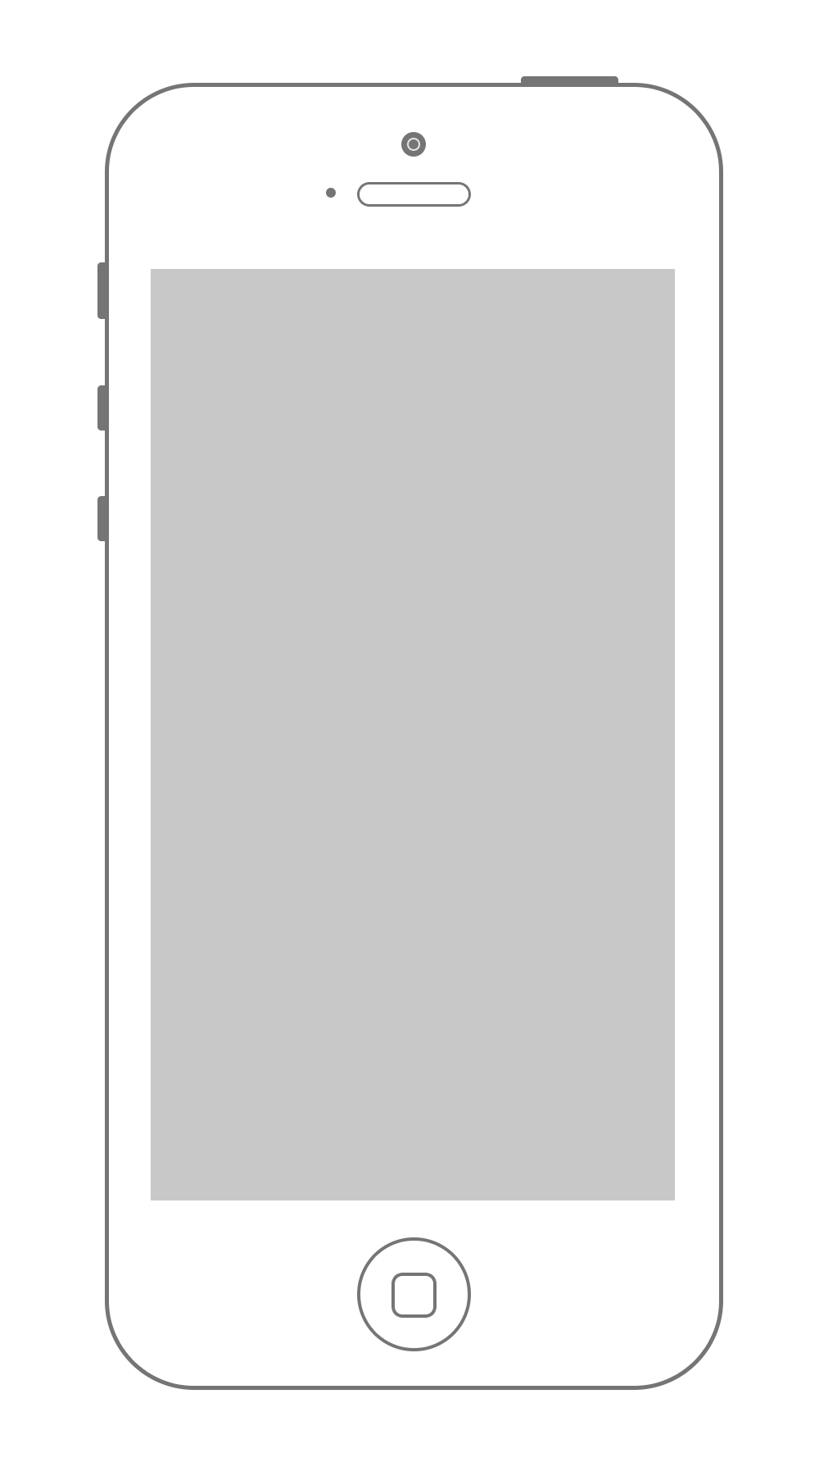




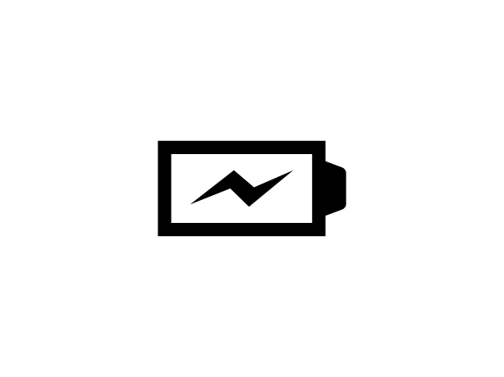





nervousnet HUB
Mobile App UI Wireframes
nervousnet
Sensors
Accelerometer
App Showcase
Automatic
Data Collection
Accelerometer
Light
ON
OFF
Sensors
Sensor Analytics
Sound
Battery
App Showcase
Settings
Proximity
Temperature
Help
About
Home Screen
Sensors Main Screen
Accelerometer Reading

Slide 2

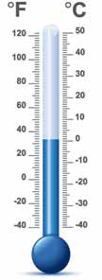
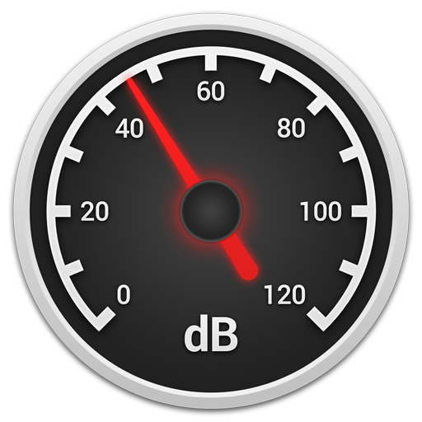
nervousnet HUB
Mobile App UI Wireframes
Light Sensor
Sound Sensor
Temperature
560
luxes
46
dB
Light Reading Screen
Sound Reading Screen
Temperature Reading Screen

Slide 3

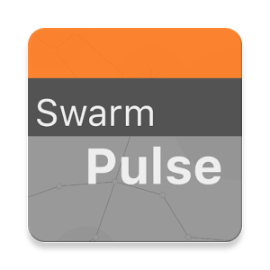


nervousnet HUB
Mobile App UI Wireframes
App Showcase
App Showcase
Sensor Analytics
App Showcase
App Showcase
Select a sensor:
Accelerometer
Battery
Gyroscope
Magnetic
Pressure
Proximity
Temperature
SwarmPulse
nervousnet
Competition
The SwarmPulse service allows for collective visualization and sharing of mobile sensor data, text messages, media files and more.
The "SwarmPulse" service is built on top of the nervousnet research platform, a large-scale distributed research platform that provides real-time social sensing services as a public good. Existing Big Data
SwarmPulse
Time-Range
Plot
Real-time
Plot
Download from App Store
Sensor Analytics Screen
App Showcase List Screen
App Showcase Details Screen

Slide 4
nervousnet HUB
Mobile App UI Wireframes
nervousnet
Automatic
Data Collection
ON
OFF
Sensors
Sensor Analytics
Home Screen
0
App Showcase
Settings
Help
About

Slide 5
nervousnet HUB
Mobile App UI Wireframes
Sensors
Accelerometer
Light Sensor
Accelerometer
Light
560
lux
Sensors Main Screen
0-1
Sound
Battery
Proximity
Temperature
Sound Sensor
Temperature
46 dB

Slide 6
nervousnet HUB
Mobile App UI Wireframes
Sensor Analytics
Select a sensor:
Accelerometer
Battery
Gyroscope
Magnetic
Pressure
Proximity
Temperature
Sensor Analytics Screen
0-2
Time-Range
Plot
Real-time
Plot

Slide 7
nervousnet HUB
Mobile App UI Wireframes
App Showcase
App Showcase
nervousnet
Competition
App Showcase
SwarmPulse
App Showcase Screen
0-3
The SwarmPulse service allows for collective visualization and sharing of mobile sensor data, text messages, media files and more.
The "SwarmPulse" service is built on top of research platform, a
SwarmPulse

Slide 8
nervousnet HUB
Mobile App UI Wireframes
Settings
Sensor Settings
App Showcase
App Showcase
Data Retention:
(Store Shared Data on Server)
Retain data for:
Log
Share
Delay
(secs)
ON
OFF
Accelerometer
☑
☑
10
Battery
☑
☑
30
Settings Screen
0-4
1 day
Beacons
☐
☐
-
Connectivity
☑
☑
30
Sensor Settings
Save

Slide 9
nervousnet HUB
Mobile App UI Wireframes
Help
App Showcase
Help Screen
0-5

Slide 10
nervousnet HUB
Mobile App UI Wireframes
About
nervousNet HUB
v 0.0.1 – beta
www.nervousnet.info
About Screen
0-6

Slide 11
nervousnet HUB
Mobile App UI Wireframes
Light Sensor
Sound Sensor
Temperature
560
luxes
46
dB
Light Reading Screen
Sound Reading Screen
Temperature Reading Screen

Slide 12
nervousnet HUB
Mobile App UI Wireframes
App Showcase
App Showcase
App Showcase
App Showcase
SwarmPulse
nervousnet
Competition
The SwarmPulse service allows for collective visualization and sharing of mobile sensor data, text messages, media files and more.
The "SwarmPulse" service is built on top of the nervousnet research platform, a large-scale distributed research platform that provides real-time social sensing services as a public good. Existing Big Data
SwarmPulse
TreasureHunt
Download from App Store
App Showcase List Screen
App Showcase Details Screen

