Slide 1
nervousnet
An Overview
Author: ppulikal@ethz.ch

Slide 2

nervousnet
The Ecosystem
Community
Development
Products | Applications
Tools
Maintenance
Visualization
New Features
Status Checking
Data Analytics
Forums
Surveys
IoT Sensors
Mobile Applications
Tutorials
Blogs

Slide 3
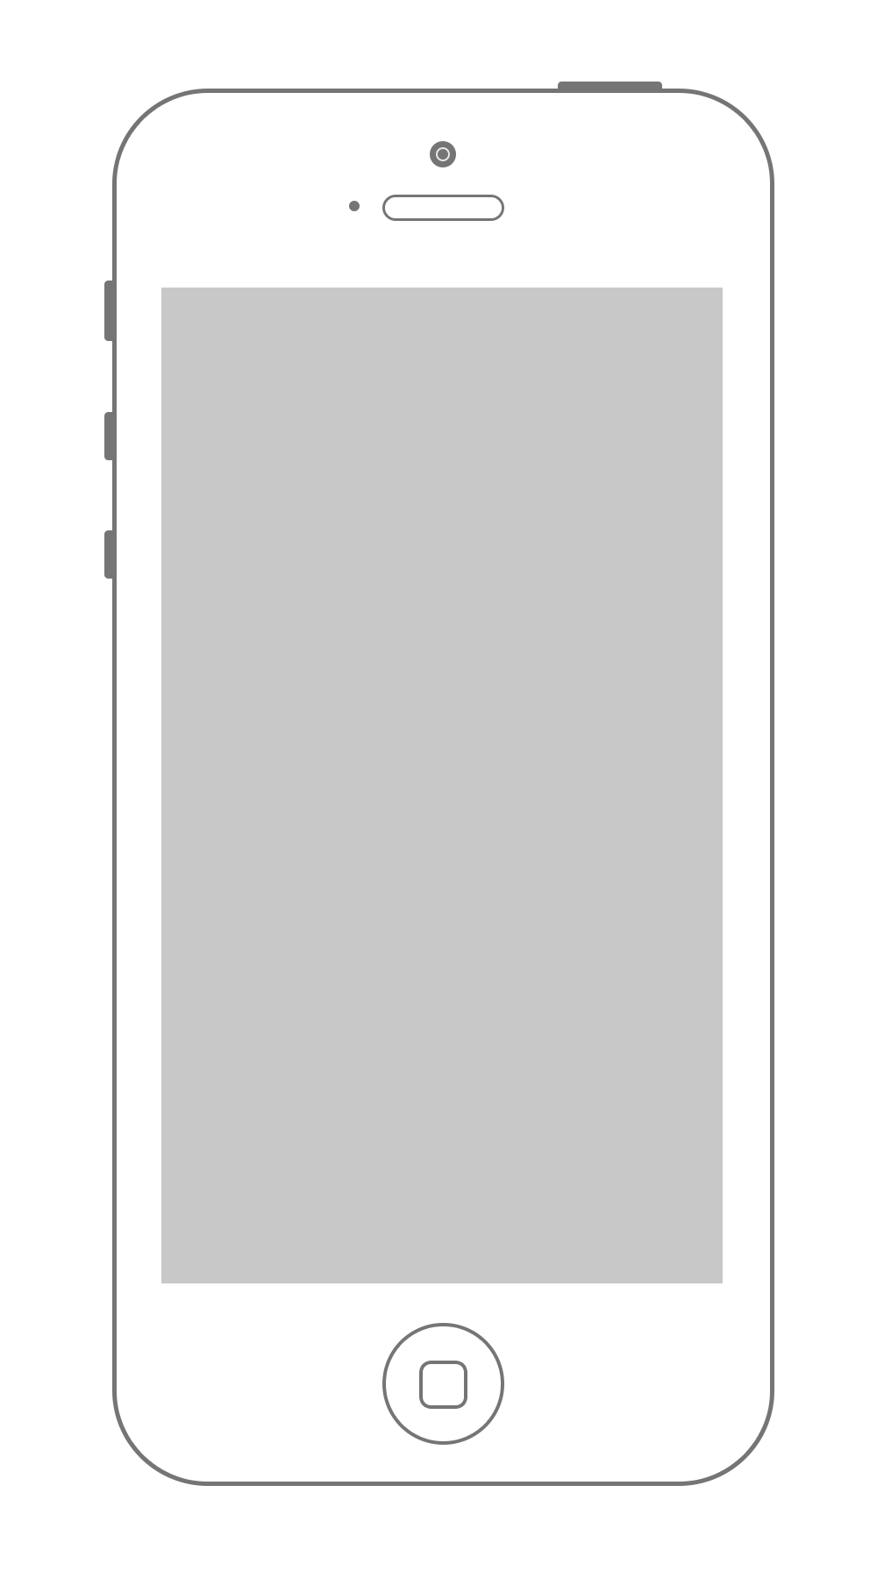

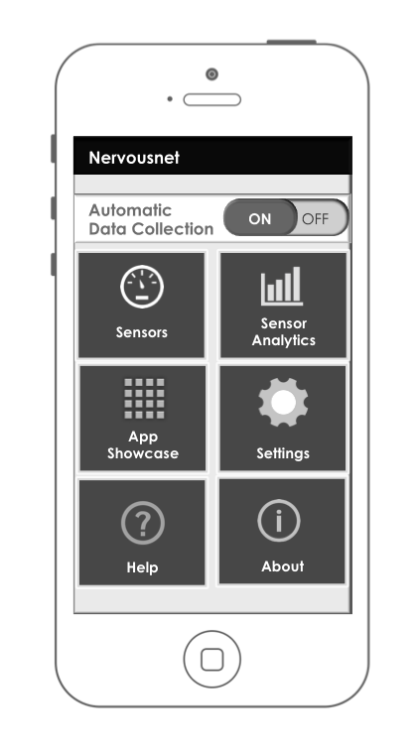

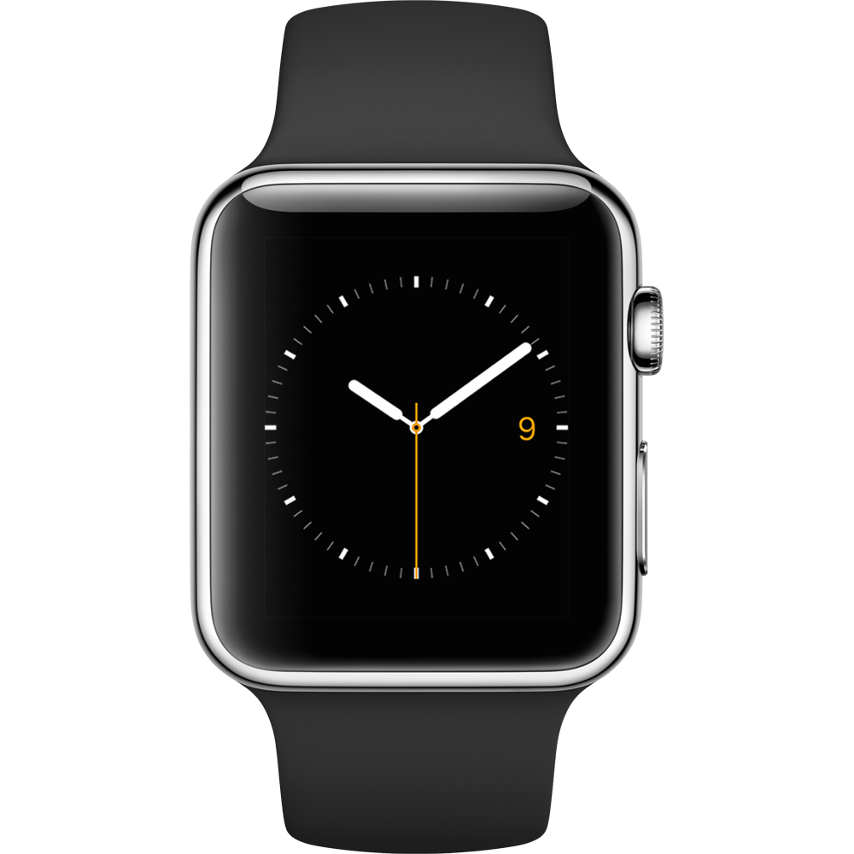





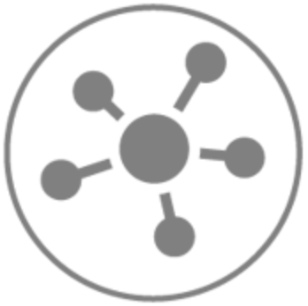
nervousnet
The Platform
Extensions
Or
Axons
Analyze
HUB
IOT
devices
Visualize
Nervousnet CORE
( Distributed Servers )
Partner
Platforms
Utilize

Slide 4

nervousnet HUB
Mobile Application Architecture
Third party applications / Axons
Extensions
Background Services (Android)
WebView
External Applications
API’s
WebView Server
Authentication Engine
nervousnet HUB API Interface
Read API’s
Write API’s
Query API’s
V. Sensor Registration API’s
Local Analytics Engine (LAE)
SSL
Storage Engine
VM
nervousnet HUB
Database
Distributed Servers
Sensors
Mobile Phone Environment
Nervousnet CORE
( Distributed Servers )

