Slide 1
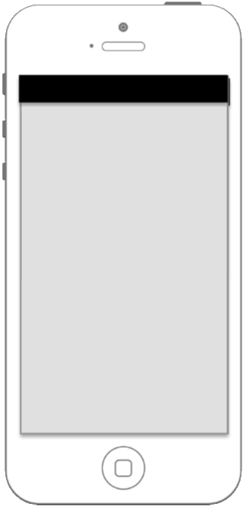


nervousnet
Data Collection
treasurehunt
Swarm Pulse
Sensor Analytics
nervousnet competition

Slide 2
nervousnet
Data Collection
treasurehunt
Swarm Pulse
Sensor Analytics
nervousnet competition

Slide 3




nervousnet
Data Collection
nervousnet space
Sensors
Settings
Help

Slide 4
nervousnet
Data Collection
nervousnet space
Sensors
Settings
Help

Slide 5

Sensors
<<< Noise >>>

Slide 6
Sensors
<<< Noise >>>
Accelerometer
Gyroscope
Light
Noise
Temperature
Gravity

Slide 7
Sensors
<<< Noise >>>

Slide 8





Sensors
Accelerometer
Light
Noise
Battery
Proximity
Temperature
Proximity
Proximity

Slide 9
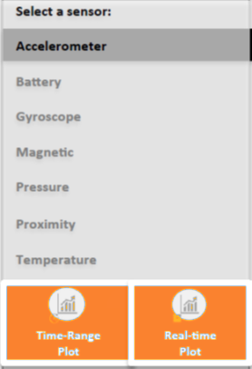
Sensor Analytics

Slide 10
More Apps

Slide 11


Help
Getting Started
FAQ
About

Slide 12



Settings
Collection Rate
Sharing Nodes
Sensor Permissions

Slide 13






Collection Rate
Accelerometer
high
Light Sensor
low
Proximity
low
Noise
Off
Battery
medium
Temperature
low

Slide 14
Collection Rate
Accelerometer
high
Light Sensor
low
Change Rate:
high
medium
Low
off
.
Proximity
low
Noise
Off
Cancel
OK
Battery
medium
Temperature
low

Slide 15
Sensor Permissions

Slide 16




Swarmpulse
Accelerometer
Light Sensor
Proximity
Temperature

Slide 17


Sharing Nodes
Home Server
nervousnet
Bob’s Server

Slide 18
Servers
Home Server
nervousnet
Add Server
Registered
Manual
.
Bob’s Server
Cancel
OK

Slide 19
Bob’s Server
Accelerometer
Light Sensor
Proximity
Noise
Battery
Temperature

