Slide 1
CBIS-DDSM
Dataset Exploration
Curated Breast Imaging Subset of DDSM
Lee et al., Scientific Data 2017 • Source: TCIA

Slide 2
What is CBIS-DDSM?
The Problem
The Solution
The Dataset
Most CAD research used private datasets — results couldn't be compared or reproduced across labs.
CBIS-DDSM is a standardized, publicly available mammography benchmark curated by Stanford researchers.
753 calcification cases + 891 mass cases. Full DICOM images, ROI masks, and clinical metadata.

Slide 3
Dataset Structure
1,318
378
1,546
326
Mass Train
Mass Test
Calc Train
Calc Test
abnormality rows
abnormality rows
abnormality rows
abnormality rows
Case vs Abnormality
One patient case can contain multiple abnormalities. Each row in the CSV = one abnormality, not one patient.
Example: Mass Train has ~748 cases (from Table 3 of the paper) but 1,318 rows — because each finding is photographed from CC and MLO views.
14 columns per row: patient_id • breast_density • left/right • image view • mass shape • mass margins • assessment • pathology • subtlety • image paths

Slide 4
Class Balance
Binary balance: Malignant (637) vs Benign (577) — fairly balanced. Good for binary classification.
Three-class imbalance: Benign_without_callback (104) is much smaller — a challenge for multi-class modeling.
Why it matters: A model trained on imbalanced data learns to predict the dominant class — 90% accuracy can still be clinically useless.
Mass Train Dataset — Pathology Distribution

Slide 5
Breast Density vs Pathology
D1
D2
D3
D4
1
Density 2 dominates (~580 cases) — mirrors real clinical population distribution.
Fatty
Scattered
Dense
Very dense
~290
~580
~340
~105
2
Malignant outnumbers benign at D1, D2, and D3. Reverses at D4 — extremely dense tissue makes malignant findings harder to confirm.
3
BENIGN_WITHOUT_CALLBACK shrinks with density — radiologists only assign no follow-up when tissue is clearly readable.

Slide 6
Missing Values
Mass Train
Calc Train
mass shape
calc type
4 missing
20 missing
Shape not recorded — negligible impact
Type not identified — small gap
mass margins
calc distribution
43 missing
376 missing ⚠️
Edges invisible in dense tissue — clinically meaningful
~25% of cases missing the most important calcification descriptor
Key insight: In medical datasets, missing values are never random. When a radiologist leaves a field blank, it usually means the feature was not visible — the missingness itself is clinically informative.

Slide 7
BI-RADS Assessment Distribution
BI-RADS 2 → almost entirely benign. BI-RADS 5 → almost entirely malignant. Radiologists are reliable at the extremes.
BI-RADS 4 is the gray zone — both benign and malignant high. This is where most unnecessary biopsies happen.
BI-RADS 0 still contains ~15 malignant cases. Cancer can hide even when radiologists can't make a call.
AI adds most value at BI-RADS 4 — reducing false positives and unnecessary biopsies.

Slide 8
Subtlety Distribution
What subtlety means
1 = very hard to see
5 = obvious to radiologist
Describes diagnostic difficulty of the finding.
Why it's skewed
Cases enter the dataset only after a radiologist notices them. Extremely subtle findings were never spotted — so they never get recorded.
Selection Bias
The dataset is weakest precisely where clinical need is strongest — subtle, easy-to-miss findings.

Slide 9
DICOM Image Exploration
4616 × 3016
16-bit
0 – 61,780
~14 MP
Image dimensions (px)
Pixel depth (uint16)
Pixel value range
Total pixels per image
Background dominance
Most pixels (~10M out of 14M) are pure black (value=0) — empty space outside the breast. Raw pixel statistics are misleading without masking the background.
16-bit depth matters
Standard photos use 8-bit (0–255). Medical images use 16-bit (0–65535) to preserve subtle tissue density differences invisible in 8-bit.
Preprocessing required
Models cannot use raw DICOM directly. Required steps: resize (4616×3016 → 224×224), normalize (0–65535 → 0–1), convert bit depth. ROI crops are essential.

Slide 10
Key Limitations
What CBIS-DDSM cannot tell us
01
Selection Bias
02
No Normal Cases
Only cases a radiologist already noticed are included. Subtle, missed findings are invisible to this dataset.
Every case contains an abnormality. A real screening population is mostly normal — model performance will differ in practice.
03
Missing Clinical Features
04
Scanned Film, Not Digital
calc_distribution is missing in ~25% of calcification cases — one of the most diagnostically important fields.
Images are digitized from film mammograms (pre-2000 technology), not modern full-field digital mammography.

Slide 11
MITI Lab
Week 2 — Progress Report
Breast Lesion Classification on CBIS-DDSM
01
Visual introduction — what do the 3 lesion classes look like?
02
CC + MLO dual-view — evidence for using both views
03
Data preparation & updated 3-class folder structure
04
PyRadiomics – feature extraction, next steps

Slide 12
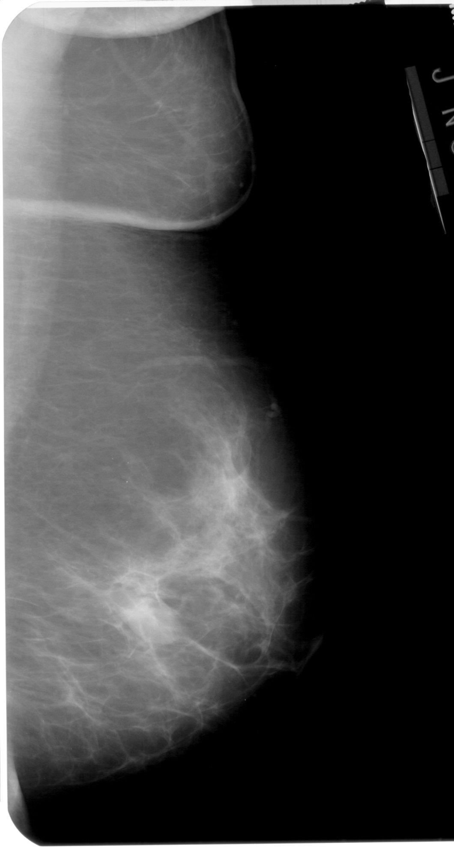
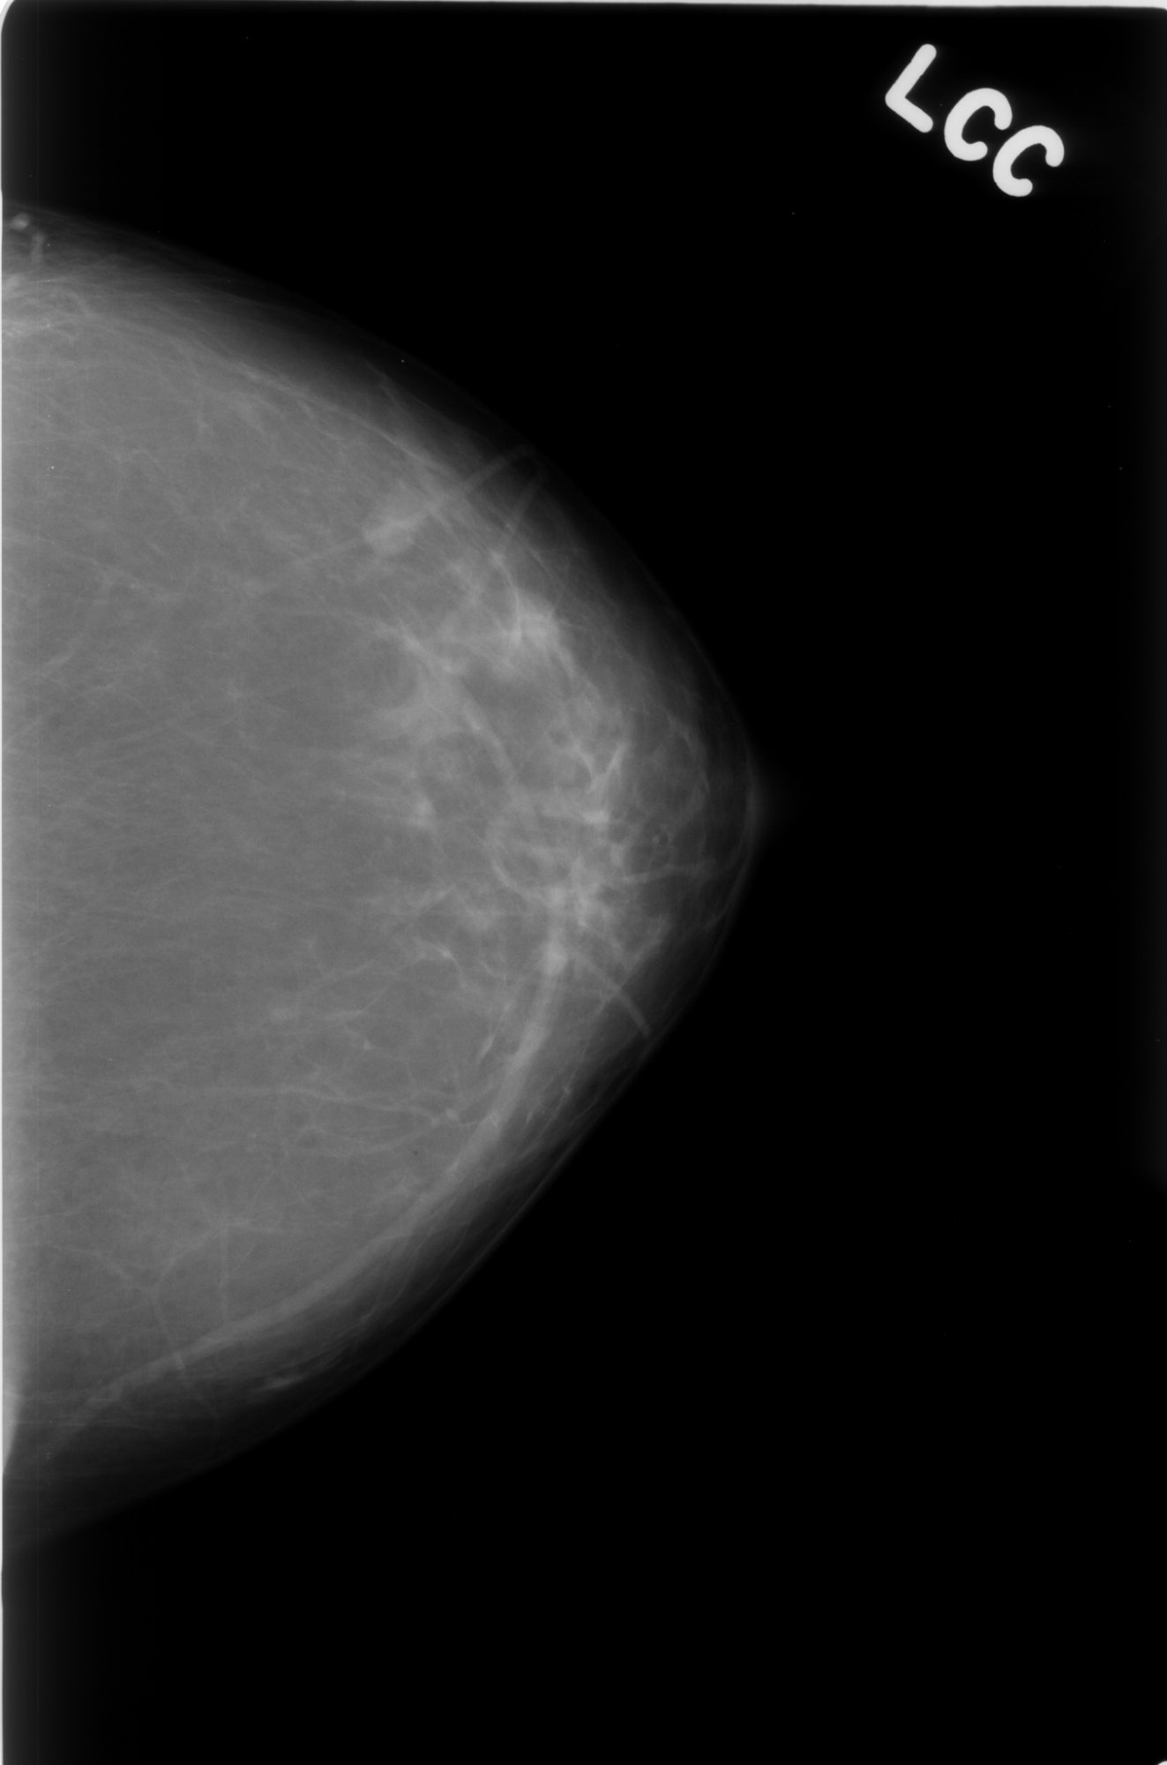
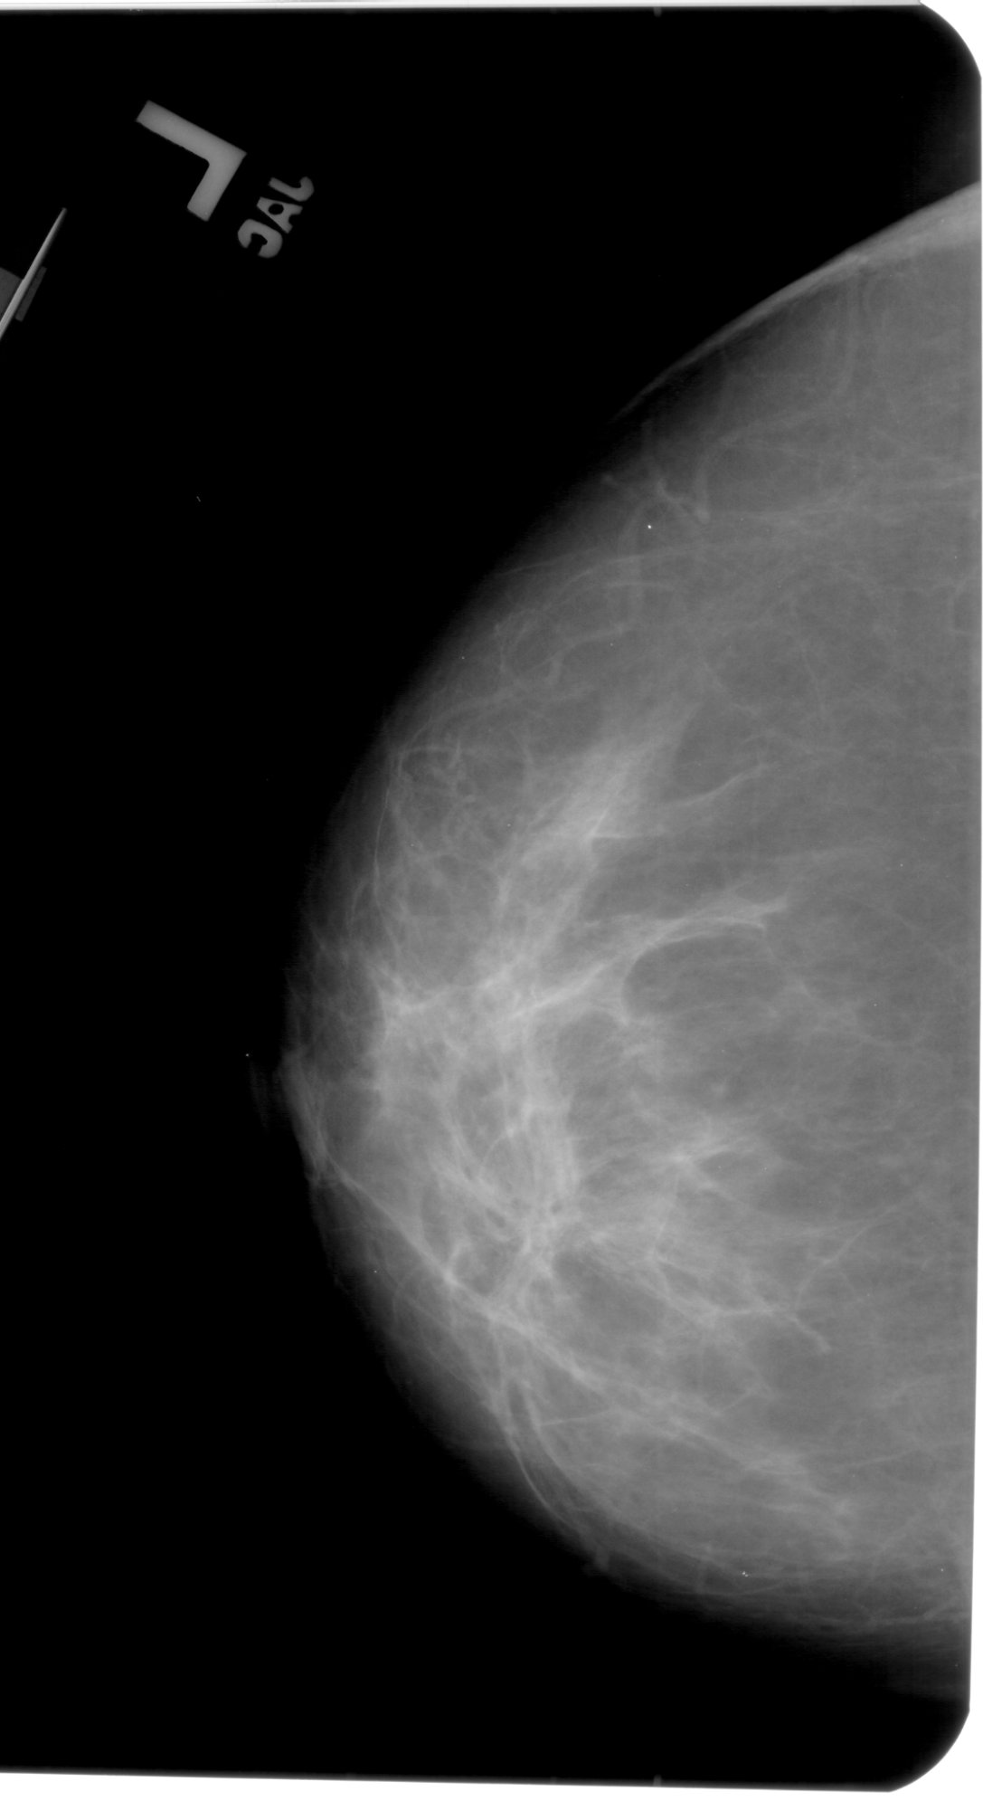
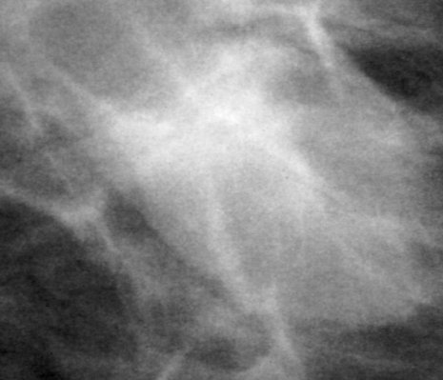
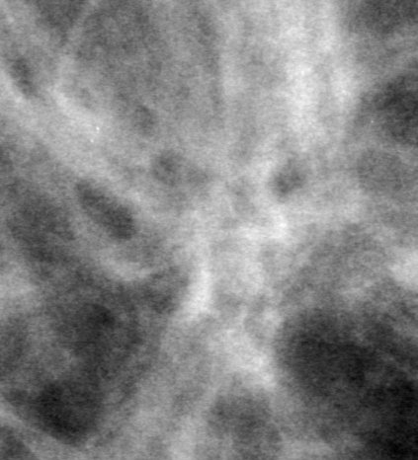
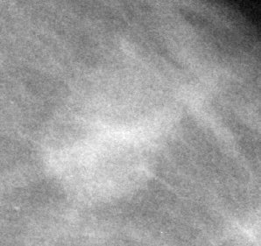
01
Introduction — What Do the Three Lesion Classes Look Like?
Malignant
Benign
Normal / Healthy
FULL MAMMOGRAM
FULL MAMMOGRAM
FULL MAMMOGRAM
ROI / CROPPED
ROI / CROPPED
ROI / CROPPED

Slide 13
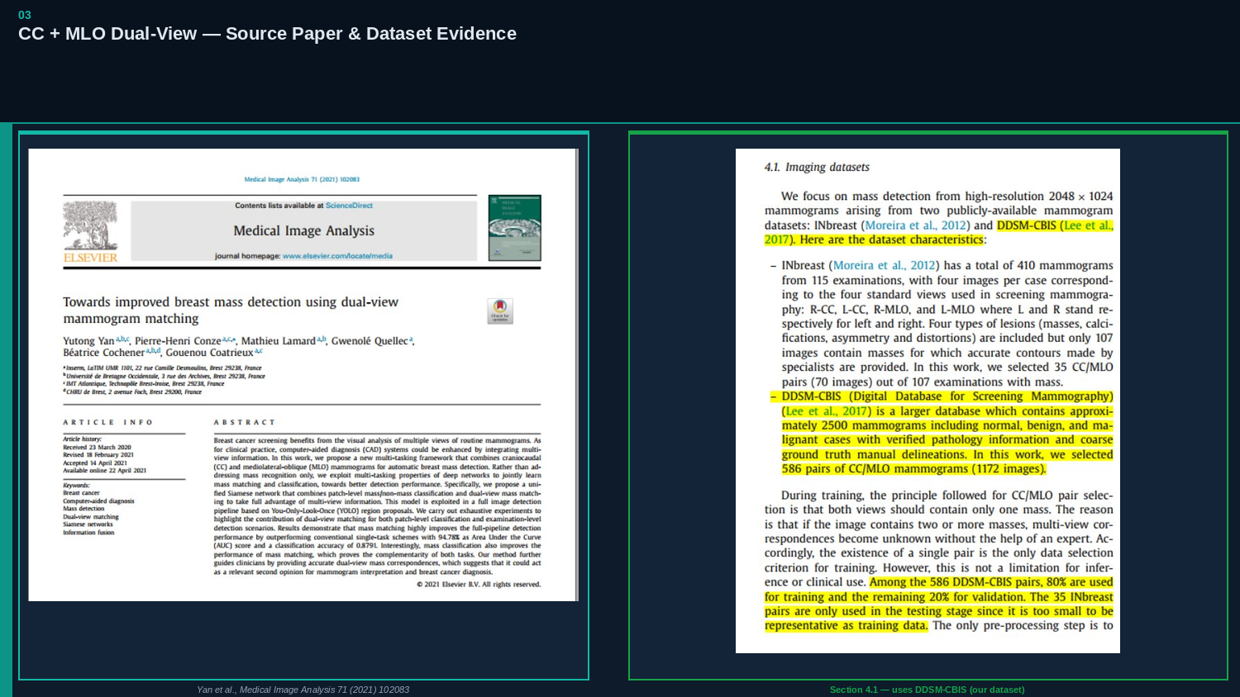

Slide 14
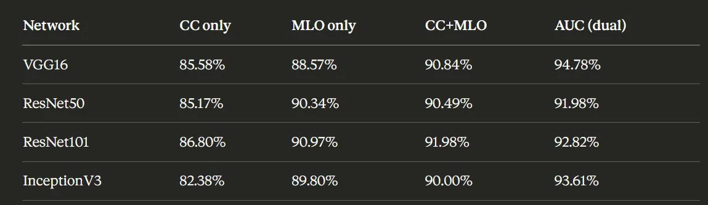
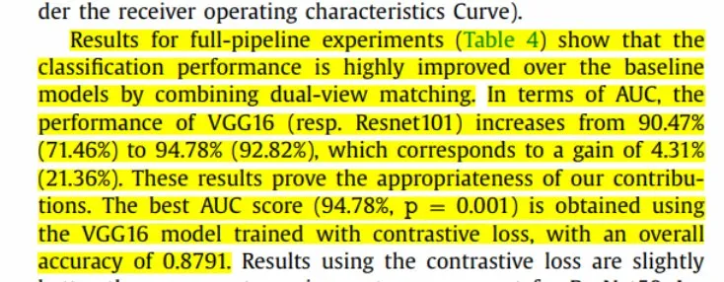
03
CC + MLO — Quantitative Results: Table 4 (Section 4.3)
+4.31%
+21.36%
87.91%
VGG16 AUC gain
ResNet101 AUC gain
Best accuracy
90.47% → 94.78%
71.46% → 92.82%
VGG16 + contrastive loss
DIRECT QUOTE — Section 4.3, paragraph 2:
Source: Yan et al. (2021), Medical Image Analysis 71, 102083 — Section 4.3, Table 4

Slide 15
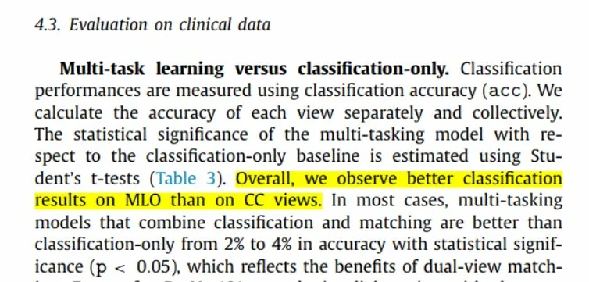
03
CC + MLO — Statistical Significance (Section 4.3)
DIRECT QUOTE — Section 4.3, paragraph 1 (p < 0.05):
MLO > CC (single view)
Dual-view +2% to +4% accuracy
p < 0.05 — statistically proven
Better classification on MLO than CC views across all tested backbones.
Multi-task models combining classification + matching beat single-view with statistical significance.
Student's t-test confirms dual-view matching is not a random improvement.
Implication for our MITI lab project:
This paper uses the same dataset (DDSM-CBIS, 586 CC/MLO pairs). Even naive CC+MLO concatenation beats single-view. Our planned cross-attention fusion sits further along this spectrum — directly justifying the dual-view input strategy in our pipeline.

Slide 16
PyRadiomics Feature Extraction
CBIS-DDSM Breast Mass Dataset
Radiomics Research Project | 2026

Slide 17
Data Preparation
1
2
3
Moved Mass Train Images
Separated by Pathology
Renamed by their features
Copied all CBIS-DDSM images into a unified Mass Train folder
Split into Benign, Benign_without_callback, and Malignant subfolders
Renamed each file to reflect its pathology and source folder structure
Input: PyRadiomics | Source: CBIS-DDSM Dataset

Slide 18
Before & After: Folder Restructuring
BEFORE
AFTER
Data/
CBIS-DDSM
├── Benign/
└── Mass-Training_P_00001_LEFT_CC
│ └── Mass_Training_...
→
├── Benign_without_callback/
└── 07-21-2016-DDSM-NA-67509
│ └── Mass_Training_...
└── 1.000000-ROI mask images-91195
└── Malignant/
└── 1-1.dcm → cropped
└── Mass_Training_...
├── 1-2.dcm → ROI
Output/
└── features.csv
Script/
└── radiomics-extract.py

Slide 19
Filename Convention
Mass_Training - P_0001 - LEFT - CC - 1-2 .dcm
Mass
Training
P_0001
LEFT
Abnormality type
Folder type
Patient name / structure
Side of breast
CC
1-2
.dcm
Image view angle
Numbering (cropped / ROI)
File type

Slide 20
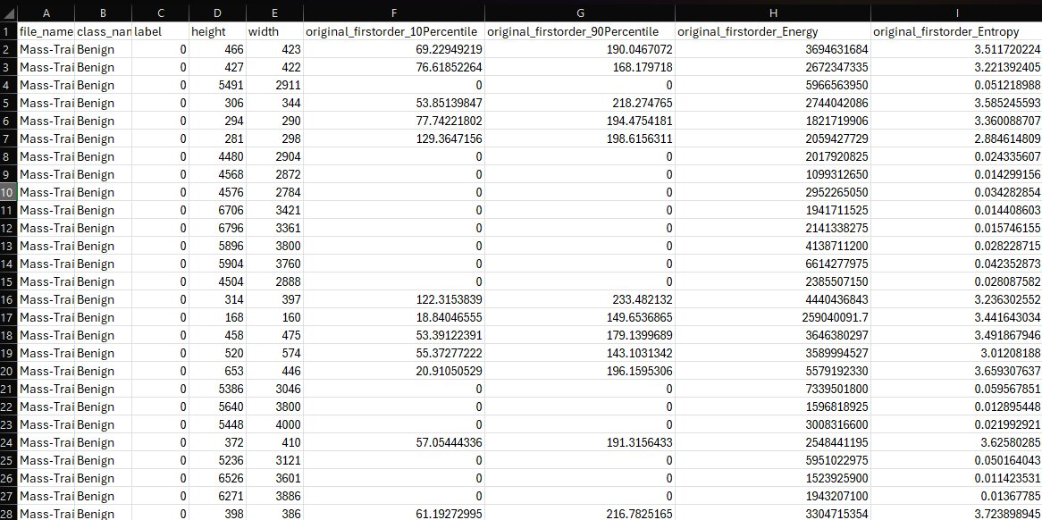
Extracted Features — features.csv
40+ Feature Columns
3 Pathology Classes
DCM Input Format

Slide 21
What We Learned
PyRadiomics Knowledge
Milestones Achieved
What PyRadiomics is and where it is used
✔ Extracted features for one image successfully
Most important features on breast DICOM images
✔ Extracted from all images
Coding parts related to radiomics extraction
✔ Generated features.csv with 40+ columns
Key Feature Types
Shape
Texture
Intensity

Slide 22
Next Steps
01
Learn About Extracted Features
Understand the meaning and significance of each feature column in the CSV — which features are most predictive for breast cancer classification.
02
Study Column Meanings
Deep-dive into each radiomics feature: first-order statistics, GLCM, GLRLM, shape descriptors — and what they represent clinically.
03
Step into CNN
Begin convolutional neural network development — using the extracted radiomics features and/or raw images to build a breast mass classification model.

