Slide 1
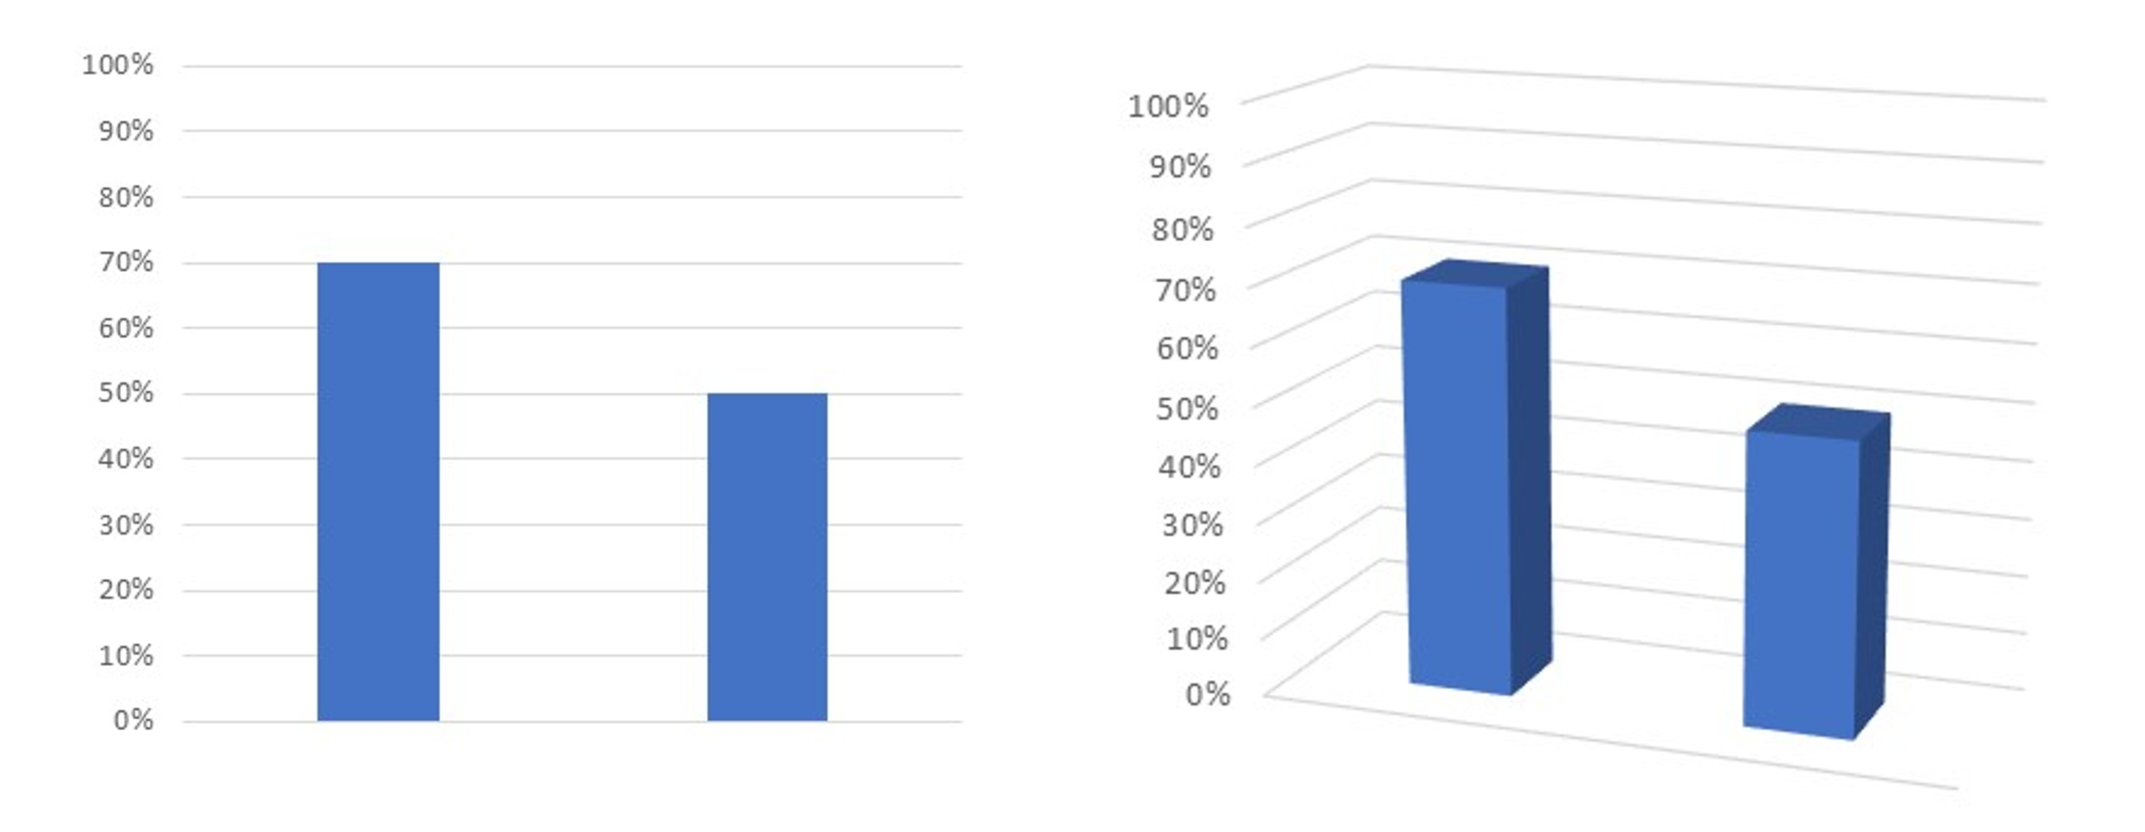


Smart Irrigation Requirement Prediction
Using Machine Learning
Student Name: Muhammad Ali (SU92-MSDSW-F25-021)
Shakeel Ahmad (SU92-MSAIW-F25-008)
Course Name: Machine Learning
Instructor: Sir Talha

Slide 2




Problem Statement
Inefficient irrigation leads to water wastage and reduced crop yield
Traditional irrigation relies on fixed schedules or manual judgment
Lack of data-driven irrigation decision support systems

Slide 3





Project Objectives
Predict irrigation requirements using machine learning
Compare baseline and deep learning models
Improve performance through hyperparameter tuning
Support sustainable water management

Slide 4




Dataset Overview
Agricultural dataset with approximately 16,000 records
Input Features
Moisture Index (MOI)
Temperature
Humidity
Target Variable
Irrigation requirement level

Slide 5









Methodology
Dataset
Preprocessing
Train-Test Split
Model Training
Evaluation
Model Saving
Inference

Slide 6



Models Used
Baseline Model
Logistic Regression
Advanced Model
Transformer-based Deep Learning Model
Evaluation Metric
Accuracy

Slide 7
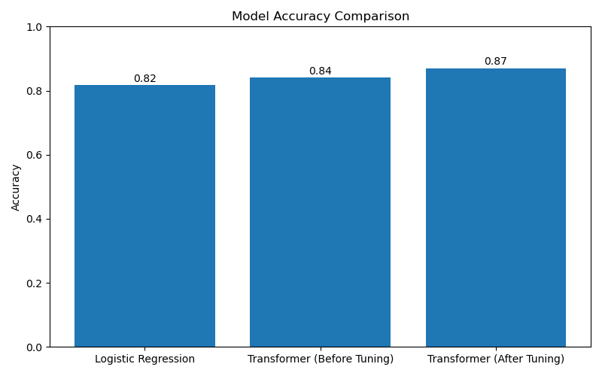



Results & Comparison
Logistic Regression
81%
Transformer (Before Tuning)
84%
Transformer (After Tuning)
87%

Slide 8




Hyperparameter Tuning
Tuned number of training epochs
Adjusted hidden dimensions
Optimized learning rate
Final configuration selected to avoid overfitting

Slide 9




Conclusion & Benefits
Improved irrigation prediction accuracy
Reduced water wastage
Supports sustainable agriculture
Demonstrates effectiveness of machine learning

Slide 10





Model Deployment & Usage
Model trained and saved after training
Separate inference pipeline used
User provides environmental input values
System outputs irrigation requirement prediction

