Slide 1
Data Incubator Capstone Project Predicting Health Risks and Phenotyping based on Body Shape Descriptors from 3D Scans
Ali Mehrnezhad
Feb, 2020

Slide 2
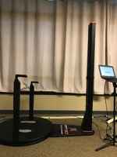
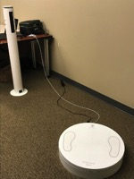
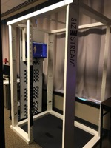


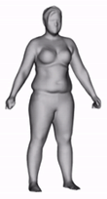
Introduction and Goal
Shape
Composition
Quantify Body Shape with 3D Optical Scanners
Height
Health Risks:
Age
Diabetes
Race
Cardiovascular disease
Weight
Cancers
BMI
Digital Anthropometry Measurements :
Scan Analysis Software
Body 3D Scan
Waist Circumference
Leg Length
Total Volume
Hip Circumference
Arm Length
And …
Research Question:
Can a population be triaged and their health status categorized solely based on their body shape?
Market Opportunity:
In case proof-of-concept is achieved, this will have direct application in clinical settings and is a competitive feature in any digital health platform

Slide 3
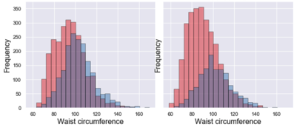
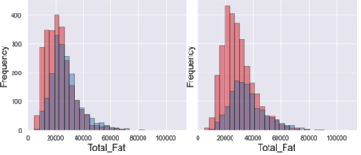
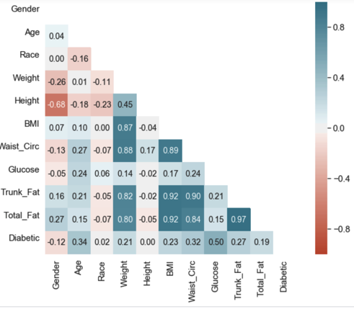
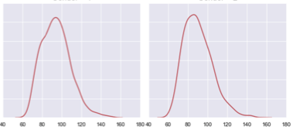
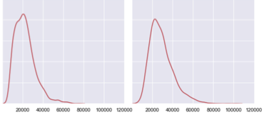
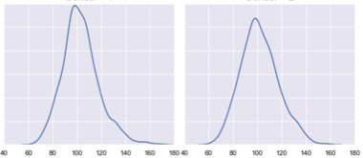
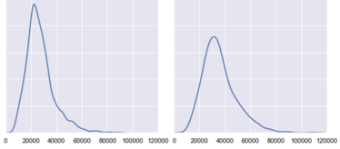

Data Analysis
Waist Circumference distribution
Total Fat distribution
Female
Male
Female
Male
More diabetic female than male
Correlation Heatmap
Similar to a Rayleigh distribution
Similar to a Gaussian distribution
Bias
Bias
Bias
Bias
Non-Diabetic
Diabetic (or Prediabetic)
Meaningful correlations between features and Glucose level observed , However not strong enough to accurately predict the glucose level .
2 major points :
1- Risk of diabetes is significantly higher in females than males.
2-Distribution of waist circumference and total fat in diabetic males and females is different from non-diabetic males and females.

