Slide 1
RELAY
Stop repeating yourself
to every AI.
Relay keeps your project context synced across
ChatGPT, Claude, Perplexity — and every AI agent.
Alimkhan Yergebayev · Founder & CEO
onrelay.app · youtu.be/15aqzManX-0
CONFIDENTIAL · 2026

Slide 2

THE PROBLEM
Context is the new bottleneck.
Knowledge workers now use 3–5 AI tools daily — but each one starts from zero.
Re-explaining your stack, your goals, your constraints — every single session.
Constant repetition
No cross-AI memory
Agent blindness
Pasting the same context into ChatGPT, Claude, Perplexity every day. Time wasted, flow broken.
Insight you discovered in Claude yesterday? Gone when you open ChatGPT today.
Coding agents like Claude Code have zero context about your product or decisions.
2.5 hrs
wasted per developer per week re-entering context across AI tools (Stack Overflow Dev Survey 2024)
RELAY
2 / 11

Slide 3
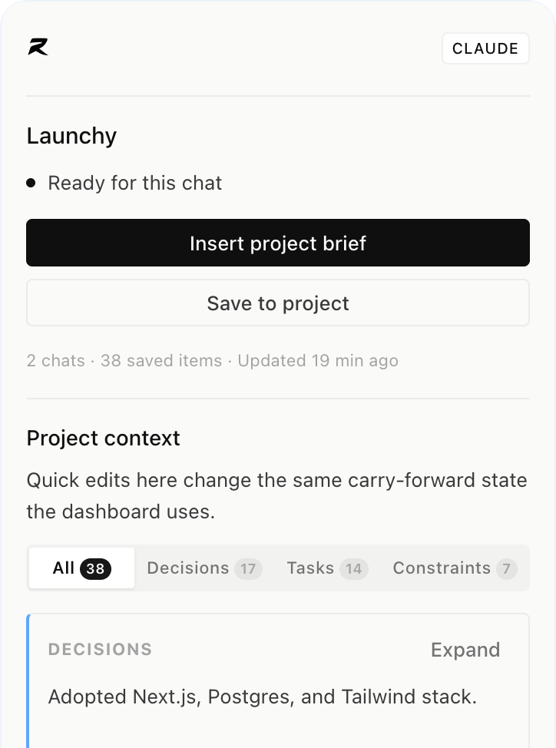
THE SOLUTION
One memory layer for every AI you use.
Relay is a browser extension that silently captures your AI conversations, builds a living project brief, and injects the right context into every tool — automatically.
Auto-captures chats across ChatGPT, Claude & Perplexity
Builds a smart project brief from your real conversations
Inserts brief with one click — or MCP for agents
Syncs across all tools in real-time
Works with any MCP-compatible agent — Claude Code, Cursor, GitHub Copilot and more
RELAY
3 / 11

Slide 4
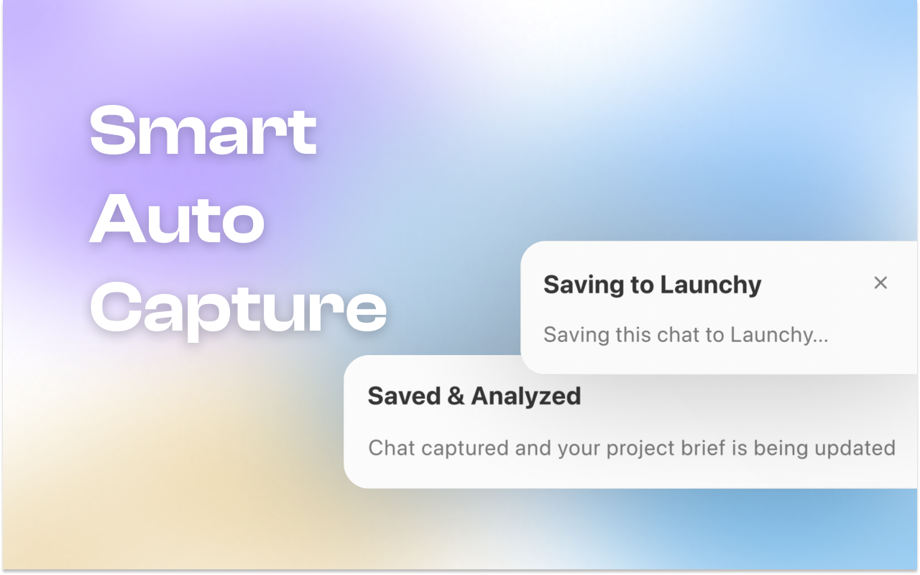
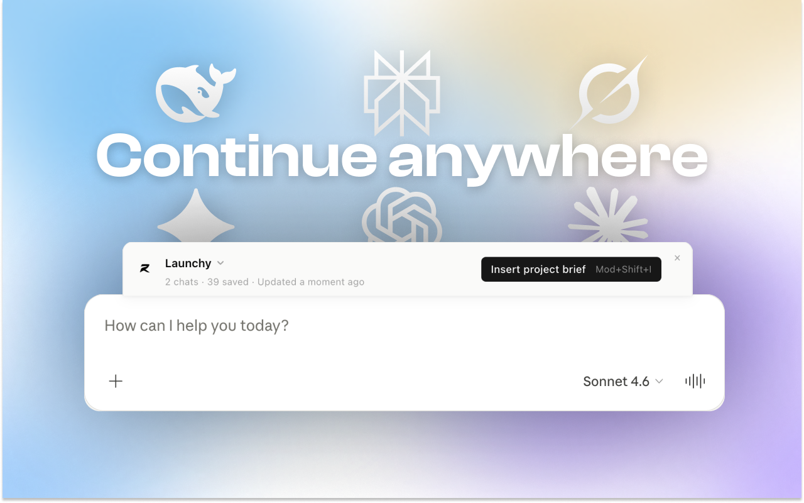
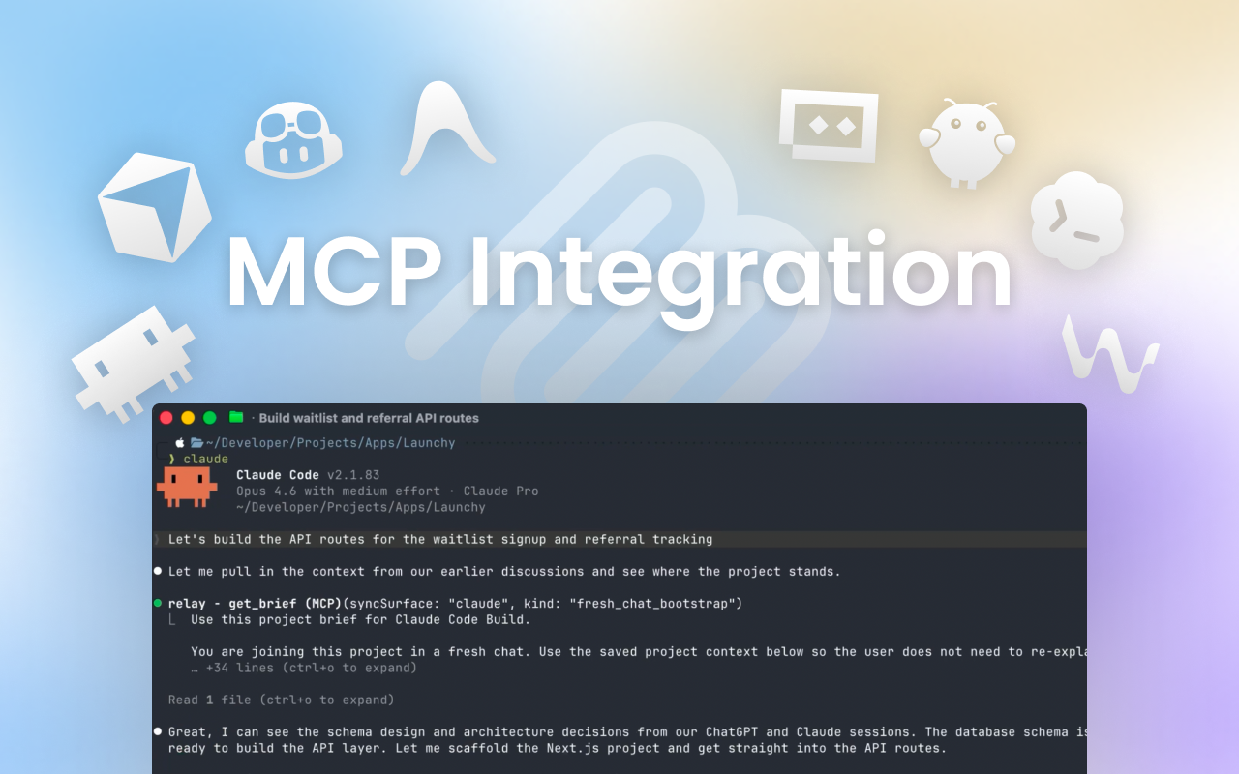
PRODUCT IN ACTION
See it. Use it. Ship faster.
Auto-capture toasts
Insert context in any AI
MCP for code agents
Watch the launch demo → youtu.be/15aqzManX-0
RELAY
4 / 11

Slide 5
COMPETITIVE LANDSCAPE
We do what no one else does.
Key differentiator: Relay is the only tool that automatically captures browser-based AI conversations — no manual input required.
Feature
Relay
Supermemory
MCP Mem. Tools
Native AI Memory
Auto-captures browser AI chats
✓
✗
✗
✗
Works across multiple AI tools
✓
✓
~ partial
✗
MCP integration for agents
✓
✗
✓
✗
Zero-config setup
✓
✗
✗
✓
Project-level context briefs
✓
~ basic
✗
✗
Browser extension (no app switch)
✓
✗
✗
✗
RELAY
5 / 11

Slide 6
MARKET OPPORTUNITY
A massive, fast-growing market.
$1.3T
400M+
$47B
Productivity Software
global TAM by 2030
monthly active AI
assistant users (2024)
AI developer tools
market by 2028 (IDC)
Relay's beachhead
SAM
~50M knowledge workers using 3+ AI tools daily
SOM
~2M power users: devs, PMs & founders — Year 1–2
Product-led growth in developer tools is 3× more capital-efficient than sales-led (OpenView Partners, 2024)
RELAY
6 / 11

Slide 7
WHY NOW
Three tailwinds converging.
01
AI tool explosion
ChatGPT hit 180M users. Claude, Perplexity, Gemini are all growing fast. Context fragmentation is a universal pain — not a niche one.
02
MCP becomes the standard
Anthropic's Model Context Protocol is rapidly becoming the inter-agent memory standard. Relay is built native-first on MCP.
03
Chrome extension renaissance
Browser-layer tools (Grammarly, Loom, Superhuman) command $10+ ARPU. The AI equivalent layer is wide open.
RELAY
7 / 11

Slide 8
BUSINESS MODEL
Freemium SaaS with a clear upgrade path.
MOST POPULAR
Free
Pro
$0 / forever
$9 / month · $90 / year
• 2 projects
• 10 projects
• 6 AI analyses / day
• 32 AI analyses / day
• 200 captures / month
• 2,000 captures / month
• MCP access
• Priority MCP + sync
Path to $1M ARR: ~9,300 Pro subscribers · Target LTV:CAC > 5× via PLG
RELAY
8 / 11

Slide 9
GO-TO-MARKET
Distribution where developers already live.
Phase 1
Phase 2
Phase 3
Phase 4
Developer community
MCP ecosystem
Content & SEO
Team & B2B
Hacker News, Reddit r/devtools, Product Hunt. Founders + builders who already feel this pain daily.
Partner with Anthropic's MCP registry. First-mover advantage as agents proliferate — Relay appears wherever MCP is mentioned.
"Best AI memory tools" and "MCP setup" queries are unclaimed. Own this search space early with developer-focused content.
Shared team workspaces. One Pro user = 3–5 seat expansion. Enterprise MCP deployments.
→ 1,000 users
→ 10,000 users
→ 100,000 users
→ $1M ARR
RELAY
9 / 11

Slide 10
TEAM
Built by someone who felt the pain.
AY
Alimkhan Yergebayev
Founder & CEO · Solo founder
Full-stack engineer — built Relay end-to-end (Next.js, Chrome MV3, MCP)
Power AI user — experienced the context-switching pain firsthand, daily
Product-minded builder — shipped and iterated fast from 0 to live product
Looking for: advisors with GTM expertise, distribution in dev tools, or connections to MCP ecosystem players
RELAY
10 / 11

Slide 11
VISION & ASK
The AI memory layer
for the modern worker.
Every knowledge worker will need a way to carry context across AI tools. Relay is the first browser-native product solving this — before the big players notice.
The Ask
Open to capital, advisors, and strategic introductions — especially in dev-tools GTM and the MCP ecosystem. Let's talk: alimkhan@onrelay.app
RELAY
onrelay.app

