Slide 1

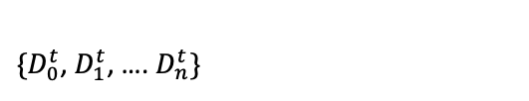

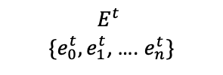
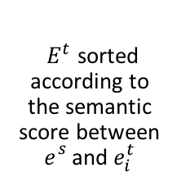


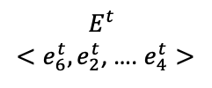
SEMANTIC MATCHING OF GUI EVENTS
input
output
$$e_{}^{s}$$
Event
Descriptor Extractor
(Component 3)
$$D_{}^{s}$$
Semantic
Matching Algorithm
(Component 4)
$$E_{ }^{t}$$
$<e_{6}^{t}, e_{2}^{t}$, …. $e_{4}^{t}>$
source event
descriptor of the source event
${ E}_{ }^{t}$ sorted according to the semantic score between $e_{}^{s}$and $e_{i}^{t}$
$\{D_{0}^{t}$, $D_{1}^{t}$, …. $D_{n}^{t}\}$
$$E_{ }^{t}$$
$\{e_{0}^{t}, e_{1}^{t}$, …. $e_{n}^{t}\}$
descriptors of the candidate target events
candidate target events
score
(${txt}_{}^{s}{txt}_{}^{t}$)
$${txt}_{}^{s}{txt}_{}^{t}$$
Word Embedding Model
Corpus of Documents (Component 1)
Word Embedding
(Component 2)

Slide 2







input
Test Reuse
output
$$t_{ }^{t}$$
Source event
Migrated
test case
$$e_{}^{s}$$
$$t_{ }^{s}$$
Source test case
Test Generator
Candidate target events
Semantic Matcher
$$E_{ }^{t}$$
$$A^{t}$$
Target Application
Ordered candidates
$$E_{ }^{t}$$
Execution Platform

Slide 3













TEST GENERATOR
LLM Translator (O2)
Translated test case
RL Agent (O3)
$e^{t}$target event
Source test case
$$t_{ }^{s}$$
Event Selector
(C5)
Target Application Model
$$t_{ }^{t}$$
$A^{t}$
Target Application
$e^{t}$target event
Migrated test case
$E_{ }^{t}$candidate events
paths that leads to $e^{t}$
$$e_{}^{s}$$
$E_{ }^{t}<e_{6}^{t}, e_{2}^{t}$, …. $e_{4}^{t}>$
source event
$E_{ }^{t} (e_{0}^{t}, e_{1}^{t}$, …. $e_{n}^{t}\}$
$E_{ }^{t}$ sorted according to $e_{}^{s}, e_{i}^{t}$semantic score
Current state
candidate target events
SEMANTIC MATCHER
Execution
Platform
Event Descriptor Extractor
(C3)
$$D_{}^{s}$$
Semantic
Matching Algorithm
(C4)
Descriptor of the source event
Image of widget
$\{D_{0}^{t}$, $D_{1}^{t}$, …. $D_{n}^{t}\}$
Label
Descriptor of candidate target events
$${<txt}_{}^{s}{txt}_{}^{t}>$$
Score (${txt}_{}^{s}{txt}_{}^{t}$)
Image
Classifies (O1)
Corpus of Documents
(C1)
Word Embedding
(C2)
Word Embedding Model

