Slide 1

Application of data science in e-commerce
Ali Moinfar
Capstone Project Proposal
The Data Incubator Fall 2021 Program

Slide 2
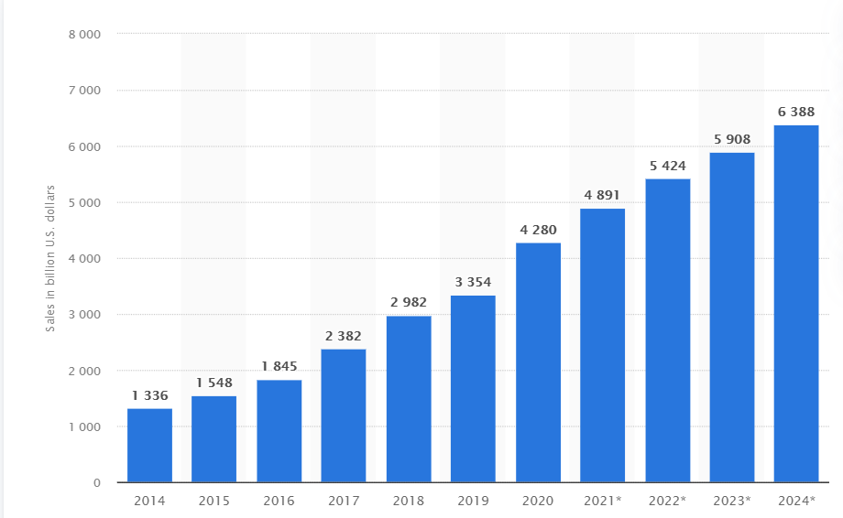
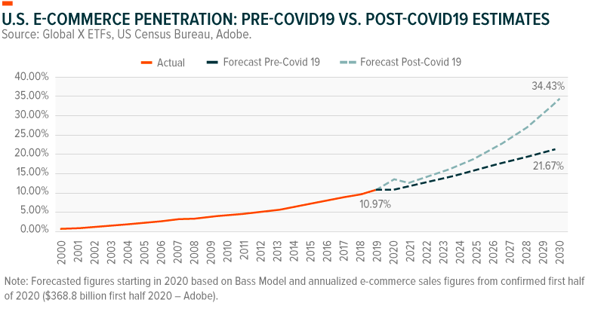
E-commerce growth
E-commerce (electronic commerce) is the activity of electronically buying or selling of products on online services or over the Internet.
Online shopping is one of the most popular online activities worldwide.
E-commerce still has ample opportunities to expand, and 2020 gave us a glimpse of that growth potential.
Retail e-commerce sales worldwide from 2014 to 2024 (in billion U.S. dollars)
U.S. e-commerce penetration:
pre-COVID19 vs. post-COVID19 estimates
Statista.com
seekingalpha.com

Slide 3
Data science applications in e-commerce
Recommendation Engines
Market Basket Analysis
Customer Retention / Churn Model / Loyalty Analysis
Segmentation Analysis (customer segmentation, market segmentation)
Customer Sentiment Analysis
Pricing (demand, competitor analysis, optimization, real-time)
Fraud Detection
Click-Through Rate (CTR) Analysis
Inventory Management
……

