Slide 1
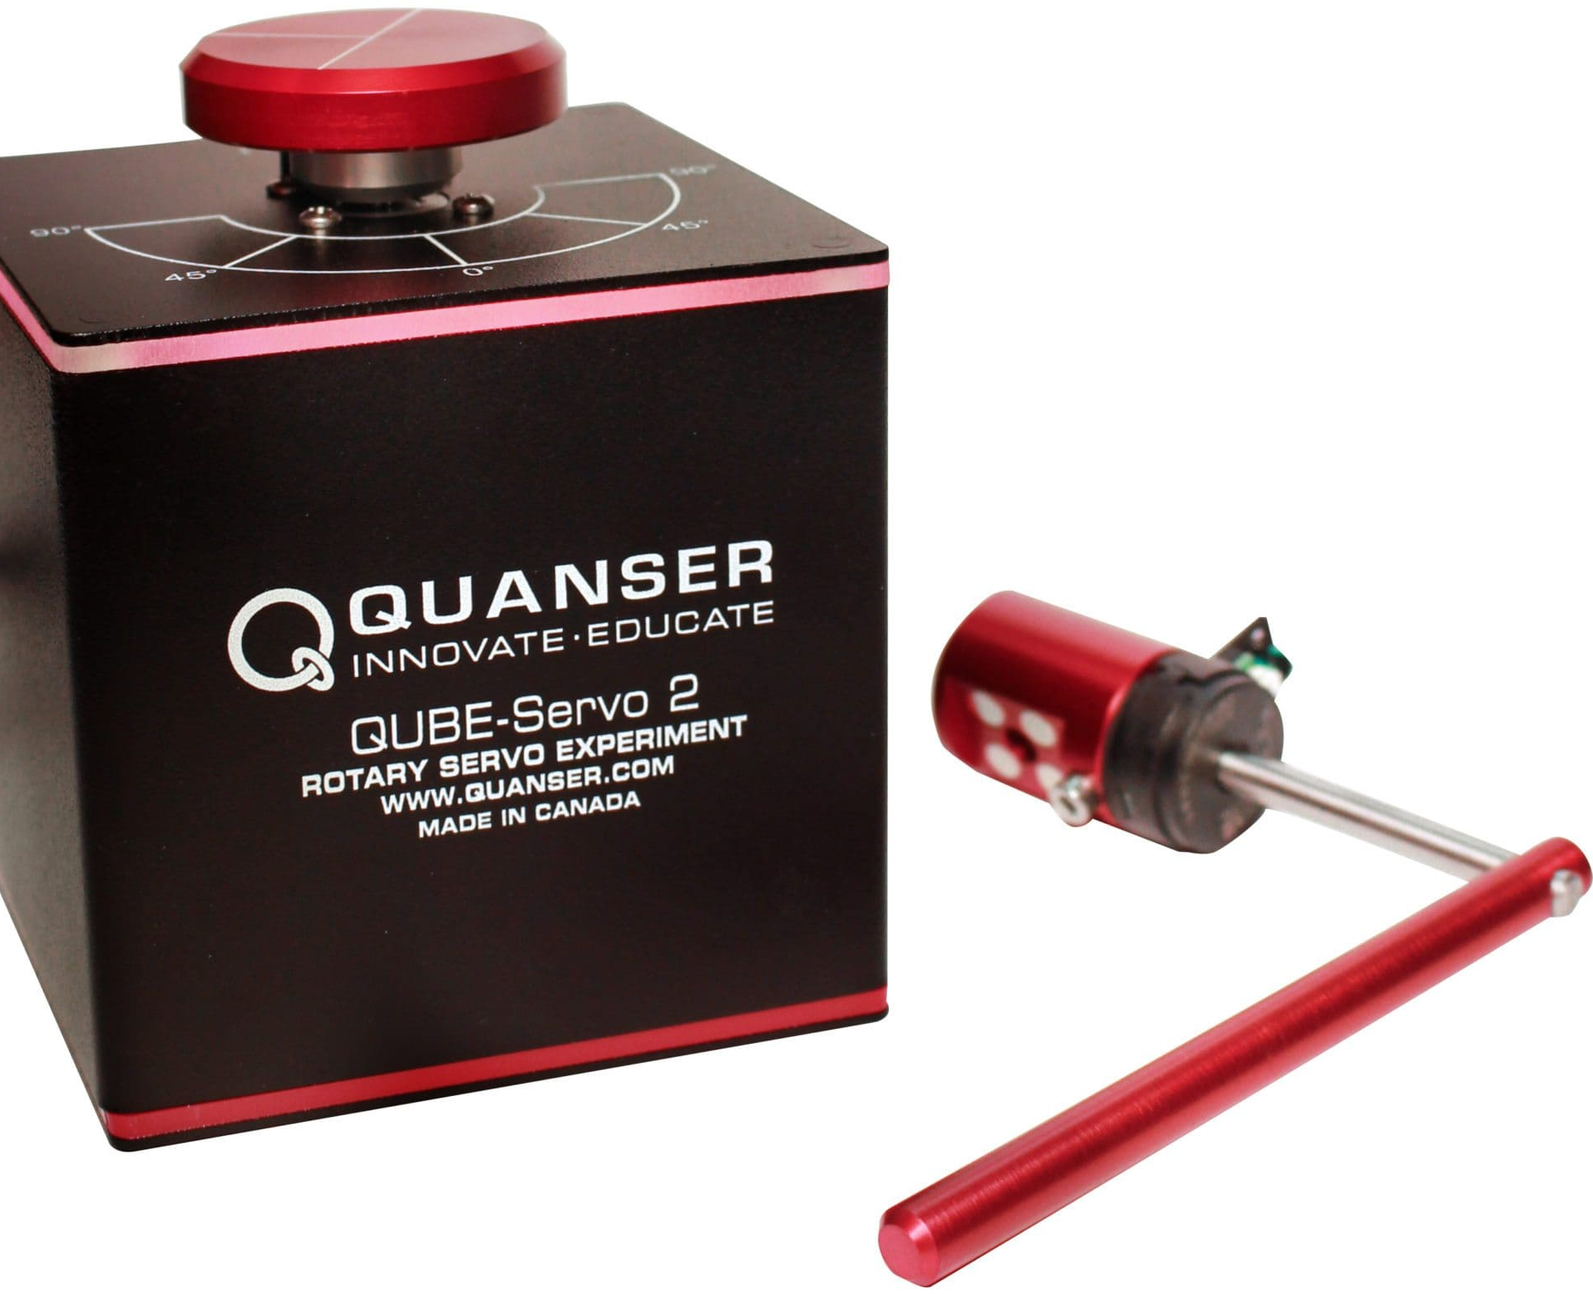
Project_Furuta pendulum
Project overview :
1. In this project, you will model a rotary inverted pendulum using the Lagrangian method.
2. The objective is to derive the equations of motion of the system,
3. Linearize the system around the equilibrium point (where the pendulum is upright),
4. Obtain the state-space representation of the system, and apply a control algorithm to balance the pendulum.
5. This project will enhance your understanding of dynamics, control theory, and modeling physical systems.

Slide 2
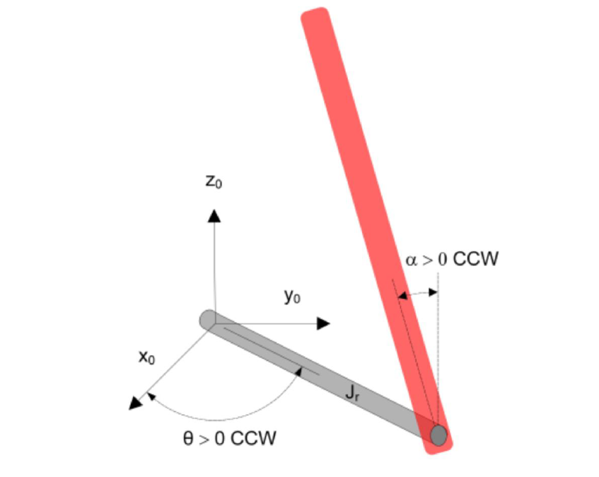

Furuta pendulum
Kinetic equations:
Consider: $l=\frac{L_{p}}{2}$ (center of mass of the pendelum)
$$\begin{aligned}T_{total}=T_{pendelum}+T_{arm}\#\left(1\right)\end{aligned}$$
- For the rottery arm:
$$T_{arm}=\frac{1}{2} J_{r}{\left(\frac{dθ}{dt}\right)}^{2}$$
- For the pendulum:
Translational :
$$T_{pend,trans}=\frac{1}{2}m_{p}\left[{\left(r\frac{dθ}{dt}\right)}^{2}+{\left(l\frac{dα}{dt}\right)}^{2}+2rl\frac{dθ}{dt}\frac{dα}{dt}\cos{α}\right]$$
Rotational :
$T_{pend, rot}=\frac{1}{2}J_{p}$ ${\left(\frac{dα}{dt}\right)}^{2}$
$$T_{total}=\frac{1}{2} J_{r}{\left(\frac{dθ}{dt}\right)}^{2}+\frac{1}{2}m_{p}\left[{\left(r\frac{dθ}{dt}\right)}^{2}+{\left(l\frac{dα}{dt}\right)}^{2}+2rl\frac{dθ}{dt}\frac{dα}{dt}\cos{α}\right]+\frac{1}{2}J_{p} {\left(\frac{dα}{dt}\right)}^{2}$$

Slide 3
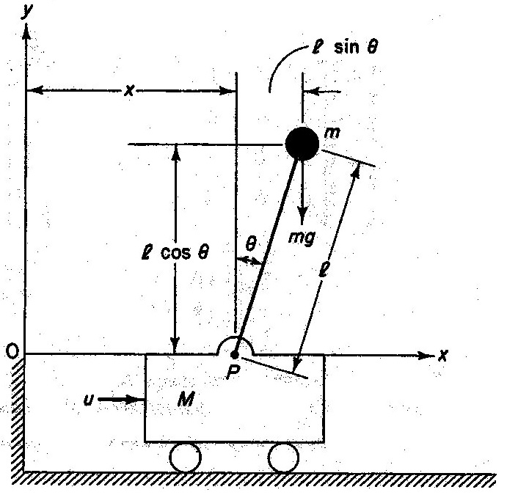


Furuta pendulum
Potential equation for the center of mass of the pendulum:
Center of mas $=l=\frac{L_{p}}{2}V$
$$\begin{aligned}V=m_{p}glcos α\#\left(2\right)\end{aligned}$$
Lagrangian L of the system:
$$\begin{aligned}L=T−V\#\left(3\right)\end{aligned}$$
Caculating L:
$$L=\frac{1}{2} J_{r}{\left(\frac{dθ}{dt}\right)}^{2}$$
$$+\frac{1}{2}m_{p}\left[{\left(r\frac{dθ}{dt}\right)}^{2}+{\left(l\frac{dα}{dt}\right)}^{2}+2rl\frac{dθ}{dt}\frac{dα}{dt}\cos{α}\right]$$
$$+\frac{1}{2}J_{p} {\left(\frac{dα}{dt}\right)}^{2}+m_{p}glcos α$$

Slide 4

Furuta pendulum
For convenience :
$$A=J_{r}+m_{p}r^{2}$$
$$B=m_{p}rl$$
$$C=J_{p}+m_{p}l^{2}$$
$$D=m_{p}gl$$
$τ_{m}=K_{m}V_{m} (V_{m})$is the input
Applying the Lagrangian for v=$α$and v= $θ$:
$$\begin{aligned}\frac{d}{dt}\left(\frac{∂L}{∂\dot{v}}\right)−\frac{∂L}{∂v}=0\#\left(4\right)\end{aligned}$$
$$\begin{aligned}L=\frac{1}{2}A{\dot{θ}}^{2}+B\cos{α}\dot{θ}\dot{α}+\frac{1}{2}C{\dot{α}}^{2}−D\cos{α}\#\left(5\right)\end{aligned}$$
With respect to $θ$:
$$\begin{aligned}A\ddot{θ}+B\cos{α}\ddot{α}−B\sin{α}{\dot{α}}^{2}+b_{r}\dot{θ}=τ_{m}\#\left(6\right)\end{aligned}$$
With respect to $α$:
$$\begin{aligned} B\cos{α}\ddot{θ}+C\ddot{α}+b_{p}\dot{α} −D\sin{α}=0\#(7)\end{aligned}$$

Slide 5

Furuta pendulum
L$inearising around α≈0$: Applying small angle approximation :
$\cos{α}≈1$
$\sin{α}≈α$
$\sin{α}\dot{α}≈0$
$$A\ddot{θ}+B\ddot{α}+b_{r}\dot{θ}=τ_{m}$$
$$B\ddot{θ}+C\ddot{α}+b_{p}\dot{α} −Dα=0$$
L$inearising around α=π$: Expanding trigonometric terms:
$α=π+α$
$\cos\left(π+α\right)=1$
$\sin\left(π+α\right)=−α$
$sin⁡(π+α)\dot{α}≈0$
$$A\ddot{θ}−B\ddot{α}+b_{r}\dot{θ}=τ_{m}$$
$$−B\ddot{θ}+C\ddot{α}+b_{p}\dot{α}+Dα=0$$

Slide 6

Furuta pendulum
State space representation
$$A=\left[\begin{matrix}0 & 1 & 0 & 0 \\ 168.58 & −0.555 & 0 & 0.6318 \\ 0 & 0 & 0 & 1 \\ −55.15 & 0.1815 & 0 & −3.6745\end{matrix}\right]$$
$$B=\left[\begin{matrix}0 \\ −153.2631 \\ 0 \\ 155.066\end{matrix}\right]$$
$$C=\left[\begin{matrix}1 & 0 & 0 & 0 \\ 0 & 0 & 1 & 0\end{matrix} \right]$$
$$D=\left[\begin{matrix}0 \\ 0\end{matrix}\right]$$

Slide 7
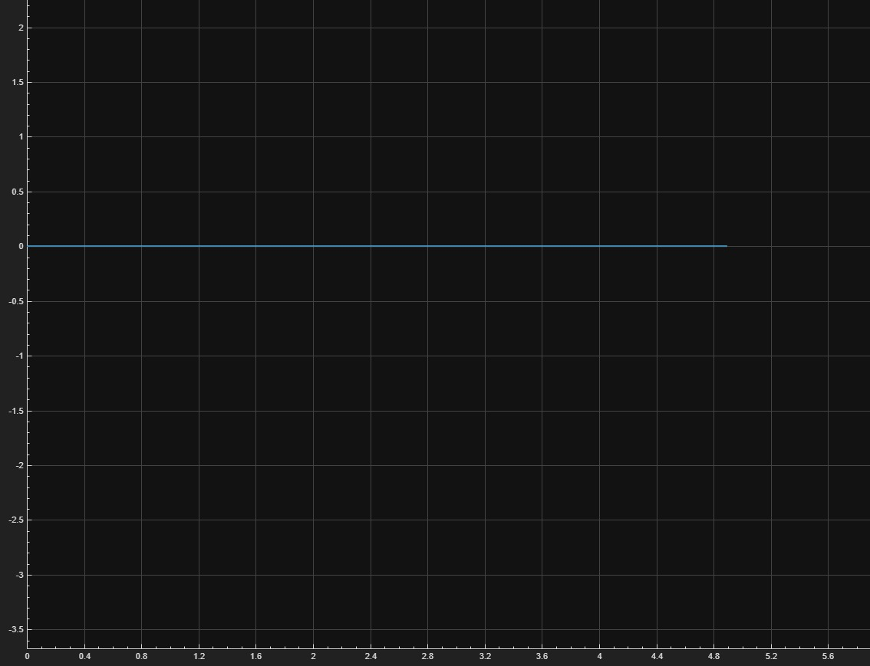
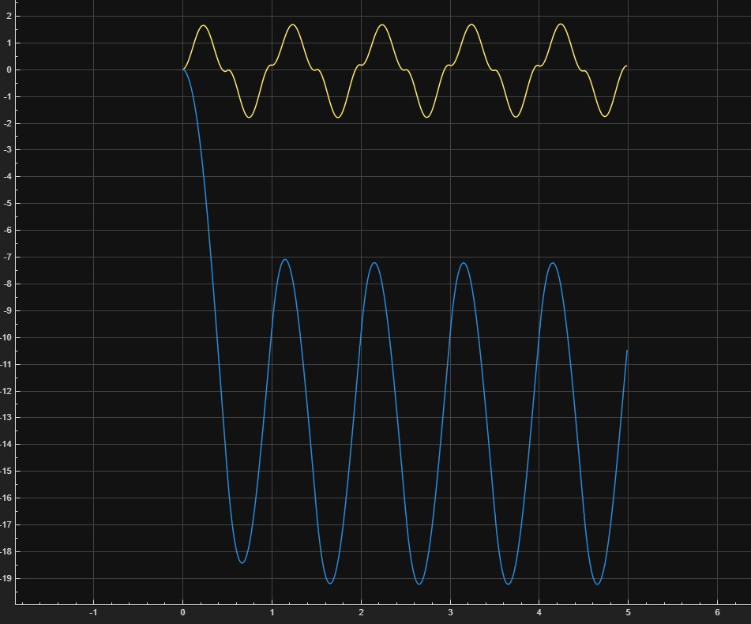
Furuta pendulum

Slide 8
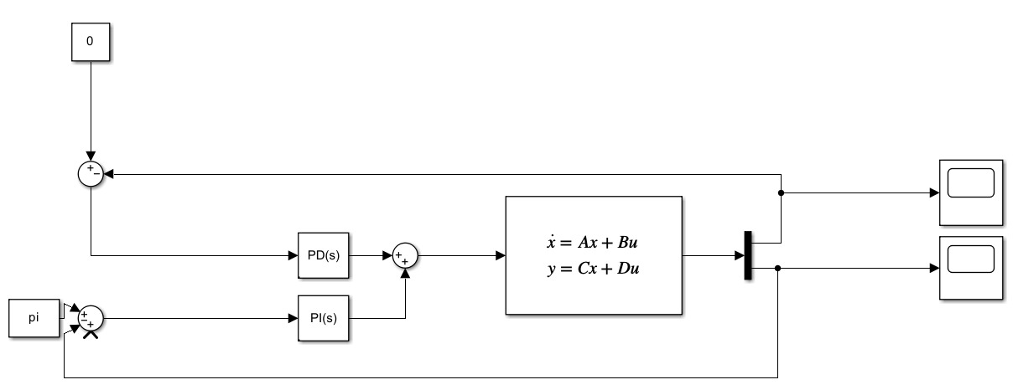
Furuta pendulum

Slide 9
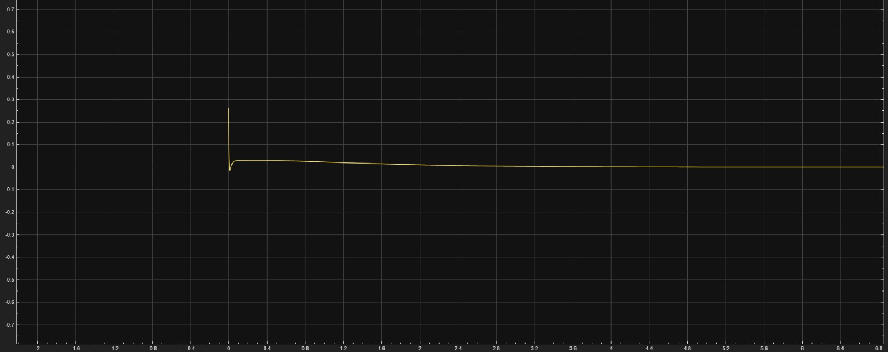
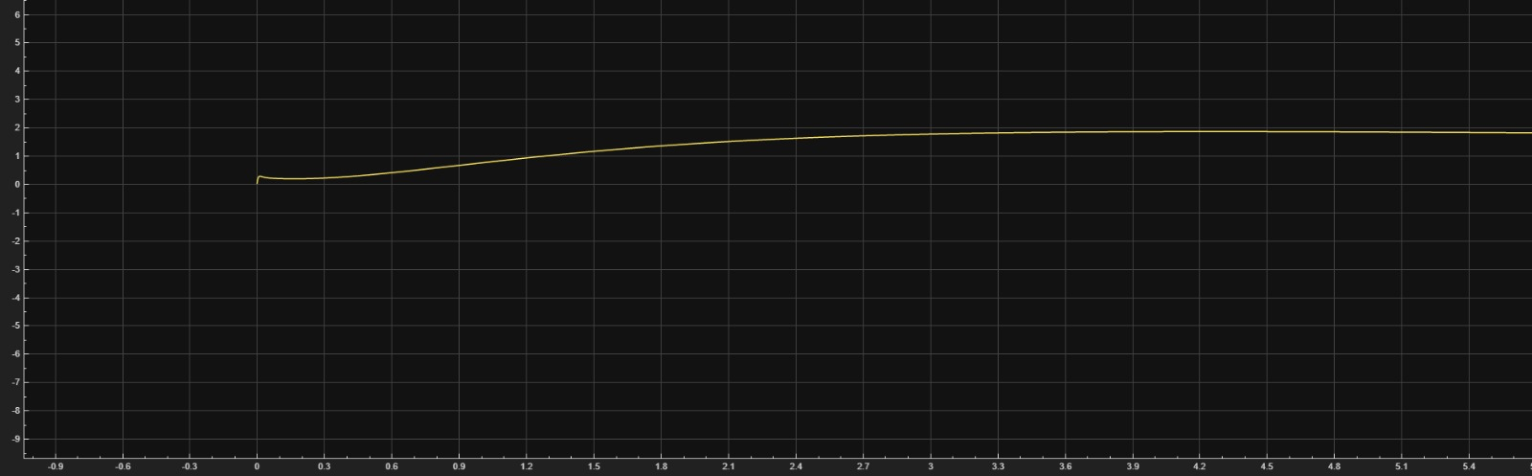
Furuta pendulum

Slide 10
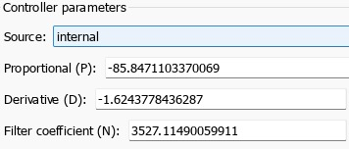
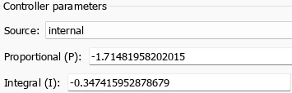
Furuta pendulum

Slide 11
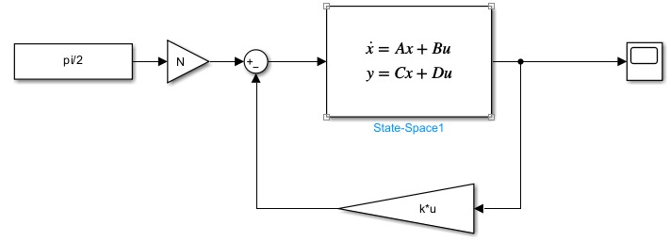
Furuta pendulum

Slide 12
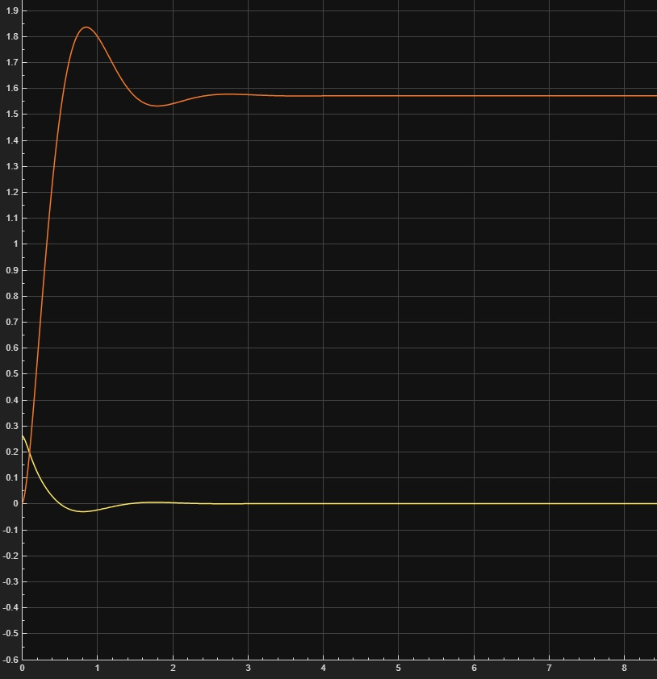
Furuta pendulum

Slide 13
Furuta pendulum

Slide 14


Furuta pendulum

Slide 15


