Slide 1
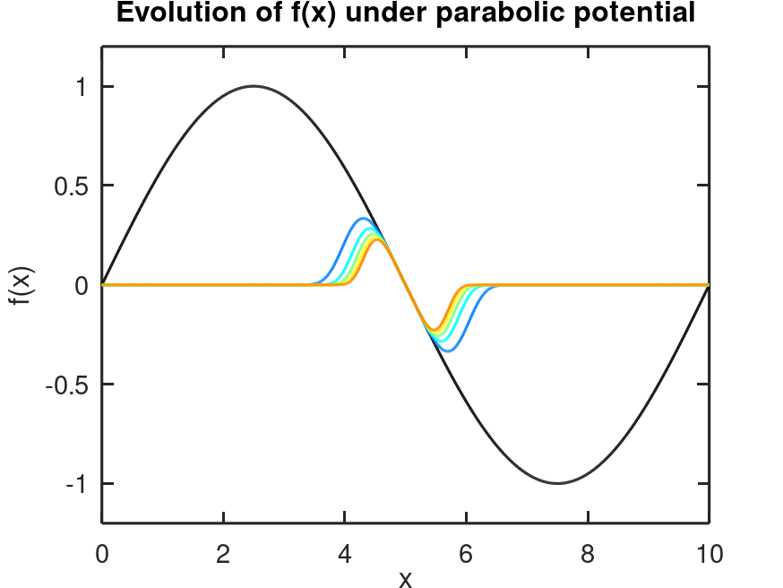
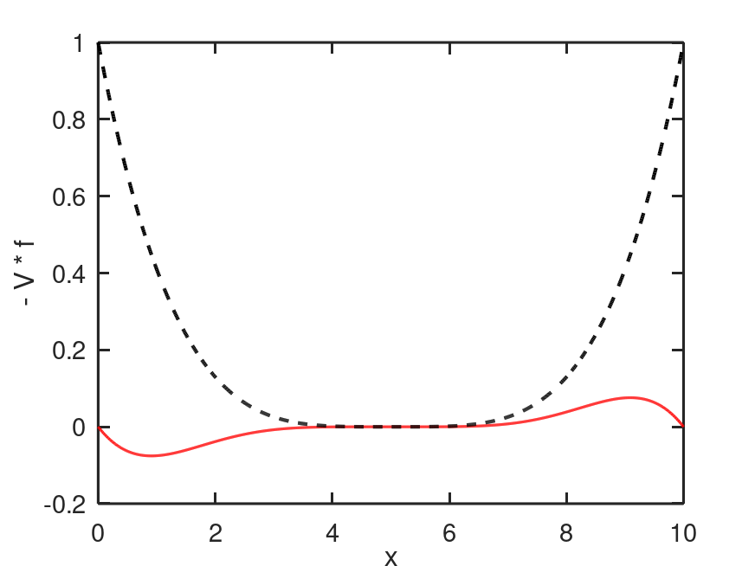
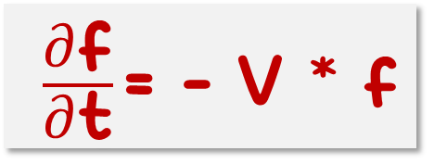

Potential
If V does not depend on f : As V(x) but NOT V(f)
f = sin (x)
$$\text{V}\text{ =0.5 }{\left(\text{x}\text{-5}\right)}^{\text{4}}$$
final
$\frac{\text{∂}\text{f}}{\text{∂}\text{t}}\text{= }$- V * f
f^{n+1} = f^{n} + df /dt * dt

Slide 2
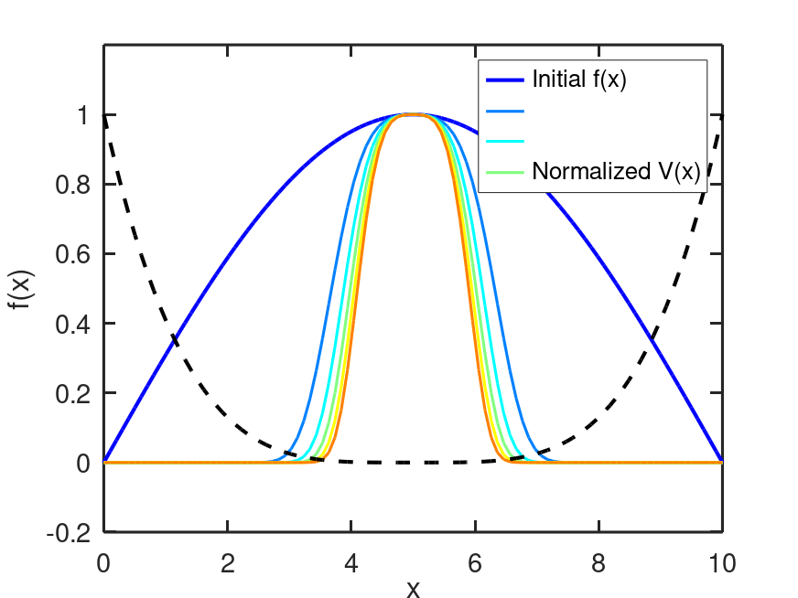
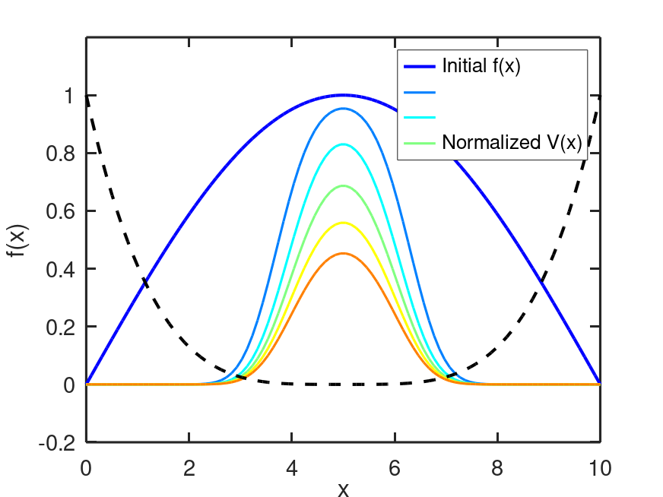
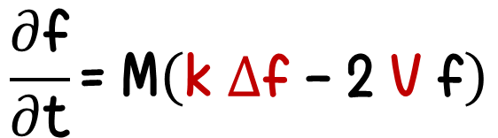
Diffusion + Potential
$$\frac{\text{∂}\text{f}}{\text{∂}\text{t}}\text{= }\text{M}\left(\text{k}\text{ ∆}\text{f}\text{ - 2 }\text{V} \text{f}\right)$$
Potential
Diffusion + Potential

Slide 3
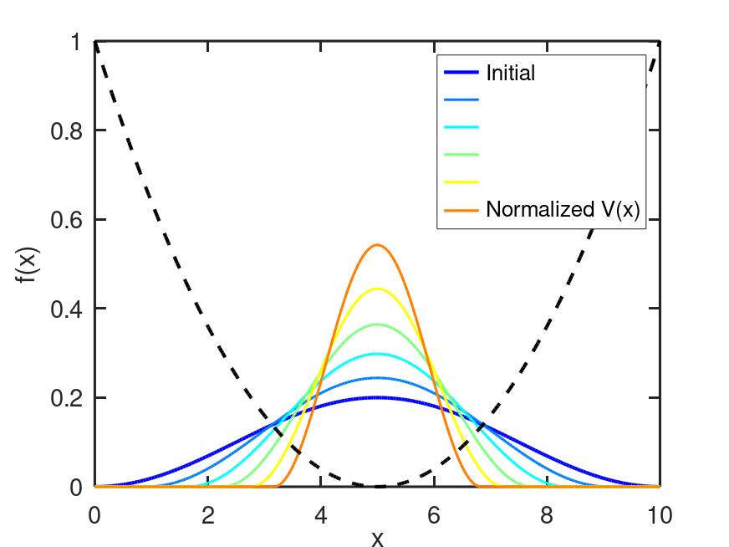
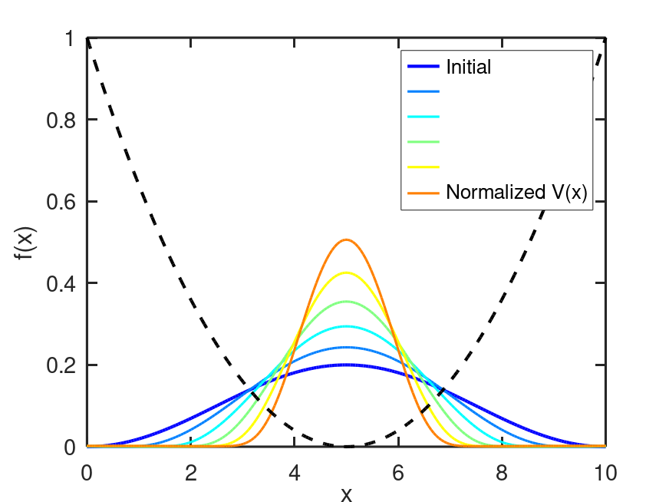
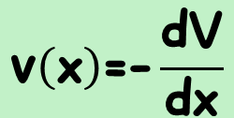
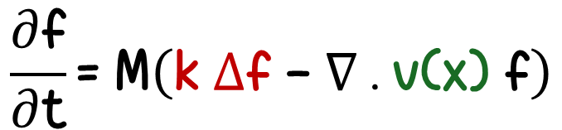
Diffusion + Advection
$$\frac{\text{∂}\text{f}}{\text{∂}\text{t}}\text{= }\text{M}\left(\text{k}\text{ ∆}\text{f}\text{ - }∇\text{ . }\text{v}\text{(}\text{x}\text{) }\text{f}\right)$$
Velocity comes from a potential
$$\text{v}\left(\text{x}\right)\text{=-}\frac{\text{dV}}{\text{dx}}$$
Advection
Advection + Diffusion

Slide 4
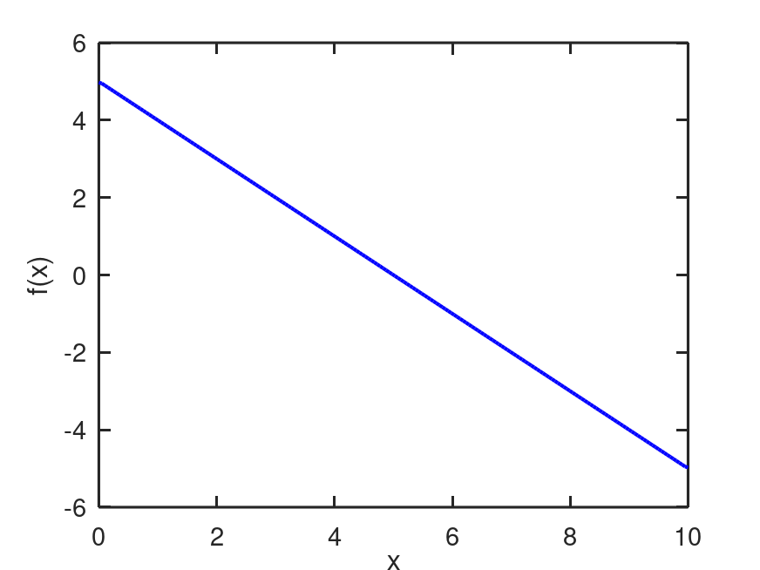
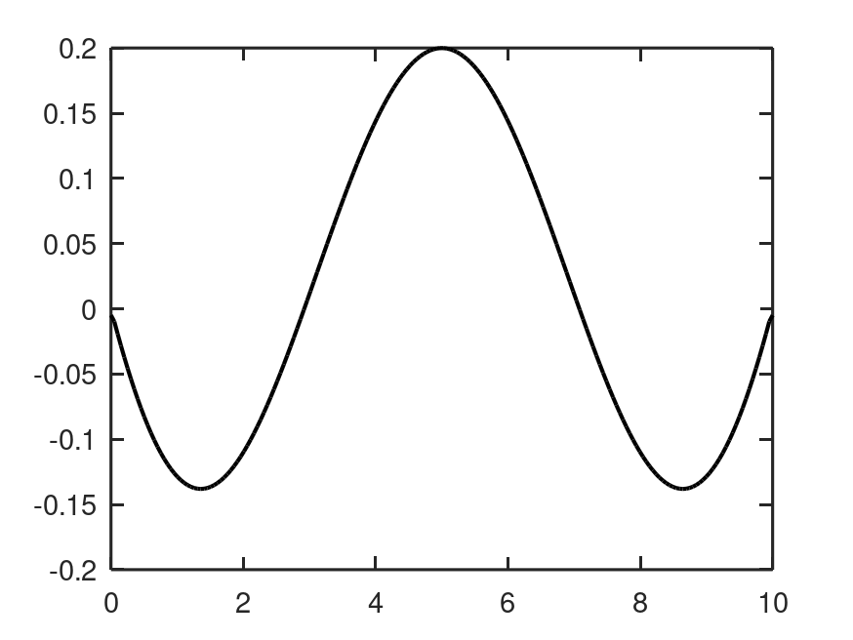


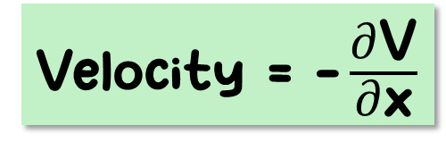
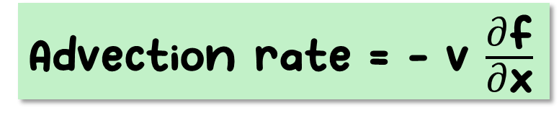
Velocity = $\text{-}\frac{\text{∂}\text{V}}{\text{∂}\text{x}}$
Advection rate = - v $\frac{\text{∂}\text{f}}{\text{∂}\text{x}}$

Slide 5
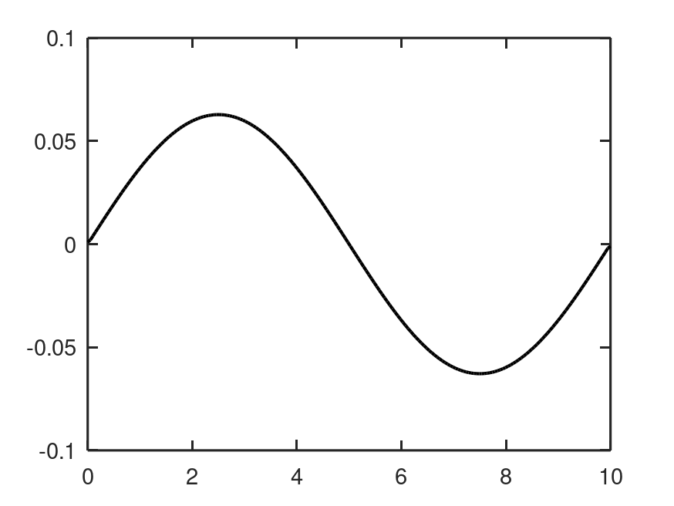
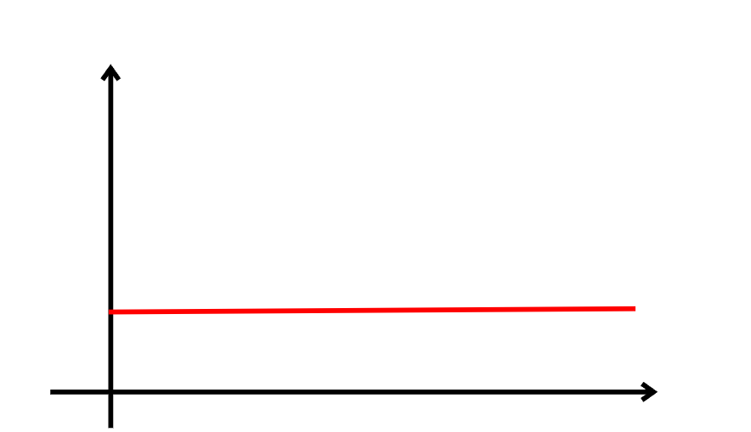
If Velocity = 1
Advection rate = - v $\frac{\text{∂}\text{f}}{\text{∂}\text{x}}$
1

