Slide 1
Telecom Network Intelligence
Architecture proposal • role-based AI agents • local proof of concept
Objective: turn vendor inventory, topology and performance counters into trusted, explainable incident evidence.
Three capabilities: Connection Factory (normalize), KPI Engine (measure), Topology Engine (relate).
Design principle: deterministic data services and policy enforcement; LLM for synthesis, not facts or execution.
Scale assumptions: 5 tenants • 250k cells • 2m relationships • 50m counter rows/day • 100 concurrent investigations.

Slide 2
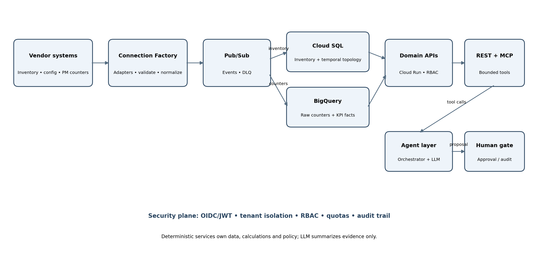
1. Proposed architecture
Use managed GCP services first; keep the operational footprint small.

Slide 3
2. Data model and correctness
Inventory: stable entity IDs, tenant_id, source IDs, version, provenance, observed_at and valid_from/valid_to.
Topology: typed edges with tenant scope, relationship confidence and bitemporal validity; as-of queries reconstruct incident-time topology.
Storage: Cloud SQL PostgreSQL for canonical inventory + temporal edges; BigQuery for immutable counters and KPI facts.
KPI windows: UTC 15-minute buckets; deduplicate; provisional before 2-hour watermark, final after watermark; late arrivals trigger versioned recomputation.
Missing samples are PARTIAL/UNAVAILABLE—not zero. Return formula_version, coverage, sample_count, watermark and calculation_run_id.

Slide 4
3. API, MCP and role boundaries
Canonical REST: GET /v1/topology/{id}; GET /v1/kpis/{id}; POST /v1/investigations; POST /v1/change-proposals.
MCP tools are thin adapters over the same service layer and authorization checks; no separate privilege path.
Alarm management: read topology/KPIs; propose incident updates. Performance analysis: read and export. Change planning: simulate and propose only.
OIDC/JWT claims supply subject, tenant and roles. Never trust agent-provided tenant IDs. Enforce depth ≤2, ≤20 affected cells, response caps, deadlines and quotas.
Production network changes require a separate human approval and audited execution identity.

Slide 5
4. Agent workflow, delivery and risks
Trigger → validate/dedupe cells → retrieve topology as-of alarm time → fetch baseline/current KPIs → deterministic correlation → evidence classification → LLM summary.
LLM: summarize structured findings, explain uncertainty, draft incident update. Deterministic code: calculations, thresholds, authorization, completeness and action gating.
Stop/escalate on tenant ambiguity, unresolved topology conflicts, stale/missing KPI coverage or conflicting evidence. Never execute a production change autonomously.
Release 1: one vendor + temporal inventory + 2-hop API + KPI query + alarm investigation + synthetic fixtures. Then add watermark/recompute, MCP/OIDC, audit and load testing.
Risks: tenant leakage, late/missing data, vendor identity drift, LLM overclaiming, unbounded traversal/cost. Benchmark PostgreSQL; add graph DB only if measured needs justify it.

