Slide 1
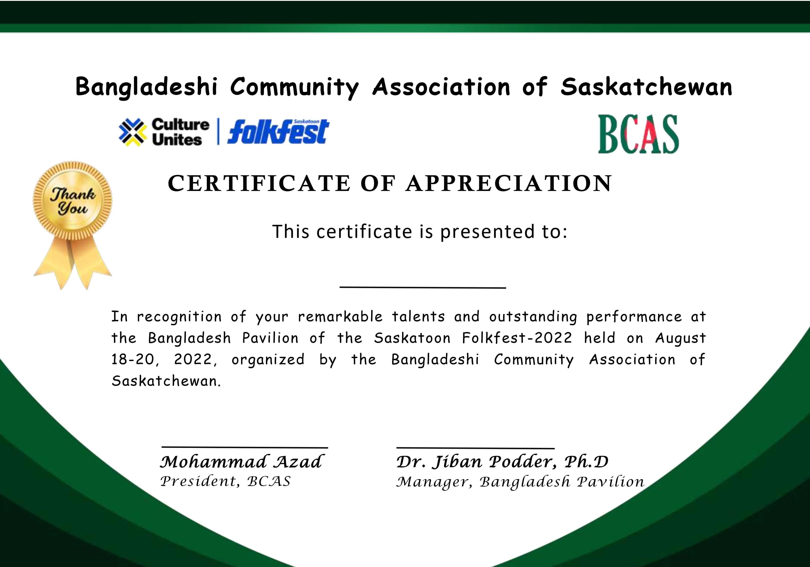




Bangladeshi Community Association of Saskatchewan
বাংলাদেশী কমিউনিটি এ্যসোসিয়েশন অব সাসকাচুয়ান
CERTIFICATION OF APPRECIATION
This certificate is presented to:
In recognition of your generous help and remarkable volunteer service at the Bangladesh Pavilion, Saskatoon Folkfest 2023, hosted by Bangladeshi Community Association of Saskatchewan on August 17-10, 2023.

Slide 2
Bangladeshi Community Association of Saskatchewan
বাংলাদেশী কমিউনিটি এ্যসোসিয়েশন অব সাসকাচুয়ান
CERTIFICATION OF APPRECIATION

Slide 5
Bangladeshi Community Association of Saskatchewan
বাংলাদেশী কমিউনিটি এ্যসোসিয়েশন অব সাসকাচুয়ান
CERTIFICATION OF APPRECIATION
This certificate is presented to:
In recognition of your remarkable talents and outstanding performance at the Bangladesh Pavilion of the Saskatoon Folkfest-2023 held on August 17-19, 2023, organized by the Bangladeshi Community Association of Saskatchewan.
Mohammad Azad
Khan A Wahid

Slide 6

Bangladeshi Community Association of Saskatchewan
বাংলাদেশী কমিউনিটি এ্যসোসিয়েশন অব সাসকাচুয়ান
CERTIFICATION OF APPRECIATION
This certificate is presented to:
In recognition of your outstanding contributions and remarkable performance as a cricketer representing the Bangladesh Community Association of Saskatchewan in the Mini World Cup Cricket 2023, Saskatoon, Saskatchewan.
Mohammad Azad
Joydip Das
Team Manager, Bangladesh Team

