Slide 1
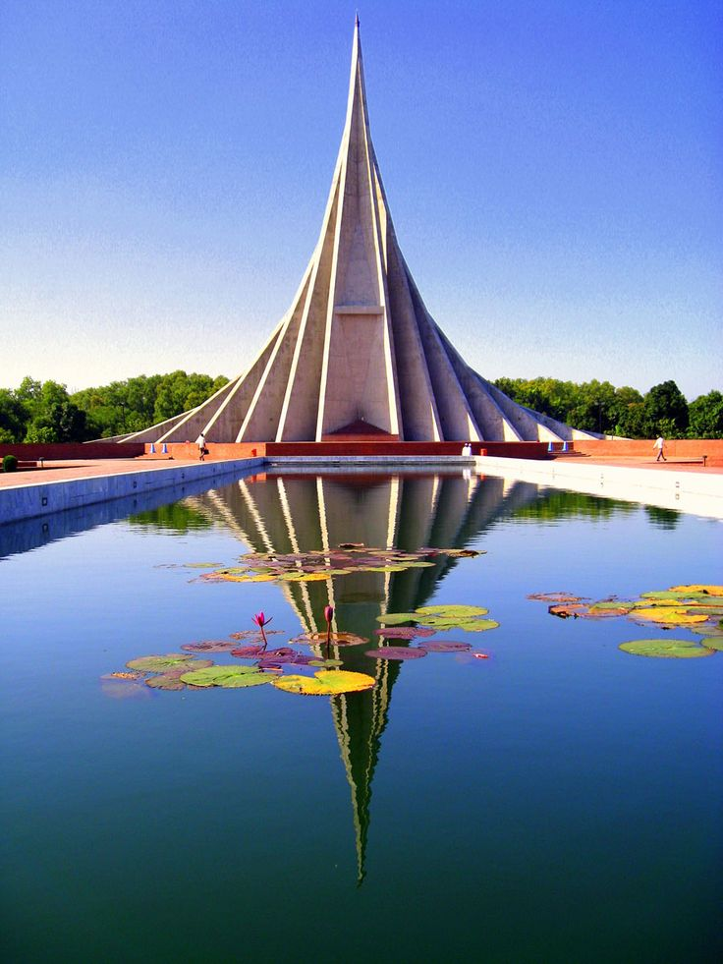


Slide 3





১৬
ডিসেম্বর
Mayfair United Church
902 33rd St W,
Saskatoon, SK S7L 0W6
মহান
বিজয়
Saturday, 16 Dec, 2023
দিবস
5:30 PM
দিবস
OUR SPONSORS
•Asif Khan •Priyanka Nandi •Feroza Financial •Makkah Halal Grocery
•First Choice Supermarket & Halal Meat •S M Auto Sales Ltd.
•Guide Me Immigration •Popular Auto •Sky Motors
•Economy Auto Repair •Nas-Motive Auto Sales & Services

Slide 4

Venue: Mayfair United Church902 33rd St W, Saskatoon, SK S7L 0W6
Date: Saturday Dec 16, 2023Time: 5.30pm

Slide 5


SUNDAY
17 DEC, 2023
5:30 PM
St. Paul’s United Church
454 Egbert Ave
Saskatoon, SK S7N 1X3
OUR SPONSORS
•Priyanka Nandi •Feroza Financial •S M Auto Sales Ltd. •Popular Auto
•Sky Motors •Economy Auto Repair •Nas-Motive Auto Sales & Services •Confederation Inn & Suites •First Choice Supermarket & Halal Meat •Beautyleven Canada •Guide Me Immigration

Slide 6

Bangladeshi Community Association of Saskatchewan
বাংলাদেশী কমিউনিটি এ্যসোসিয়েশন অব সাসকাচুয়ান
SUNDAY, 17 DEC, 2023
5:30 PM
St. Paul’s United Church
454 Egbert Ave
Saskatoon, SK S7N 1X3
OUR SPONSORS
•Priyanka Nandi •Feroza Financial •S M Auto Sales Ltd. •Popular Auto
•Sky Motors •Economy Auto Repair •Nas-Motive Auto Sales & Services •Confederation Inn & Suites •First Choice Supermarket & Halal Meat •Beautyleven Canada •Guide Me Immigration

Slide 7
১৬
ডিসেম্বর
মহান
বিজয়
দিবস
মনোজ্ঞ সাংস্কৃতিক সন্ধ্যা
অংশগ্রহণেঃ
Bangla School, BSAUS,Local Artist
Sunday, 17 Dec, 2023 @5:30 PM
St. Paul’s United Church, 454 Egbert Ave, Saskatoon, SK S7N 1X3
OUR SPONSORS
•Priyanka Nandi •Feroza Financial •S M Auto Sales Ltd. •Popular Auto
•Sky Motors •Economy Auto Repair •Nas-Motive Auto Sales & Services •Confederation Inn & Suites •First Choice Supermarket & Halal Meat •Beautyleven Canada •Guide Me Immigration

Slide 8
Bangladeshi Community Association of Saskatchewan
বাংলাদেশী কমিউনিটি এ্যসোসিয়েশন অব সাসকাচুয়ান
১৬
ডিসেম্বর
মহান
বিজয়
দিবস
মনোজ্ঞ সাংস্কৃতিক সন্ধ্যা
অংশগ্রহণেঃ
Bangla School, BSAUS,Local Artist
Sunday, 17 Dec, 2023 @5:30 PM
St. Paul’s United Church, 454 Egbert Ave, Saskatoon, SK S7N 1X3
OUR SPONSORS
•Priyanka Nandi •Feroza Financial •S M Auto Sales Ltd. •Popular Auto
•Sky Motors •Economy Auto Repair •Nas-Motive Auto Sales & Services •Confederation Inn & Suites •First Choice Supermarket & Halal Meat •Beautyleven Canada •Guide Me Immigration

