Slide 1
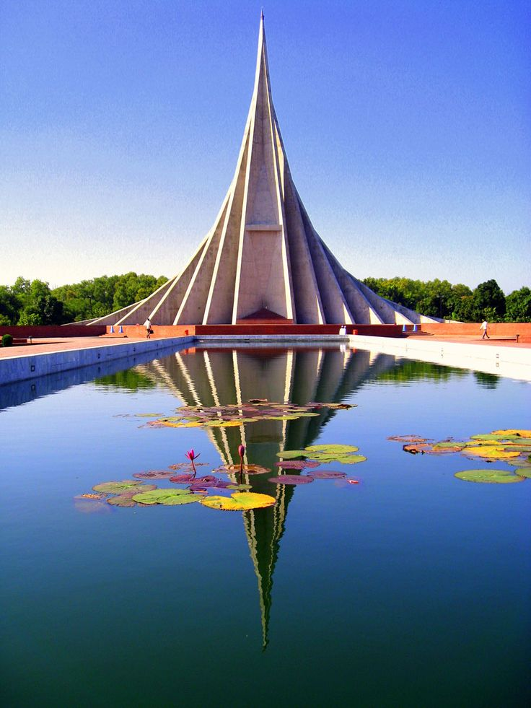


Slide 3


Slide 4





১৬
Victory Church
2802 Rusholme Road
Saskatoon, SK
Saturday, 16 Dec, 2023
6PM – 10PM

Slide 5


