Slide 1
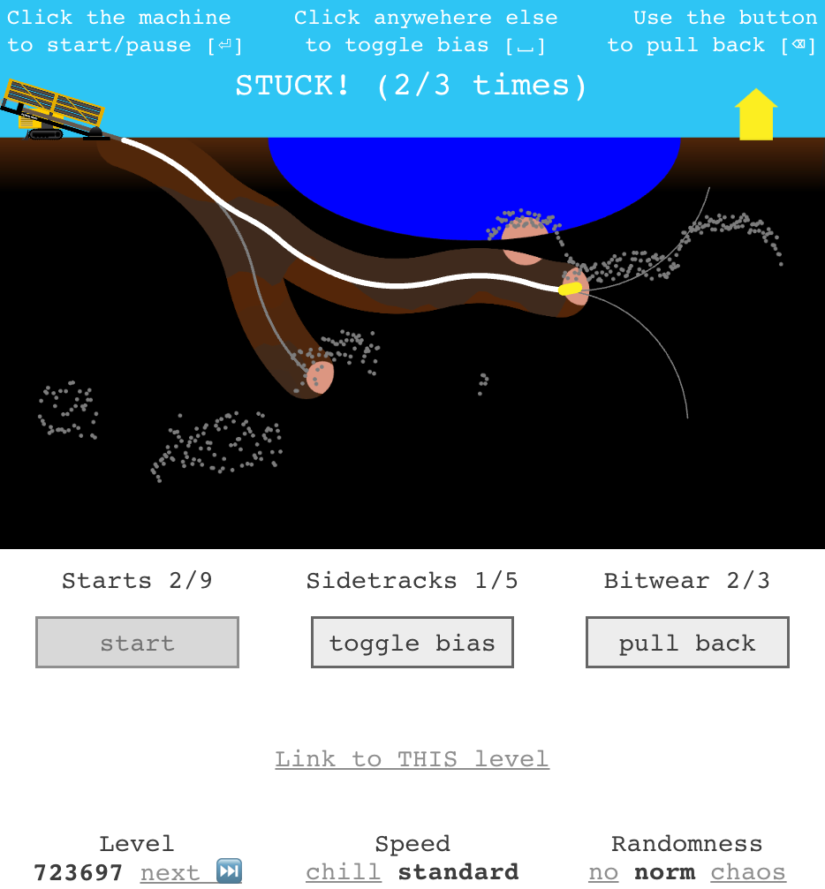
Drilling machine
Drilling target
Starting point
Visible boulder
Reflected soundwaves
(gray dots) identify the position of boulders closest to the surface
RIVER
Logging instruments near drill bit remove the Fog of uncertainty
Old side-track
Current well
Bit direction (aka bias)
Steering limit indiction
“Lives” left
Pause and go back to drill in different direction
Change drilling direction in real-time
Keep trying this or go to next level
Keep trying this or go to next level
How much bit resists the turns

Slide 2
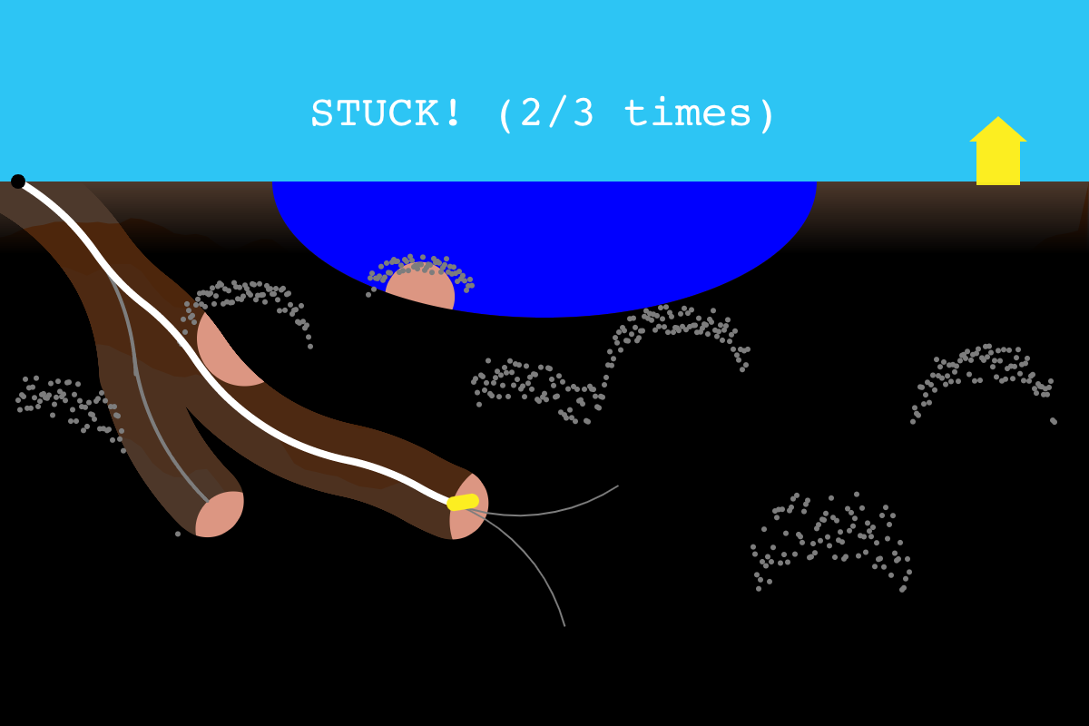
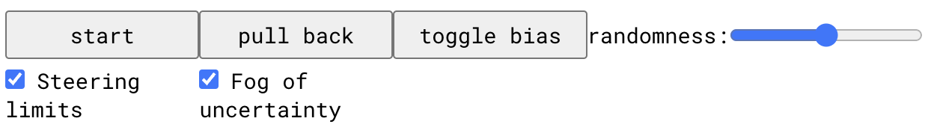
Starting point
Drilling target
Visible boulder
Logging instruments near drill bit remove the Fog of uncertainty
Reflected soundwaves identify the position of the boulders closest to the surface
Current well
Old side-track
Bit direction (aka bias)
Steering limit indiction
Pause and go back to drill in different direction
Change drilling direction in real-time
How much the bit resists the turns, %

Slide 3
toggle bias
Pause
Pull back
Fog of uncertainty
Steering limits
Instructions
Copyright

