Slide 1
Optimizing Artificial Neural Network Parameters for Predicting Horseshoe External Curve Lengths
Alina Ahmed

Slide 2
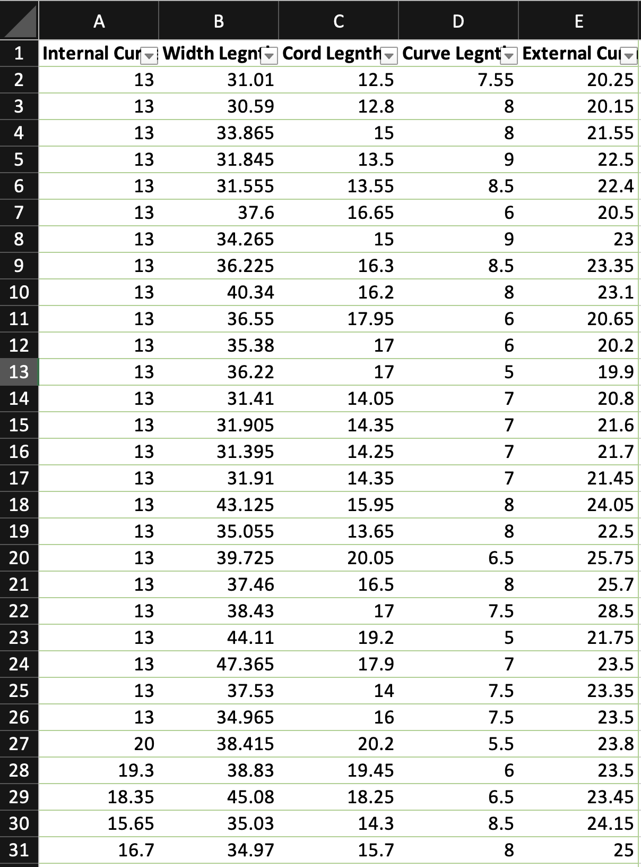
Abstract
An artificial neural network was built and optimised to find the external curve length of a horse shoe from the 4 predictor variables; Internal curve length width length, cord length and internal curve length
The model was trained on a dataset of 219 samples, 4 data points were identified to be outliers and were modified so as not to bias the system with invalid data
4 main parameters were experimented with and evaluated using mean squared error and cross validation to build an optimised model which provides the most accurate predictions of the external curve length of a horseshoe. Graphs and plots were also generated to visually assess the impact of different parameters on the models performance.
The optimised model had the following parameters as a result of multiple iterative processes:
Data pre-processing – data normalised with min-max scaling, outliers modified
Topology – 1 hidden layer with 9 hidden units
Activation function of hidden layer - radbas
Training function - traincgp
Data splicing ratio – 80:10:10 for training, validation and testing
The final optimised model had a mean square error of: 0.0541 and a mean squared loss value from cross validation of: 0.0051
Snippet of the dataset provided

Slide 3
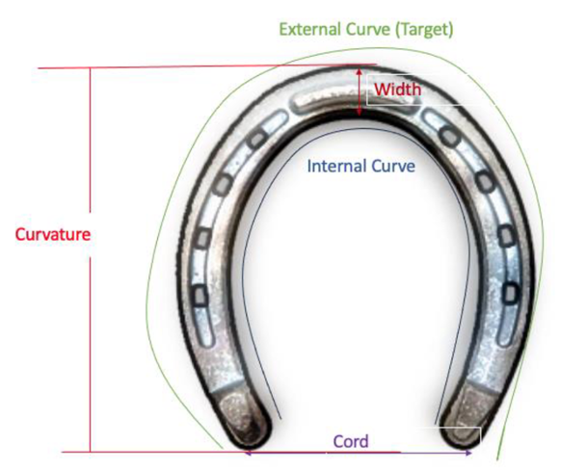
Introduction
Horseshoes are metal plates fitted to horses for protection or extra traction, depending on the type of work the horse will be doing. Currently the correct size is found through manual fitting and adjusting and trial and error which can be time consuming and inefficient as well as a waste of resources.
The task was to create an ANN to predict the external curve of a horseshoe based on 4 predictor variables. (Internal curve length (cm), Width Length (mm), Cord Length (cm), Curve Length (cm)
This problem was a multiple linear regression problem since there is more than one predictor variable. The importance of ensuring an accurate prediction of the external curve length is so we can optimize the design and fitting of horseshoes to ensure comfort and performance of horses.
A mathematical equation could be derived and used in a program instead but a model is a more sophisticated solution as it can capture complex patterns and relationships in data and represent any noise or variability in the data which an equation could not so therefore it would be a better solution.
The focus was on systematically exploring the impact of different parameters on the models predictive performance. The goal was to create a neural network model with the best combination of parameters to most accurately predict the external curve length. Through systematic experimentation to find the optimal:
Activation function
Training function
Network topology
Data Splicing ratio
Diagram of the measurements of a horseshoe
Notes:
Horseshoes are metal plates fitted to horses for protection or extra traction, depending on the type of work the horse will be doing. Currently the correct size is found through manual fitting and adjusting and trial and error which can be time consuming and inefficient as well as a waste of resources.
The task was to create an ANN to predict the external curve of a horseshoe based on 4 predictor variables. This problem was a multiple linear regression problem since there is more than one predictor variable. The importance of ensuring an accurate prediction of the external curve length is so we can optimize the design and fitting of horseshoes to ensure comfort and performance of horses. A mathematical equation could be derived and used in a program instead but a model is a more sophisticated solution as it can capture complex patterns and relationships in data and represent any noise or variability in the data which an equation could not so therefore it would be a better solution.
The focus was on systematically exploring the impact of different parameters on the models predictive performance. The goal was to create a neural network model with the best combination of parameters to most accurately predict the external curve length. Exploration of these parameters involved experimentation with different types and combinations of:
Data pre-processing
Loss Function (Activation Function) and Evaluation Metrics
Architecture and topologies
Data Splicing
Hyperparameter Tuning(such as learning rate, number of epochs)
Different data Normalization Technique
Through this exploration, I aimed to compare and find the optimal combination of parameters that maximizes the predictive power of the neural network.

Slide 4
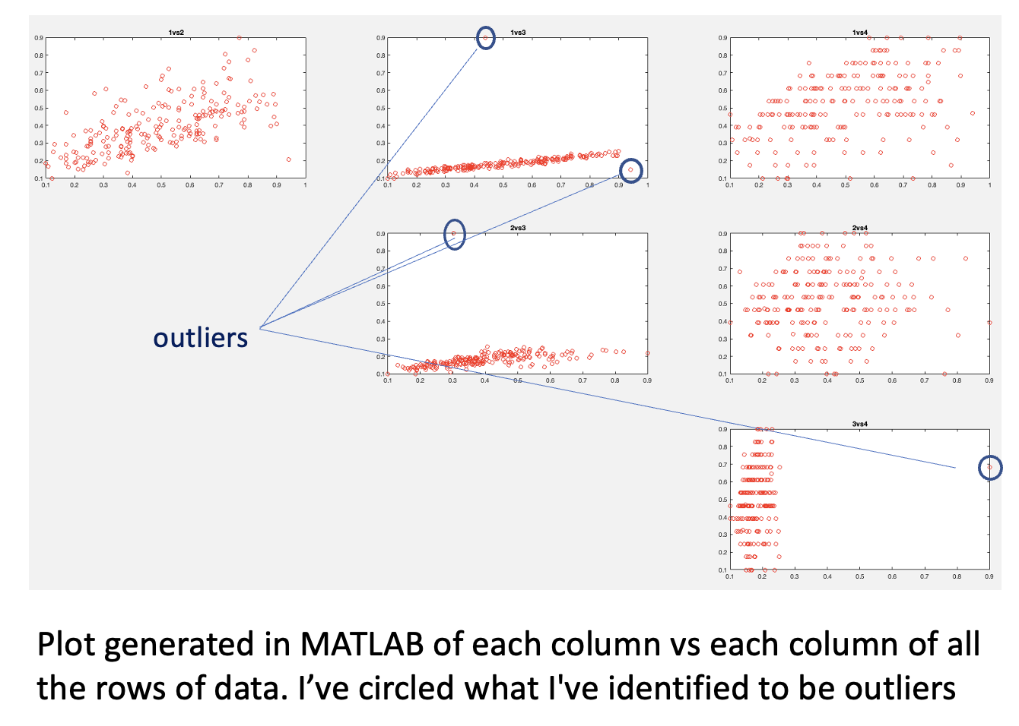
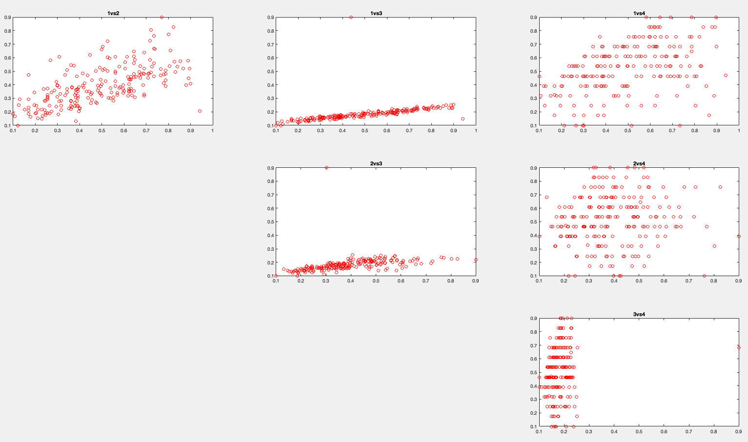
Data Pre-Processing
Dataset Normalization
219 samples
Normalized by min/max scaling
At the end of the method explored other methods of normalization
Outliers
Generated graphs to visually spot outliers
Changed the outliers to the mean value – there were not many, so did not remove due to small dataset
outliers
Plot generated in MATLAB of each column vs each column of all the rows of data. I’ve circled what I've identified to be outliers

Slide 5
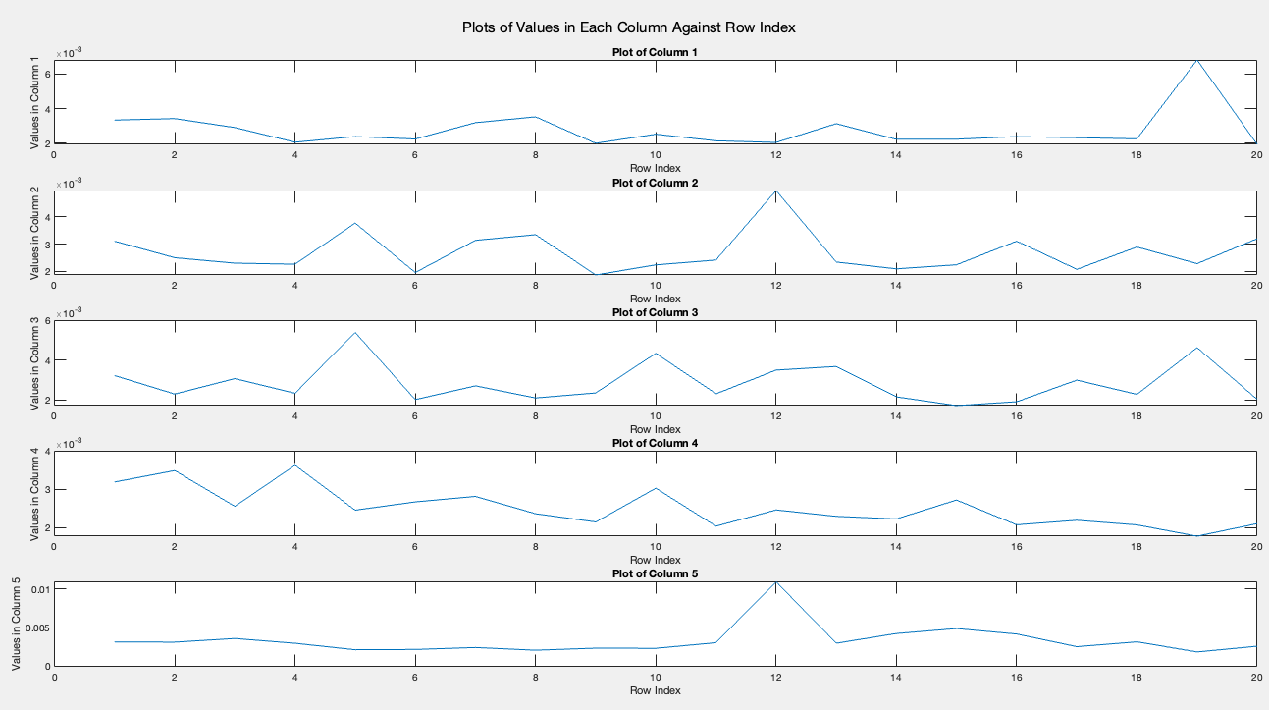
Topological Exploration
Conclusion
Input layer –> 4 neurons
Hidden Layer 1 –> 9 neurons
Output layer –> 1 neuron
Methodology
Input layers and Output layers were not interfered with
Number of hidden layers was decided to be 1, experimentation of the number of hidden units
Through multiple iterative processes, the number of neurons for the hidden layer was selected to be one which produced the smallest Mean Squared Error
Tested 1-20 neurons for the hidden layer
Used parallel processing to reduce training time
Repeated each test for a neuron 5 times
Identified which neuron contained the lowest MSE from a matrix of MSE values
Plot generated in MATLAB of each row index (number of hidden units) vs MSE values.
Suitable values for the best topology could be: 6(average mse=0.00222), 9(average mse=0.00214), 11(average mse=0.00236), 14(average mse=0.00258), 18(average mse=0.00256)

Slide 6
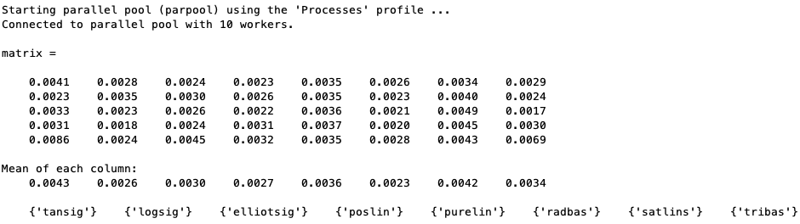
Activation (Transfer) Function Exploration
Outcome Decision
Hidden Layer 1 activation function: radbas
Output Layer activation function: purelin
Methodology
Only experimented with the activation functions which were suitable for regression tasks: tansig, logsig, elliotsig, poslin, purelin, radbas, satlins, tribas
Functions such as softmax which are more suited to classification tasks were not tried
Matrix generated where each column represents a different activation function tried and the MSE error result. The average of each column is then calculated to show the lowest MSE error value is for radbas (0.0023)
Through multiple iterative processes, the activation function was selected to be one which produced the smallest Mean Squared Error
Tested 8 different activation functions
Repeated each test for each different function 5 times and then found the average
Identified which function produced the lowest average MSE value

Slide 7
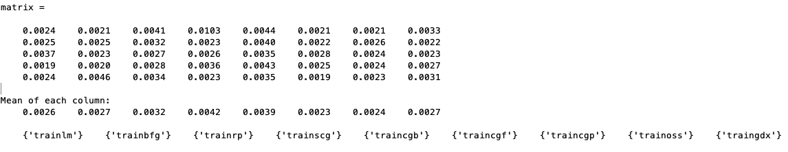
Training Function Exploration
Outcome Decision
Training function: traincgp
Methodology
Experimented with all 9 matlab training functions: trainlm, trainbfg, trainrp, trainscg, traincgb, traincgf, traincgp, trainoss, traingdx
Through multiple iterative processes, the training function was selected to be one which produced the smallest Mean Squared Error
Tested 9 different training functions
Repeated each test for each different function 5 times and then found the average
Identified which function produced the lowest average MSE value
Matrix generated where each column represents a different training function tried and the MSE error result. The average of each column is then calculated to show the lowest MSE error value is for traincgp (0.0023)

Slide 8
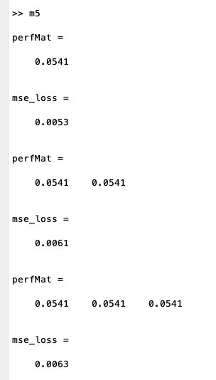
Data Splicing Ratio Exploration
Conclusion
Data splitting ratio: 80 for training, 10 for validation and 10 for testing
Data was split into the following 3 categories:
Training set: data for the network to learn patterns and relationships and update its weights and biases
Validation set: data to identify and minimize overfitting so the network does not learn the training data and can perform well with unseen data
Test set: data that is unseen and assesses the final performance of the trained model on its ability to generalize new data
Methodology
Experimented with 3 different common ratios of splitting of data:
80:10:10
70:15:15
60:20:20
Evaluated the performance of the model with the different ratios using MSE
MSE indicated the same error value for each ratio so cross validation was also used as an evaluation tool
The lowest value indicated by cross validation was selected as the optimal ratio for data splitting

Slide 9
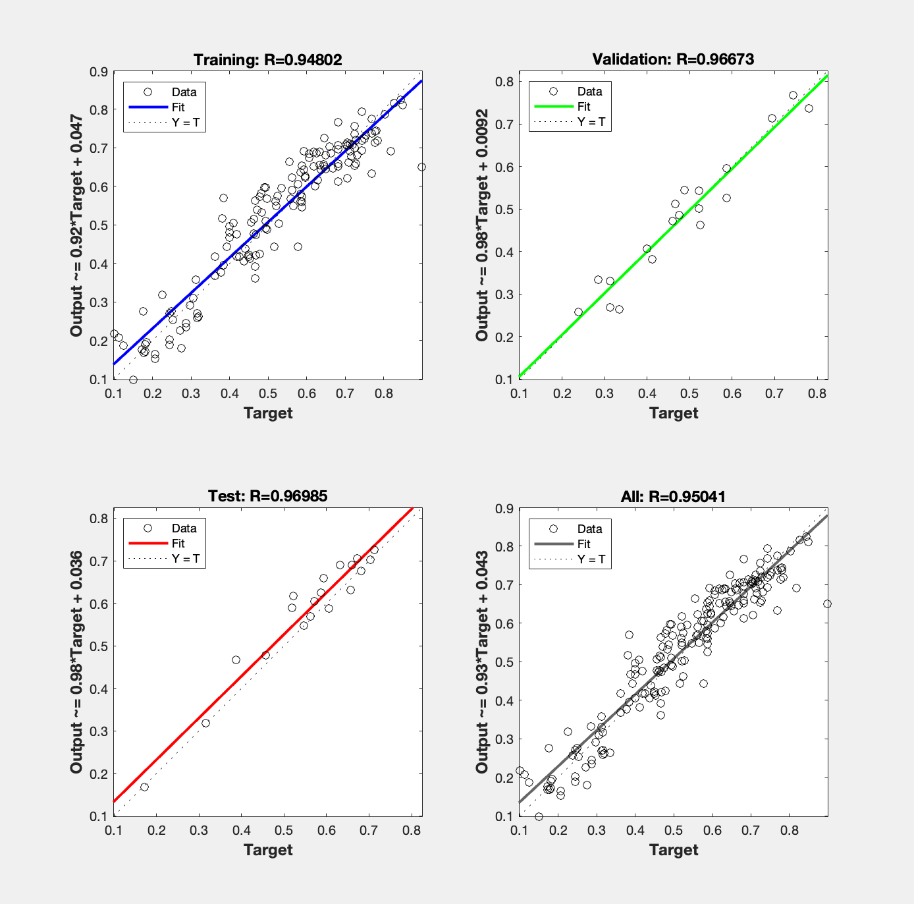
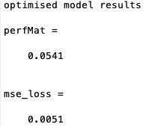
Results and Conclusions
The model’s key limitation is the size of the dataset. The dataset contains only 219 samples, a larger sample size would be more representative and better at allowing the model to train.
A recommendation for future work would be to explore the results of deriving a mathematical equation to calculate the external curve length compared to the predictions of a model and observe which is more accurate.
A mathematical solution may be more efficient, however, a model is able to represent noise and variability in data
Result of mean squared error
Result of cross validation

