Slide 1
Class Project:
Forum - E-commerce
Alina Akram - MET CS665 Software and Design Patterns
Notes:
Hello everyone, My name is Akram Akram and I’m going to present my term project for for MET CS 665 Softwrare and design patterns class.
I opted to make a simple implementation of an e-commerce site where the user gets a prompt to view the inventory and is required to submit user input based on the corresponding number in order to add and remove from a shopping cart then eventually checking it out and getting your total. I chose this as I wanted to focus on the builder design pattern and this proved to be effective and helped me think a few steps ahead to simplify the development process.

Slide 2
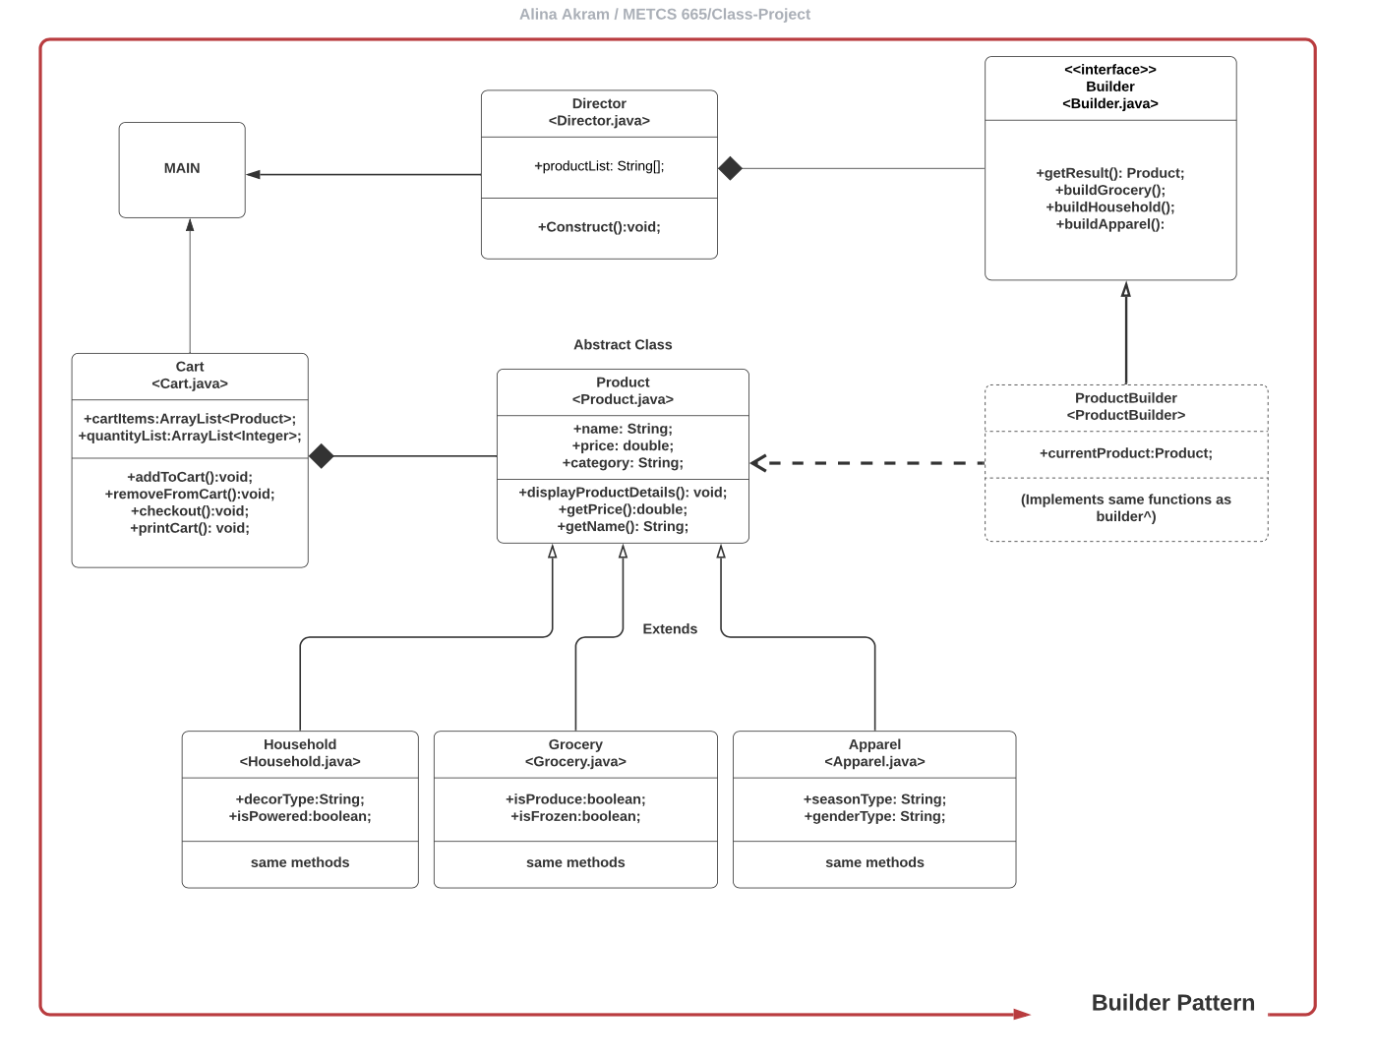
Notes:
To give you a brief idea for the way the project is structured, here is a UML representation of my classes and implementation of the builder design pattern. As you can see main class is the point of execution the initiating and concluding classes point to. The director class contains the necessary construct method vital to this design pattern, which then refers to the Builder interface that contains the getResult() and product specific build methods. This interface is then implemented by our Concrete Builder class named PRODUCT builder which generates a product object i.e our product class. Using similar functionality of the builder interface the same methods are accessible in our product builder the get result, build gtocery etc. product builder to generates an abstract product class with the universal attributes and methods required of all products in the inventory such as name, price, category with our get methods for price, name and displayproduct details. Due to the variety of products on the sit it comes under categories that generate the concrete product classes that ALL extend the abstract class product. Household, grocery and apparel have the same attributes and methods as the product class, their product specific details are listed specifically.

Slide 3
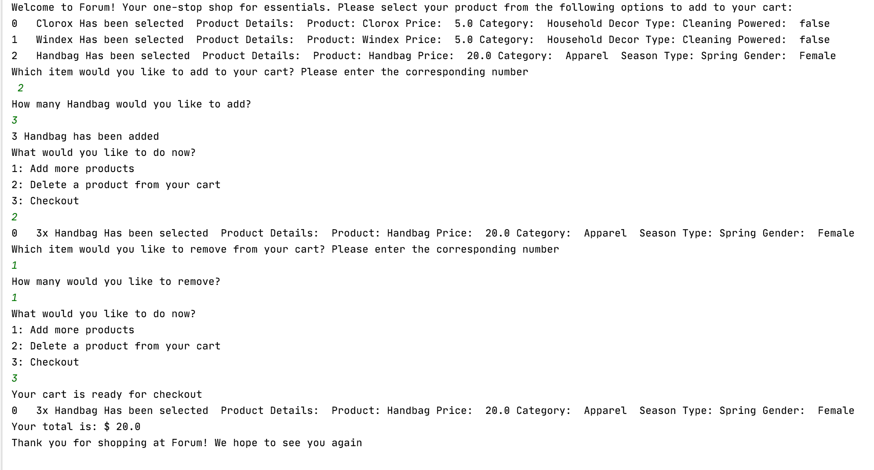
PROGRAM SNAPSHOT
Notes:
Here is the complete program output when the program has ended. We will run it in the terminal after these slides
mvn clean compile
mvn -q clean compile exec:java -Dexec.executable="edu.bu.met.cs665.Main" -Dlog4j.configuration="file:log4j.properties"

Slide 4
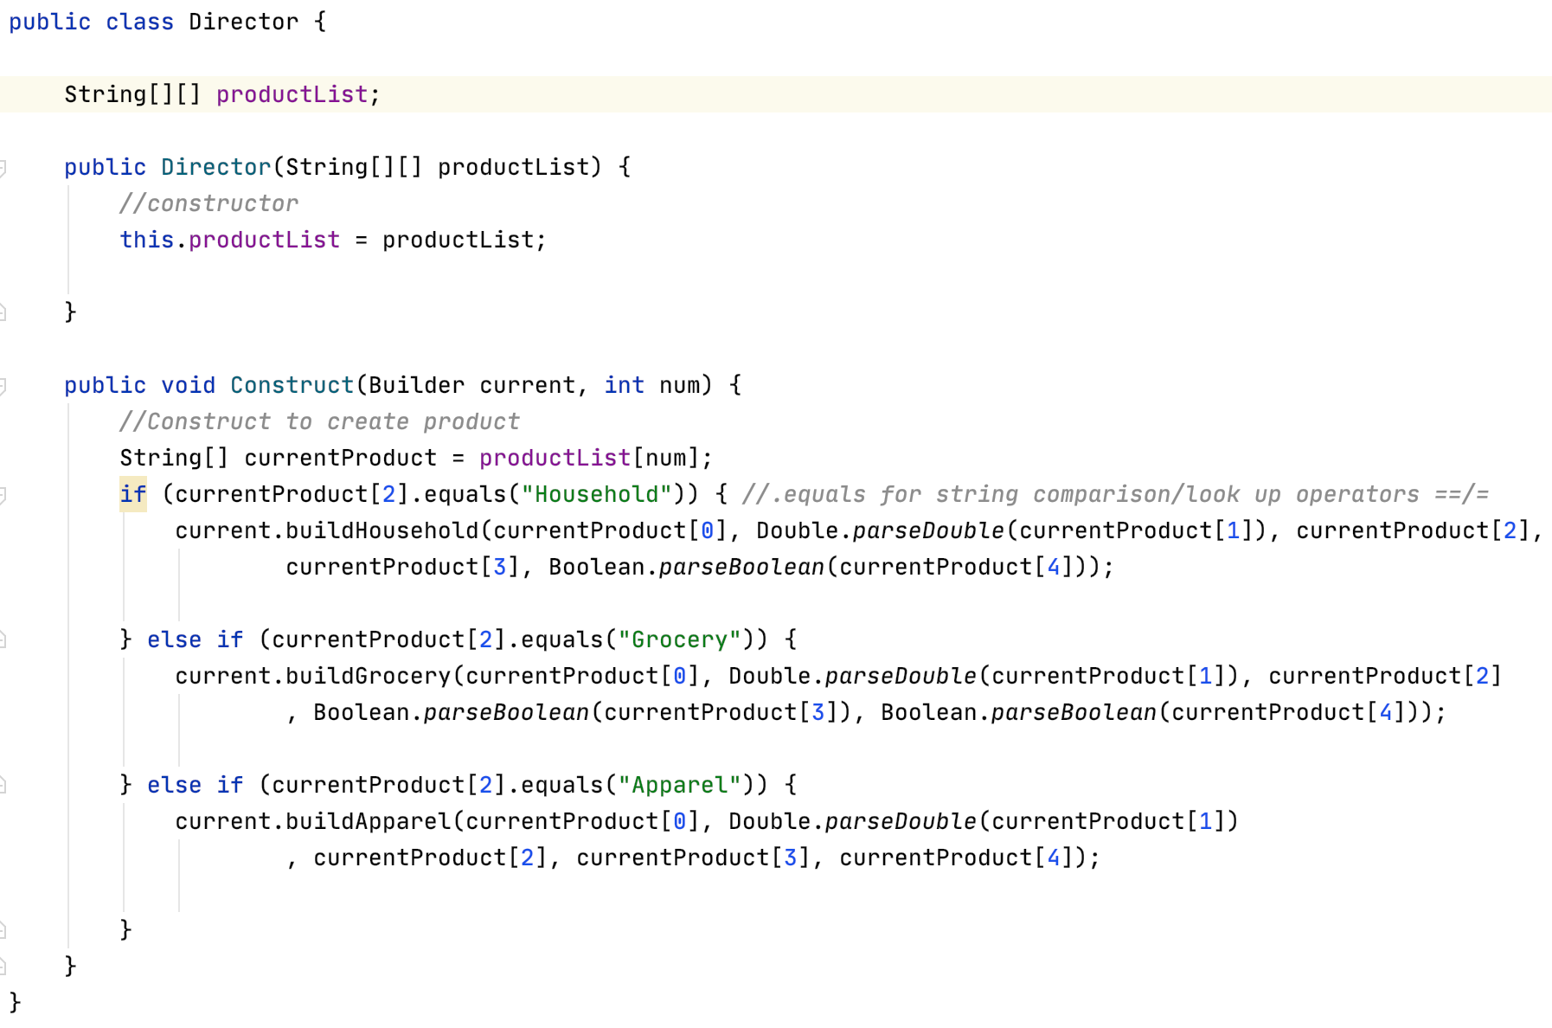
Director
Notes:
The Director class defines the order in which to call construction steps, so you can create and reuse specific configurations of products. As you can see the conditions we have set dictate which product will everntually be generated based on user input

Slide 5
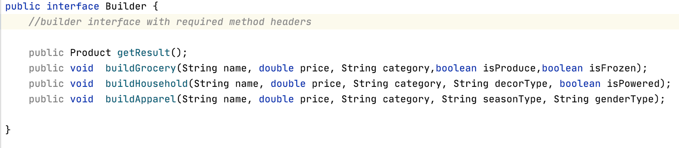
Builder Design Pattern - Components
Notes:
The design goal was to encapsulate code for construction and representation
as needed to accomodate a variety of products without having to hard-code and avoid duplicate code. It allows for more control over constructing more complex objects. This pattern entails referencing and delegating responsibility down to the generation of a specific Product.
The main cmponent the builder - The Builder interface declares product construction steps that are common to all types of builders.

Slide 6
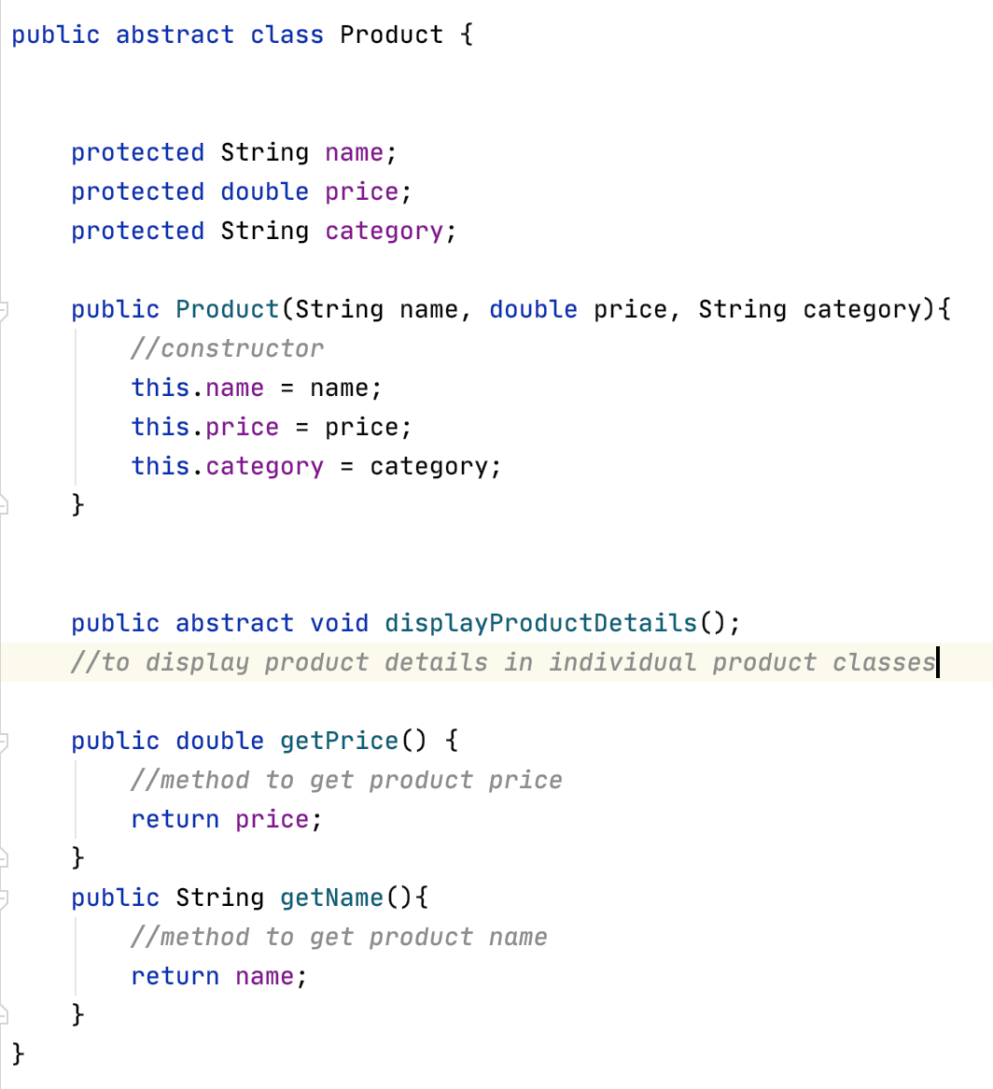
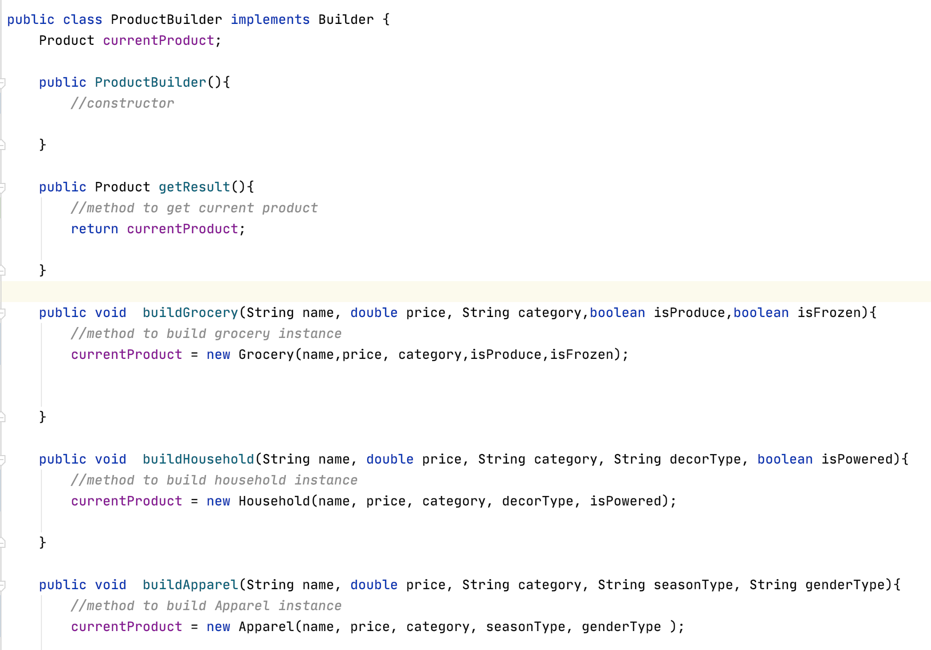
Notes:
ProductBuilder implements the builder interface with same implementations of the construction steps. Side note, concrete builders may also produce products that don’t follow the common interface.
Product is an abstract class we created to hold the commonalities between all products so we can use them in a clean organized manner and avoid duplicate code. Name, price, category are common across the whole inventory, with the necessary getPrice, getName and displayproduct details methods. You will see in the next slide how we managed to work with limited code

Slide 7
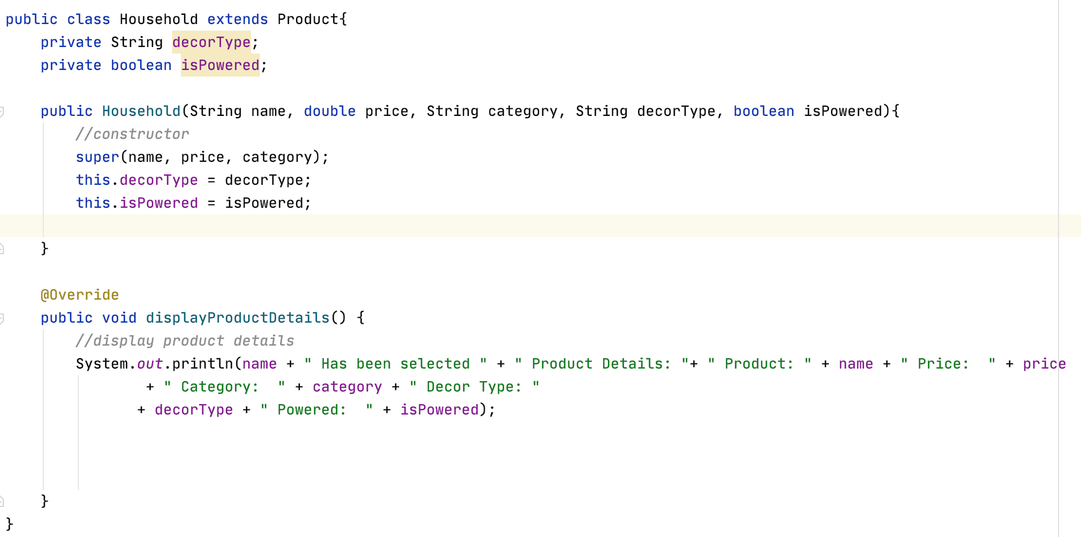
Notes:
Just an example of the resulting concrete product in household as you can see super has been called allowing us access to the same methods and attributes as the product class.

Slide 8
Github Repo: https://github.com/alina-akram/metcs-met-cs665-assignment-project-alina-akram
Thank you
Notes:
I’ve included a link to the github repo the project is currently on please have a look if you would be happy to receive some feedback and suggestions

