Slide 1
WEBSITE DESIGN
SESSION1

Slide 2
Motivation: Arrange the jumbled letter to form a word
T I R E T E N N -
R I F N G U S -
E R W S O R B -
D U L A O P -
D A L O N O D W -

Slide 3
Browser – Short for web browser, a software used to locate and display Web pages. This enables us to view HTML pages without the codes. The most popular web browsers are Internet Explorer, Mozilla Firefox and Opera.
Surfing – a term used to browsing through the net.

Slide 4
Download – To transfer a file from other computer system in the internet to your own computer system. (ex. Getting music files such as MP3. and Videos)
Upload – To transfer a file from your computer system to another computer system. (ex. Sending E-Mail)
WWW or World Wide Web – one of the protocols that let you link to many sites in the internet. Consists of a huge collection of documents stored on computers around the world.

Slide 5
Hyperlinks – an HTML anchor tag that serves as a link to another HTML document. Hyperlinks may come in the form of a simple text or an image.
Web page – is a document on the World Wide Web. It may contain pictures, videos, animated GIFs, or just plain text.
Web Site- is a collection of web pages about a particular organization, company, individual or topic. Each web site contains a home page which is the first document users see when they enter the site.

Slide 6
HTML (Hyper Text Markup Language)- the authoring language used to create documents on the World Wide Web.
URL – Uniform/Universal Resource Locator. It is the global address of documents and other resources on the World Wide Web. Also known as the “Web site Address.”
Search Engine- a web site that allows you to search all or parts of the world wide web for the keyword that you input.

Slide 7

History of the
Internet

Slide 8

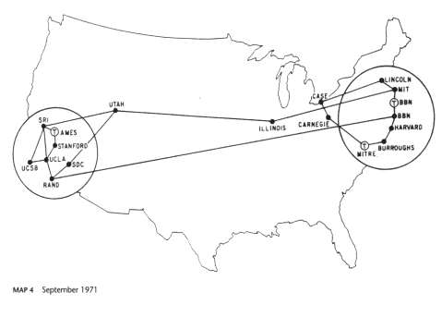
ARPANET
Was the world's first operational network, and the predecessor of the global Internet

Slide 9
ARPANET
ARPANET was developed by the U.S. Department of Defense. One theory was that it was developed to survive a nuclear attack. That theory is often disputed by scientists.

Slide 10

The Internet
In the beginning, only government “think tanks” and few
universities were linked. Basically the Internet was an emergency military communications system

Slide 11

Why is it called the Internet?
Short for “Interconnected Network.”

Slide 12
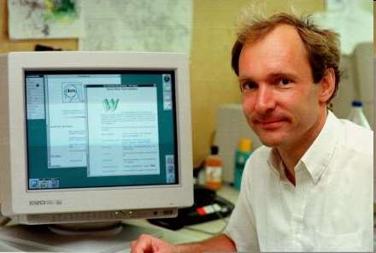
Creation of the World Wide Web
Tim Berners Lee brought all of this together at the European Laboratory for Particle Physics (CERN) to form the World Wide Web in 1990.

Slide 13
Mosaic: The First Web Browser (1993)
Very slow
Did not handle loading pictures very well
Modems were very slow
Did not give an indication of the potential of this medium

Slide 14

The Explosion of the Internet

Slide 15
1994 -- 2000
The Internet exploded during this period.
The first commercial site was Amazon.com.
In 1994 the World Wide Web grew by an astounding 2300 percent!
Amazon saw that online shopping was the wave of the future.
The rest is history…

Slide 16
Browser Wars
Netscape was the standard until 1998
It folded and was taken over by AOL
Microsoft Internet Explorer snagged 96% of the browser market
IE has only recently been challenged by the excellent Mozilla browser

Slide 17











A worldwide system of interconnected networks and computers.
It is a collection of computers throughout the world which are mostly interconnected using telephone lines or even satellites for the purpose of sharing information.

Slide 18



What is a Network?
A computer network is an interconnection of a group of computers.

Slide 19




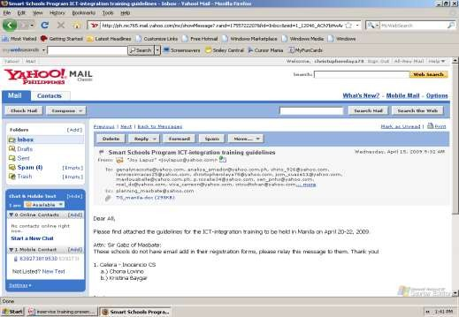
What can you do on the Internet?
enables us to send and receive messages through e-mail all over the world.

Slide 20



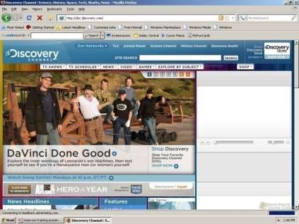
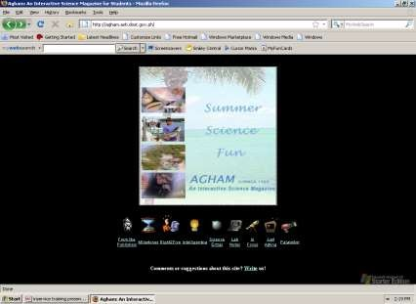
You can access any information on any subject through the Internet. That is why the internet in now a very important tool for research works and educational purposes.

Slide 21

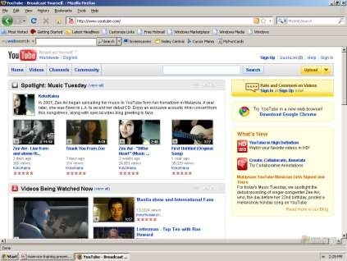
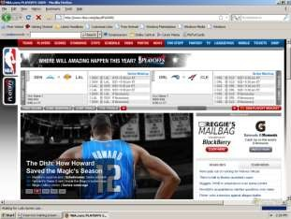
The Internet offers thousands of sites where you can watch your favorite celebrity.

Slide 22


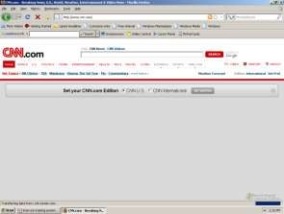
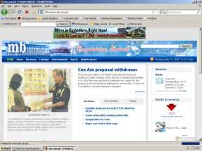
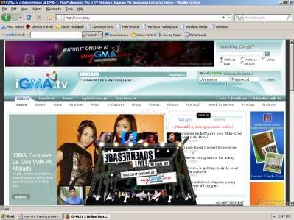
News from CNN, NBC, ABS-CBN or GMA7 or from your national newspaper can be accessed through the internet.

Slide 23





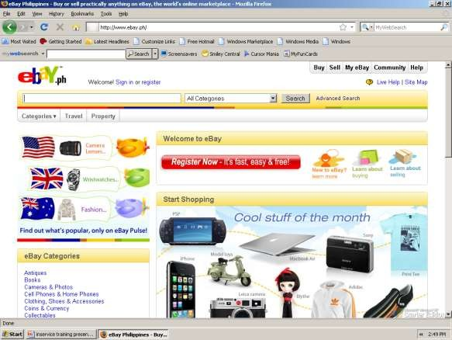
We can order desired goods and services on the Internet in the comports of our home.

Slide 24
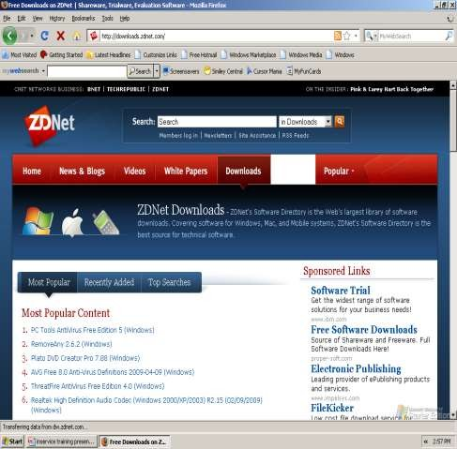
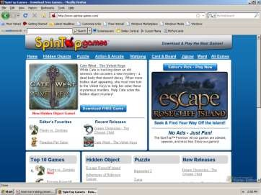

Slide 25


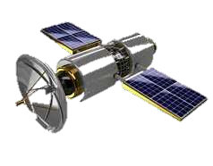

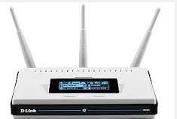
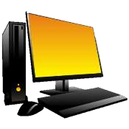

What is the Web Made Of?
Internet Service
Provider
Servers Computers
Internet
Router Switch Hub
Internet
Explorer
PERSONAL COMPUTER

Slide 26
Understanding the World Wide Web

Slide 27
How to access the Web?
Once you have your Internet connection, then you need special software called a browser to access the Web.
Web browsers are used to connect you to remote computers, open and transfer files, display text and images.
Web browsers are specialized programs.
Examples of Web browser: Netscape Navigator (Navigator) and Internet Explorer.

Slide 28
Client/Server Structure of the Web
Web is a collection of files that reside on computers, called Web servers, that are located all over the world and are connected to each other through the Internet.
When you use your Internet connection to become part of the Web, your computer becomes a Web client in a worldwide client/server network.
A Web browser is the software that you run on your computer to make it work as a web client.

Slide 29
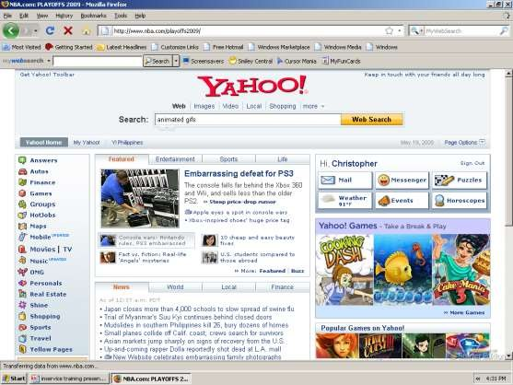
PARTS OF THE WEB BROWSER
Internet Explorer/Mozilla Firefox
MENU BAR
Displays different menus for specific commands
TITLE BAR
Displays name of the web page you are viewing.
LOCATION/
TITLE BAR
Where the internet address is being typed in
TOOL BAR
Displays shortcut tools for specific commands
BROWSER PANE
Displays the current webpage
STATUS BAR
Shows the bottom of the screen when you drag the mouse
Shows the progress of
loading a web page
SCROLL BAR

Slide 30
Hypertext Markup Language (HTML)
The public files on the web servers are ordinary text files, much like the files used by word-processing software.
To allow Web browser software to read them, the text must be formatted according to a generally accepted standard.
The standard used on the web is Hypertext markup language (HTML).

Slide 31
Addresses on the Web:IP Addressing
Each computer on the internet does have a unique identification number, called an IP (Internet Protocol) address.
The IP addressing system currently in use on the Internet uses a four-part number.
Each part of the address is a number ranging from 0 to 255, and each part is separated from the previous part by period,
For example, 106.29.242.17

Slide 32
Domain Name Addressing
Most web browsers do not use the IP address to locate Web sites and individual pages.
They use domain name addressing.
A domain name is a unique name associated with a specific IP address by a program that runs on an Internet host computer.
This program, which coordinates the IP addresses and domain names for all computers attached to it, is called DNS (Domain Name System ) software.
The host computer that runs this software is called a domain name server.

Slide 33
Domain Name Addressing
Domain names can include any number of parts separated by periods, however most domain names currently in use have only three or four parts.
Domain names follow hierarchical model that you can follow from top to bottom if you read the name from the right to the left.
For example, the domain name gsb.uchicago.edu is the computer connected to the Internet at the Graduate School of Business (gsb), which is an academic unit of the University of Chicago (uchicago), which is an educational institution (edu).
No other computer on the Internet has the same domain name.

Slide 34
Domain Name
Denotes the name of a specific Internet area controlled by a
company, school, or organization.
Typical Domain names consist of some form of organization’s name and a suffix that describes the type of organization.
Examples:
.com – corporations
.edu – educational institution
.gov. – government institution
.mil – military
.net – network provider
.org. – non profit org.
The end of the domain name can often tell you the country of orgin.
ex. .ph – philippines
.uk – United Kingdom
.fr – france
.jp – Japan

Slide 35
Uniform Resource Locators
The IP address and the domain name each identify a particular computer on the Internet.
However, they do not indicate where a Web page’s HTML document resides on that computer.
To identify a Web pages exact location, Web browsers rely on Uniform Resource Locator (URL).
URL is a four-part addressing scheme that tells the Web browser:
What transfer protocol to use for transporting the file
The domain name of the computer on which the file resides
The pathname of the folder or directory on the computer on which the file resides
The name of the file

Slide 36
HTTP
The transfer protocol is the set of rules that the computers use to move files from one computer to another on the Internet.
The most common transfer protocol used on the Internet is the Hypertext Transfer Protocol (HTTP).
Two other protocols that you can use on the Internet are the File Transfer Protocol (FTP) and the Telnet Protocol

Slide 37
How to find information on the Web?
A number of search tools have been developed and available to you on certain Web sites that provide search services to help you find information.
Examples:
Yahoo → www.yahoo.com
Excite → www.excite.com
Lycos → www.lycos.com
AltaVista → www/alta-vista.com
MSN WebSearch → www.search.msn.com

Slide 38
How to find information on the Web?
You can find information by two basic means.
Search by Topic and Search by keywords.
Some search services offer both methods, others only one.
Yahoo offers both.
Search by Topic
You can navigate through topic lists
Search by keywords
You can navigate by entering a keyword or phase into a search text box.

Slide 39
URL-Uniform Resource Locator
The Global address of documents and other resources on the World Wide Web.
Parts of the URL:
http://www.yahoo.com.ph/index.htm
Protocol Domain Name Resource Location
Procotol – indicates that the browser and web server will communicate using the Hypertext Transfer Protocol, indicates a resources coming from the World Wide Web.
Domain name - identifies which computer called web server, host site. Resource Location – The Exact Location of the Web Page

Slide 40
THANK YOU

