Slide 1

Hackathon - Team X-Faktor
Beyond Belief
Fact or Fiction?
Notes:
Change team name, game name and add your logo and slogan.
Photo by charlesdeluvio on Unsplash

Slide 2

Game Description
Welcome to my game, dear guests.
Have you ever heard a story that seemed too strange to be true—only to find out it actually happened? In this game, Two Truths and a Lie, you'll face that very challenge.
You will be presented with three statements. Two are true. One is a lie.
Your task? To separate fact from fiction.
To spot the deception.
To know: What really happened... and what was fabricated entirely?
Think you can tell the difference?
Let’s find out.
Notes:
Photo by Marc A on Unsplash

Slide 3
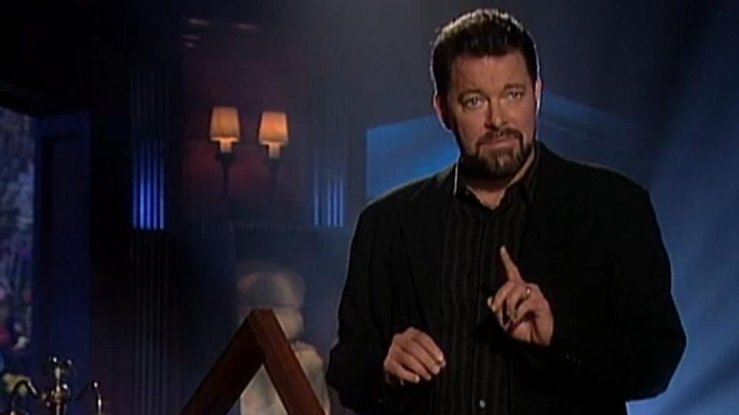
Game Rules
Objective
Test your knowledge and instincts! In each round, the Presenter reads the title of a real Wikipedia article and presents three "facts" about it. Two are true, one is a cleverly disguised lie. Your goal? Spot the lie.
Player’s Turn:
Read carefully the three statements.
Decide which one you believe is the lie.
Scoring:
Correctly spot the lie? +1 point
Notes:
Photo by Nik on Unsplash

Slide 4
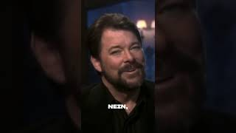
Can you tell truth from lie?
Think you can tell what's real and what's not?
Enjoy this journey through fact and fiction
Your Jonathan Frakes
Notes:
Change this title to whatever you want.

