Slide 1
Beer Recommendation Project
Proof of Concept
Alina Molnar

Slide 2
Goal
SAVE MONEY
Reduce environmental footprint

Slide 3
Workflow
clean
explore
analyze
model
evaluate

Slide 4
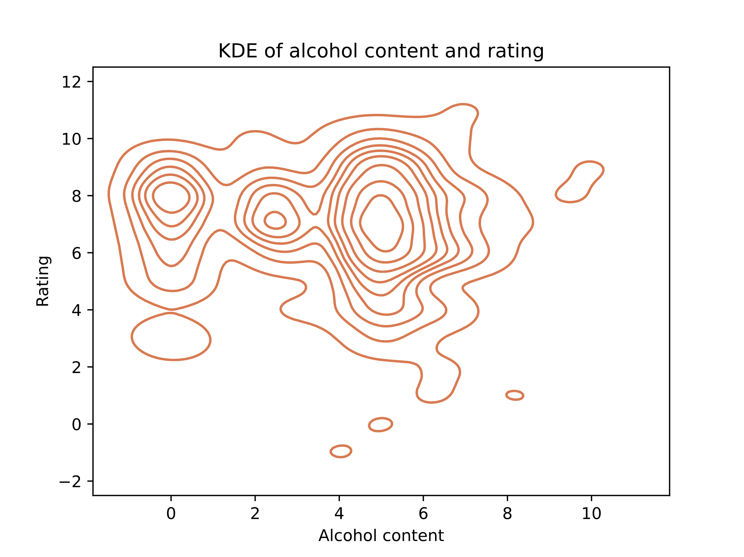



Why model data separately?
Because data has subgroups

Slide 5



Why model with H2O?
Distributed Random Forest
Categorical input
H2O
Gradient Boosting Machine
Numeric output
Categorical predictors create numeric target

Slide 6
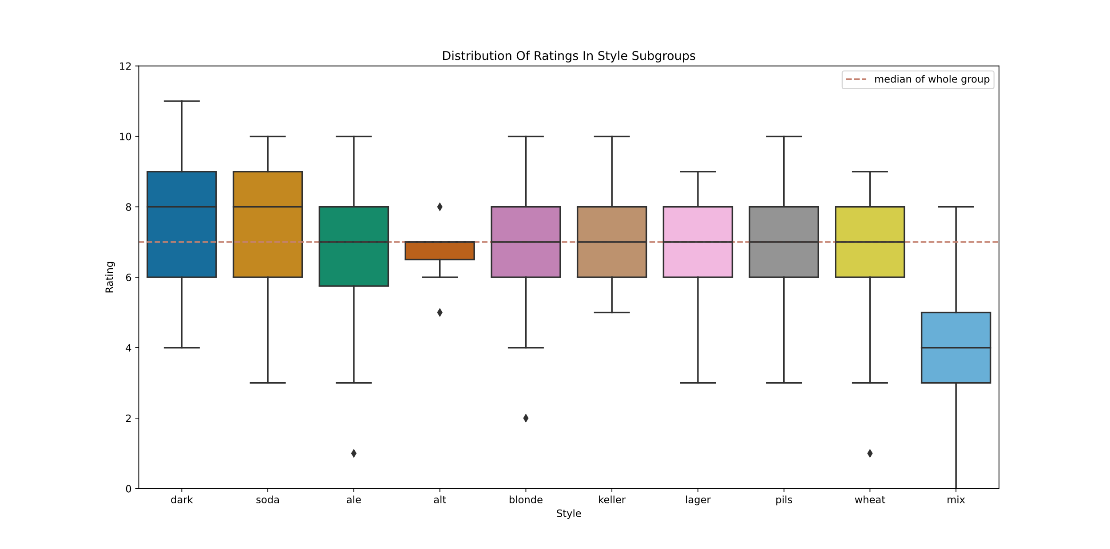
Dark Is The Best Beer Style
And the worst style is beer mixed with other alcohols

Slide 7
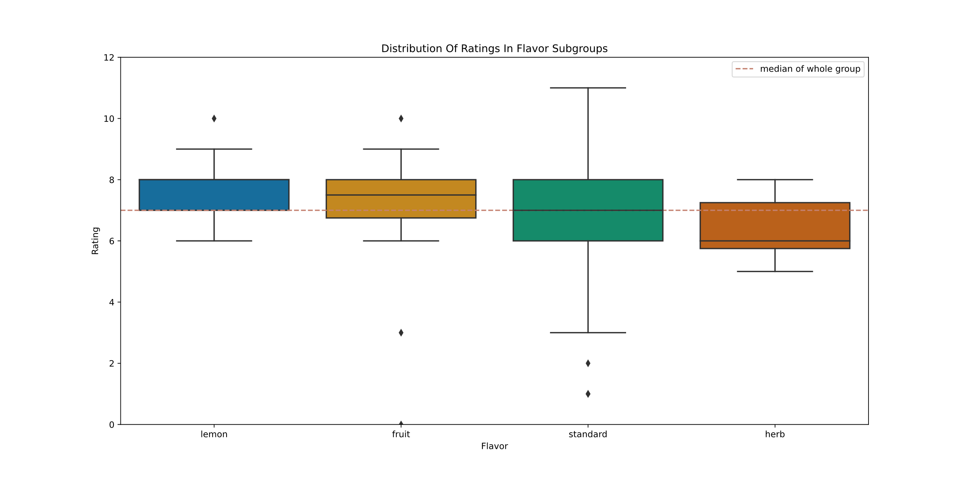
Lemon Is The Best Flavor
And the worst flavor is herb beer

Slide 8
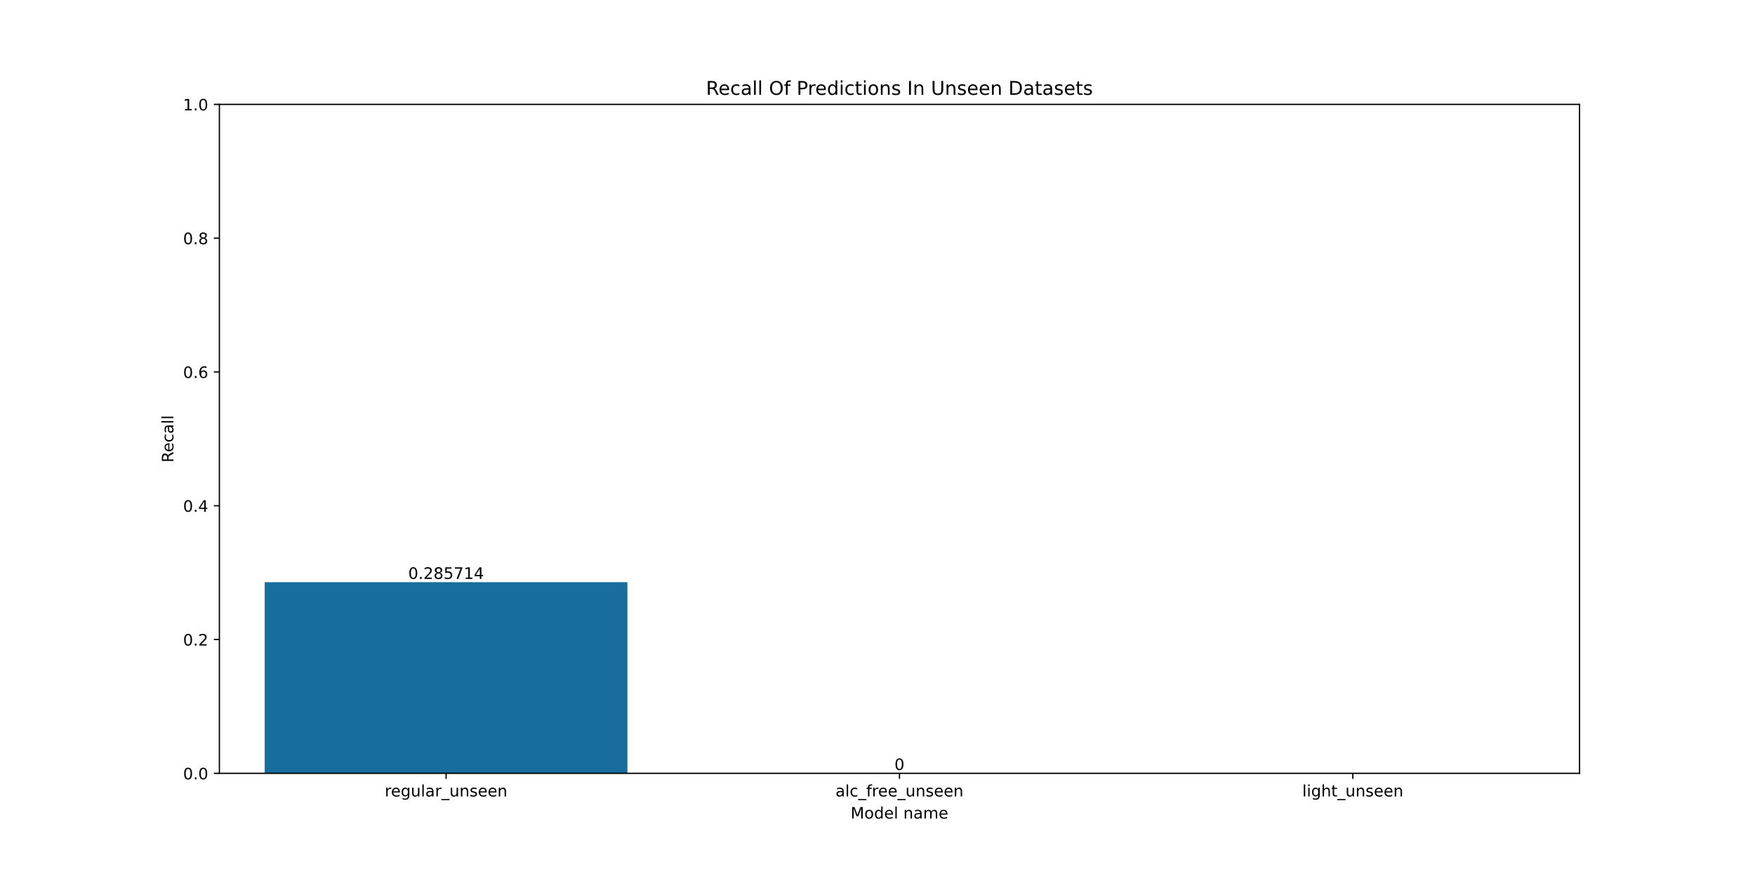
Recall Score of DRF Models
Regular model has detected 28% of low rated beer.
Alcohol-free model had only one low rated beer to detect, and it missed it.
Light model had no low rated beer to detect, so no recall score to compute.

Slide 9
Cost Reduction
Regular
Light
Alcohol-free
-28%
inconclusive
inconclusive
*insufficient beer with low ratings to test upon
*insufficient beer with low ratings to test upon
Distributed Random Forest models

Slide 10




Evaluation of Models
Deploy model
Collect more data

Slide 11
Future Improvements
1
2
3
Function to clean data in one go
Automate feature selection
Build model on parameter search grid

Slide 12




Lessons Learned
Predict outliers
Keep outliers when training
Predict outliers
Make a useful model instead
Perfect model

Slide 13

Thank you!
Click links for more details:
Github repository: https://github.com/alina-molnar/Beer-Recommendation-Project-Proof-of-Concept
Video code: https://github.com/alina-molnar/Beer-Recommendation-Project-Proof-of-Concept/blob/main/Video_Code_Presentation.mp4
LinkedIn: https://www.linkedin.com/in/alina-molnar/

