Slide 1
Analyzing Federated Learning through an Adversarial Lens
Authors
Arjun Nitin Bhagoji
Supriyo Chakraborty
Prateek Mittal
Seraphin Calo
  Presented by
  Alina Zaman
  Saha Kuljit Shantanu
  Md Tahmid Islam Tomal

Slide 2
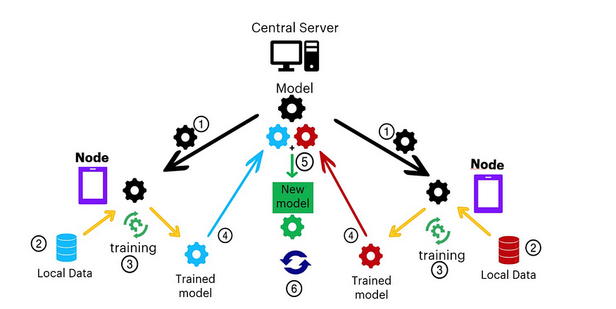
Federated Learning
Background

Slide 3
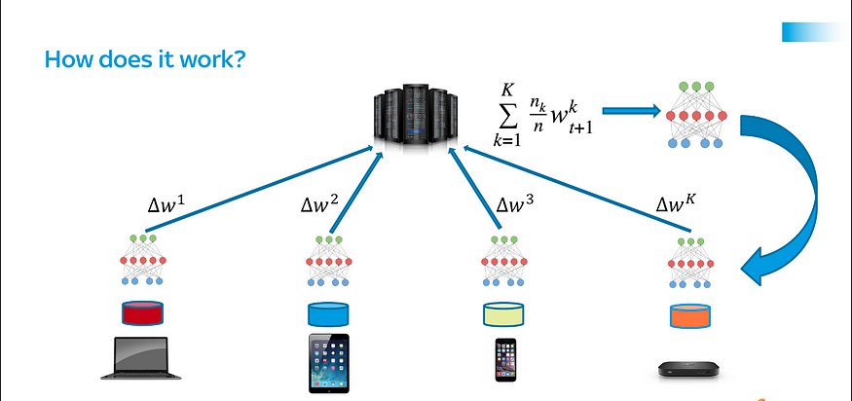


Federated Learning
Background
Where,

Slide 4
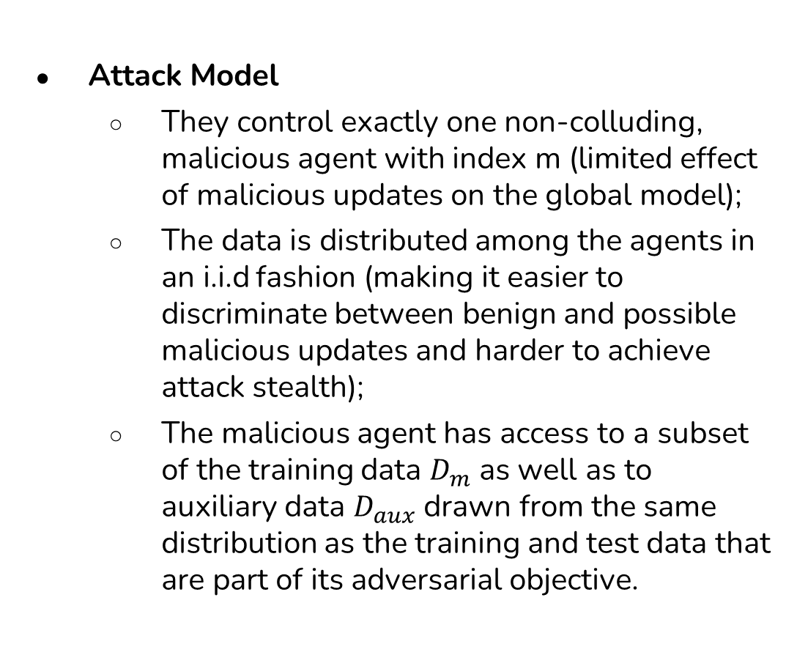
Threat Model
(Problem Statement)

Slide 5
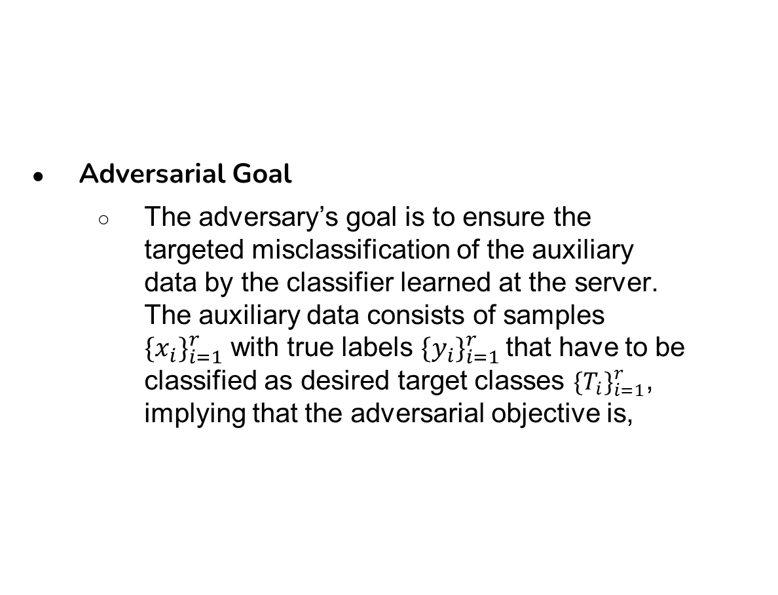

Adversarial Goal

Slide 6
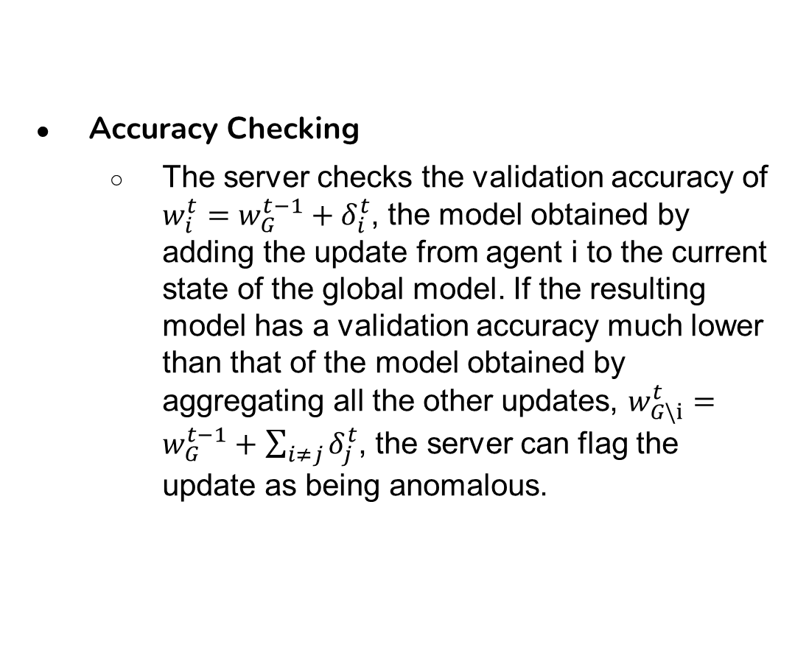
Stealth Matrices

Slide 7
Stealth Matrices
Weight Update Statistics
  The range of pairwise distances between a particular update and the rest provides an indication of how different that update is from the rest when using an appropriate distance metric d(.,.). We rely on the full range of pairwise distances which can be computed for all agent updates and for an agent to be flagged as anomalous, their range of distances must differ from the others by a server defined, time-dependent threshold t.

Slide 8
Recent Works
MPAF: Model Poisoning Attacks to Federated Learning based on Fake Clients. In this attack, the attacker injects some fake clients into the system. It sends fake model updates to the server, decreasing the general model's accuracy.
Backdoor Attack: The attacker adds a trigger, for example, a small pixel pattern to the data set. The model performs well with most inputs but as a hidden trigger causing it to misbehave in specific situations. As a result, it easily bypasses normal security measures and gains unauthorized access to the global model’s functions.

Slide 9
Novelty of this Work
The attack is targeted, so the adversary attempts to ensure that the global model converges to a point with good performance on the test or validation data. These inputs are not modified to induce misclassification. Rather, their misclassification is a product of the adversarial manipulations of the training process. The paper focuses on an adversary that directly performs model poisoning instead of data poisoning.
The Byzantine adversaries aim to ensure convergence to ineffective models, i.e. models with poor classification performance. The goal of the adversary considered in this paper is targeted model poisoning, which implies convergence to an effective model on the test data. This difference in objectives leads to the lack of robustness of these Byzantine-resilient aggregation mechanisms to the attacks. The authors have considered the efficient aggregation mechanisms Krum and coordinate-wise median for their evaluation, both of which are provably Byzantine-resilient and converge under appropriate conditions on the loss function. In section 4 the authors have shown that the model poisoning attacks are effective against these two completely different Byzantine-resilient aggregation mechanisms.

Slide 10
Novelty of this Work
The model poisoning attack is much more effective than normal data poisoning. Because data poisoning can not ensure convergence of the global model on the test data.
Various interpretability techniques are designed for understanding the underlying basis of the decisions of the neural networks. These techniques are used to try and discriminate between the behavior of a benign global model and one that has been trained to satisfy the adversarial objective of misclassifying a single example. Targeted perturbation of the model parameters coupled with tightly bounded noise ensures that the internal representations, and relevant input features used by the two models, for the same input, are almost visually imperceptible. This further exposes the fragility of interpretability methods

Slide 11
Methodology
Targeted Model Poisoning for standard mean aggregation
Stealthy Model Poisoning for standard mean aggregation
Alternating Minimization for improved model poisoning
Model poisoning for attacking Byzantine Resilient Aggregation
  Targeted Model Poisoning for Krum Mechanism
  Targeted Model Poisoning for Coordinate-wise Median

Slide 12
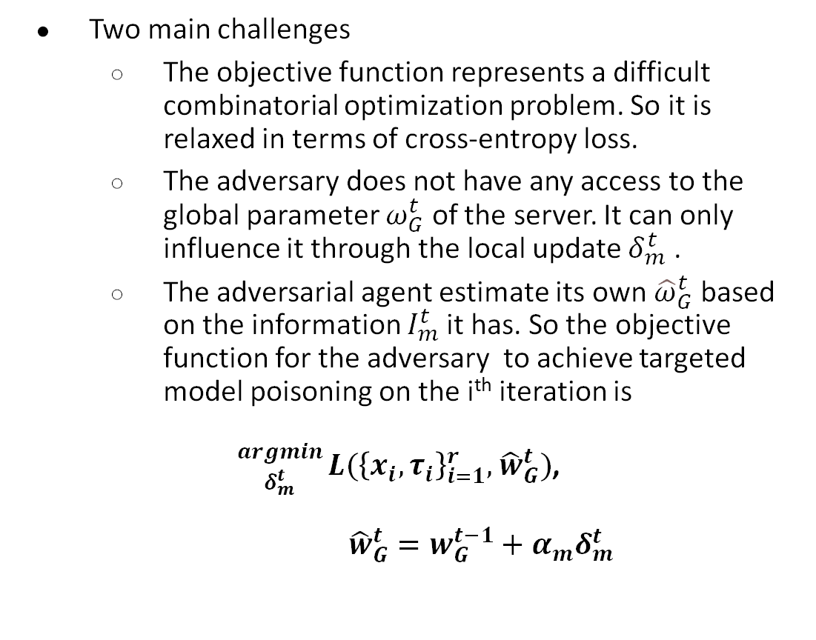
Adversarial Optimization Step

Slide 13
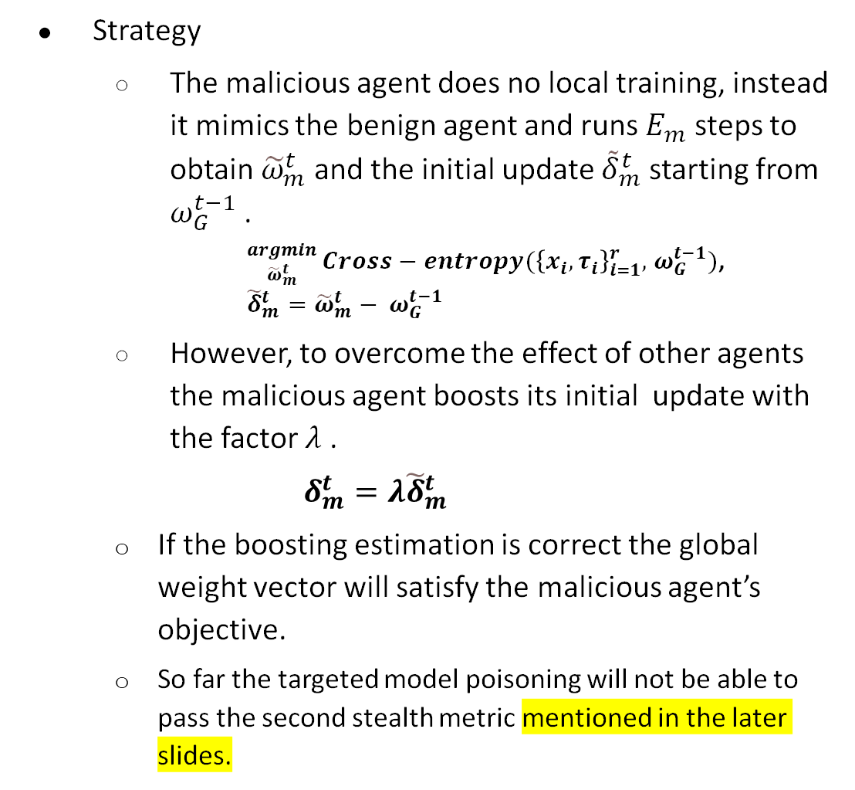
Targeted Model Poisoning

Slide 14
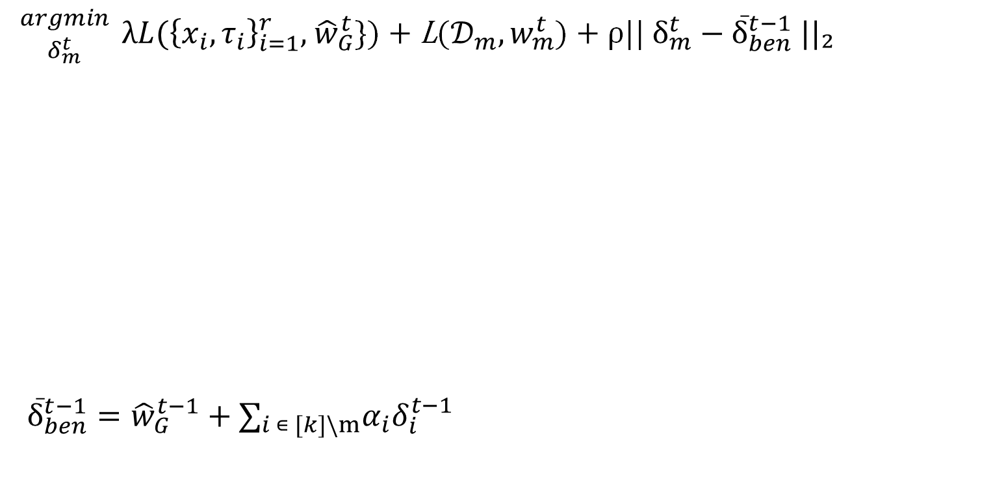
Stealthy Model Poisoning
Using explicit boosting so that only the portion of the loss corresponding to the malicious objective gets boosted by a factor λ
Optimization is performed just as a benign agent would do
Distance Constraint : The norm of second order between benign agent and malicious agent is minimized

Slide 15
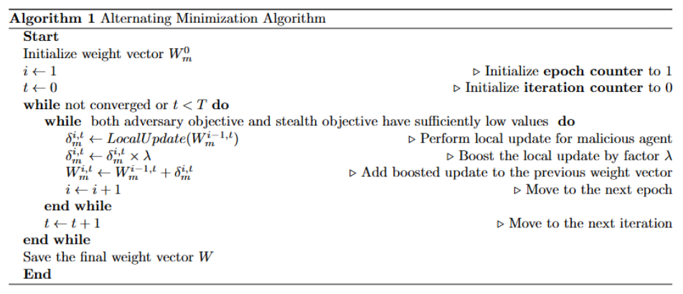
Alternating Minimization for Improved Model Poisoning

Slide 16
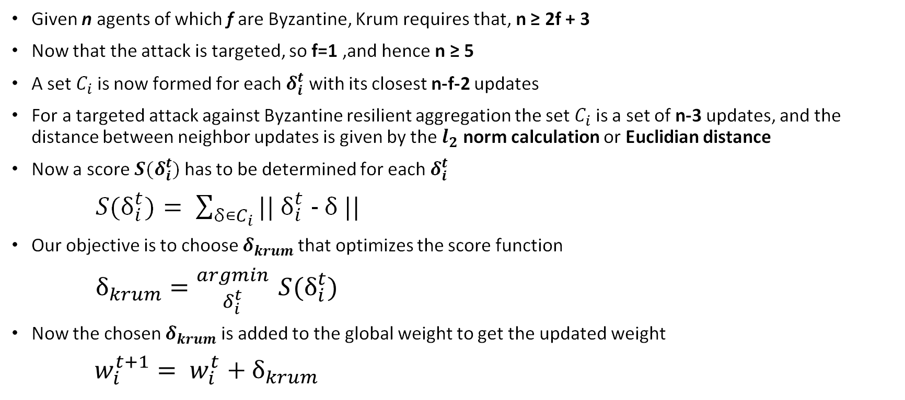
Targeted Model Poisoning for Krum Mechanism

Slide 17
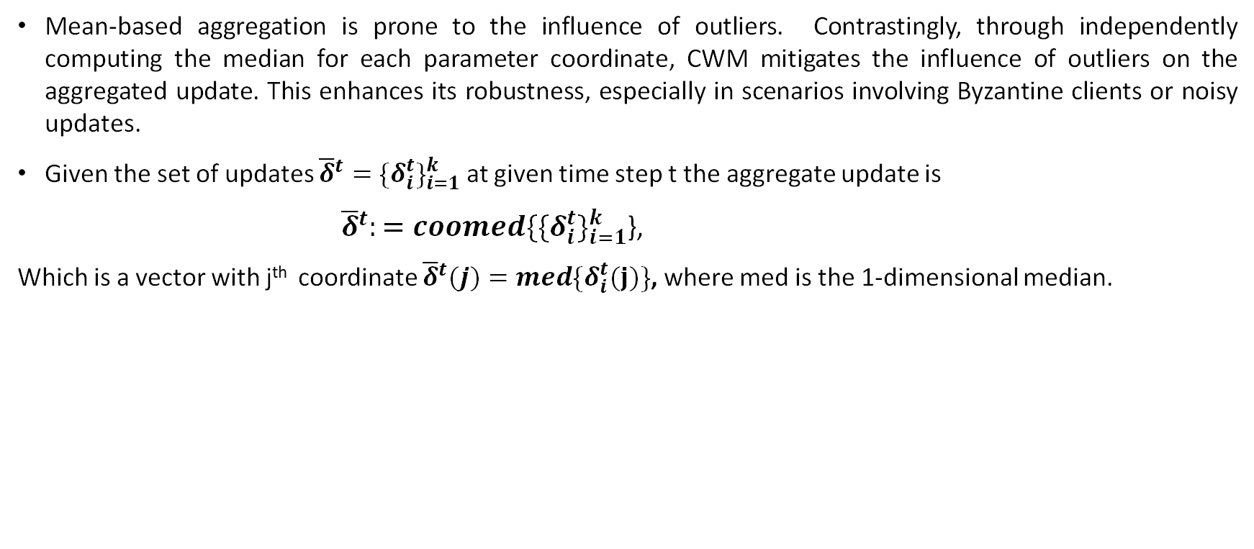
Targeted Model Poisoning for CWM

Slide 18
Evaluation
Stealth Metrics to be considered
  First Stealth Metric: Accuracy Checking
  Second Stealth Metric: Appropriate Distance for weight Update statistics
Model Poisoning to be evaluated
  Targeted Model Poisoning
  Stealthy Model Poisoning
  Alternating Minimization

Slide 19
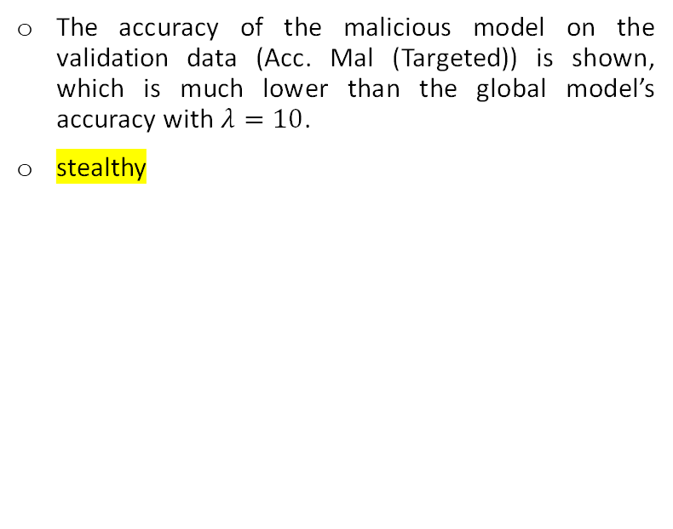
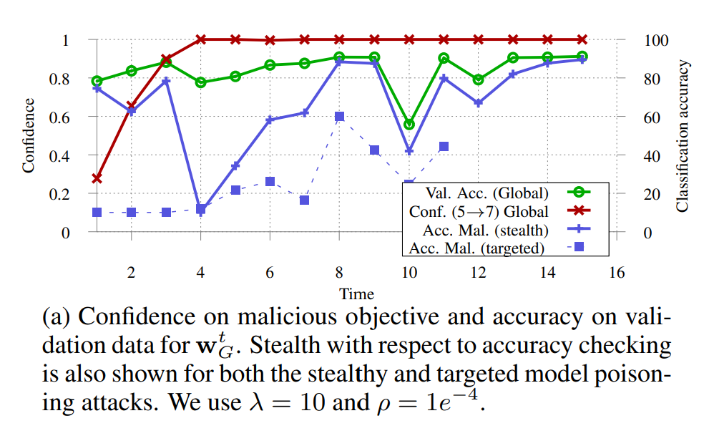
^{Targeted Model Poisoning:}
^{Accuracy Checking}
Confidence on malicious objective and accuracy on validation data for wt

Slide 20
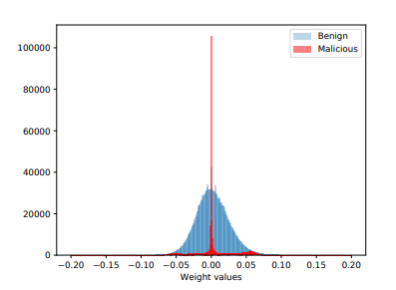
Comparison of weight update distributions for benign and malicious agents for targeted model poisoning attack for CNN on Fashion MNIST data
Compared to the weight update from a benign agent, the update from the malicious agent is much sparser and has a smaller range
The results imply that the malicious agent won’t be able to bypass the second stealth metric(weight update statistics) with only explicit boosting.

Slide 21
Stealthy Model Poisoning: Accuracy Checking
The accuracy threshold λ_{t} to be 10% which implies that the malicious model is chosen for 10 iterations out of 15
Only the loss function with malicious objective is boosted, and hence whenever an iteration does not choose any malicious agent, the accuracy on validation data for that iteration is surely closer to the accuracy of the global model
It is clear that the validation accuracy of stealthy model poisoning is within 10% of the global model whenever the malicious agent is not chosen

Slide 22
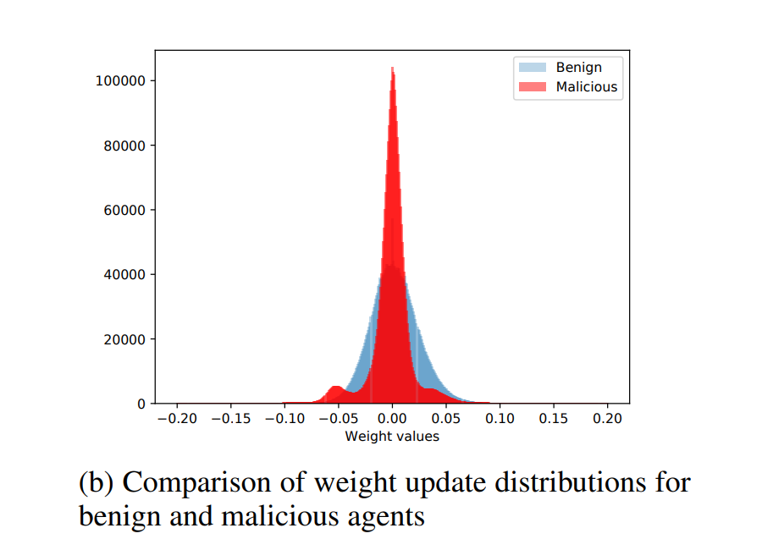
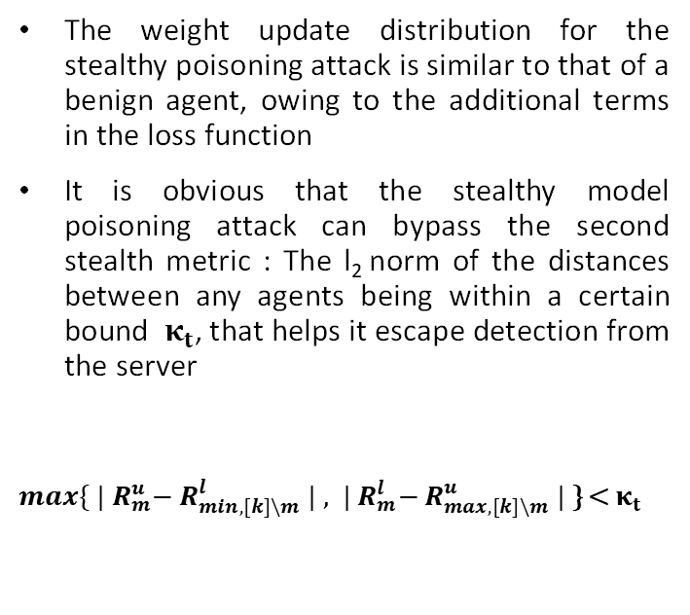
Stealthy Model Poisoning: Appropriate Distance

Slide 23
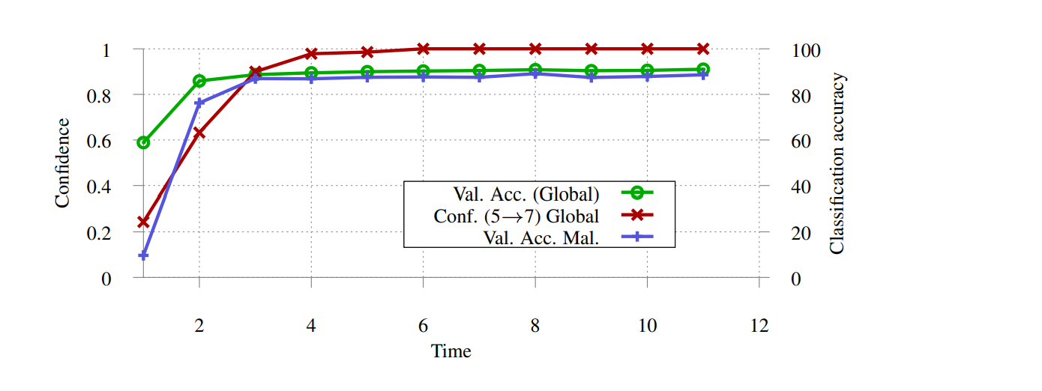
Alternating Minimization : Accuracy Checking
The adversary objective is achieved with high confidence at t = 2,
It is clear that malicious agent is optimizing stealth metrics in such a way that within t = 2, the accuracy of the model on the validation data of the malicious agent is always close to the accuracy of the global model
This attack can bypass the accuracy checking method as the accuracy on validation data of the malicious model is close to that of the global model

Slide 24
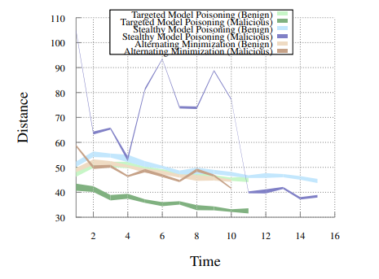
Range of l₂ distances between all benign agents and between the malicious agent and the benign agents.
In the case of explicit boosting, for the baseline attack, both the minimum and maximum distance away from any of the benign updates keep decreasing over time steps, while it remains relatively constant for the other agents.
It is clear that the distance spread for the alternating minimization attack closely follows and even overlaps that of benign updates throughout

Slide 25
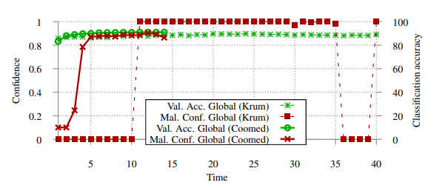
Model poisoning attacks with Byzantine resilient aggregation mechanisms
Krum is explained through the alternating minimization technique. Using alternating minimization attack with a boosting factor of λ=2 for a federated learning setup with 10 agents, the malicious agent’s update is chosen by Krum for 26 of 40 time steps which leads to the malicious objective being met.
Coomed is explained through targeted model poisoning. Using targeted model poisoning with a boosting factor of λ = 1, i.e. no boosting, the malicious objective is met with confidence close to 0.9 for 11 of 14 time steps. In this case, unlike with Krum, we note that there is convergence to an effective global model. We believe this occurs since the coordinate-wise median does not simply pick one of the updates to apply to the global model and uses information from all the agents while computing the new update.

Slide 26
Discussion
Preference of Model Poisoning over Dirty Label Data Poisoning
Interpretation of Poisoned Models
Estimation, Correction and Optimization

Slide 27
Prefer Model Poisoning to Dirty Label Data Poisoning
Dirty Label Data Poisoning : Several copies of a sample image in a training dataset has to be made with a different label by the adversary so that sample image can be misclassified
But this approach is not that effective in federated learning because the weight of malicious agent is scaled until boosting
We may clone 1000 images at random, and in fact, change a few pixels in the images to raise a chance of misclassification
But the attack will not be as confident as the Model Poisoning Attack

Slide 28
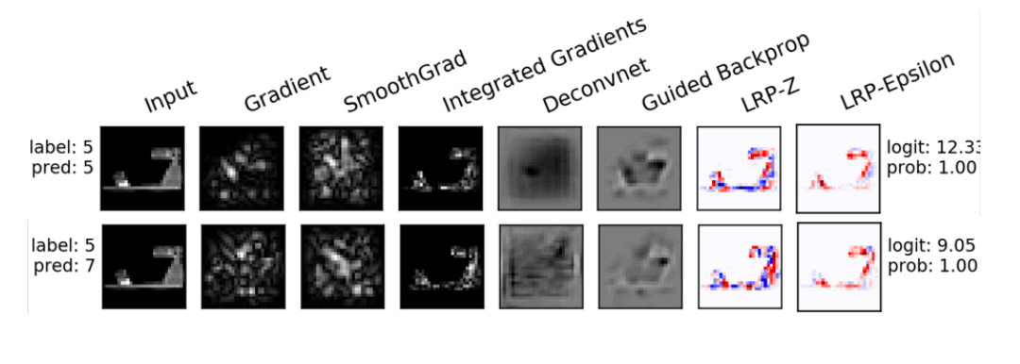
Interpret Poisoned Models
Gradient Generation for score prediction
Visualization of the association of image features and neuron activation
Identification of relevant features

Slide 29
Estimation
Correction​
Optimization​

Slide 30
Future Works
Implement model poisoning attacks that are stealthier compared to the attacks worked with so far
Analyze a server to identify how much stealthy an attack should be to bypass detection strategies of the server
Explore more sophisticated detection strategies at the server, which can provide guarantees against the type of attacker that has considered here
Improvise the server implementing these detection strategies such that these attacks cannot bypass detection strategies of the server

