Slide 1
Things Sharing App

Slide 2

Hello!
We are the team of 4 developers.
Hassan Malik, Fayazz GM, M. Waqas, Ali Naeem
( From Team G5 from Saylani. )
We are here to present an idea of Things Sharing app. You can share almost anything here.
You can find us at alitheflyingtiger1@gmail.com

Slide 3

Ronnie Chan
To be honest, we donate to projects that we think are meaningful.

Slide 4


Diana Gabaldon
If you donate to a charity and save a few kids, 20 years down the line, there will be more people who exist because of you. In other words, you should consider your actions fully.

Slide 5
Anyone can share things with anyone in our App..
Place your screenshot here

Slide 6
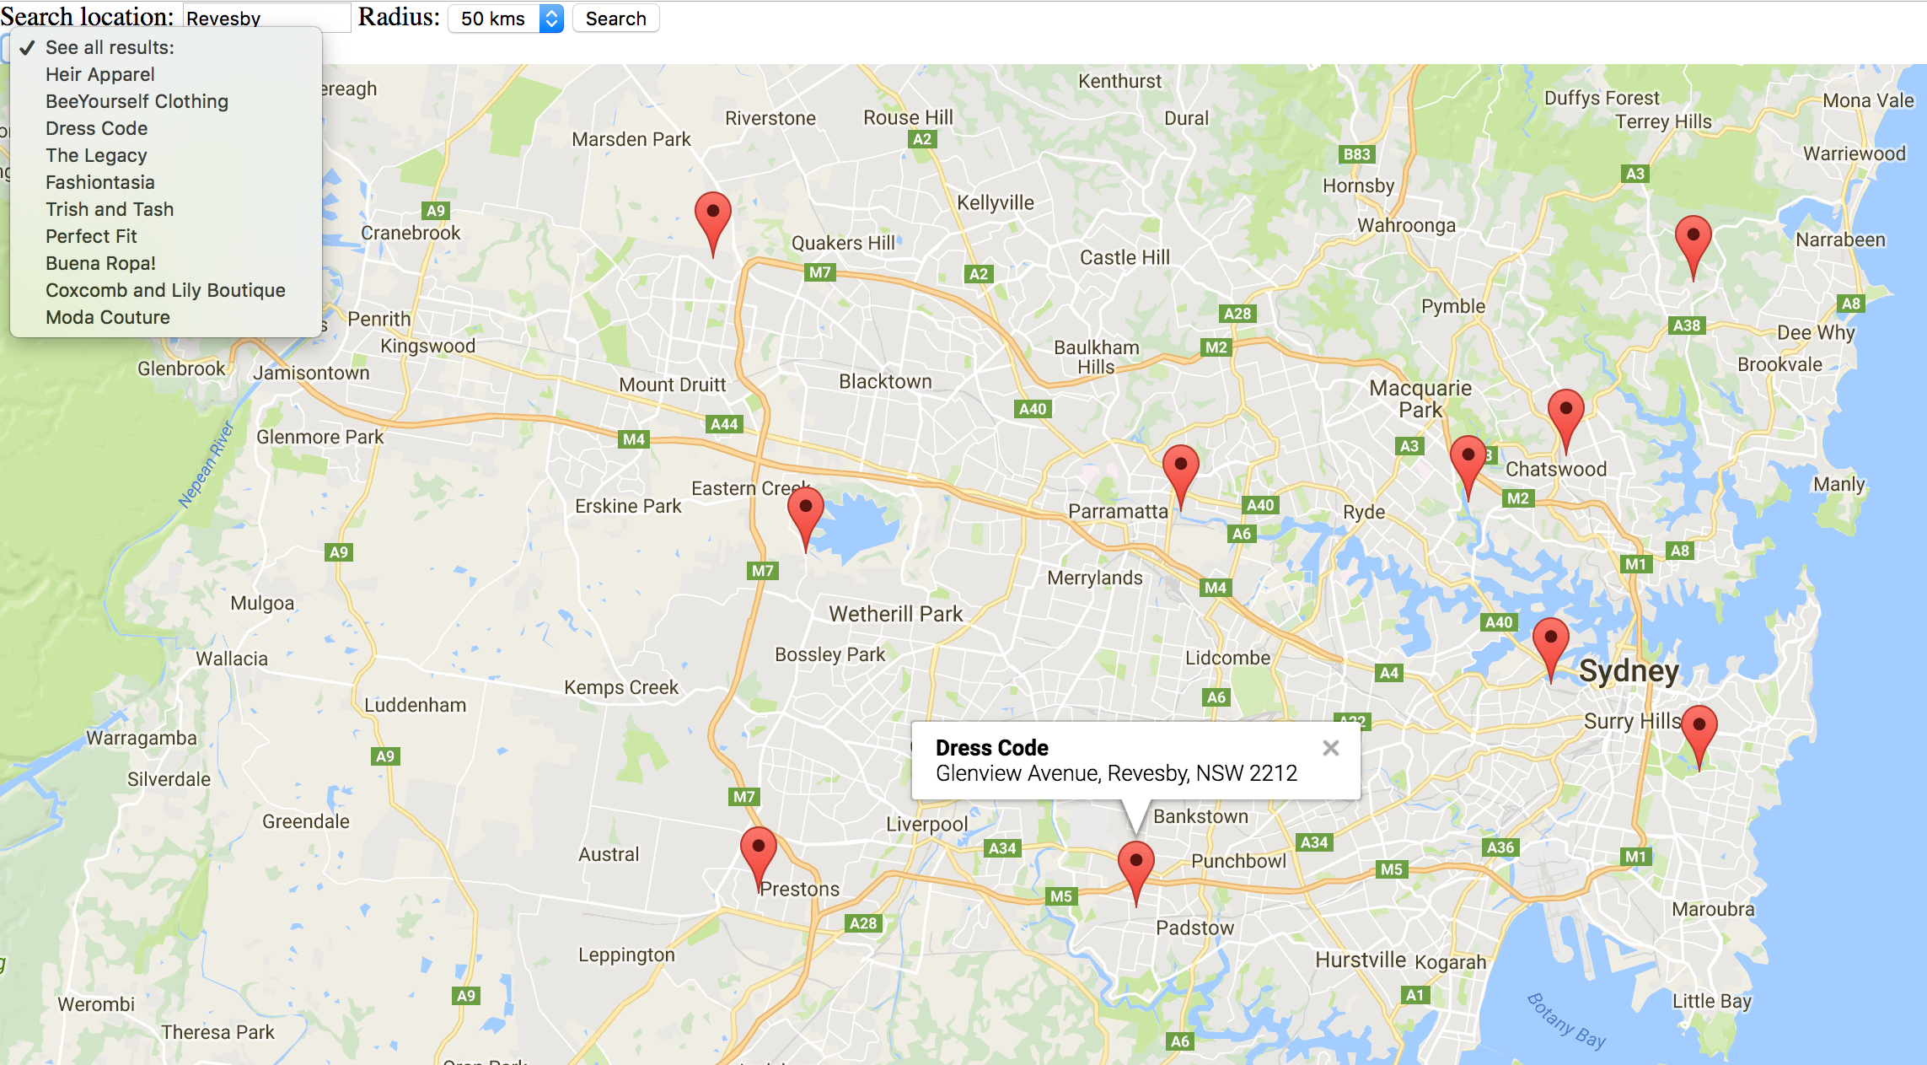
Donor and Donee can see each other location through maps.

Slide 7
Case: 1
Step: 1
A donor can post what he or she wants to donate.
A donee can contact the donor and receive donation.
OR
A middleman can contact the donor and then deliver to the donee.
Step: 2

Slide 8


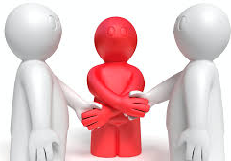
Communicate
Communicate
POST
Reads
Middleman
Reads
Deliver to the donee

Slide 9

Case: 2
Step: 1
A donee can post what he or she needs.
A donor can contact the donee and give donation.
Step: 2
Connect
Communicate

Slide 10
You can donate from your home.
Donate Clothes
Donate Furniture
Donate Books
Donate Toys
Donate Shoes
Donate a Bicycle
Donate Computers
Donate a Couch
Donate TV
Donate Appliances
Donate a Dress
Donate Baby Items
Donate Magazines
Donate Household Items

Slide 11
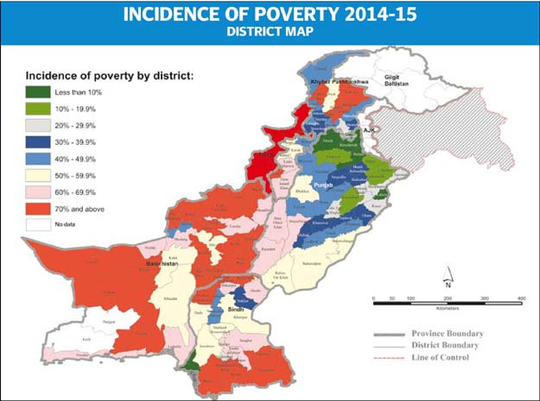
In Pakistan 30% of people live in poverty. ( approximately 55 million people)

Slide 12
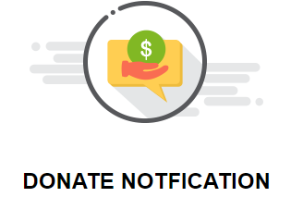
Share Books With Others YOU NO LONGER NEED

Slide 13
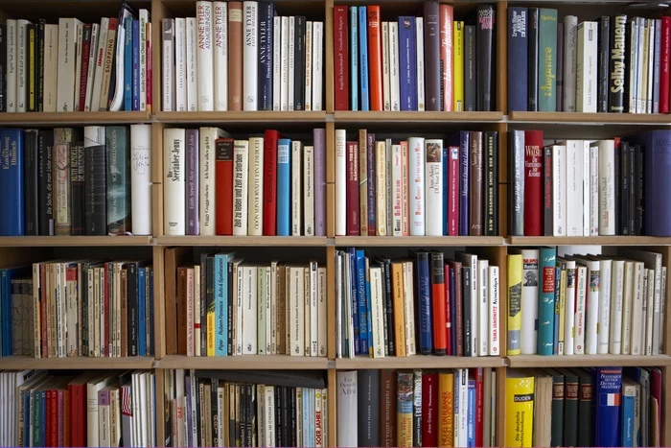
At Books For Pakistan, we believe that education is the great equalizer in the world, and books are at the foundation of a strong educational system. For many children in Pakistan, the gift of books truly is a gift of hope.

Slide 14
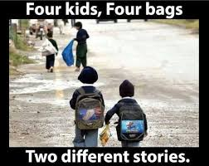
In Pakistan 40% of school-age children are out of school.

Slide 15
Share Your Clothes with Others

Slide 16
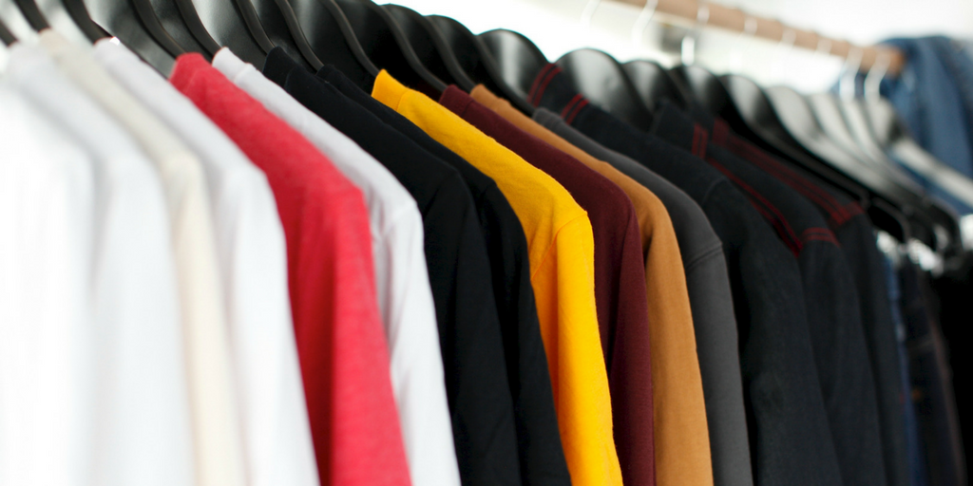
Not being able to commit to giving your clothing another chance just means you are continuing to support a fast paced cycle of consuming.
Jamie Feldman

Slide 17
Sharing your old clothes to someone is a wonderful way to recycle and stop clothes from going to waste.
Sometimes it may be better to skip the middle man entirely and give you clothes directly to the people who need them.
Luckily Our App Supports Both.

Slide 18
Share Your Furniture

Slide 19
Whether you’re downsizing or in need of a home refresh, it may be time to say “goodbye” to your old furniture. From outdated college futons to hand-me-down decor, not all furnishings are meant to stay in your house forever.
Fortunately, you can also donate it here.

Slide 20
Donate For Dams

Slide 21
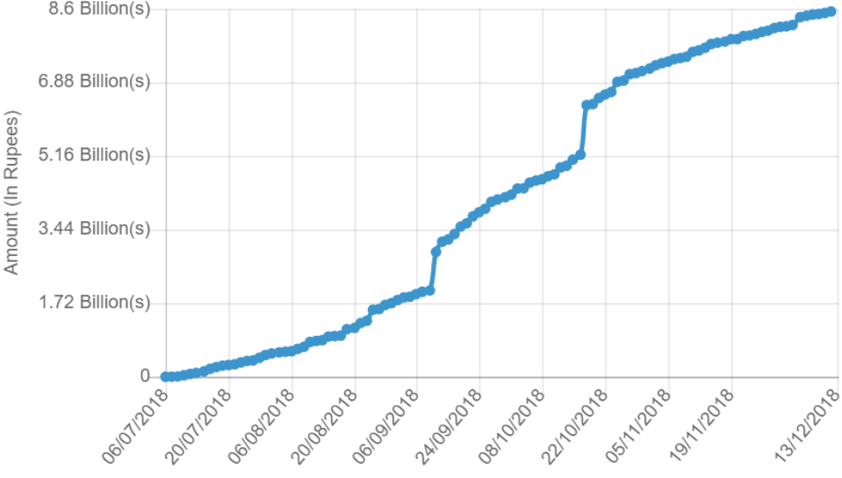
1450 Billions Need for dam but we collect just 8 Billions in 5 month
At this rate, Imran Khan will take 73 years to fund the dam
Account No:
03-593-299999-001-4
Total Amount:
Rs. 8, 540, 515 ,842

Slide 22


Our App will give user notification every day for the donation for dams.

Slide 23
Donate Your Time

Slide 24

Are you thinking that it would be a good idea to donate your time to a good cause?

Slide 25
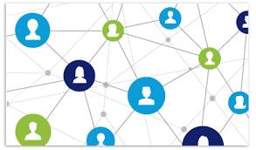
You can connect people through our app.
You can teach them.
You can provide assistance to those who cannot help themselves.
Raising money for a worthy cause.
You can donate your time here in many other Ways.

