Slide 1


Party Gaming : T12_Desktop_Deposit_CTA_Text
Date: 21th December 2016
Campaign objective: As: Gioco Digitale
I want: to test has an effect changing the text of the deposit button on deposit conversion So that: it drives them to deposit more frequently and increase the deposit conversion
Notes:
Tech Note:

Slide 2
User Story 1: Personalization Criteria
I want to: separate users behavior depending on they make deposit or not
So that: I can filter reports
Acceptance Criteria
Given: I am logged in AND I don’t previously make deposit (don’t have cookie “mm-last-deposit”)
When: I land on whole site
Then: The PC ‘UserState’ tracks AND
The value is ‘NonDep’
1
Given: I am logged in AND I previously make deposit (have cookie “mm-last-deposit”)
When: I land on whole site
Then: The PC ‘UserState’ tracks AND
The value is ‘Dep’
1
Notes:
Test account details Login Techplazait@gmail.com Pword Test12345 https://www.giocodigitale.it/*

Slide 3
User Story 1: Generation
I want to: include logged in users on desktop
So that: I can target this group of users
Acceptance Criteria
Given: I am on desctop
AND I am logged in When: I land site wide ( ex. https://giocodigitale.it/ )
Then: I generate
1
Notes:
Tech Note:
Test account details ( previously deposited user) Techplazait@gmail.com Test12345 Test account details ( previously not deposited user) carlo.barchetti@hotmail.it
n0ngi0co

Slide 4
Weights
 |  |  | Variants
 |  |  | 1 | 2 | 3 | 4
Elements | A | Deposit CTA | Default (Campaign T06) | Ricarica | Deposita | Versa
 |  | Traffic weighting | 100 | 100 | 100 | 100
The Default experience will be the T06 winner

Slide 5

Variant – A1_Default

Slide 6
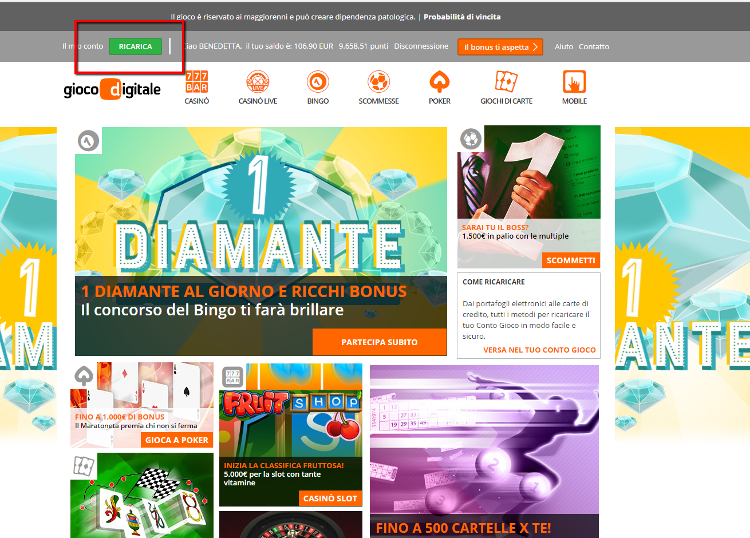
Variant – A2_Ricarica_CTA

Slide 7
User Story 2: – A2 Ricarica CTA
I want to: change the text for the deposit CTA So that: I can encourage more customers to make a deposit
Acceptance Criteria
Given: I generate
When: I am logged in
Then: The ‘VERSAMENTI’ CTA is changed to ‘Ricarica’ CTA
1
Notes:
Redirect to https://www.giocodigitale.it/it/account/money/deposit

Slide 8
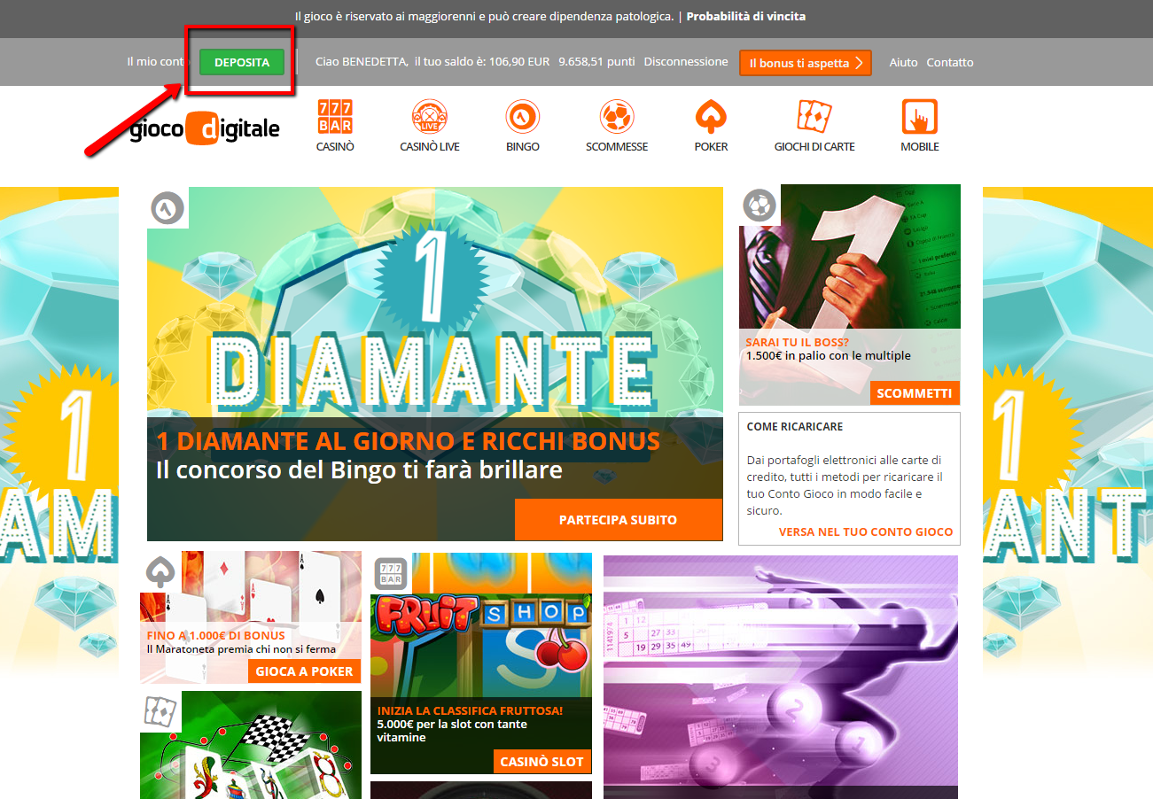
Variant – A3_Deposita_CTA

Slide 9
User Story 3: – A3_Deposita_CTA
I want to: change the text for the deposit CTA So that: I can encourage more customers to make a deposit
Acceptance Criteria
Given: I generate
When: I am logged in
Then: The ‘VERSAMENTI’ CTA is changed to ‘Deposita’ CTA
1
Notes:
Redirect to https://www.giocodigitale.it/it/account/money/deposit

Slide 10

Variant – A4_Versa_CTA

Slide 11
User Story 4: – A4_Deposita_CTA
I want to: change the text for the deposit CTA So that: I can encourage more customers to make a deposit
Acceptance Criteria
Given: I generate
When: I am logged in
Then: The ‘VERSAMENTI’ CTA is changed to ‘VERSA’ CTA
1
Notes:
Redirect to https://www.giocodigitale.it/it/account/money/deposit

Slide 12
User Story 5: – Deposit (Primary)
I want to: track customers making a deposit
So that: I can determine the impact of the campaign
Acceptance Criteria
Given: I generate
When: I make a deposit with success by clicking through the ‘VERSAMENTY’/ “RICARICA”/ “DEPOSITA” CTA in the header
Then: The action Deposit is tracked AND ‘CTA’ is tracked as the Attribute AND The Deposit value is tracked as the Value (in EUR)
1
Given: I generate
When: I make a deposit with success by clicking through the currency/balance indicator in the header
Then: The action Deposit is tracked AND ‘Other’ is tracked as the Attribute AND The Deposit value is tracked as the Value (in EUR)
2

Slide 13
User Story 6: – Header Clicks
I want to: track customers clicking to deposit within the header
So that: I can determine the impact of the campaign
Acceptance Criteria
Given: I generate
When: I click on the CTA within the header Then: The action HeaderClick is tracked
AND
‘CTA’ is tracked as the Attribute
1
Given: I generate
When: I click on currency/balance indicator within the header
Then: The action HeaderClick is tracked
AND
‘Other’ is tracked as the Attribute
2

Slide 14
Publish Instructions
Campaign | Site Pages | Site Scripts | Actions
T12_GD_Deposit_CTA_Text | [D] Whole Site [IT] [D] Deposit Process Pages [IT] [D] T12_GD_Deposit_CTA_Text | T12_Header_Clicks T12_Deposit | critUserState UserState

Slide 15
Test Report
QA TESTING LEGEND | T | Tested on physical device
 | E | Tested in emulated environment
 | A | Assumed to work based on the results of prior related tests
 | S | Tested on client’s staging environment
 | F | Tested using Fiddler captured session
 | - | Has not been checked
 |  |  | DESKTOP |  |  |  | Comments
 |  |  | IE 11 | Firefox (latest) | Chrome | Safari 10
Story Tab | Passed /Failed | Acceptance Criteria
Personalization Criteria | Y | 1. | A | T | T | A
 | Y | 2. | A | T | T | A
Generation | Y | 1. | T | T | T | T
A2 Ricarica CTA | Y | 1. | T | T | T | A
A3_Deposita_CTA | y | 1. | T | T | T | A
A4_Deposita_CTA | y | 1. | T | T | T | A
Deposit (Primary) | y | 1. | A | A | A | A
 | y | 2. | A | A | A | A
Header clicks | y | 1. | T | T | T | A
 | y | 2. | T | T | T | A

