Slide 1
Speed Dating Project
Machine learning - 2023
Alina Greenberg & Rom Dvir

Slide 2
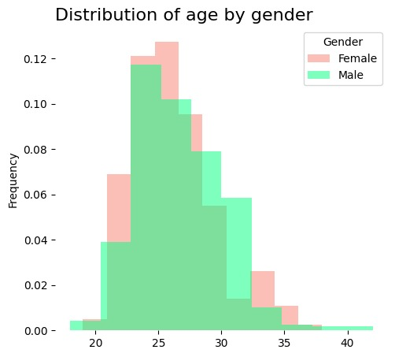
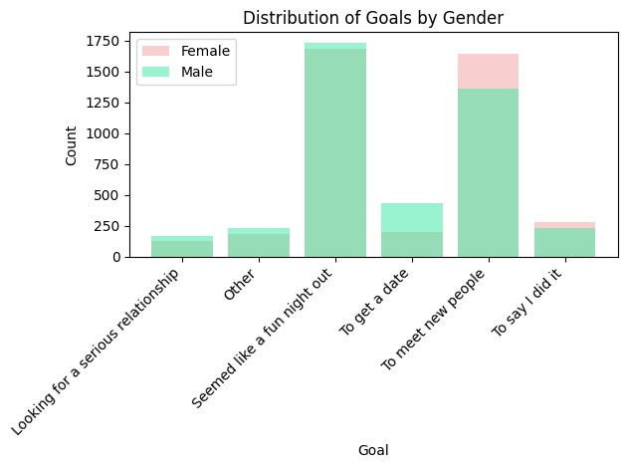
EDA
Approx. 11% of the males are aged 23-25
Approx. 13% of the females are aged 25-27
Most participants are aged 22-33
Most participant’s goals are: > ‘Seemed like a fun night out’ > ‘To meet new people
Least selected goal >‘Looking for a serious relationship’

Slide 3
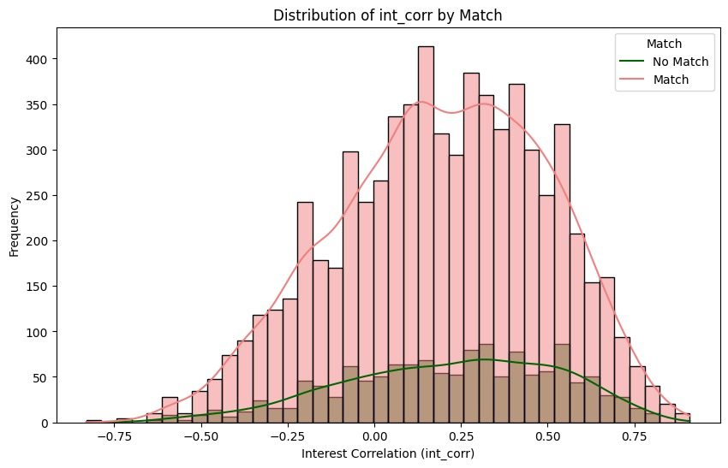
EDA
The successful and unsuccessful matches are quite normally distributed around the 20%-30% 'interest correlation’.
Interest correlation higher than 0 between participants is important for match decision but only up to around 30% correlation, above that it is not affecting the decision.
We can conclude that 'interest correlation' between both participants in a date doesn't necessarily contribute to the success of a date.

Slide 4
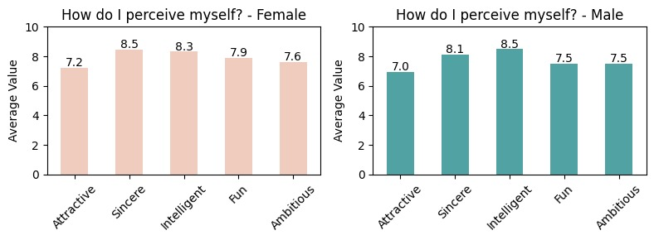
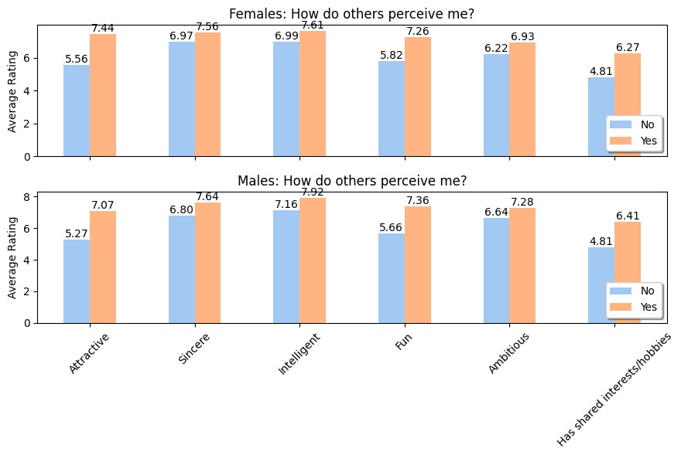
EDA
Highest rated attributes that both male and female perceive themselves is 'Intelligent Traits’.
Lowest rated attributes that both male and female perceive themselves is ‘Attractive'.
Highest rated attributes that both male and female perceive others is 'Intelligent Traits’.
Lowest rated attributes that both male and female perceive others is ‘Has shared interests/hobbies’.
‘Attractive’, ‘Fun’ and ‘Has shared interests /hobbies’ attributes have a major contribution to the match decision.

Slide 5
Hypothesis
Modeling
What is a person's tendency to say yes?
Using 104/191 features
After correlation - 83 features left for model
Normalize all waves attribute rating to be between 1-10
Feature engineering: Vote_differently, On_a_budget, With_magazine, With_book
What do people like in others/Me?
Using 15/191 features
More features with high correlation to the label will return higher accuracy ratings to the prediction.
‘Attractive’ attribute will contribute mostly to the decision (Yes/No)
Most accurate model will be Random Forest
Notes:
Random forest adds additional randomness to the model, while growing the trees. Instead of searching for the most important feature while splitting a node, it searches for the best feature among a random subset of features. This results in a wide diversity that generally results in a better model.

Slide 6
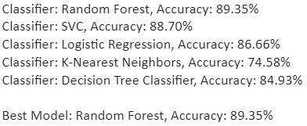
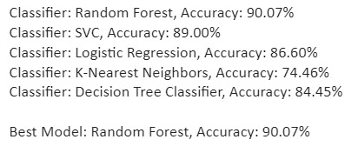
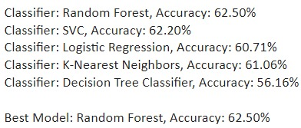
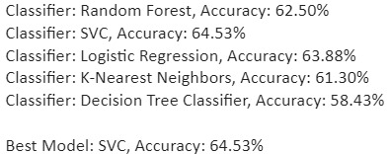
Results
Models (What is a person’s tendency to say ‘YES’?)
Feature Engineering
Models (What do people like in others?)
Models (What do people like in me?)

Slide 7
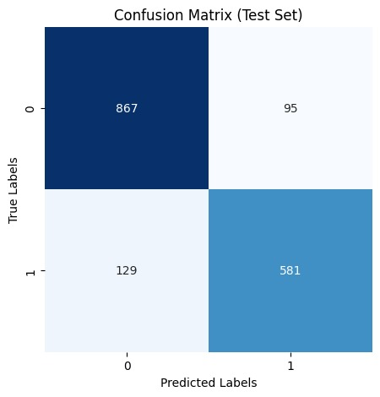

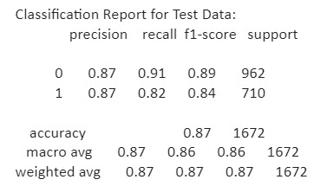
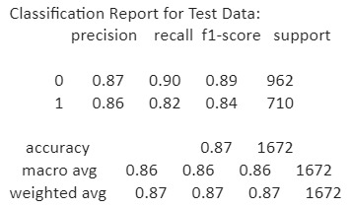
What is a person’s tendency to say ‘YES’?83 features
Before feature engineering

Slide 8
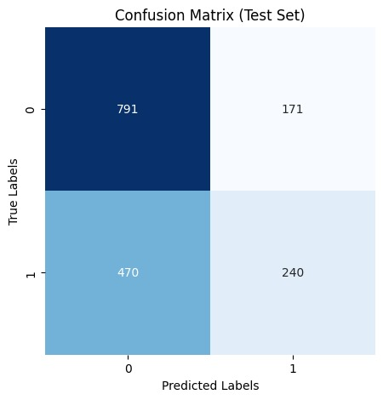

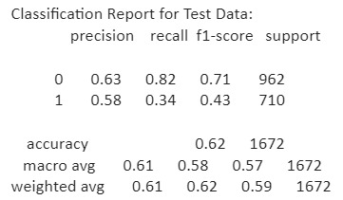
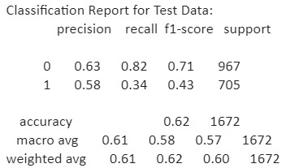
What do people like in others?15 features
What do people like in me?15 features

Slide 9
Conclusion
More features with high correlation to the label will return higher accuracy ratings to the prediction. > Hypothesis 1 reached around 90% accuracy using 83 features > Hypothesis 2 reached around 60% accuracy using 15 features
Feature engineering improved accuracy- adding 4 more features
Random forest performed best when the data consists of many features
When features were reduced other models performed like Random forest, SVC was even better

Slide 10

Pneumonia Detection Deep learning project 2024
Alina Greenberg

Slide 11
Background
Pneumonia is an infection that inflames the air sacs in one or both lungs.
It kills more children younger than 5 years old each year than any other infectious disease, such as HIV infection, malaria, or tuberculosis.
Diagnosis is often based on symptoms and physical examination.
Chest X-rays may help confirm the diagnosis.

Slide 12
Project Steps
Model Choice - The choice of a pre-trained ResNet-18 model for transfer learning was made. The model was loaded with ImageNet weights, and all layers, except the fully connected (fc) layer, were frozen for binary classification.
Data Preprocessing - Standard image preprocessing techniques, including resizing, center cropping, and normalization, were applied using the transforms module from torchvision.
Data Loading - PyTorch's ImageFolder and DataLoader were utilized for dataset loading and processing, creating distinct sets for training and testing.
Training - Training involved the use of Stochastic Gradient Descent (SGD) as the optimizer and CrossEntropyLoss as the loss function. The training spanned 10 epochs, with continuous monitoring of both training and testing accuracy and loss.

Slide 13
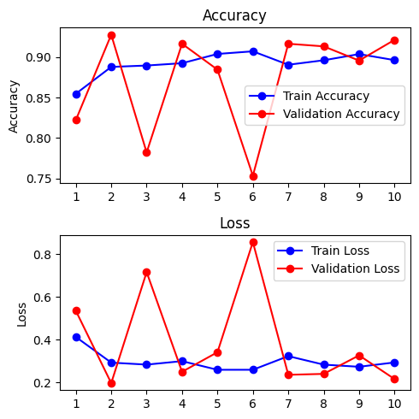
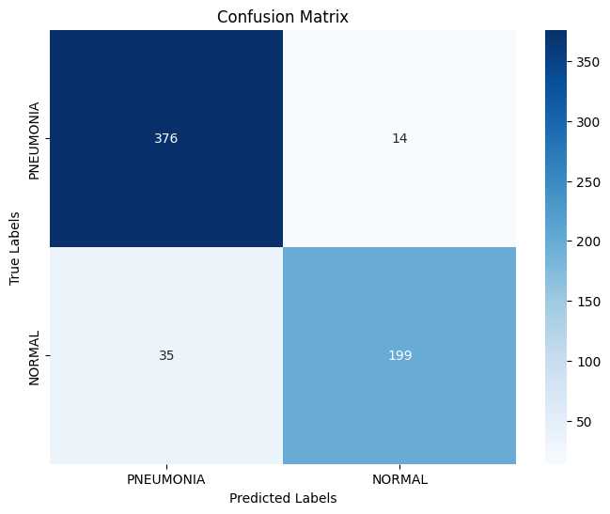
Results
Training Accuracy and Loss:
The model achieved a training accuracy of around 90% after 10 epochs.
The training loss decreased over epochs, indicating that the model was learning from the training data.
Testing Accuracy and Loss:
The testing accuracy varied, reaching around 92% after 10 epochs.
The testing loss showed fluctuations but generally remained within acceptable limits.
Confusion Matrix and Classification Report:
The confusion matrix and classification report provided detailed insights into the model's performance on specific classes (NORMAL and PNEUMONIA).
Precision, recall, and F1-score metrics were used to assess the model's performance.

Slide 14
challenges
Model Training and Transfer Learning:
Potential Challenge: Fine-tuning a pre-trained model for binary classification requires careful handling to prevent overfitting or underfitting.
Code Solution: Freezing all layers except the fully connected layer (`fc`) for transfer learning is a good strategy to leverage pre-trained weights while adapting the model for the specific task. This helps in preventing overfitting.
Class Imbalance:
Potential Challenge: If there is an imbalance between NORMAL and PNEUMONIA classes, the model may bias predictions towards the majority class.
Code Solution: While the code doesn't explicitly address class imbalance, the impact could be seen in the classification report. Further strategies like class weighting or sampling techniques could be explored if imbalance is observed.
Inference on New Images:
Potential Challenge: Ensuring the model's ability to generalize to new, unseen images is crucial for real-world applications.
Code Solution: The code demonstrates how to load a pre-trained model, modify it for binary classification, and make predictions on new images. This validates the model's ability to generalize beyond the training set.

Slide 15
Conclusions
Overfitting/Generalization:
The slight difference between training and testing accuracy suggests reasonable generalization, indicating that the model did not overfit the training data excessively.
Model Inference:
Detailed metrics for each class (NORMAL and PNEUMONIA) in the classification report provided insights into the model's strengths and weaknesses for different cases.
Model Performance:
The model demonstrated good performance, achieving high accuracy on both the training and testing sets.
The confusion matrix and classification report revealed a balanced assessment of the model's ability to correctly classify instances.
Class-specific Performance:
Detailed metrics for each class (NORMAL and PNEUMONIA) in the classification report provided insights into the model's strengths and weaknesses for different cases.

