Slide 1
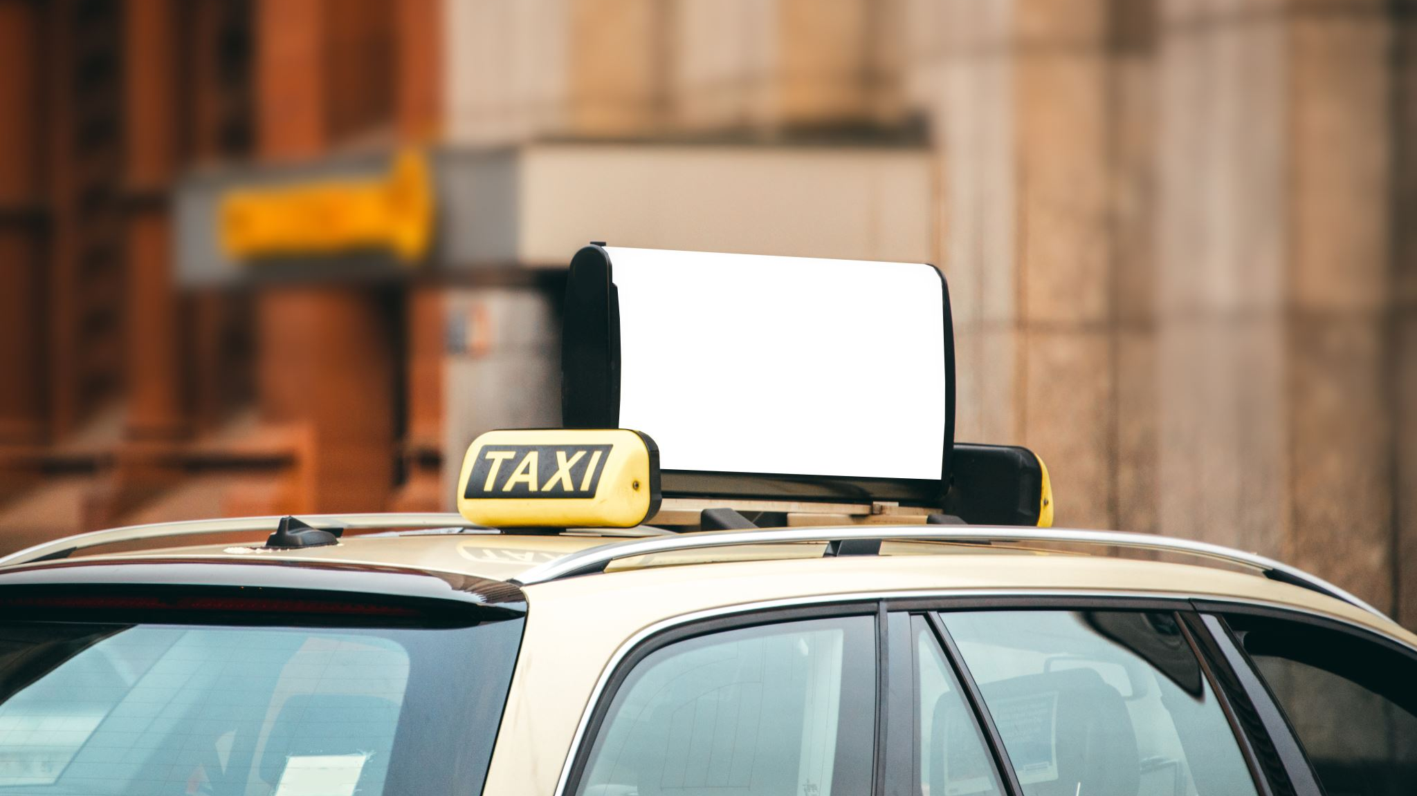
Optimizing NYC Taxi Operations: A Data-Driven Approach to Profitability
Presented By: Alina Hussain
Date Updated: May 2, 2024

Slide 2
Table of Contents
Objectives
Data Processing
Revenue Analysis
Cost Analysis
Conclusions
Recommendations
Open Questions

Slide 3

Objectives
Identify opportunities to improve revenue for NYC taxis
Identify opportunities to cut costs for NYC taxis

Slide 4
Data Processing
Data Duplication
Data Completeness
Data Inaccuracy
Incorrect Trip distance
Incorrect Trip duration
Incorrect Passenger count
Incorrect fare (–ive)
Tip amount > Fare Amount
Outliers

Slide 5
Revenue Analysis
Fare_Amount | Surcharge | mta_Tax | Tip_amount | Tolls_amount
Contributes to Revenue

Slide 6
Peak Time
Revenue Analysis
No of Trips Vs Fare %
Peak hours: 5-10 pm.
With an increasing number of trips, fare revenue growth is relatively stagnant.

Slide 7
Revenue Analysis
Trips within Different Distance Ranges
Most people travel within 0-15 km

Slide 8
Cost Analysis
Trip Distance Vs Trip Duration
During the time period of 1-5 pm, there is a significant increase in trip duration compared to trip distance.

Slide 9
Cost Analysis
Trip Time Vs Fare
Fare does not increase with an increase in trip time.

Slide 10
Cost Analysis Passengers Count per Trip
Passengers | Trips Percentage
1 | 61%
2 | 13%
3 | 5%
4 | 2%
5 | 11%
6 | 8%

Slide 11
Conclusions
Revenue Analysis
Peak hours are from 5-10 pm. The pricing system is static, as with an increasing number of trips, fare revenue growth is relatively stagnant. Most people travel a distance of 0-15 km.
Cost Analysis
There is an increase in trip duration compared to trip distance from 1-5 pm, possibly due to traffic congestion or weather conditions. Extra charges are not implemented for waiting time, as the fare does not increase with an increase in trip time. 61% of trips carry only 1 passenger.

Slide 12
Recommendations
increase their operational efficiency, leading to more trips and higher revenue per vehicle
To Increase Revenue
Implement a dynamic pricing strategy. Reallocating resources based on demand patterns. Since most customers travel within a 15 km distance, provide promotional offers to attract more customers, resulting in increased revenue.
To Reduce Cost
Implement extra charges during waiting hours due to traffic congestion or any reason. Encourage ride-sharing and carpooling initiatives. Consider replacing larger vehicles with smaller ones to optimize efficiency and reduce costs.

Slide 13
Open Questions
Is there anything to be concerned about regarding the quality of this dataset?
Data Duplication
Data Completeness
Data Inaccuracy
Incorrect Trip distance
Incorrect Trip duration
Incorrect Passenger count
Incorrect fare (–ive)

Slide 14
2. If there are data quality issues, where are they, and how can they be remedied?
Negative and unrealistic values can be addressed through discussion with the team or by consulting the personnel from whom the data was obtained.
Missing values can be handled by taking the average value of the data or removing the record or discussing with team.
Duplicate data can be removed.
Format error can be easily corrected.

Slide 15
3. Are there any observations which might look like data quality issues, but are actually fine?
Zero fare amounts
Extreme trip distances or durations

Slide 16
4. What should a data scientist or data engineer be mindful of before beginning to work with this data?
Verify Data Source and Relevance
Data Recency
Data Completeness
Data Accuracy

Slide 17
Thank You

