Slide 1

FIN 439 / NETFLIX / VIDEO 1
Why I selected Netflix
Research question
QUESTION 1
QUESTION 2
QUESTION 3
Growth
Cash generation
Price paid
Historical analysis • January 23, 2026 reference close • WBD excluded
01
Notes:
RECORDING NOTES — VIDEO 1, SLIDE 1
My name is Alina Mato, and this is my first video presentation for project one. The company I picked to research over the course of these 8 weeks is Netflix.
I have a Netflix subscription, and have some background knowledge on the company and know that it has been publicly traded for 24 years. I selected Netflix to investigate whether its business growth could translate into an attractive investment opportunity. My objective was to assess whether the potential return justified the price and the risks for a fund considering a new position. I wanted to understand what investors would actually receive from the company's future cash generation.
This project uses historical financial disclosures and compares the standalone valuation with the January 23, 2026 closing price. It is a retrospective analysis, rather than a recommendation to trade Netflix today.

Slide 2
FIN 439 / NETFLIX / VIDEO 1
The opportunity was worth investigating
FY2025 operating results
REVENUE GROWTH
OPERATING-PROFIT GROWTH
QUESTION
16%
28%
Is value > price?
Historical analysis • January 23, 2026 reference close • WBD excluded
02
Notes:
RECORDING NOTES — VIDEO 1, SLIDE 2
The initial evidence gave me a reason to look more closely. In 2025, revenue grew 16%, while operating income grew 28%. Membership growth, pricing and advertising supported revenue. That suggested a business in which growth might also improve profitability.
The investment question was whether those gains could continue after paying for the programming and other spending needed to keep customers. I also needed to determine how much future success the share price already reflected. Strong company performance alone could not answer that question.

Slide 3
FIN 439 / NETFLIX / VIDEO 1
My initial decision was to wait
Edition A → research plan
Watch–defer was the initial stance
Needed a defensible share-price range
Needed cash-flow and downside evidence
Historical analysis • January 23, 2026 reference close • WBD excluded
03
Notes:
RECORDING NOTES — VIDEO 1, SLIDE 3
Edition A recorded a watch-and-defer view. The evidence supported further research, but the initial memo did not yet have a verified historical price or a completed valuation range. The research plan called for normalized cash generation, downside analysis and transaction underwriting before committing capital.

Slide 4
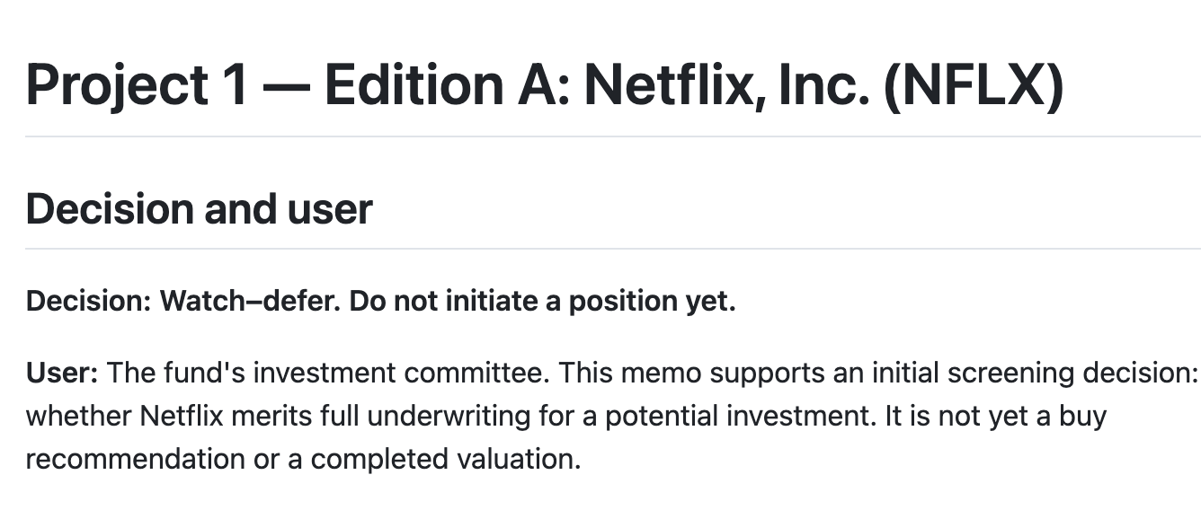
FIN 439 / NETFLIX / VIDEO 1
Unchanged Edition A
Edition A → research plan
Screenshot from Markdown file. See GitHub repository for full information.
Historical analysis • January 23, 2026 reference close • WBD excluded
03
Notes:
RECORDING NOTES — VIDEO 1, SLIDE 3
Edition A recorded a watch-and-defer view. The evidence supported further research, but the initial memo did not yet have a verified historical price or a completed valuation range. The research plan called for normalized cash generation, downside analysis and transaction underwriting before committing capital.

Slide 5
FIN 439 / NETFLIX / VIDEO 1
Content spending changes the story
Three connected financial measures
STEP 1
STEP 2
STEP 3
Additions
›
Amortization
›
Cash payments
Historical analysis • January 23, 2026 reference close • WBD excluded
04
Notes:
RECORDING NOTES — VIDEO 1, SLIDE 4
The most important company-specific issue was content spending. Netflix invests in programming, records content assets, and recognizes expense over time through amortization. Cash payments also depend on when liabilities are settled.
That means profit and cash can move differently. To judge investment value, the analysis had to connect growth and operating profit to the cash remaining after content investment. A generic earnings-growth projection would miss that relationship.

Slide 6
FIN 439 / NETFLIX / VIDEO 1
Research changed the valuation model
From plausible numbers to linked cash flow
Linked operating forecasts to FCFF
Corrected duplicate depreciation treatment
Separated $619m Brazil charge from $700m expected cash deposit
Historical analysis • January 23, 2026 reference close • WBD excluded
05
Notes:
RECORDING NOTES — VIDEO 1, SLIDE 5
Earlier work produced values around $61 per share using different cash-flow approaches. Similar answers could look reassuring, but they did not validate the definitions or assumptions. The revised model connects the operating forecast directly to cash available to lenders and shareholders, then discounts it at the weighted average cost of capital.
The revision corrected an extra depreciation deduction in the earlier model. It also removed an identified $619 million Brazil charge from recurring forecast costs, while retaining the expected $700 million deposit as a cash outflow. Removing an expense from the recurring base does not remove a cash obligation.
The correction regarding the $619 million Brazil charge most changed my understanding. It highlighted how easily a non-recurring item can distort a long-term forecast if incorrectly left in the recurring cost base, while reminding me that removing an expense doesn't eliminate the actual $700 million cash obligation.

Slide 7
FIN 439 / NETFLIX / VIDEO 1
Challenges made the evidence stronger
What still needs judgment
AI-assisted conclusions require independent checks
Partner challenge must be supported by a genuine credited exchange
What evidence would show that Netflix's revenue growth and margin expansion cannot persist without unsustainably increasing content and marketing spending?
January 23 filing timing requires disclosure
Historical analysis • January 23, 2026 reference close • WBD excluded
06
Notes:
RECORDING NOTES — VIDEO 1, SLIDE 6
AI assisted the analysis and code revision. One output that required correction was the earlier cash-flow approach: the revised work checked the definition against operating cash flow and financing, rather than accepting a plausible-looking valuation.
Edition A also records a partner's question about whether growth and margin improvement could persist without excessive content and marketing spending. That question focuses attention on the central risk to the forecast, the cost of keeping us watching. To see if their growth is hitting a wall, we have to look at how much they are spending versus how much value they are actually getting back.
Right now, Netflix is trapped into spending more and more money on new, expensive ideas like live sports and gaming. To put it in perspective, they are dumping about 5% of their budget into these new areas, but only getting 1% of their total views in return. That is a really tough return on investment.
The problem is that streaming content loses its flavor fast. Netflix is basically on a treadmill—they have to keep pouring billions into fresh content just to stop people from hitting the cancel button.
If they can’t grow their subscriber base naturally without these massive cash injections, their marketing and production costs will spin out of control. Ultimately, that will crush their goal of a 31.5% profit margin, proving that this level of spending isn't sustainable.
I also found a timing limitation. The January 23 closing price is a comparison benchmark, and the 10-K was accepted after the market closed. Some financial information had been released earlier, but every material input still needs a dated source before claiming a model available at the close.

Slide 8
FIN 439 / NETFLIX / VIDEO 1
From a company story to a decision
Historical standalone estimates
LOW
BASE
HIGH
REFERENCE PRICE
$42.13
$51.20
$60.33
$86.12
Historical analysis • January 23, 2026 reference close • WBD excluded
07
Notes:
RECORDING NOTES — VIDEO 1, SLIDE 7
The revised operating cases estimate about $42 to $60 per share, with a base of about $51, compared with the $86.12 historical close. That supports continuing to watch the company while deferring initiation on this evidence.
The research gave me a specific decision to defend: whether supported cash generation justified the price, given the content economics and the transaction excluded from the model. The next video explains how the analysis connects those business questions to valuation.

